Slide 1
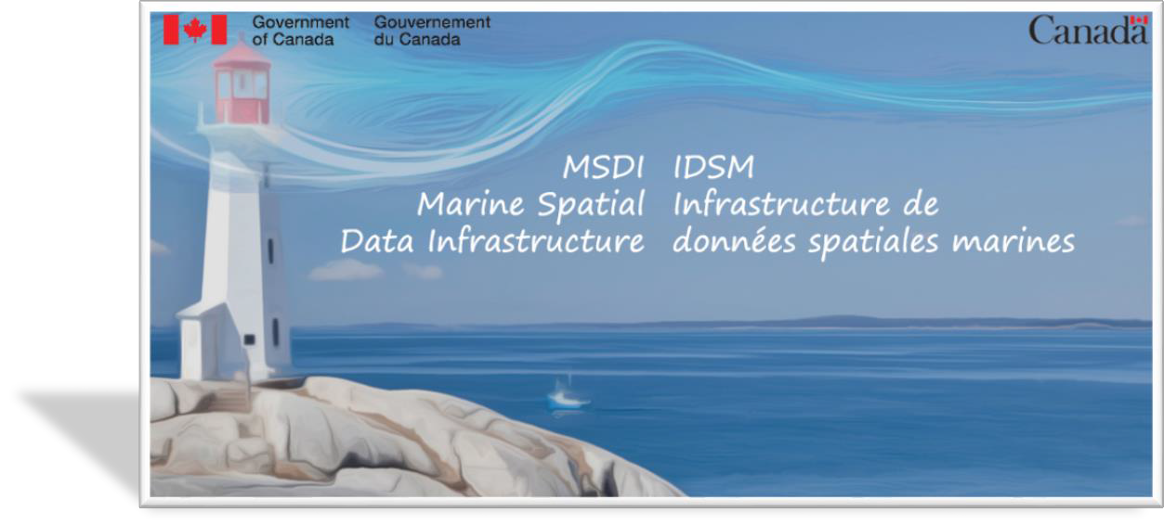


US-Canada Hydrographic Commission
Canadian Hydrographic Service (CHS)
« ACCESSING BIG MARINE DATA (volume-velocity-variety) »
Chris Hemmingway, Director CHS
March 26, 2018

Slide 2


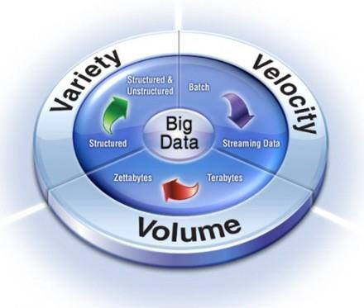



What a Marine Spatial Data Infrastructure (MSDI) is built on:
“Authoritative – Accessible – Accurate… Data”
Technical Standards
Geographic Content: Data
/ Applications /
Metadata
Infrastructure (IT) &
Information Systems
MSDI
Policy & Governance

Slide 3

















Marine Spatial Data Infrastructure (MSDI) International
Marine Geospatial Working Group
August 2017
International
Geoinformation Standards
Three Advisory
Bodies
Marine Domain Working Group
IHO:
International Hydrographic Organisation
MSDI Working group
+ specific Maritime Geoinformation standards

Slide 4



Marine Spatial Data Infrastructure (MSDI)
Federal Context
Federal
Included in the Federal Committee on Geomatics and Earth Observation (FCGEO NRCan-led) and the Interdepartmental Committee on Oceans (ICO DFO-led)
In line with Open Government directives
Leverages the Federal Geospatial Platform (FGP)
Funded via Ocean Protection Plan within the Regional Response Planning initiative.

Slide 5








What a Marine Spatial Data Infrastructure (MSDI) is for:
Clean-up the house
  Data
DFO
Metadata
Applications
Tailored to the needs of the Marine Domain
  Brings in :
Marine side
Federal
example
Thematic approach (Marine Protected Areas, Fisheries, Habitat & Aquaculture zones, science, safety of navigation,…)
Value-added products
Metadata processes

Slide 6











































Marine Spatial Data Infrastructure (MSDI) Benefits

Slide 7











Marine Spatial Data Infrastructure (MSDI) Status
Leading the way forward
2016-2017 :
•Prototype built
•Presented
federal wide
2017-2018 :
•OPP Funding accelerates development
•Implementation
•Collaboration
•Training
2018-2019
•Integration
•Processes
•Documentation
•Delivery
2019 & …
•Increase
•Maintain
•Adapt
•Improve
Interoperable Administration of the Authoritative Marine Domain
  Throughout International and Federal Levels
  Seamless between both the land and marine (Freshwater & Oceans) domain
  Plan & Opportunities after 2018-2019…

Slide 8
HYDROGRAPHY : MUCH MORE THAN JUST NAUTICAL CHARTS

Slide 9
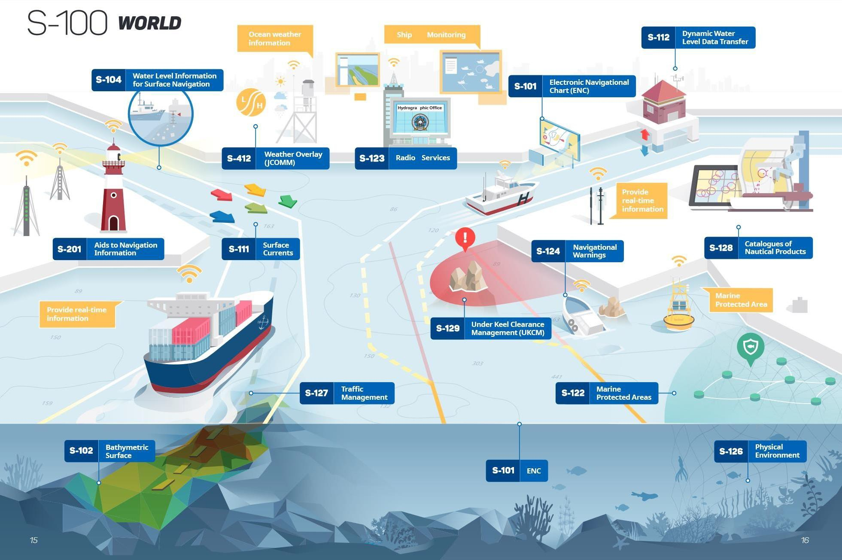





Slide 10

What is a Marine Cadastre?
Renewable Energies
Recreation
Oil and gas resources
Aquaculture
Marine protected area
Shipping
Fishing zone
Ocean disposal
Cables and pipelines
Heritage protection
Graphic courtesy of Natural Resources Canada

Slide 11
Immediate Next Steps
Receipt and prioritization of DFO Area Response Planning datasets and integration in Federal Geospatial Platform (FGP)/Marine Spatial Data Infrastructure (MSDI) workflow.
MSDI development and training.
Organizing training for MSDI/FGP and data managers at large within DFO and across the other Government Departments and Agencies.
Continue to connect and influence on an International and global perspective (United Nations, International Organizations, Canada- US)
10

