Slide 1
9th Meeting of the MSDIWG Niterói, RJ, Brazil (JAN/FEB 2018) USCHC-41
26 MAR 2018

Slide 2
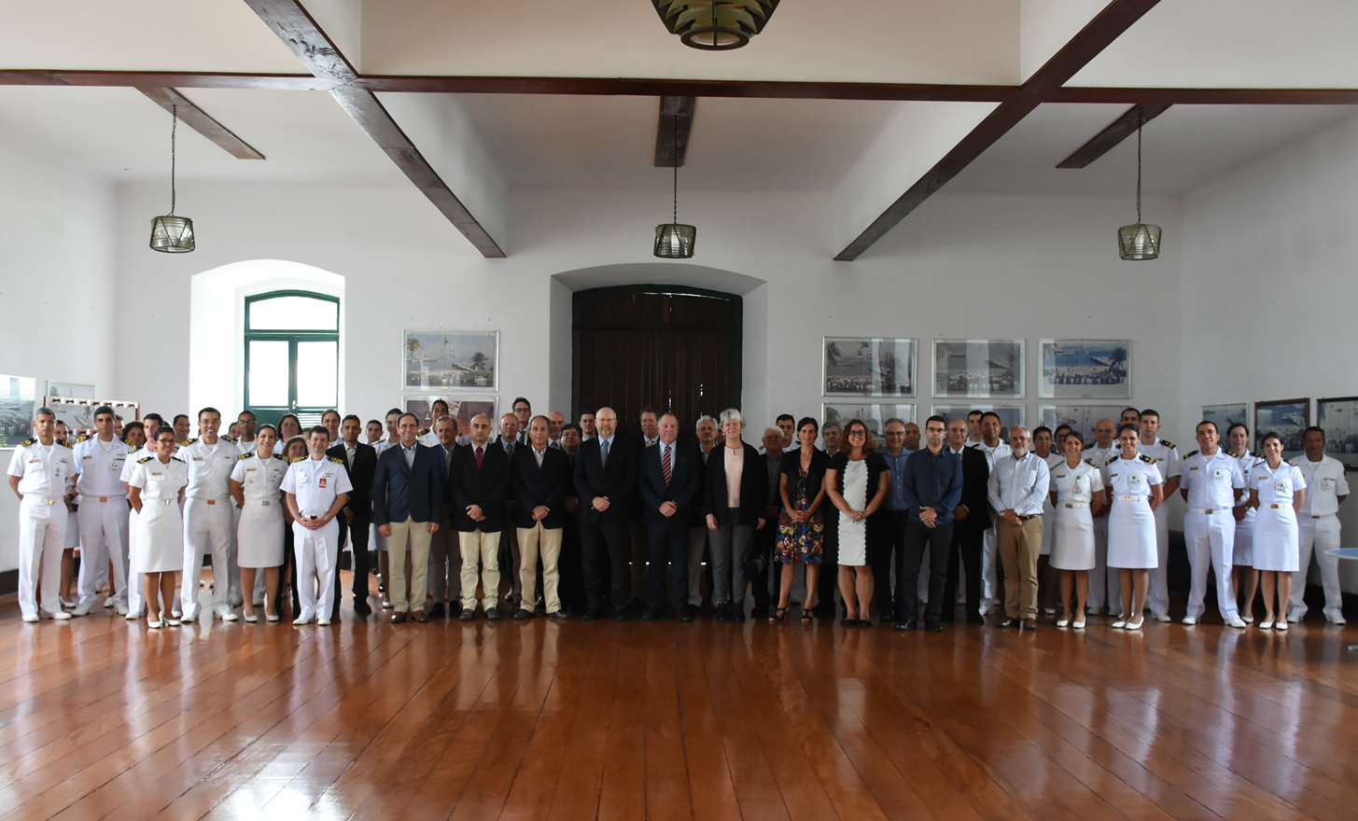
MSDI Open Forum – 29 JAN 2018
Presentations on MSDI Development and initiatives from intergovernmental orgs, government agencies, non-profit, industry, academia:
IHO MSDIWG
OceanWise
Ministry of Defense (Brazil)
ESRI
Brazilian Geological Survey
NOAA Office of Coast Survey / NGA Maritime Safety Office
Brazilian Institute of Geography and Statistics
Land Information New Zealand (LINZ)
Open Geospatial Consortium (OGC)
Petrobras Company
Vale Company
Federal University of Paraná (UFPR)
Federal University of ABC (UFABC)
Notes:
Solomon had applied before the amendments came into force. Need to apply under the news rules.

Slide 3
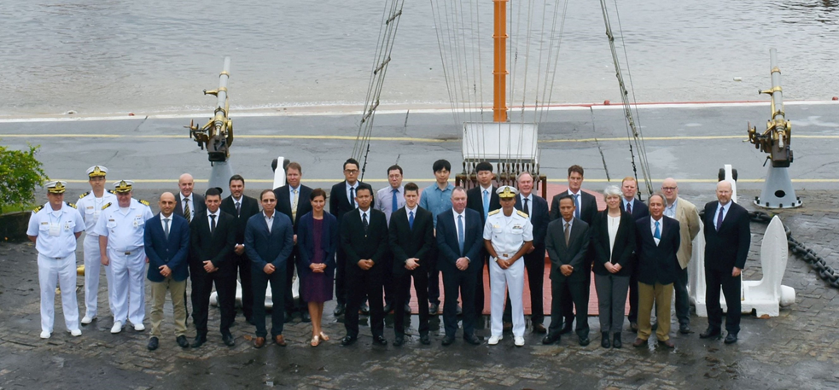
MSDIWG-9 – 30 JAN-01 FEB 2018
Member State reports on national MSDI activities
RHC reports on MSDI WGs
ARMSDIWG
BS-NSMSDIWG
Other relevant bodies
Arctic SDI
OGC Marine DWG
IHO CSBWG
UN-GGIM MGIWG
Marine Cadastre in Europe
EMODNet
International Cable Protection Committee (ICPC)
Expert Contributors’ Presentations
Work Plan status
Highlight Discussions
Concept Development Study on MSDI (OGC)
Re-use and licensing of data
MSDI movie (Republic of Korea)
https://youtu.be/5m15KBhd9v0 (4 min)
Breakout sessions:
MSDI Vision
Future of C-17
Progress on Work Plan Actions
MSDI Security (Data Assurance)
Notes:
Solomon had applied before the amendments came into force. Need to apply under the news rules.

Slide 4
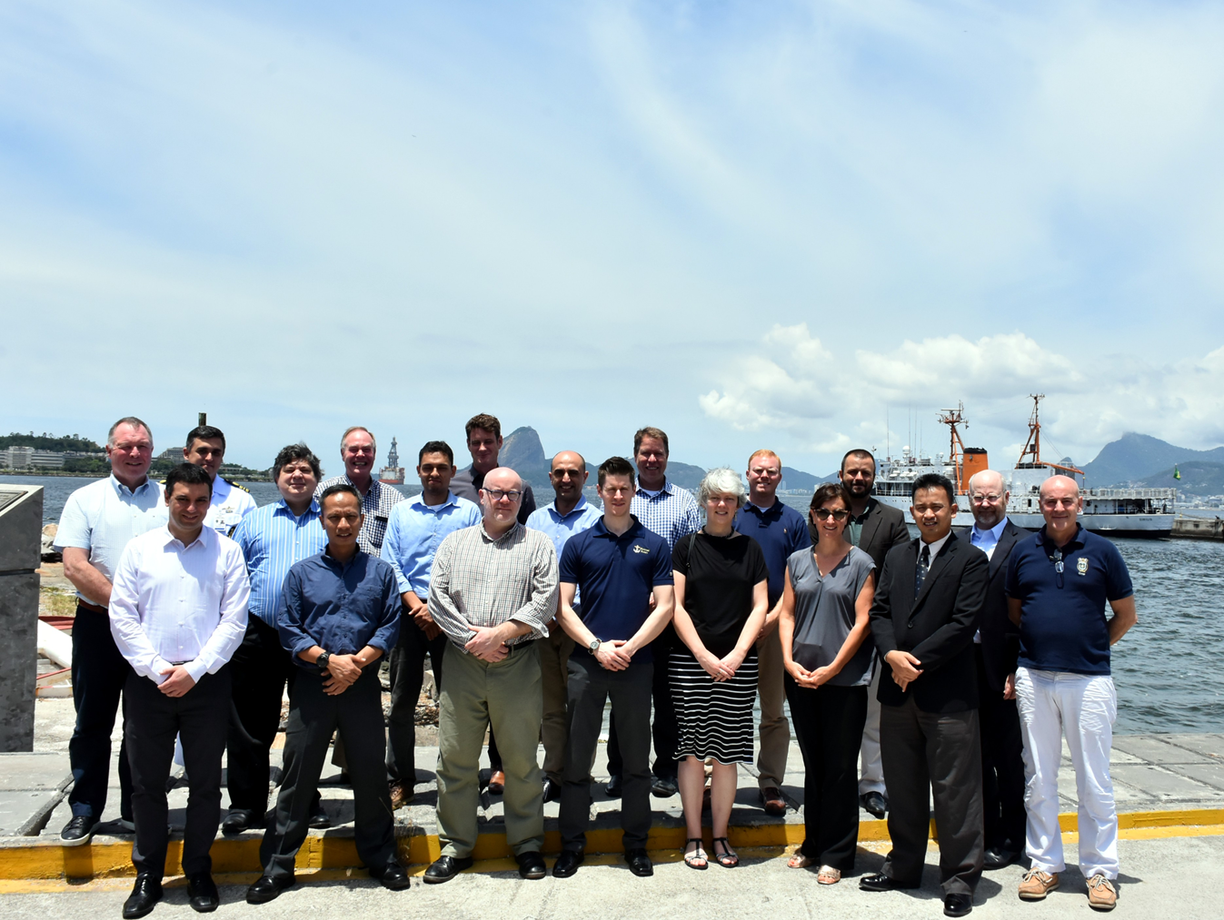
OGC Marine DWG – 02 FEB 2018
Held in conjunction with IHO MSDIWG.
Content of meeting:
Input to IHO MSDIWG.
Review of key OGC activities.
DGGS (Discrete Global Grid Systems)
Testbed 14
Update on existing initiatives within Marine DWG
Concept Development Study on MSDI
New activities and strategies
GEBCO 2030
S-121 Pilot Study
Notes:
Solomon had applied before the amendments came into force. Need to apply under the news rules.

Slide 5
IHO www.iho.int

