Slide 1
East Asia Hydrographic Commission (EAHC) Three Year Work Plan
Jung Hyun Kim
Republic of Korea
EAHC Capacity Building Coordinator
CBSC14
Abu Dhabi, UAE
24-26 May 2016

Slide 2
Table of Contents
I
Introduction
II
Five Year CB Work Plan (2014-18)
III
Three Year CB Work Plan (2018-20)
IV
Action Required of CBSC

Slide 3
I . Introduction
EAHC
Tasked the Training, Research and Development Center (TRDC) Board of Directors (BOD) to plan, implement and monitor CB programmes.
EAHC Steering Committee
TRDC BOD
Charting and Hydrography Committee
MSDI WG
Secretariat

Slide 4
I . Introduction
Approved the five-year Capacity Building Work Plan (shown on the next slide) proposed by the TRDC BOD during the 2nd TRDC BOD meeting in 2014.
Due to the limited CB fund, only a small number of programmes were funded by the CBSC/IHO.
→ A number of the proposed programmes not implemented

Slide 5
II . Five Year CB Work Plan (2014-18)
Training | 2014 | 2015 | 2016 | 2017 | 2018
 | Programme | Programme | Programme | Programme | Programme
Basic | Basic (Carto) (a. Indonesia b. Malaysia c. Singapore d. ROK) | - Basic (Carto) (a. Indonesia b. ROK c. Malaysia d. Philippines e. Singapore f. China) - MS & SC⁴⁾ (Indonesia) | - Basic (C & H) - MS & SC | Basic (C & H) | Basic (C & H)
Intermediate | CAT B M2 (Carto) | CAT B M2 (Carto) | CAT B (Carto) | CAT B (Carto) | CAT B (Carto)
Advanced | - MBA¹⁾ - TWL²⁾ - TFT³⁾ Foundation Course | - IHO MSI⁵⁾ - MSDI - TFT Basic (H) - MIO | - TWL - TFT Basic (H) - SDB⁶⁾ - MIO⁷⁾ | - TFT Basic (C&H) - SDB - MIO | - MSDI - TFT Basic (C&H)
Special | S-100 Seminar | - S-100 Seminar - Hydro. Survey for disaster relief Seminar - Tsunami Inundation Mapping Workshop | - S-100 Seminar - Hydro. Survey for disaster relief Seminar - Cartographic Production Database System Workshop - Multi-beam Survey and Seabed Classification | - Hydrographic Database System Workshop - Enhanced Delivery Method of Hydrographic Data Seminar | S-101 Seminar
Staff Exchange Programme | Singapore, Hong Kong
Technical Visits | -Vietnam - Brunei Darussalam | Cambodia | Timor Leste
MBA¹⁾: Technical aspects of maritime boundaries, baselines and extended continental shelf
TWL²⁾: Tides and water level for hydrographic survey
TFT³⁾: Training for Trainers
MS & SC⁴⁾: Multi-beam Survey & Seabed Classification
MSI⁵⁾: Maritime Safety Information
MIO⁶⁾: Marine Information Overlay
SDB⁷⁾: Satellite Derived Bathymetric Charting
Highlighted: Funded
Highlighted: Funded and to be conducted in 2016

Slide 6
EAHC Regional Countries Capacity Phase Stage
Country/Territory |  | NHC/NHCC | Phase1 | Phase2 | Phase3 | Last TV
1 | Brunei Darussalam | 0 | 0 | 0 | 0 | 2014
2 | Cambodia | 0 | 0 | 0 | 0 | 2016
3 | China | -1 | 4 | 4 | 4 | 0
4 | Democratic People’s Rep. of Korea | 0 | 0 | 0 | 0 | 0
5 | Indonesia | -1 | 4 | 4 | 2 | 0
6 | Japan | -1 | 4 | 4 | 4 | 0
7 | Malaysia | -1 | 4 | 4 | 4 | 0
8 | Philippines | 1 | 4 | 4 | 4 | 0
9 | Republic of Korea | -1 | 4 | 4 | 4 | 0
10 | Singapore | -1 | 4 | 4 | 4 | 0
11 | Thailand | -1 | 4 | 4 | 4 | 2004
12 | Timor-Leste | 0 | 0 | 0 | 0 | 2016
13 | Viet Nam | -1 | 1 | 1 | 0 | 2014
Phase 1
- collection and circulation of nautical information, necessary to maintain existing charts and publications up to date
Phase 2
- creation of a surveying capability to conduct coastal and offshore projects
Phase 3
- produce paper charts, ENC and publications independently.
Key to required training
-1 - No information available
0 - The country is unaware of its national obligations / The country established a NHC/NHCC
1 - The country is aware of its national obligations but does not have the means to do it / The country is in the process to establish a NHC/NHCC
2 - The country has the ability to fulfil national obligations / The country is in the process to establish a NHC/NHCC
3 - The country fulfils its national obligations in a sustainable manner
4 - The country fulfils its national obligations through a third party

Slide 7
III . Three Year CB Work Plan (2018-20)
Training | 2018 | 2019 | 2020
 | Programme | Programme | Programme
Basic | Basic (Carto & Hydro) | Basic (Carto & Hydro) | Basic (Carto & Hydro)
Intermediate | Cat B Cartography (Phase 1) | Cat B Cartography (Phase 2) | Cat B Cartography (Phase 3)
Advanced | - TFT Basic Hydro (Phase 2) - MSDI | - TFT Basic (Carto & Hydro) - MIO - TWL | - TFT Basic (Carto & Hydro) - SDB
Special | - Cartographic Production Database System Workshop - S-101 Seminar | - Hydrographic Database System Workshop | - Enhanced Delivery Method of Hydrographic Data Seminar

Slide 8
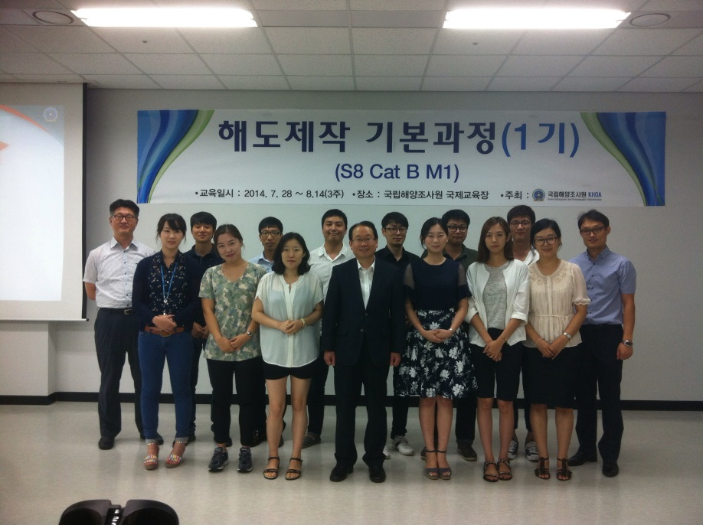
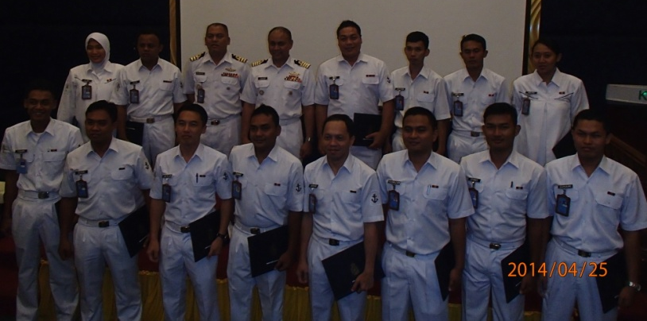
III . Three Year CB Work Plan (2018-20)
Training for Trainers (TFT) courses are highly valued since they nurture trainers to train others in their mother tongues.
→ More effective outcome as most MSs are non-English speaking countries
→ Higher priority in the EAHC CB Work Plan
▲ MSs conducted basic trainings in their home countries (2014)

Slide 9
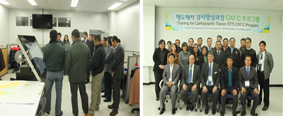
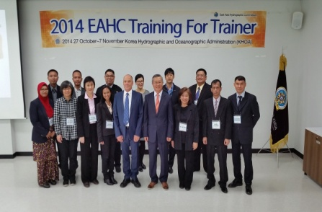
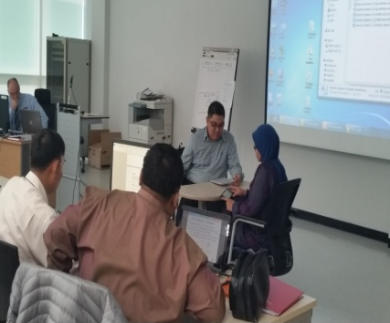
III . Three Year CB Work Plan (2018-20)
1st TFT Carto Workshop: Nov. 2013 2nd TFT Carto Workshop: Nov. 2014 both in the ROK
The ROK will host the 1st TFT Hydro Basic in Oct. 2016 (Phase 2 in 2017)
The EAHC monitors its capacity building activities and sets up plans at TRDC BOD meetings every year.
▲ 1st TFT Carto Workshop
Busan, ROK, November 2013
▲ 2nd TFT Carto Workshop
Busan, ROK, November 2014

Slide 10
IV . Action Required of CBSC
The CBSC is invited to take note of this report.

Slide 11
Thank you

