Slide 1

International Hydrographic Organization
CBSC 15 Chairman Report
by Thomas Dehling
Chairman CBSC
Notes:
1

Slide 2
Contents
Strategy
Assembly 1
CB Funds
Work of the IHO Secretariat
CB Management
Contribution to CB
Joint CB
Developments and Improvements

Slide 3
Strategy
Revised CB Strategy very efficient and regulations very helpful in the progress of our CB work
Living document, review it regularly.
take a closer look at e-learning part.
In my view adjust Strategy or its interpretation internally before initiating an adoption procedure via Council/Assembly.

Slide 4
Assembly 1
Capacity Building played its role as one the strategic topics of the IHO.
Positive decisions have been made such as
  the increase of the annual regular contribution from the IHO budget to the CB fund. This improves the planning and execution of the projects significantly.
  development of the e-learning component.
Indication of having additional personal at the IHO Secretariat for the CB Management.
Change from 5-year to 3-year planning cycle

Slide 5
CB Funds (1)
To deal with the deficit stick strictly to strategy and regulatio
  waiting list comparable to this year
  consider to have enough funds left for the following year
Strive to increase the CB funds
Prioritize the projects submitted
Some chances now at hand to multiply our direct investments

Slide 6
CB Funds (2)
Not the dramatic lack of funds we had in 2015 at the time of the CBSC meeting. Situation improved significantly over the year, but it showed the need of an early confirmation of the available funds. This situation has changed for 2017 and will improve further due to the now regular contribution from the IHO budget.
Without the earmarked projects we will have at this stage 256.000 € available for 2018.

Slide 7
Work of the IHO Secretariat
With the growing success of CB, the administrative work is growing likewise. The support from the IHB staff is essential to cope with that. I am explicitly thankful for the fundamental support from Alberto Costa Neves and for the very good contribution in the financial execution accomplished by Sandrine Brunel.

Slide 8
CB Management (1)
In 2016 the execution of the CB WP went very smoothly for the first time. This has several factors.
  The good preparation by almost all of the CB coordinators and the RHCs,
  correct and timely provision of the documents and
  the good support from the IHO Secretariat.

Slide 9
CB Management (2)
CB Coordinators play an extraordinary important role in the success of CB efforts in the IHO and I again urge all Regional Hydrographic Commissions not to change this position too often. RHC´s with a frequently rotating CB Coordinator have less chances to receive adequate support because of the lack of experience.

Slide 10
Contribution from ROK and Japan
The extraordinary generous ongoing contribution from Japan and ROK have been one major factor in the success of CB. I am very confident to sustain the fruitful cooperation with both countries.

Slide 11
Joint CB
Planned joint CB meeting of IHO, IMO, IOC, WMO, IALA, FIG and IAEA at the IMO in London was cancelled by the IMO
Disadvantageous that IMO TCP withdrew from a cooperation with the IHO in CB.
A success of comprehensive projects will depend on a good cooperation.
The next meeting is scheduled to be held in November at the IALA Headquarters.

Slide 12
Developments and Improvement (1)
Current scheme works with the funds available.
Developments to reduce administrative workload and procedural to be solved.
Technical visits: Still not all reports are timely and adequate. Finalize raft procedure 9 on TVs.
Strategic level: look at issues already laid down in the CB Strategy.

Slide 13
Developments and Improvement (2)
Acquisition of comprehensive projects:idea of getting support on a governmental level in consultancy.
Second stakeholder seminar planned in 2019.
And finally, how can we include and extend contributions from developed MS to Capacity Building.

Slide 14
PHASES OF DEVELOPMENT OF HYDROGRAPHIC SURVEYING AND NAUTICAL CHARTING CAPABILITY
Phase 1 (MSI)
Collection and circulation of nautical information, necessary to maintain existing charts and publications up to date
Phase 2 (Surveying)
Creation of a surveying capability to conduct:
Coastal projects
Offshore projects
Phase 3 (Charting)
Produce paper charts, ENC and publications independently

Slide 15
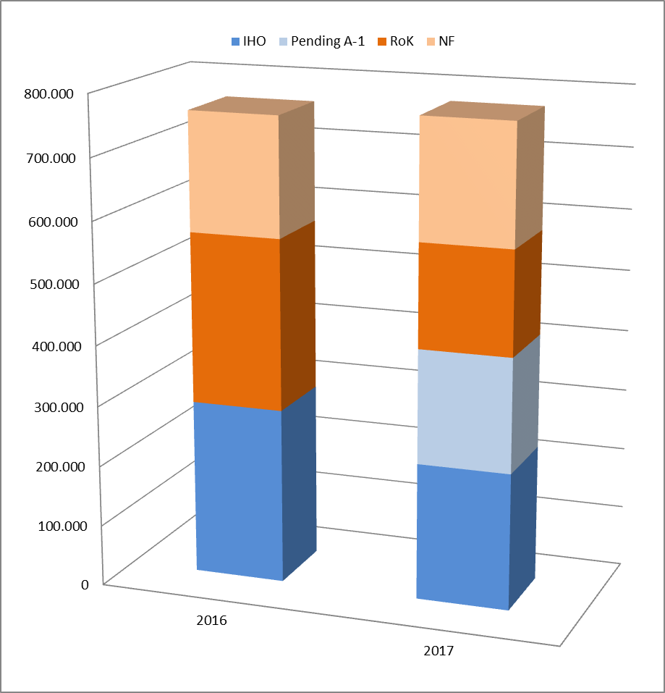
Fund limitation
CB funds: estimated availability for 2016 and 2017
NF
NF
ROK
ROK
IHO
IHO
IHO

