Slide 1
SWPHC report to CBSC16 May 2018
Adam Greenland
CB Coordinator
Notes:
Title slide

Slide 2
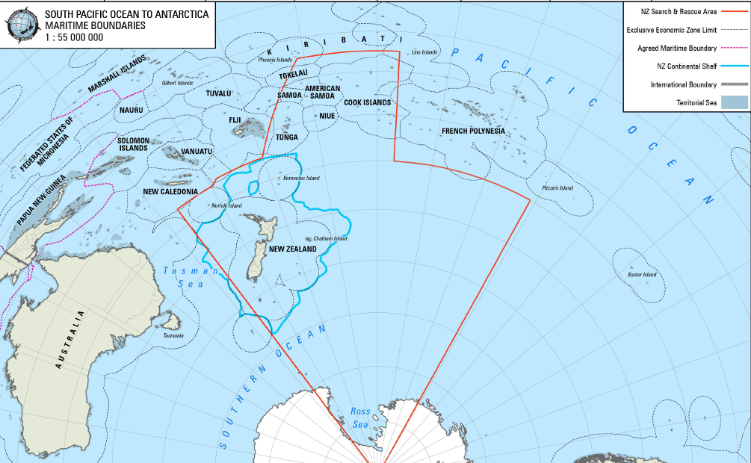
SWPHC Region

