Slide 1
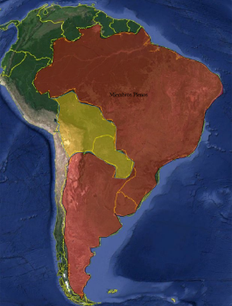
South West Atlantic Hydrographic Commission (SWAtHC) Report
In 2006, Argentine, Brazil and Uruguay signed the cooperation agreement that result in the South West Atlantic Hydrographic Commission (SWAtHC). Main achievements have been the development of a regional Cartographic Plan, establishment of a Planning Commission to coordinate INT Charts and ENC production and the acceptance of Paraguay and Bolivia (recently accepted) as Associate Members.

Slide 2
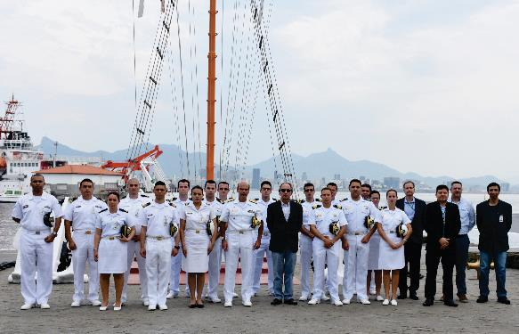
Activities completed since CBSC15
SWAtHC attended three events on the second semester of 2017
Bathymetry training course using RTK Technology, in Niteroi-RJ, Brazil, 02-06 October, for the following States: Argentina, Brazil, Uruguay, Colombia and Mexico. The objective of this course was to increase the capacity of Latin American hydrographers to perform bathymetry using RTK technology.

Slide 3
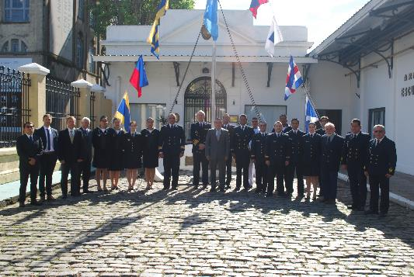
Activities completed since CBSC15
Digital Photogrammetry with Satellite Imagery, at SHN, Argentina, October, 30 – November, 03, with participants of the following States: Argentina, Brazil, Uruguay, Colombia, Ecuador, Peru, Guatemala and Mexico. The focus of the training was taking advantage of the free options of images processing software for images treatment and improving interpretation in coastal areas, to improve nautical charts, ENCs production and updating methods.

Slide 4
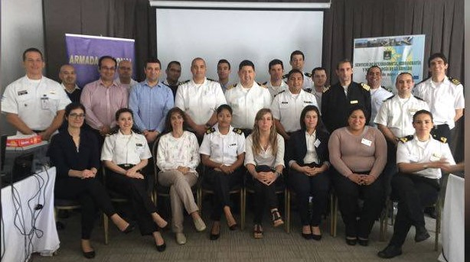
Activities completed since CBSC15
Data Management Workshop, in Uruguay, at SOHMA, November, 20 – 24, with 18 participants of Argentina, Brazil, Uruguay, Colombia and Mexico. The course was an opportunity to the RHC members discuss issues like data acquisition and qualifying, metadata profile, data and metadata storage/database, and database uses/queries, giving the participants an understanding of spatial data infrastructures (SDI) for the provision of basic geospatial data.

Slide 5
Activities completed since CBSC15
In 2017, SWAtHC member were invited to participate in the MACHC's Workshop off Geophysical Analysis and Identification of Seamounts which was held in Cartagena das Indias, Colombia, in October 23-27.
The SWAtHC acknowledges the efforts of the MACHC and the SEPRHC to coordinate joint CB activities across the three regions.

Slide 6
Activities completed since CBSC15
Training of Foreign Countries Personnel:
- at DHN (Brazilian Funding), in 2017, two Mozambican personnel, from INAHINA, concluded the Advanced Training Course in Hydrography and Navigation for Petty Officers, course recognized by IHO as Cat “B”; and
- at DHN (Brazilian Funding), in 2018, one Bolivian Officer are studying in Advanced Training Course in Hydrography for Officers, course recognized by IHO as Cat “A”.

Slide 7
Activities planned for 2018 and 2019
SWAtHC will perform three events on the second semester of 2018:
- MSI Workshop. Brazil, DHN, planned to be held in October.
- Port and Shallow Water Survey Course. Argentina, SHN.
- MSDI and Data Management Workshop. Uruguay, SOHMA.
SWAtHC submitted to CBSC three events to be delivered in 2019:
- Multibeam Data Processing and bathymetry database Workshop. Argentina, SHN.
- Tide Training. Brazil, DHN.
- Multibeam Systems Total Uncertainty Workshop. Uruguay, SOHMA.

Slide 8
Conclusions
SWAtHC is committed to carrying out forward hydrographic, cartographic and capacity building activities in a strait alignment with IHO objectives and goals.
Action Required of CBSC16
The CBSC is invited to:
a. Note this report.
b. The SWAtHC is proposing three events to be delivered in 2019 and requires approval.

