Slide 1
CATZOC Allocation in Japan
Hydrographic and Oceanographic Department
Japan Coast Guard
Satoshi SATO, DQWG13 Workshop, 2018/01/15-16

Slide 2
CATZOC Allocation in Japan
CATZOC values were allocated in 2011.
Taking into account of IHO S-57 ZOC-table, ZOC values for navigational purposes 3, 4, and 5 are allocated based on the information provided in the report of surveys in accordance with the following principles.
Recent Surveys
Full Area Search (S-44 special or 1a order) ZOC A1
Single Beam Surveys ZOC B
Older Surveys
Single Beam Surveys ZOC B, C, D (depending on line spacing)
Surveys before 1966 ZOC D
Unsurveyed Area (No survey was carried out after new construction) ZOC U

Slide 3
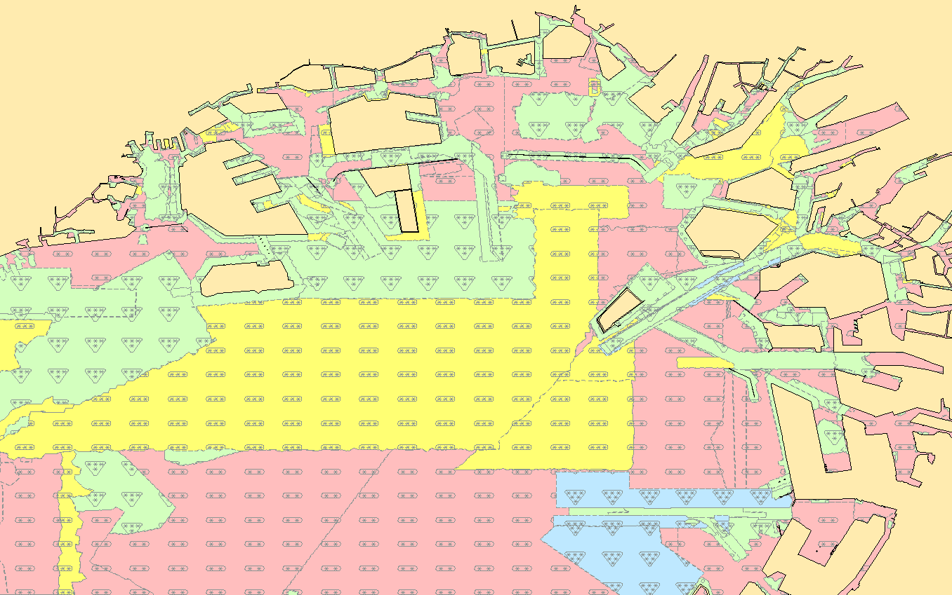
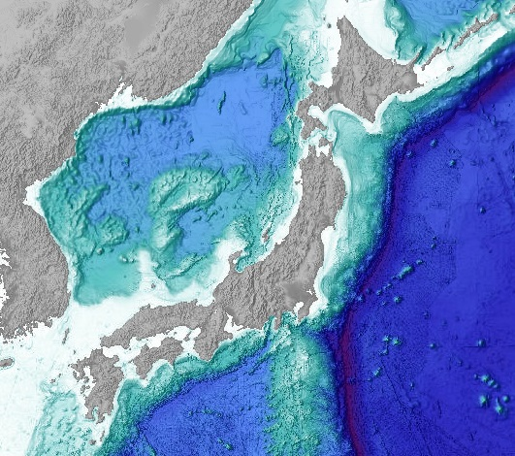
CATZOC Allocation in Osaka Bay
Port of Osaka
Port of Kobe
Osaka Bay Area
3km
A1
B
C
D

Slide 4
Dates of Hydrographic Surveys
Last 10 years
Last 20 years
Last 40 years
Last 30 years
Last 60 years

Slide 5
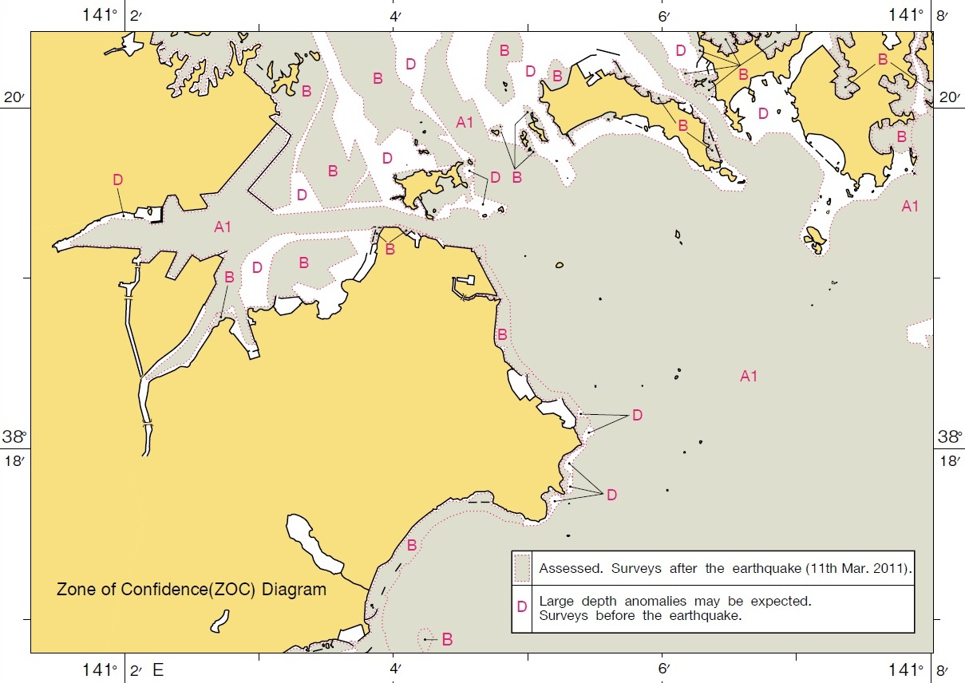
CATZOC after Tsunami Disaster
Port of Shiogama
ZOC D was allocated for the area affected by the great tsunami on March 11th, 2011.
For the area surveys were carried out after the disaster, ZOC A1 or B were allocated.
ZOC Diagram of the chart JP64-A Port of Shiogama

