Slide 1
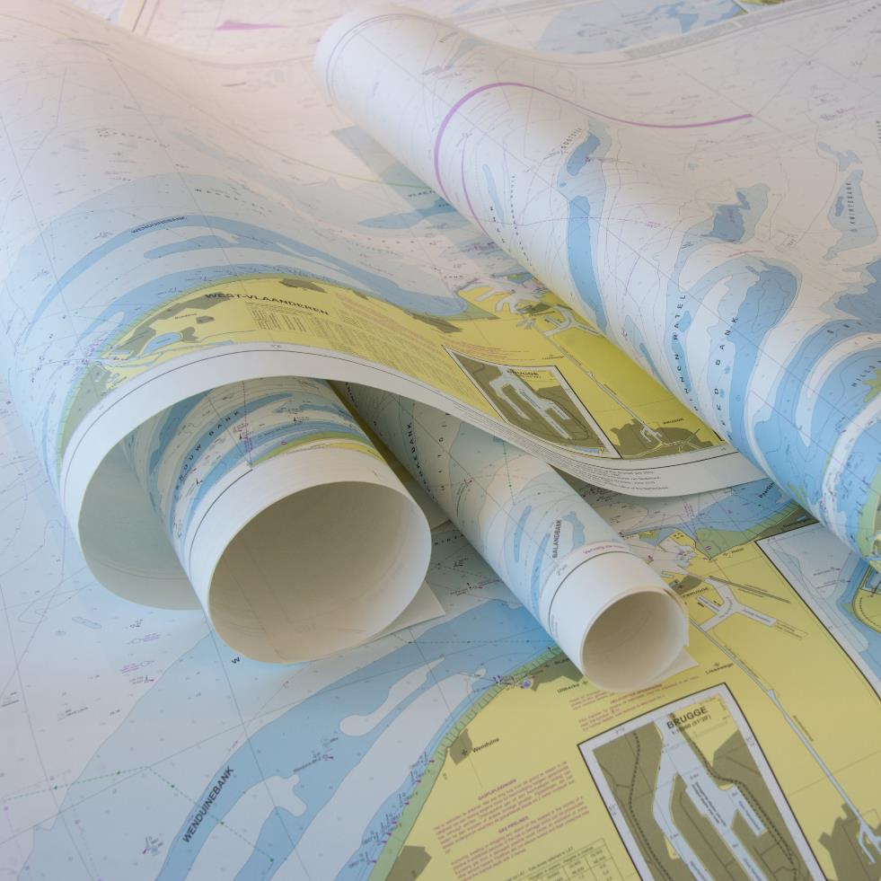
North Sea Hydrographic Commission report to IRCC10
GOA June 2018
Chair: Virginie Debuck (Belgium) Vice-chair: Hilmar Helgason
Members: Belgium, Denmark, France, Germany, Iceland, Netherlands, Norway, United Kingdom
Last meeting 33rd Conference: 27th and 28th March, Ostend, Belgium

Slide 2
Achievements 2016-2018
22nd Tidal WG, Ostend, 25th and 26th October 2017
7th Resurvey WG, London, 7th and 8th November 2017
Establishment of the International Chart Coordination WG
33rd NSHC Conference: 27th and 28th March, Ostend, Belgium

Slide 3
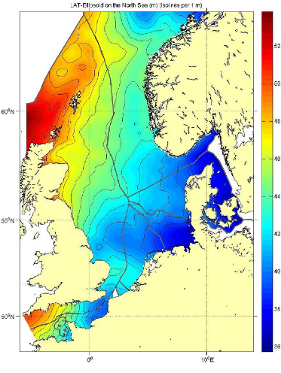
22nd Tidal WG (1/3): Common Reference Surface
WP Item 18/01:
Improve North Sea wide realization of reference surfaces
Thanks to R. Kuilman NLHO

Slide 4
22nd Tidal WG (2/3) : Common Reference Surface
 | BE | DK | FR | GE | NL | NO | UK | SW | IC
BE
DK | 1
FR | 2 | 1
GE | 1 | 4 | 1
NL | 4 | 1 | 1 | 4
NO | 1 | 2* | 1 | 1 | 1
UK | 3 | 3 | 4 | 3 | 3 | 2*
SW | 1 | 2* | 1 | 1 | 1 | 2* | 1
IC | 1 | 1 | 1 | 1 | 1 | 1 | 1 | 1
Legend:
1: no common LAT boundary
2: differences on a common boundary but not checked
2*: differences on a common boundary, not checked, different CD
3: differences on a common boundary checked to be not significant
4: differences on a common boundary checked to need to be reduced
Thanks to R. Kuilman NLHO

Slide 5
22nd TWG (3/3): Common Reference Surface - Results
Next steps for WP Item 18/01
Revisit the usefulness of the 1% norm
Now arbitrarily chosen: LAT difference/ depth
Make a proposal for something more practical
Continue studying differences with the aim to improve the LAT surfaces
Examine the origin of the observed differences
Make error estimates on each reference surface
Compare whole reference surfaces iso. only borders

Slide 6
7th Resurvey WG (1/2)
Risk assessment is for the time being continued on the levels of data exchange and mutual assessment of each other’s policies using relevant datasets.
AP7: Provision of CATZOC polygons
AP9: Provision of resurvey frequency plan
AP10: Risk Assessment : Dover Strait Survey Strategy (DSSS Area) – BE, FR, NL, UK.
Ambition common strategy for Dovers Straits
For time being share and evaluate each others strategies
http://nshc.pro/?p=185

Slide 7
7th Resurvey WG (2/2)
WRT IHO CSB paper: comments by each individual MS
Discussion on CSB on ferries
WRT new techniques i.e. LIDAR, SDB, CSB and autonomous surveying: MS shared experiences
General: exchange of information between the MS on recent developments concerning new ships, applications, …

Slide 8
North Sea Int. Chart Coordination WG
Replaces former North Sea ENC Harmonisation WG
Overlap IENC : has been removed as much as possible between the different neighbouring countries within the North Sea Region
First meeting: still to be planned

Slide 9
33nd NSHC: Open AP and decisions (1/2)
1/2018: Crowd sourced data: RWG investigates how CSD can support work of NSHC
2/2018: DE organises workshop on sharing knowledge and experiences of Contouring algorithms
6/2016: Vertical reference (LAT) comparison: in accordance with AP 18/1 of TWG
Including validity of 1% norm
3/2010: overview and harmonization of resurvey schemes, availability on NSHC.pro for whole NSHC region

Slide 10
33nd NSHC: Open AP and decisions
6/2014: North Sea wide Risk Assessment, including Dover straits
Risk assessment is for the time being continued on the levels of data exchange and mutual assessment of each other’s policies using relevant datasets
There will be no North Sea wide Risk assessment, but the RWG will reconsider this for the DSSS area due to its specific characteristics. (see AP10 of 7th RWG)
8/2014: MS nominate contact person fotrMSDI WG:
list is not complete

Slide 11
Action required?
The IRCC is invited to note the report of the NSHC
Thank you for your attention

