Slide 1
Report of BSHC to IRCC 10
Inter-Regional Coordination Committee

Slide 2

BSHC - Chair
Chair: Mr Mindaugas Cesnauskis (Lithuania) from Sept 29, 2016
Mr Thomas Dehling (Germany) from Sept 21, 2017
Vice-Chair: Dr. Mathias Jonas (Germany) from Sept 29, 2016
Mr. Thomas Dehling (Germany) from Sept 1, 2017
Mrs Pia Dahl Højgaard (Denmark) from Sept 21, 2017

Slide 3
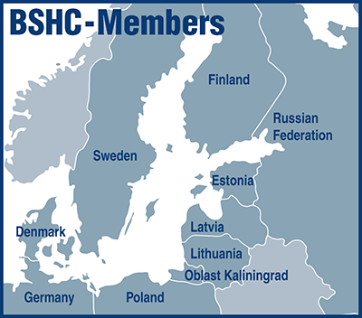
Membership
Members:
Denmark, Estonia,
Finland, Germany,
Latvia, Poland,
Russian Federation,
Sweden.
Associate Member: Lithuania

Slide 4
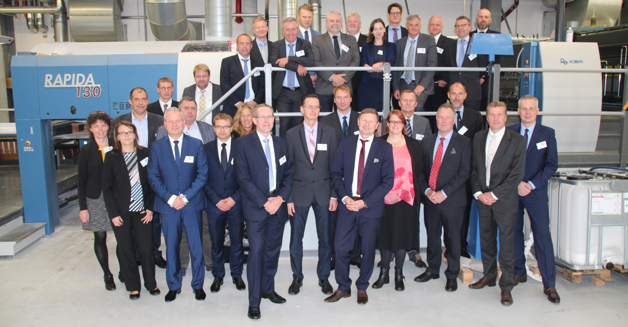
BSHC - Meetings
Conferences since IRCC9: 22nd Meeting - Rostock, Germany (19-21 Sep 2017
Next Conference 27-29 Aug 2018 in Aalborg, Denmark

Slide 5
BSHC – Status of IRCC actions
All relevant IRCC9 action items devoted to the BSHC chair have been processed accordingly.
Details are provided in the written report.

Slide 6
Baltic Sea Bathymetry Database (BSBD)
Bathymetry for the Baltic Sea is available in a resolution of minimum 500 m grid space except for Russian Federation and Lithuania.
Plans are ongoing to produce a higher resolution bathymetric model of the Baltic Sea. Several MS are already providing up to 50 m resolution. Some might me able to provide a 300 meters model.
Another action item is to regularly update the model.
http://data.bshc.pro/

Slide 7
Re-survey Monitoring and coordination
BSHC developed and operates a standing scheme of re-surveys for the region.
Schedule and execution of surveys are provided in an updated web based interface maintained and operated by Sweden.
Surveys are being regularly coordinated between neighboring countries.
Further developments of the common re-survey database as metadata repository are ongoing.
Member States update the information for their waters of jurisdiction independently.
Link to BSHC RE-Survey Database: https://helcomresurvey.sjofartsverket.se/

Slide 8
Harmonized Chart Datum in the Baltic
BSHC developed the Baltic Sea Chart Datum 2000 as a joint height reference.
It is based on the European Vertical Reference Frame (EVRF).
The specification reflects the specific needs of surface navigation and hydrography in addition to EVRF conventions.
The Chart Datum working group is monitoring and gives guidance for the implementation of the harmonized chart datum.
Several gravity measurement campaigns improve the quality of the vertical reference.

Slide 9

FAMOS - Project
BSHC Member States (DE, DK, EE, FI, LV, LT, SE) and Working Groups are involved
Project Activities
  Hydrographic surveying and chart production
  Improving future navigation
  Surveying infrastructure
  Data workflow from sounding to chart
Project receives EU co-financing from the CEF Transport programme.
First phase of the project, FAMOS Freja, was successfully executed 2014 to 2016.
The second phase of the project, FAMOS Odin, is ongoing for the time 2016-2018.

Slide 10
Achievements and lessons learned
The cooperation within the BSHC is very productive.
The Baltic Sea can be seen as a test bed for hydrographic developments.
Several projects have led to joint databases and results provided in the web. The outreach of the hydrographic work has improved even further.
Member states have continued to contribute extensively to the work of the IHO and have been active participants of working groups.
There has been substantial cooperation between commission member states and other European States and the EU on information sharing and shared projects.

Slide 11
Action requested of IRCC
The IRCC is invited to:
a. take note of the BSHC report

