Slide 1
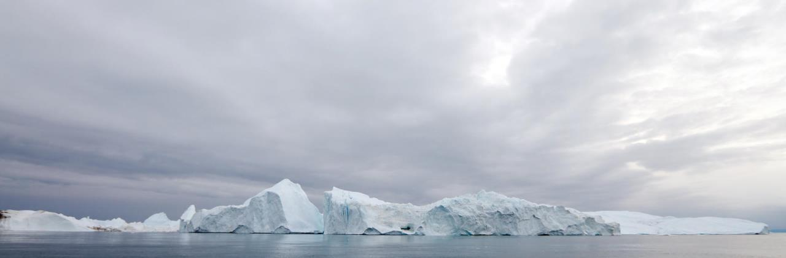
Regional Hydrographic Commission Report to IRCC10
Norwegian Mapping Authority
Norwegian Hydrographic Service
Arctic Regional Hydrographic Commission
June 2018, Goa, India

Slide 2
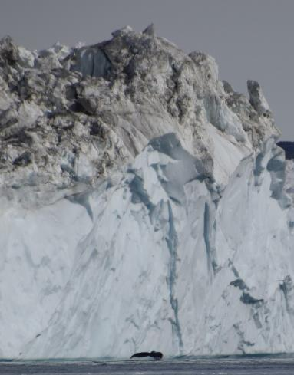
ARHC
Chair: Ms. Birte Noer Borrevik (Norway)
Vice-chair: Mr. Sergei Travin (Russian Federation)
Members: Canada, Denmark, Norway, Russian
Federation, USA
Associate Members: Finland, Iceland, Italy (new)
Observers: -

Slide 3
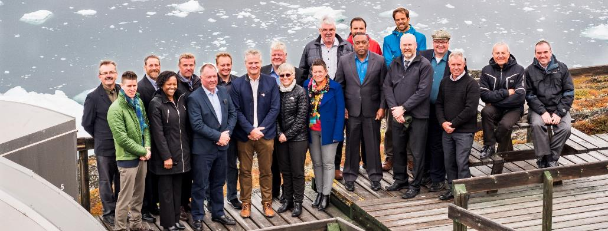
ARHC-meetings since IRCC9
ARHC Open Scientific Forum: 22 August 2017, Ilulissat, Greenland
ARHC7 Conference: 22-23 August 2017, Ilulissat, Greenland
2nd ARMSDIWG meeting: 16-19 April, Helsinki, Finland

Slide 4

ARHC Agenda Items
Associate Members
Arctic Voyage Planning Guide
Hydrographic Risk Assessment in the Arctic.
Status Arctic International Charting Coordination Working Group
Status Arctic Regional Marine Spatial Data Infrastructure Working Group
Communicate Arctic activities to associated IHO Working Groups
Remote sensing and satellite-derived bathymetry (SDB)
Crowd-sourced bathymetry
Outreach to stakeholders
Notes:
Associate Members participating in ARHC
Continued work on an Arctic Voyage Planning Guide for mariners
Operational and Technical Working Group with an emphasis on Hydrographic Risk Assessment in the Arctic.
Status Arctic International Charting Coordination Working Group
Status Arctic Regional Marine Spatial Data Infrastructure Working Group
Communicate Arctic activities to associated IHO Working Groups
Investigate potential of remote sensing and satellite-derived bathymetry (SDB)
Investigate potential of crowd-sourced bathymetry for use within the Arctic community
Outreach to stakeholders

Slide 5
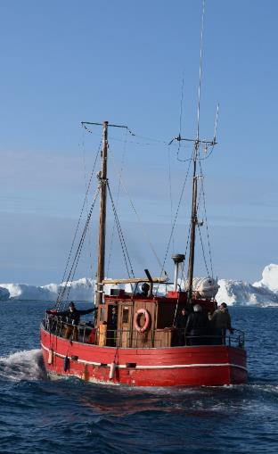
Cooperation with stakeholders
Outreach to Arctic Council working groups:
  Updating Arctic chart adequacy report to PAME
  Presentation at PAME Arctic Shipping Best Practise Information Forum (ASBPIF)
  Contribute to thematic datasets in PAME ASBPIF portal (such as Hydrography, Ice & Weather, Ports, etc)
  ARMSDIWG joined forces with Arctic SDI to improve access to marine geospatial information in the Arctic for 4 of the 6 Arctic Council WGs:
    AMAP (Arctic Monitoring and Assessment Program)
    CAFF (Conservation of Arctic Flora and Fauna)
    EPPR (Emergency Prevention, Preparedness and Response)
    PAME (Protection of the Arctic Marine Environment)
Arctic Marine users
Arctic SDI/Open Geospatial Consortium (OGC) Arctic Spatial Data pilot project
IHO-EU Network Working Group.
Arctic Science Forum during the day preceding the ARHC7 conference with stakeholder participation from local government of Greenland, shipping, cruiseship tourism, scientific institutions and industry
Notes:
Outreach to Arctic Council working groups:
Updating Arctic chart adequacy report to PAME.
Chair ARHC presented relevant work of ARHC at PAME Arctic Shipping Best Practise Information Forum, particularly in regard to the recently adopted IMO Polar Code.
ARMSDIWG joined forces with Arctic SDI to improve access to marine geospatial information in the Arctic for 4 of the 6 Arctic Council WGs:
AMAP (Arctic Monitoring and Assessment Program)
CAFF (Conservation of Arctic Flora and Fauna)
EPPR (Emergency Prevention, Preparedness and Response)
PAME (Protection of the Arctic Marine Environment)
Engage with Arctic Marine users including cruise line industry, seismic companies and research vessel operators
Participate with the Arctic SDI/Open Geospatial Consortium (OGC) Arctic Spatial Data pilot project
ARHC is represented in the IHO-EU Network Working Group. The IHO-EU Network Working Group (IENWG) has been established by the Inter-Regional Coordination Committee (IRCC) to monitor and deal with the activities and processes related to hydrographic aspects under the aegis of the European Union (EU).
Chair of ARHC7 organized the Arctic Science Forum during the day preceding the ARHC7 conference with stakeholder participation from local government of Greenland, shipping, cruiseship tourism, scientific institutions and industry

Slide 6
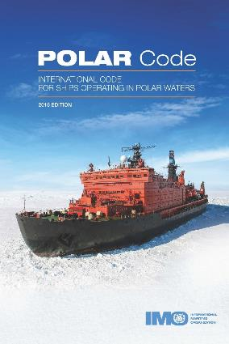
ARHC Achievements
ARHC acknowledged by Arctic Council WG PAME as the regional hydrographic authority.
ARHC engages across the Arctic community to communicate the hydrographic and charting data situation
ARHC MS actively engage and contribute to many of the IHO WG’s.
ARHC has made great strides to improve our understanding of the hydrographic data environment and communicate this situation to a broad community of users.
ARHC drafted and published a note entitled, “Caution required when using nautical charts of Arctic waters”.
The newly established Arctic Regional Marine Spatial Data Infrastructure Working Group (ARMSDIWG) is engaging with Arctic SDI to improve access to marine geospatial information for Arctic marine and ocean areas.
Notes:
ARHC is acknowledged by Arctic Council WG PAME as the regional hydrographic authority and regularly reports status of charting and survey.
ARHC engages across the Arctic community to communicate the hydrographic and charting data situation
ARHC MS actively engage and contribute to many of the IHO WG’s and especially to those that support two of the IHO strategic pillars: MSDI and Crowd Source Bathymetry.
ARHC has made great strides to improve our understanding of the hydrographic data environment and communicate this situation to a broad community of users.
ARHC drafted and published a note entitled, “Caution required when using nautical charts of Arctic waters”. The note is distributed to the secretariat of the Arctic Council, AECO, Cruise Line International Association, International Chamber of Shipping, Intercargo, Intertanko, International Group of P&I Clubs, International Maritime Pilot Association and to the editors of: Hydro International, Lloyds List, The Maritime Executive
The newly established Arctic Regional Marine Spatial Data Infrastructure Working Group (ARMSDIWG) is engaging with Arctic SDI to improve access to marine geospatial information for Arctic marine and ocean areas. Whereas modern hydrographic data is sparse in the Arctic, many other thematic datasets are available yet not easily accessible. HO’s can play a role in being a geospatial coordinator, taking a holistic SDI-approach to making data easily accessible. Through our engagement with Arctic SDI, ARMSDIWG is making its first steps towards MSDI for the Arctic.

Slide 7
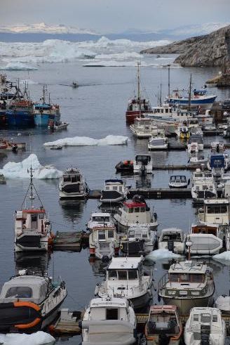
Difficulties encountered and challenges yet to be addressed
Large gaps in hydrographic data creating increased hydrographic data risk
Increased interest in the Arctic and therefore increased marine traffic
Whereas hydrographic data is largely lacking in the Arctic, many other thematic marine geospatial datasets are available but not easily accessible: Opportunity for Arctic HO’s in role as (M)SDI facilitator.
Finding methodologies for collecting and encoding traditional knowledge
Notes:
Large gaps in hydrographic data creating increased hydrographic data risk (see OTWG report)
Increased interest in the Arctic and therefore increased marine traffic
Whereas hydrographic data is largely lacking in the Arctic, many other thematic marine geospatial datasets are available but not easily accessible. There is an opportunity for Arctic HO’s beyond the classical safety of navigation role and beyond the hydrographic data provider role but in the role as (M)SDI facilitator. This requires close cooperation with both other national (government) data owners and end-users.
Finding methodologies for collecting and encoding traditional knowledge

Slide 8
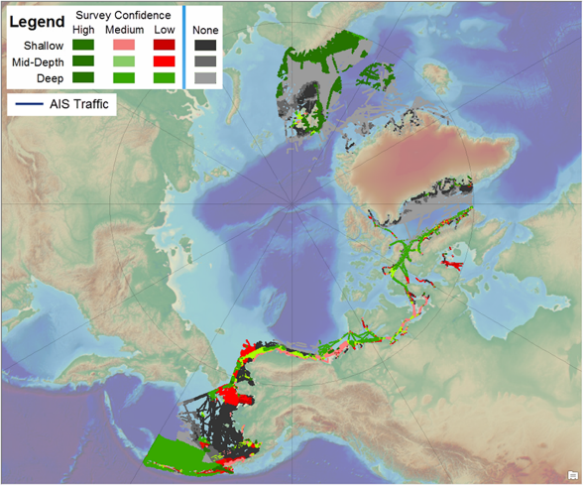
How Adequate are Arctic Charts?
ARHC study in 2015* used AIS traffic, survey confidence (based on survey vintage and survey technology), water depth, and seafloor type to highlight areas of particular navigation concern.
ARHC now updating analysis with:
new survey confidence data (CATZOC)
updated AIS traffic
including data for Northern Asia
Delivery at ARHC-8 (September 2018)
Additional Information: Samuel.Greenaway@noaa.gov
* Gonsalves, M., Brunt, D., Fandel, C., Keown, P. A Risk-based Methodology of Assessing the Adequacy of Charting Products in the Arctic Region US Hydro 2015 National Harbor, MD, USA 16-19 March 2015

Slide 9
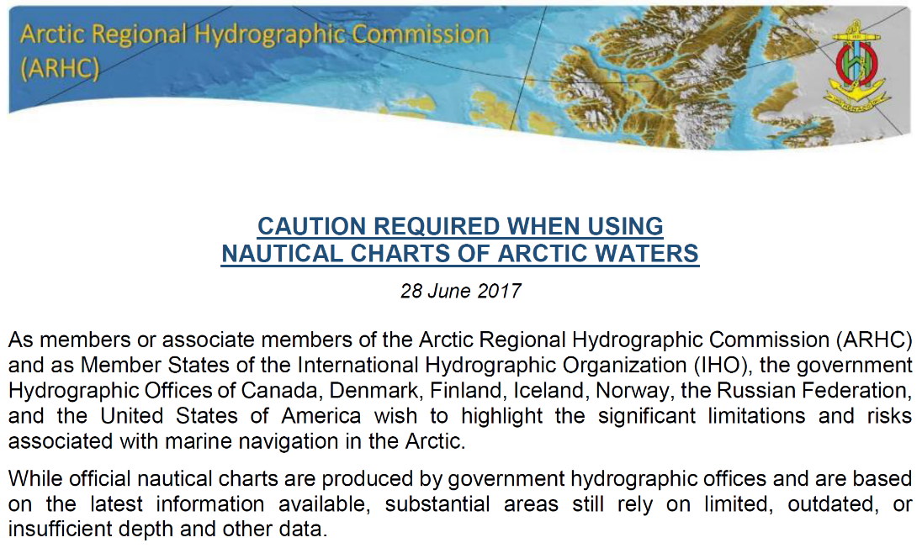
Notes:
Cautionary note on the use of ENC’s in Arctic waters. Distributed to:
- The secretariat of: Arctic Council, AECO, Cruise Line International Association, International Chamber of Shipping, Intercargo, Intertanko, International Group of P&I Clubs, International Maritime Pilot Association - The editors of: Hydro International, Lloyds List, The Maritime Executive

Slide 10
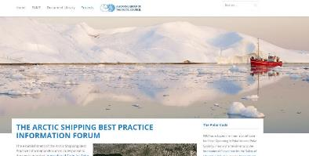
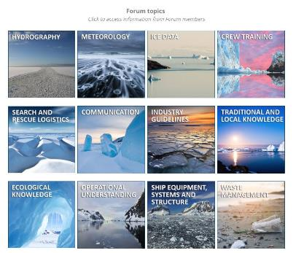
Arctic Shipping Best Practices Information Forum
ARHC identifying value content to support Arctic Voyage Planning & Chapter 11 of the Polar Code
  ice & weather
  chart information
  aids to navigation
  Ports indices
  Governance and authorities
  Etc…
Notes:
Our 2nd contribution is to help provide PAME with relevant datasets for their portal based on available datasets in the Arctic Voyage Planning Guide as provided by Canada, Denmark and US. This is work in progress and the first substantial contribution will hopefully be finalized during this year.

Slide 11
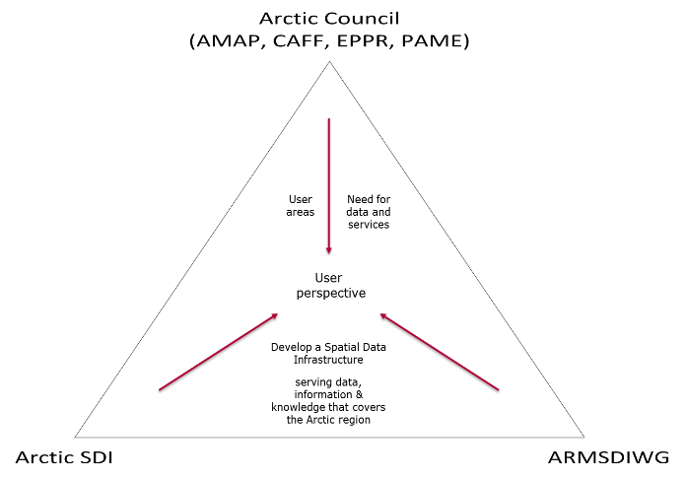
Better data and services through improved cooperation

Slide 12
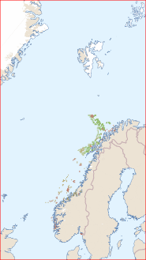
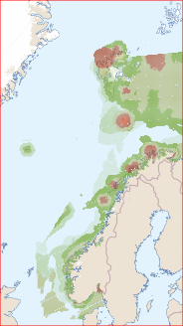
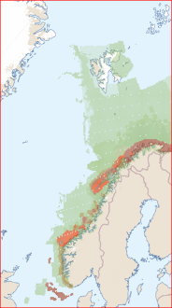
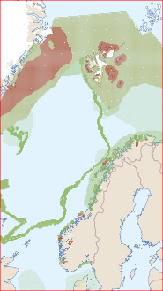
Environmental values in marine areas
Environmental value benthic organisms/habitats
Environmental value seabirds
Environmental value fish
Environmental value marine mammals
Notes:
Example of a thematic geospatial service containing «Environmental values» delivered by the Norwegian Environment Agency

Slide 13
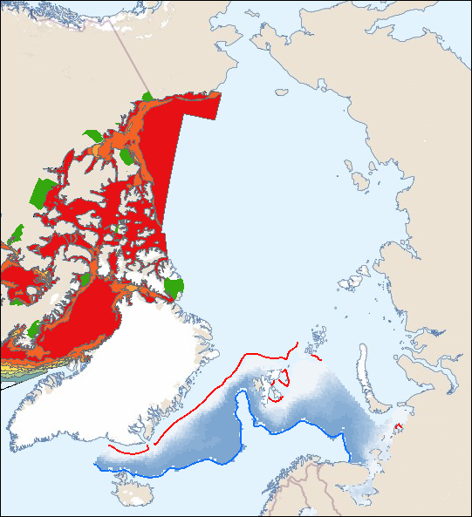
Re-use of national geospatial services in an international setting
Standard OGC services ensures easy access
and re-use of geospatial information
On-line (direct) use of geospatial data and services
from each countries governmental agencies,
ensures utilization of authoritative data
Cartographic challenges for further improvements
to achieve unified presentations within common
thematics, seamless across borders
Example: Ice frequencies
Notes:
This example illustrates re-use of national geospatial services from Norway and Canada
Thematic content in use, is « Ice frequencies»
The services is consumed on-line through the web client, directly from dataowners own geospatial services

Slide 14
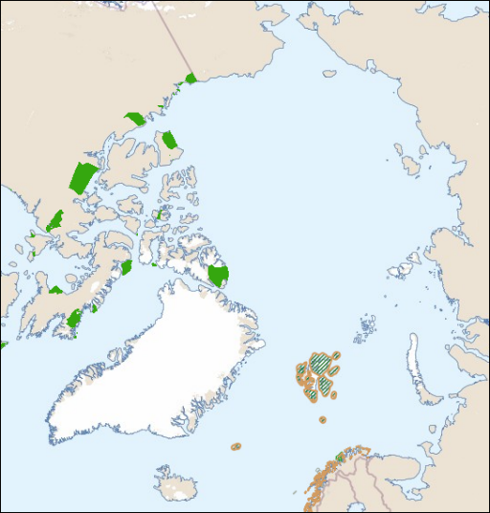
Re-use of national geospatial services in an international setting
Example: Marine protected areas
Notes:
This example illustrates re-use of national geospatial services from Norway and Canada
Thematic content in use, is «Marine protected areas»
The services is consumed on-line through the web client, directly from dataowners own geospatial services

Slide 15
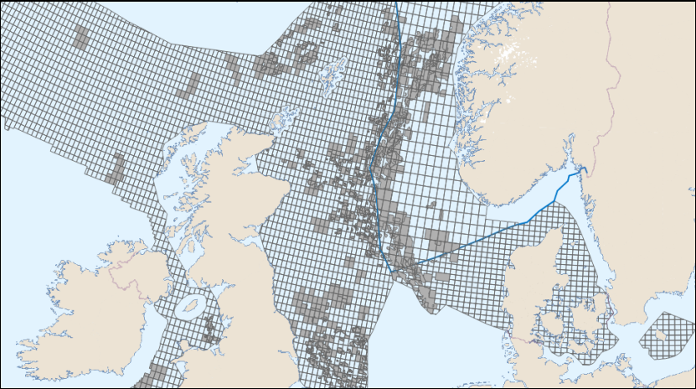
Re-use of national geospatial services in an international setting
Assembling the licencing system in the North Sea continental shelf through national geospatial datasets (Norway, UK, Denmark)

Slide 16
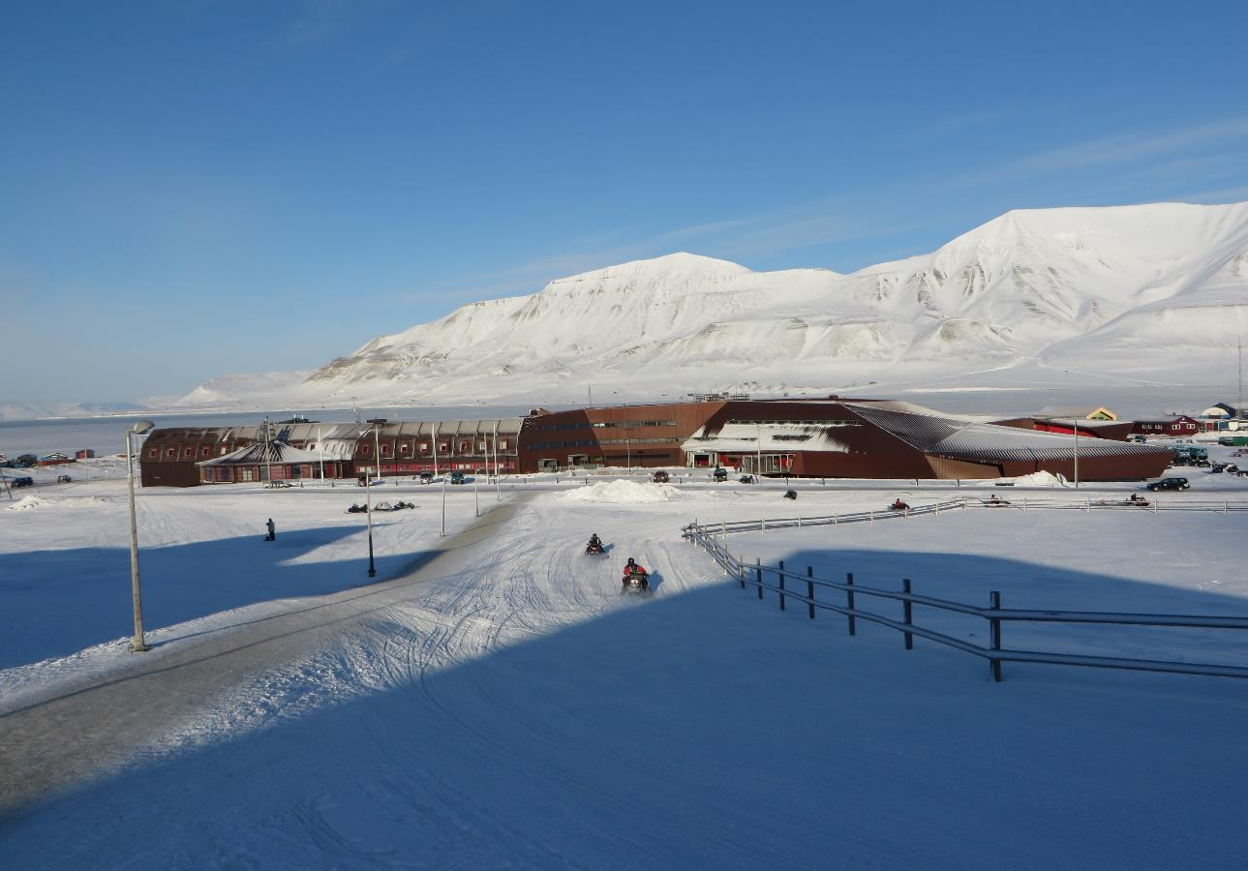
Thank you!
Notes:
And this is where we’ll have our next ARHC meeting at the University Centre in Svalbard in September at 78 deg and 13 minutes Northern lattitude.

