Slide 1
Report of the Crowdsourced Bathymetry Working Group to IRCC10
Jennifer Jencks
CSBWG Chair
Director, IHO Data Centre for Digital Bathymetry
jennifer.jencks@noaa.gov

Slide 2
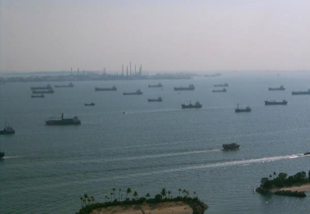
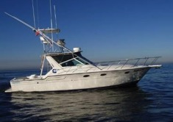
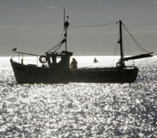

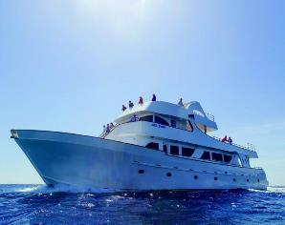

CSB Working Group Task
The CSBWG is tasked by the IRCC to develop a draft IHO publication on policy for trusted crowdsourced bathymetry (CSB) data.
This document will provide guidelines on the collection and assessment of CSB data for inclusion in the global bathymetric data set which is maintained in the IHO Data Centre for Digital Bathymetry (DCDB).

Slide 3
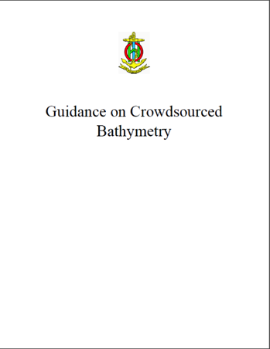
Progress on IRCC Action Item
A first draft of the Guidance Document was completed and made available via the IHO website to the public in 2017.
The final draft version of the B-12 Guidelines were made available via the IHO website prior to IRCC10.
Subject to the endorsement of the IRCC, this will be followed by consideration by the IHO Council-2 and submitted for adoption by the IHO Member States towards the end of 2018.
To access the document:
https://www.iho.int/srv1/index.php?option=com_content&amp;view=article&amp;id=635&amp;Itemid=988&amp;lang=en

Slide 4
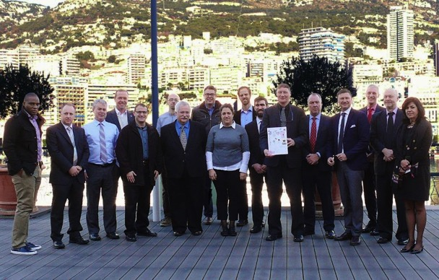
CSB Working Group 5th Meeting
Vice-Chair of CSBWG, Mr Serge Gosselin (Canada), chaired the meeting
Representatives from nine Member States
Canada, Denmark, France, Italy, Nigeria, Norway, Portugal, UK and USA
Observers and expert contributors from the Baltic and International Maritime Council (BIMCO) and Sea-ID
Secretary General Dr Mathias Jonas, Director Mustafa Iptes, and Assistant Director David Wyatt represented the IHO Secretariat
Hosted by the Secretariat of the International Hydrographic Organization, Monaco, on 5 and 6 December 2017.

Slide 5
CSB Working Group 5th Meeting
Draft chapters were developed further, taking into account the feedback received in response to IHO Circular Letter 49/2017.
Potential future tasks were considered which could be addressed by the WG in response to discussions undertaken by IHO Member States at Assembly-1 and Council-1
Initial proposed draft revisions to the ToRs were developed for further consideration.
Chapter 1: Data Contribution
Chapter 2: Data Collection
Chapter 3: Data & Metadata
Chapter 4: Uncertainty
Chapter 5: Additional Considerations
Hosted by the Secretariat of the International Hydrographic Organization, Monaco, on 5 and 6 December 2017.

Slide 6
CSB Working Group Final Editorial Meeting
Attended by the Chair, Vice-Chair, Chapter Leads and Editor.
A half day meeting to discuss and finalize IHO Publication B-12.
Held immediately after the Canadian Hydrographic Conference in Victoria on 30 March 2018

Slide 7
CSB Working Group 6th Meeting – draft agenda
Outreach Strategy
Discussion of outreach strategies in line with GEBCO and Seabed 2030 Project activities
Who are our main data collectors? Our data users? How do we target them?
Development of generic presentation, senior officer briefing notes and skeleton press input.
Recognition Strategy
Discuss an IHO and National HO Recognition strategy for data collectors
CSB Guidance Document Edition 2.0.0
Is there a need for sub-documents?
Will this be a web-hosted document eventually? What would that look like?
Do we need to develop environmental impact guidance?
To be hosted by NOAA’s National Centers for Environmental Information in Boulder, Colorado, USA, 19-21 June 2018

Slide 8
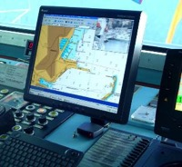
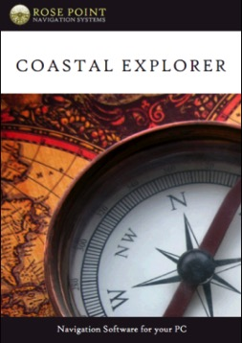
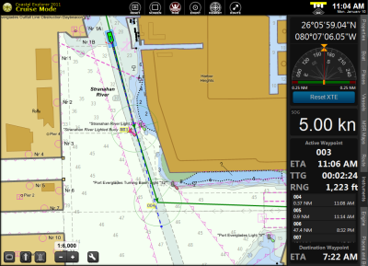
CSB Pilot Project – an update
IHO DCDB and NOAA teamed up with Rose Point Navigation Systems
Mariners given an option to enable CSB logging, allowing a modified ECS log file to record position, depth and time.
Mariners can choose to be anonymous or to submit metadata about vessel and equipment
The ECS software transmits the data via HTTPS post when the mariner updates the software or chart catalog
www.pcmaritime.com
www.rosepointnav.com

Slide 9
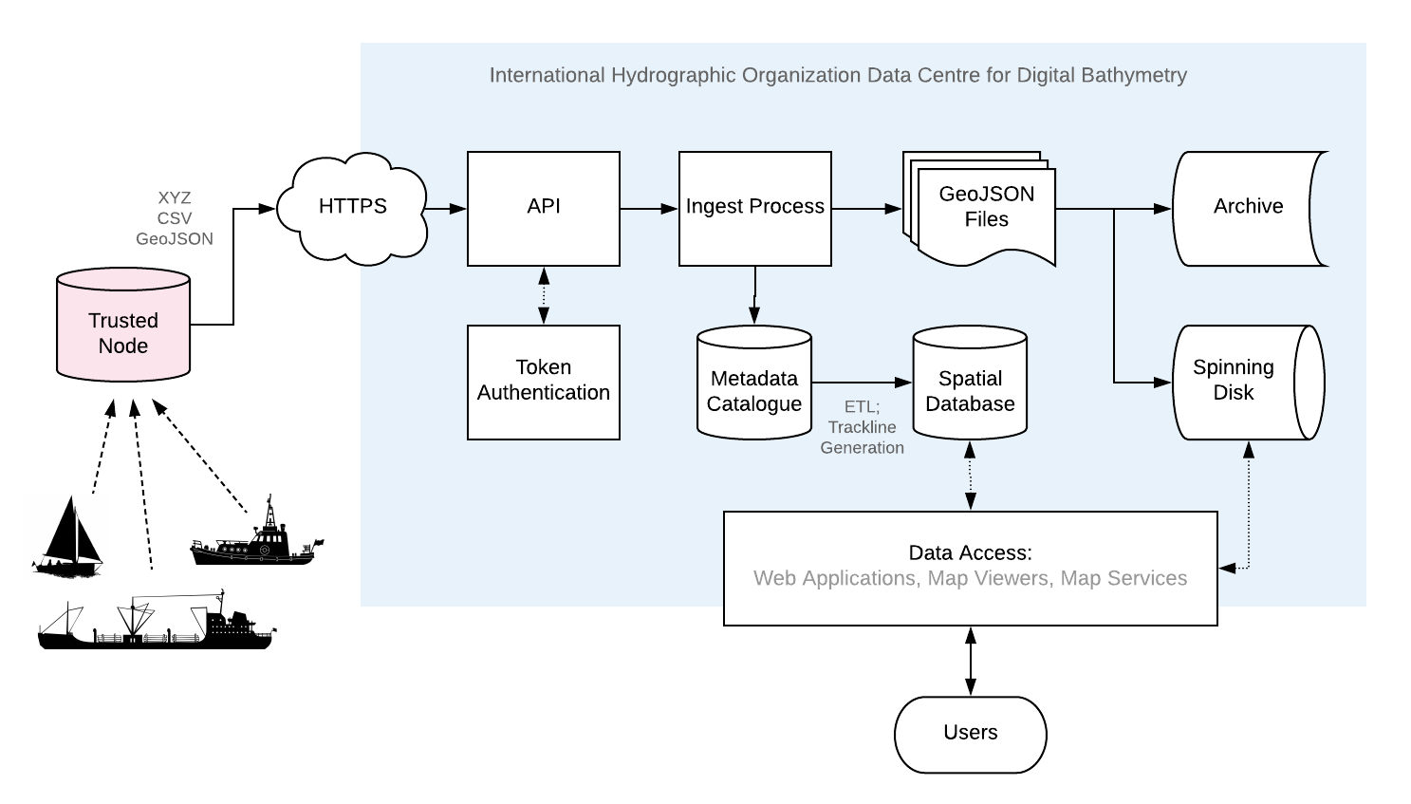
CSB Pilot Project – NOW OPERATIONAL
117 million soundings
110 contributing vessels
3435 data deliveries

Slide 10
Use Case – CHS Pacific Region
CSB data was treated by the Canadian Hydrographic Service Pacific as just another Mariner Report
~4.5 million soundings in British Columbia
6 potential “Notice to Mariners” identified in the waters off British Columbia
A large number of zero values and values where small vessel sonar lost the bottom in deep water.
Pete Wills
Hydrographic Data Centre – Pacific Region
Peter.Wills@dfo-mpo.gc.ca

Slide 11
Use Case – CHS Pacific Region
CSB filled in between systematic line spacing in a narrows providing a better limiting depth.

Slide 12
Use Case – CHS Pacific Region
CSB revealed some chart compilation problems.
Don’t use the chart to figure out how much anchor chain you need!

Slide 13
Use Case – CHS Pacific Region
Some CSB agreed with shoaler superseded leadline data and NOT with more recent charted single beam data that met survey specifications at the time.
Marked for revisory survey to resolve

Slide 14
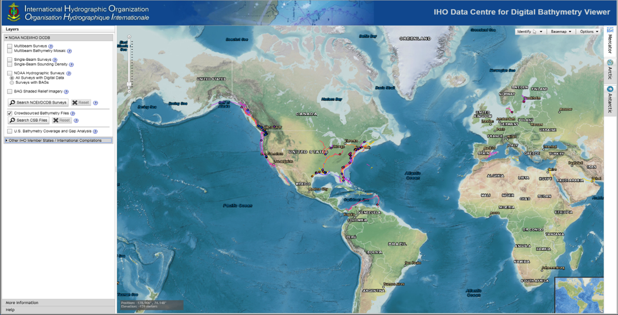
IHO DCDB = World Reference for Raw Bathymetry
https://maps.ngdc.noaa.gov/viewers/iho_dcdb/
Notes:
80 million measurements from more than 100 vessels

Slide 15
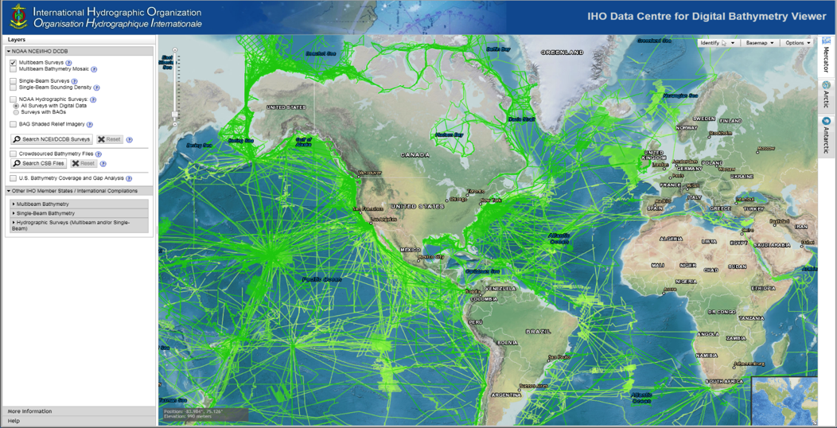
IHO DCDB = World Reference for Raw Bathymetry
https://maps.ngdc.noaa.gov/viewers/iho_dcdb/
Notes:
80 million measurements from more than 100 vessels

Slide 16
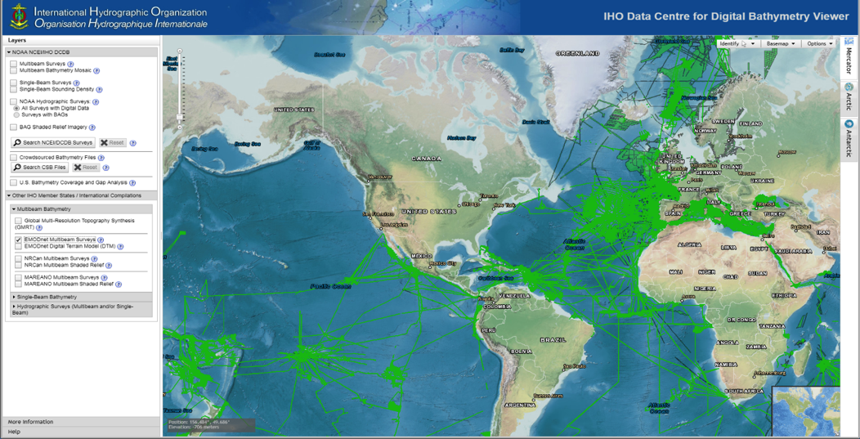
IHO DCDB = World Reference for Raw Bathymetry
https://maps.ngdc.noaa.gov/viewers/iho_dcdb/
Notes:
80 million measurements from more than 100 vessels

Slide 17
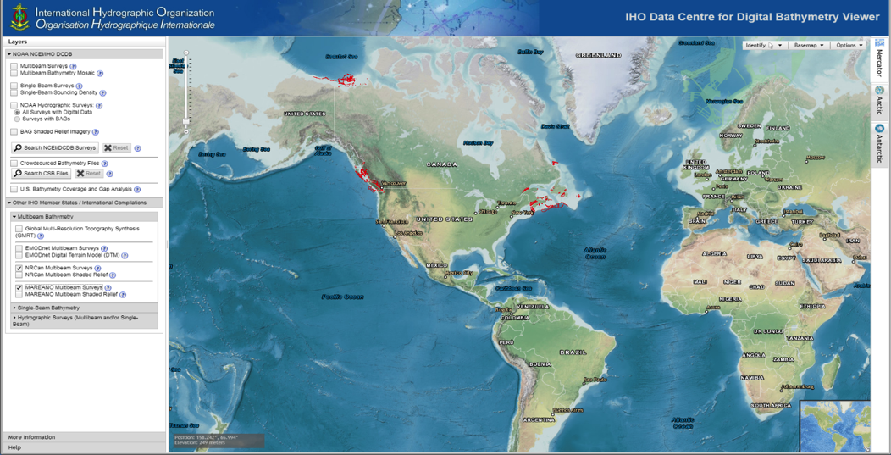
IHO DCDB = World Reference for Raw Bathymetry
https://maps.ngdc.noaa.gov/viewers/iho_dcdb/
Notes:
80 million measurements from more than 100 vessels

Slide 18
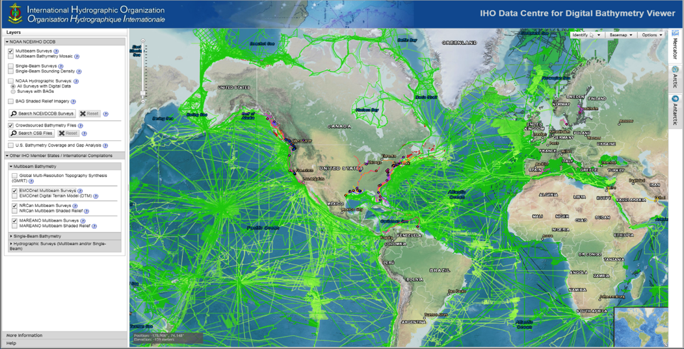
IHO DCDB = World Reference for Raw Bathymetry
https://maps.ngdc.noaa.gov/viewers/iho_dcdb/
Notes:
80 million measurements from more than 100 vessels

Slide 19
Problems Encountered
The CSBWG has received minimal feedback from IRCC participants on the draft of the CSB Guidance Document.
There continues to be a need to overcome a degree of skepticism on the CSB concept amid the maritime community and hydrographic organizations
Especially an overly cautious focus on potential, although untested, legal issues.
Increased awareness and information as well as stakeholder engagement/involvement should all help to overcome these reservations.

Slide 20
Conclusions and Recommendations
The continued importance of liaising with other IHO bodies, as well as appropriate engagement with industry to progress the work items, was identified as a key enabler for the project.
It is also noted the significant progress achieved.

Slide 21
Actions requested of IRCC
Note the contents of this report;
Circulate the draft CSB GD for formal consultation with IHO Member States and relevant stakeholders;
Encourage IHO Member States to release datasets or subsets into the public domain via the IHO DCDB;
Request IHO Member States state their policy on data gathering restrictions within their maritime areas of jurisdiction to enable CSB activities to be undertaken;
Request IHO Member States to support the CSB initiative with positive actions, such as requiring all research vessels collect bathymetric data for late uploading, when on passage or when it does not interfere with other research activities;

Slide 22
Actions requested of IRCC
Request the IHO to support a scaled trial of CSB data collection as a follow on to earlier pilot programs.
Approve the proposed revisions to the ToRs and RoPs, see annex C;
Reappoint the WG to continue its work under the proposed revised ToRs; and
Take what other action is deemed necessary.

Slide 23
Changes to ToRs
Maintain the IHO publication B-12 – IHO Guidelines on Crowdsourced Bathymetry.
Investigate and highlight ways to increase data contributions and incentives on how and why mariners should become involved.
Identify potential uses of CSB by HOs and investigate how it can be portrayed, with examples and useful land equivalents;
Provide guidance on data quality and standards for CSB in liaison with appropriate IHO Working Groups;

Slide 24
Changes to ToRs
Liaise with other IHO bodies involved with, and potential users of, CSB data, such as GGC, MSDIWG, DQWG and HSPT;
Monitor Member State and Regional progress regarding development of best practices and CSB initiatives; and
Liaise with the IHO Data Centre for Digital Bathymetry (DCDB) as it continues to develop technology to collect and distribute CSB to the public.

Slide 25
Acknowledgements
David Wyatt (Executive secretary)
Serge Gosselin (Vice-Chair)
Brian Calder, Adam Reed, Kenneth Himschoot, Aaron Rosenberg (Chapter Leads)
Whitney Anderson (Editor)
All the working group members, IHO, GEBCO, SMEs and observers whose contributions are making this possible!

