Slide 1
Report of the FIG/IHO/ICA IBSC to the IHO IRCC10
www.iho.int/ibsc

Slide 2
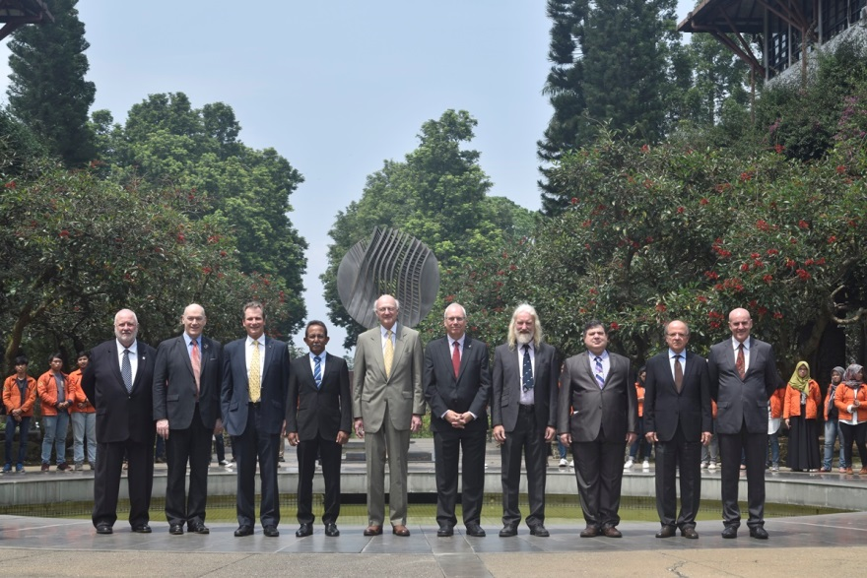
The Board
10 Board members: 4 FIG, 4 IHO, 2 ICA
(+IHO Secretariat)

Slide 3
The Role of the Board
Review syllabi of programmes and individual recognition schemes from education and training institutions
Maintain IBSC publications;
Provide guidance to education and training institutions;
Support the IHO for the establishment of new hydrographic programmes where regional training capacity does not exist;
Review the procedures of submission.

Slide 4
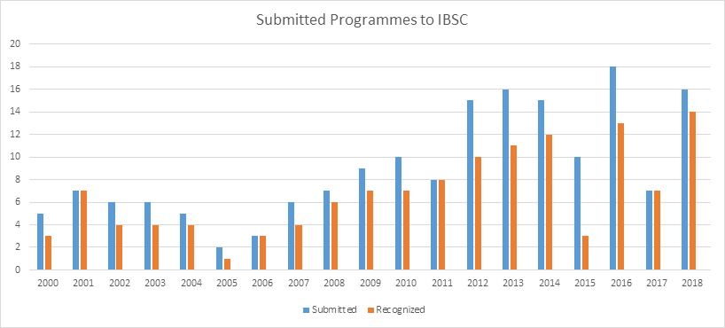
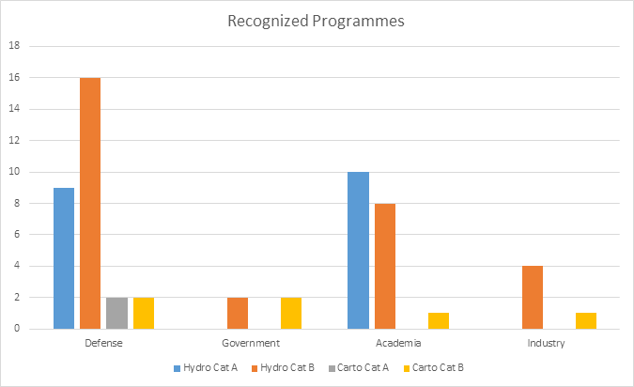
Recognised Programmes
Total 57 recognized programmes & 2 recognized schemes
49 Hydro (19xCatA & 30xCatB)
8 Carto (2xCatA & 6xCatA)

Slide 5
Work Program 2017-2018
The IBSC has been working on the following tasks :
New standards development - IBSC to develop a new Standards framework to separate competency requirements for Cat A and Cat B (Task 3.3.9.1, IHO Work Programme for 2017) and,
Review the IBSC standards and maintain IBSC Publications (Task 3.8.4, IHO 3 year Work Programme 2018-2020)
IBSC41 meeting April 2018
Engagement with the SEPRHC13 meeting, from 21 to 25 August 2017, in Cartagena, Colombia and visits to both Colombian academies - Academy for Petty Officers in Barranquilla and Course for Officers (Academy in Cartagena).
Article published in the IHR (November 2017) Maintaining the Standards of Competence for Hydrographic Surveyors and Nautical Cartographers: A Modern Approach

Slide 6
New Standards Framework Published
Following decisions made at IRCC9 and IHO MS approval and adoption of S-8A and S-8B by CL45/17 and CL54-17 the following standards were published in 2017:
Standard | Ed
S-5A Standards of Competence for Category "A" Hydrographic Surveyors | Ed. 1.0.1, June 2017
S-5B Standards of Competence for Category "B" Hydrographic Surveyors | Ed. 1.0.1, June 2017
S-8A Standards of Competence for Category "A" Nautical Cartographers | Ed. 1.0.0, September 2017
S-8B Standards of Competence for Category "B" Nautical Cartographers | Ed. 1.0.0, September 2017
They are accompanied by the companion document Guidelines for the Implementation of the Standards of Competence for Hydrographic Surveyors and Nautical Cartographers
(Ed 2.0.0, March 2017)

Slide 7
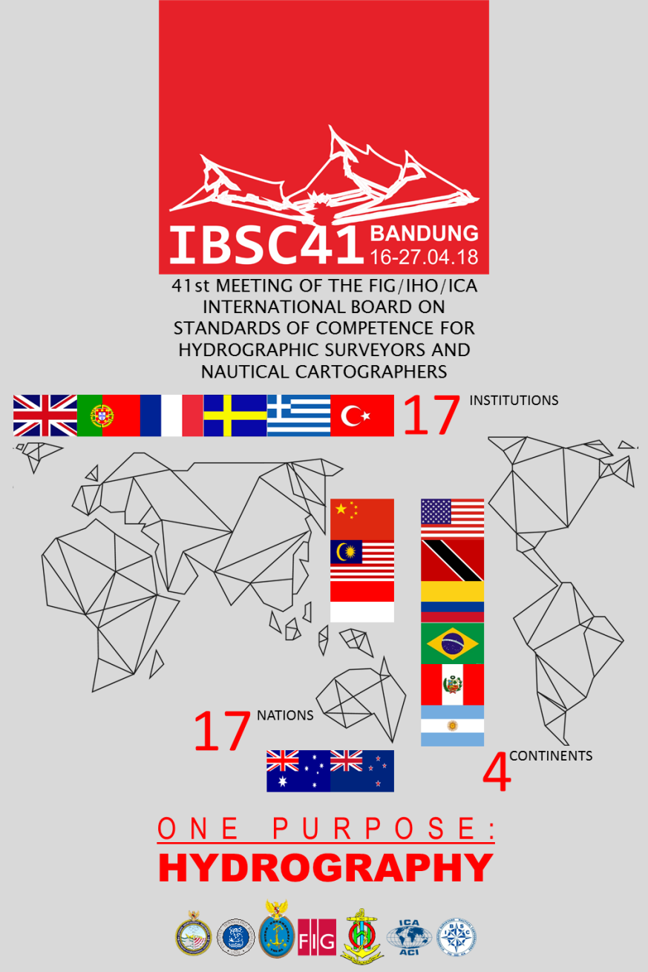
IBSC41 Meeting 16-17 April 2018
Annual meeting - 10 days
Hosted by Institut Teknologi Bandung (ITB), Indonesia
16 Submissions from 10 countries (14 Hydro & 2 Carto)
3xUSA, 2xUK, 2xArgentina, 2xChina, 2xColombia, Malaysia, Peru, Portugal, Sweden & Turkey
3 submissions per day, 10 delegations, 16 presentations

Slide 8
IBSC41 Submissions
Sixteen (16) submissions were reviewed against the new standards.
Status | N. | Standards of Competence
Recognized | 3 | 2 x Hydro S-5B 1 x Hydro S-5A
Recognized with Conditions | 11 | 4 x Hydro S-5A 6 x Hydro S-5B 1 x Carto S-8A
Not recognized | 2 | 1 x Hydro S-5A 1 x Carto S-8A
Total | 16
5 new programmes submitted
14 programmes recognized

Slide 9
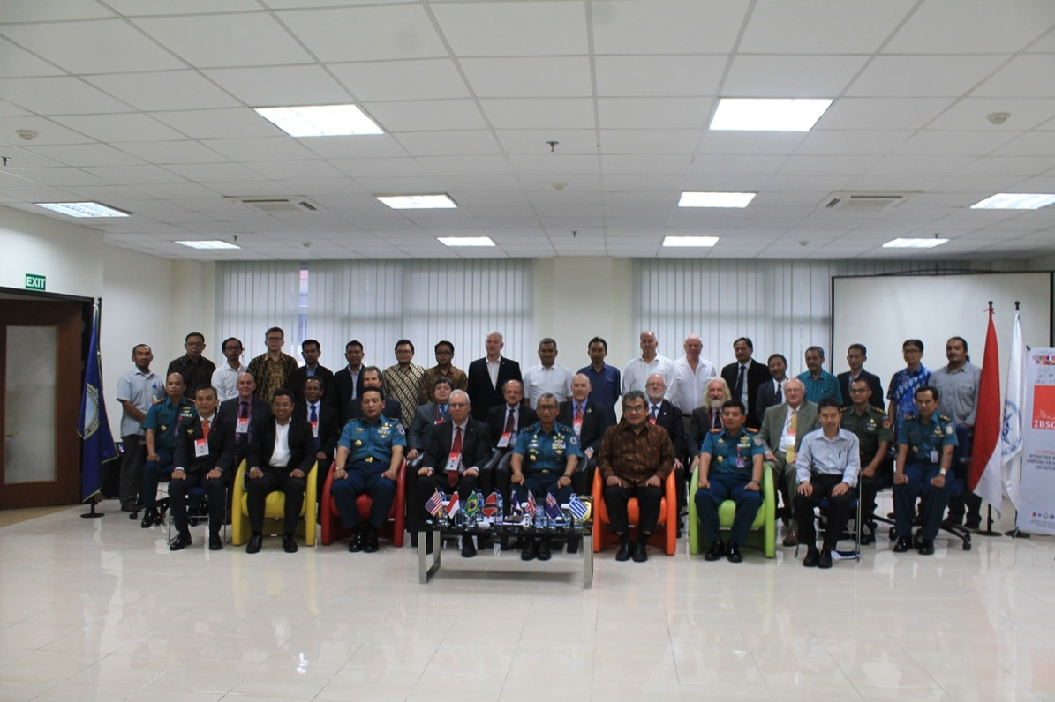
IBSC41 Stakeholder Meeting

Slide 10
Challenges:
Prof. Nicolas SEUBE, Canada (IHO), past Chair 2014-2016, has resigned from the Board.
CL23 Vacancy for IHO representative
Managing workload
Large number of submissions
Recognition period 6 yrs
New programmes and schemes
Quality of submissions
Recognized with conditions / Not Recognized
Right First Time principle - all programmes are Recognized at the first review stage
Stakeholder engagement & outreach
Promoting the work of the IBSC and Standards
Guidance and assistance to institutions

Slide 11
Proposed Work Plan
ANNEX B
Task | Work Item | Priority | Milestones | Start Date | End Date | Status | Contact Person | Affected Pubs/Standard | Remarks
1 | Review of IBSC41 Conditional Recognition submissions | H |  | Q2-Q3 2018 |  | O | Board Members |  | Intersessional
2 | Develop FAQ Right First Time companion document | H |  | Q4 2018 | Q1 2019 | P | Chair | New | 1 week workshop
3 | Review submission process | M | July 2018 Invitation Letters | Q2-Q3 2018 |  | O | Chair IHO Secretariat | Guidelines | Right First Time
4 | On-site visits to provide guidance and assistance to institutions | M |  | Q3-Q4 2018 |  | P | Board Members |  | China, Colombia, Canada, Indonesia-Navy, Malaysia
5 | Stakeholder engagement – workshops, presentations | M |  | 2018-19 |  | P | Board Members |  | Hydro18, Shallow Survey 2018, ICC 2019 General Assembly
6 | Review item 6. competency schemes | L |  | 2019 |  | P | Board Members | Guidelines | Intersessional
7 | IBSC42 | M |  | 2019 |  | P | IHO Secretariat |  | Venue and dates TBD

Slide 12
S-5A & S-8A Clarification/Amendments
ANNEX C - Standard: S-5A 1.0.1
Task: review Maritime Zones, Delimitations (H8.2a) following proposal from India on the UNCLOS.
H8.2a Delimitations (B) | Historical development of 1982 UNCLOS. Baselines – normal (including closing lines); straight and archipelagic Base points Low tide elevations Baselines: normal (including bay closing lines); straight and archipelagic Internal waters. Territorial seas. Contiguous zones. Exclusive Economic Zone Extended continental shelf. High seas | Define the types of baselines under UNCLOS and how the territorial sea limit and other limits are projected from them, including the use of low tide elevations. Plan and specify hydrographic surveys to be utilized in the delimitation of baselines and maritime boundariesConduct and document surveys with appreciation for the type of baselines and the implication of the baselines. Describe the legal operational constraints that apply within maritime zones.

Slide 13
S-5A & S-8A Clarification/Amendments
ANNEX C - Standard: S-8A 1.0.0
Task: review comments provided by Chile in CL 54/2018 on Printing on Demand and two other clarifications
F2.6 Depth measurement (I) | Evolution of technology and methodologies for depth measurement Hydrographic vs. bathymetric data measurement Influence of the environmental factors on depth measurement Error sources in depth measurement. | Classify different methods and systems used for depth measurement with respect to their accuracy. Assess the suitability of different depth measurement methods to achieve specific surveying and charting objectives. Examine data for depth measurement uncertainty in relation to the measurement methods employed.
C1.5 Cartographic data sScales of measurement of cartographic and geographical variables (I) | Scales of measurement of cartographic and geographical variablesScales of cartographic data measurement: Nominal scale Ordinal scale Interval scale. | Differentiate cartographic and geographical variablesdata according to their scale of measurement.
C4.3g Mapping on demand (I) | Customized mapping from existing databases. Printing up-to-date official nautical chart from an existing catalog | Identify and apply the processes required for mapping and printing on demand.

Slide 14
The IRCC is invited to:
Note this report;
Acknowledge the work done by the Board in the delivery of the new framework for the Standards of Competence for Hydrographic Surveyors and Nautical Cartographers
Approve the clarifications/minor amendments made in IHO Publications S-5A Ed 1.0.1 and S-8A Ed 1.0.0 (Annex C)
Note the IBSC goal of Right First Time
Agree the IBSC Proposed Work Plan – Q2 2018 to Q2 2019 (Annex B)
Take any other actions as appropriate

Slide 15
Thank You
www.iho.int/ibsc

