Slide 1
IRCC11-06.1F
BALTIC SEA HYDROGRAPHIC COMMISSION (BSHC)
BSHC report to IRCC11
Genoa, Italy 3-5 June 2019

Slide 2
Outline of BSHC
Membership
Chair: Mr Thomas Dehling (Germany) from Sept 21, 2017
Mrs Pia Dahl Højgaard (Denmark) from August 29, 2018
Vice-Chair: Mrs Pia Dahl Højgaard (Denmark) from Sept 21, 2017
Cpt. Andrzej Kowalski (Poland) from August 29, 2018Membership:
Members: Members: Denmark, Estonia, Finland, Germany, Latvia, Poland, Russian Federation, Sweden.
Associate Member: Lithuania.
Observers: UKHO, US Navy
IHO representative, Secretary General, Dr Mathias Jonas

Slide 3
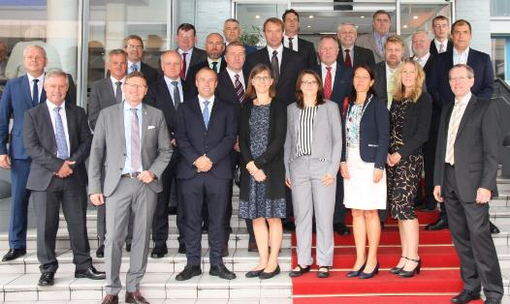
Meetings since IRCC10 (June 2018)
Metings:
  Following BSHC meetings have taken place:
  23rd Meeting - Aalborg, Denmark Germany, 27-29 August 2018
  Next meeting:
  24th BSHC meeting will take place 10-12 September 2019, Gdańsk, Poland
Current BSHC Working Groups:
  a) Baltic Sea Bathymetry Database (BSBD)
  b) Re-survey Monitoring Working Group (MWG)
  c) Chart Datum Working Group (CDWG)
  d) Baltic Sea INT-Chart coordination (BSICC)
  e) Marine Spatial Data Infrastructure WG (BS-NSMSDIWG)
  f) Baltic Sea MSI Working Group (BSMSIWG)

Slide 4
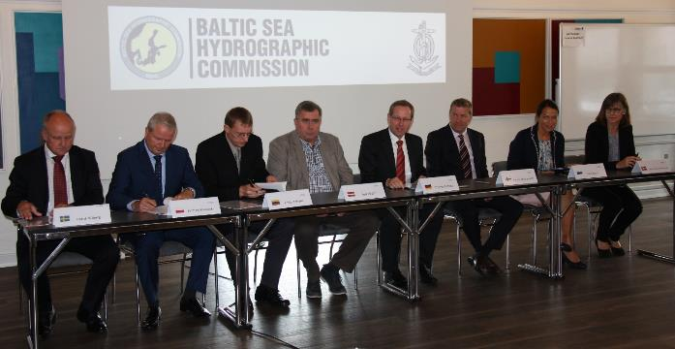
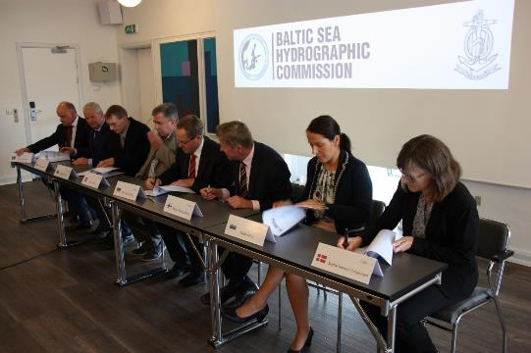
Activities - The BSHC Statutes -
The BSHC Statutes have been reviewed and updated and the amended version of the Statutes was signed at the BSHC24 Conference in Aalborg

Slide 5
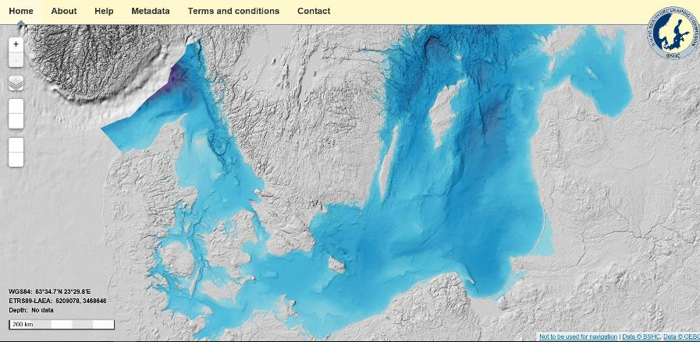
Activities - Baltic Sea Bathymetry Database -
Baltic Sea Bathymetry Database (BSBD)
Bathymetry for the Baltic Sea is available in a resolution of minimum 500 grid space.
Plans are ongoing to produce a higher resolution bathymetric model of the Baltic Sea.
Several MS are already providing up to 50 m resolution.
Some might be able to provide a 300 m model.
Another action item is to regularly update the model.
www.bshc.pro

Slide 6
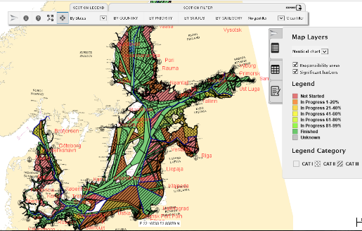
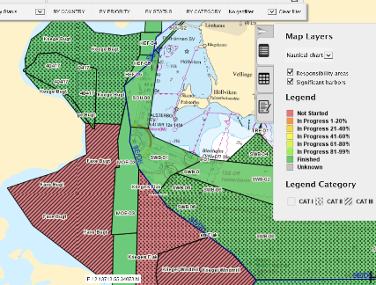
Activities - Re-survey Monitoring -
Re-survey Monitoring and coordination
BSHC developed and operates a standing scheme of re-surveys for the region.
Schedule and execution of surveys are provided in an updated web based interface.
Further developments of the common re-survey database as metadata repository are ongoing.
Member States update the information for their waters of jurisdiction independently.
The GIS tool:
is a very practicable tool for MS
MS fill in the information regularly
very good tool to convince decision makers that surveying is needed.
Link to BSHC RE-Survey Database: https://helcomresurvey.sjofartsverket.se

Slide 7
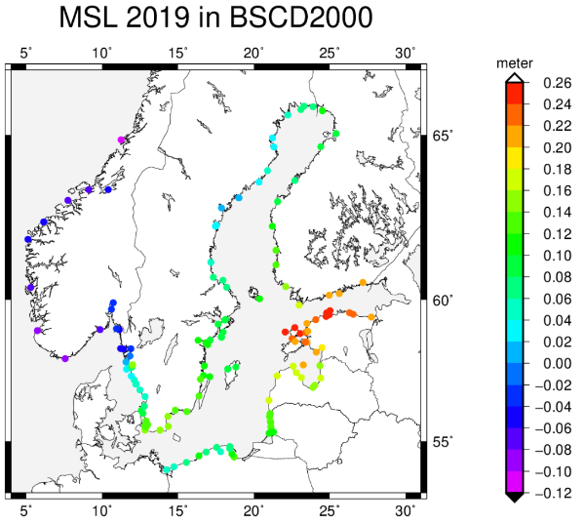
Activities - Harmonized Chart Datum in the Baltic -
Harmonized Chart Datum in the Baltic (BSCD 2000)
BSHC developed the Baltic Sea Chart Datum 2000 as a joint height reference. It is based on the European Vertical Reference Frame (EVRF).
All member state will adopt the new chart datum in the next few years.
In some countries implementation has already startede.
Difference between old and new datum varies country by country. And it is expected that the transition will take many years.
Information to the mariners about this change in the products to mariners, especially in ENCs is seen as a challenge.

Slide 8
Activities - Baltic Sea MSI Working Group -
At the recent Baltico Meeting in Sankt Petersburg in April 2018, a proposal to formalize the Baltico meeting under BSHC was discussed. The meeting agreed upon that Sweden should forwards a proposal, to the BSHC23 Conference in August 2018.
At the BSHC23 Conference it was decided to make the Baltico Meetings more official and their authority, aims and procedures more formal, therefor it was agreed to make the existing forum to be organized as a permanent Working Group under the Baltic Sea Hydrographic Commission.
It was agreed that the name of the Working Group to be the Baltic Sea MSI Working Group (BSMSIWG). The BSHC23 Conference also agreed on the Terms of Reference and Rules of Procedure for the Baltic Sea MSI Working Group (BSMSIWG).
The members of the BSMSIWG consist of the National Coordinators and other persons involved in the MSI service in the Baltic Sea Sub-area.

Slide 9
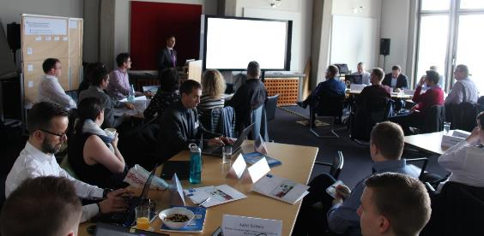
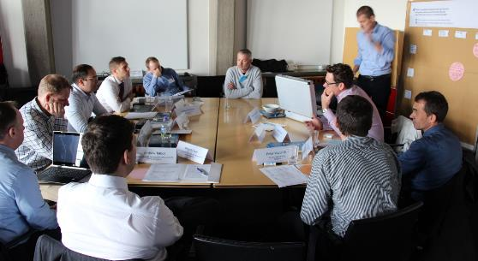
Activities - Workshop about processing of bathymetric data -
Workshop about processing of bathymetric data
The goal of the workshop was to discuss and collect general requirements concerning high density ENCs using the current S-57 and concerning future S-102 gridded data.
The German HO BSH Nautical Information Service conducted a joint workshop of data producers and software developers to exchange technical potential and requirements regarding the processing of bathymetric data and thus to receive valuable input for the development of efficient solutions in data management and the production of nautical information products. The workshop was attended by 39 participants.
The status and content of S-102 and bathymetric data processing were discussed.

Slide 10
Activities - Relations with other organizations -
Relations with other International Organizations and IHO Stakeholders
RHC’s was asked to consider the relevance of the list and its continued existence in current or different format.
At the BSHC 23 meeting the relevance of the list of stakeholder events was discussed.
The BSHC MS concluded that the relevance of the list of stakeholder events was considered rather low and that the BSHC MS see no need for a further existence of the list.

Slide 11
Action requested to IRCC
Conclusions:
The BSHC Statutes have been reviewed and updated and the amended version of the Statutes was signed at the BSHC24 Conference in Aalborg.
Achievements and lessons learned:
The cooperation within the BSHC is very productive. The Baltic Sea can be seen as a test bed for hydrographic developments. Several projects have led to joint databases and results provided in the web.
The outreach of the hydrographic work in the region and beyond has improved even further. Member states have continued to contribute extensively to the work of the IHO and have been active participants of working groups.
There has been substantial cooperation between commission member states and other European States
and the EU on information sharing and shared projects.
The IRCC is invited to note this report.

