Slide 1
South West Pacific Hydrographic Commission (SWPHC)
Report to IRCC11 Genoa, Italy – 3-5 June 2019
Commodore Fiona Freeman (In Absentia) Chair SWPHC Hydrographer of Australia

Slide 2
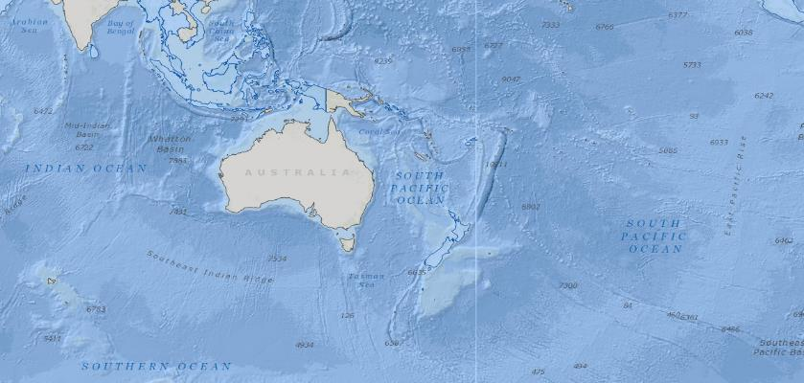
South West Pacific Hydrographic Commission

Slide 3
Commission Membership
Members | Australia (Chair), Fiji, France, New Zealand (CB Coordinator), Papua New Guinea, Tonga, United Kingdom, United States of America, Vanuatu (Vice Chair)
Associate Members | Cook Islands, Indonesia, Kiribati, Nauru, Niue, Palau, Samoa, Solomon Islands
Intergovernmental Observer Organizations | IALA, IMO, GEBCO, Pacific Community (SPC)
Observers | Marshall Islands, New Caledonia, Tokelau, Tuvalu
IHO Representatives | Director Abri Kampfer, Assistant Director Alberto Costa Neves
Notes:
Total of 17 members – i.e. 9 Members (IHO MS) and 8 Associate Members.
The Pacific Island Countries (PICs) currently having Observer status have expressed interest in becoming Associate Members.
Solomon Islands is in the process of becoming an IHO Member.

Slide 4
Meetings, Working Groups and Actions
The 16th SWPHC Meeting held in Niue 13-15 February 2019 was attended by 55 participants - representing all 9 Member States of the Commission, all 8 Associate Members, 3 Observer States, international/regional organisations, industry and the IHO.
Since the last SWPHC meeting, SWPHC International Charting Coordination Working Group (SWPHC-ICCWG) progressed the coordination of INT chart and ENC schemes in the region by correspondence among its members.
The next meeting (SWPHC17) will be held in Wollongong in February 2020.
Status of IRCC10 Actions
IRCC10 Action (3) – RHC Chairs to submit draft IHO Resolution 2/1997 as amended to the RHC Members for comments and report back to IRCC
COMPLETE (Addressed at SWPHC16)
IRCC10 Action (5) – IRCC Members to provide comments to the revised draft IHO Resolution 2/1997 as amended
COMPLETE (Response sent to IRCC Chair 12 April 2019)
Notes:
SWPHC16 hosted by the Government of Niue, and opening speech given by the Minister of Infrastructure, the Honourable Pokotoa Sipeli.
SWPHC-ICCWG members - Charting Nations and PCAs in the region, i.e Australia (Chair), France, New Zealand, UK and USA

Slide 5
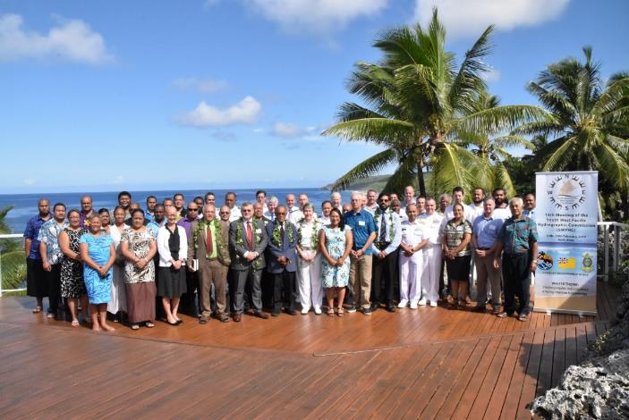
16th SWPHC Meeting - Niue, 13-15 February 2019

Slide 6
Capacity Building Activities
Activities completed since the last IRCC:
IHO CB Activities (CBWP)
- MSI Training Course (2018 CBWP P-11)
The training was carried out 6-9 August 2019 in Wellington, New Zealand with instructors provided by Australia (NAVAREA X) , Fiji (MSAF) and New Zealand (NAVAREA XIV).
- MBES Training Course (2018 CBWP P-32)
This activity was carried out by UKHO in Suva, Fiji 10-15 February 2019. It involved a bathymetric survey and training using the R2Sonic Equipment.
Notes:
MSI Training - Participants from 13 SWPHC Coastal States attended. The objective of the course was to increase the flow of MSI to the NAVAREA X and NAVAREA XIV Coordinators and emphasize the importance of establishing expertise in the countries within this region.
Inclusion of a MSAF staff (mr Sunil Kumar) is a direct response to IHO’s goal to build capacity by appointing MSI trainers from the region.

Slide 7
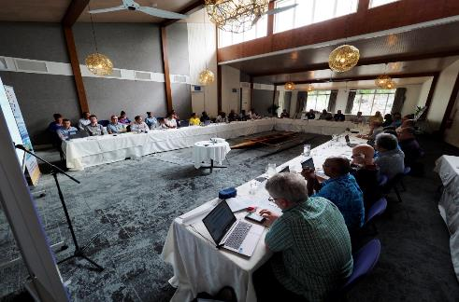
Capacity Building Activities
Technical Workshop on Disaster Response Planning and Data Discovery (2019 CBWP P-05)
Held Niue 11-12 February 2019 - linked with SWPHC16 Meeting.
Led by Land Information New Zealand (LINZ), with 14 presenters from Australia, Fiji, France, New Zealand, Samoa, United Kingdom, United States of America, IHO & SPC.
Attended by 50 participants from the PCAs, PICTs, IHO and SPC.
Notes:
‘Disaster Response Planning’ session aimed to make PICTs aware of roles of IHO and SWPHC in aftermath of a disaster and to understand the procedures needed to identify appropriate action and support. In addition it provided guidance to PICTs to establish national procedures and guidelines.
‘Data Discovery’ session provided overview of discovery tools, search capabilities, use of metadata and data, mechanisms to share data (release agreements, bilateral arrangements) and establishment of geospatial portals.

Slide 8
Capacity Building Activities
Activities planned for 2019:
IHO CB Activities (2019 CBWP)
Technical Implementation Visit - Samoa (CBWP A-01)
Technical Implementation Visit - Niue (CBWP A-02)
Follow-up of the Technical Assessment & Advice Visits carried out in 2016. The visits are to ensure that Samoa and Niue fulfil their SOLAS V obligations (V/4 & V/9), by providing support to implement the recommendations of the technical visits.
Technical Assessment and Advice Visit - Palau and Marshall Islands (CBWP A-03)
This technical visit will provide an opportunity to build Palau and Marshall Islands awareness and understanding of their hydrographic responsibilities.as per SOLAS (Chapter 5 regulations 4 & 9).

Slide 9
Capacity Building Activities
Major Support Activities
UK Commonwealth Marine Economies (CME) Programme
CME Programme aims to support the sustainable growth of Commonwealth Small Island Developing States (SIDS) within the Caribbean, Pacific and Indian Ocean regions. Part of the Programme includes providing surveys, charting and capacity building in the SWPHC.
Following CME activities were carried out:
Tonga - Survey of critical areas in the approaches to Nuku’alofa (2018)
Tuvalu - In partnership with SPC and Tuvalu government officials, a geodetic survey and installation of tide gauges in outer islands to establish vertical control
Tuvalu - SDB survey of entire island chain (2018)
Fiji - Digitisation of 10 national charts into S-57 format (2018).
Notes:
LINZ has updated charts for Tonga using the new survey data.

Slide 10
Capacity Building Activities
Major Support Activities
NZ Pacific Regional Navigation Initiative (PRNI)
New Zealand progressed with surveys and charting nationally as well as in the region through the NZ Aid programme ‘PRNI’.
Full ENC coverage of NZ waters was achieved and 45 ENCs for the PICTs released.
Hydrographic surveys comprising SDB, ALB and MBES (Vessel & USV) were carried out in the Cook Islands, Niue, Tokelau and Tonga. The data will be used to update existing charts and produce new charts, replacing charts in fathoms on undetermined datums.
PNG Maritime and Waterways Safety Project
As part of the ADB Maritime Waterways & Safety Project surveys were conducted in Papua New Guinea ports and coastal areas – in support of Government objectives to promote domestic shipping and cruise tourism. The data will be used for updating relevant charts.

Slide 11
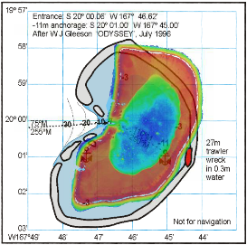
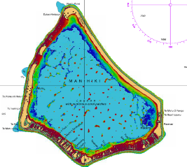
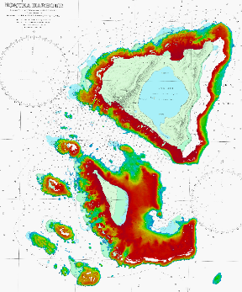
Surveys
Satellite Derived Bathymetry (SDB)
Nomuka, Tonga
Manihiki, Cook Islands
Beverideg Reef, Niue

Slide 12
Achievements
Considerable progress in hydrographic activities in the region since the last meeting.
Surveys and Charting
Australia conducted surveys in Papua New Guinea and expanded the AusENC service to include the full portfolio of published ENCs covering Australian, Papua New Guinea and Solomon Islands waters. The RAN hydrographic training course (Category B) included students from Malaysia, New Zealand and Pakistan. The AHO has developed a survey planning risk assessment tool based on the methodology adopted by LINZ.
Fiji has conducted new surveys and published charts. Significant work carried out under the ODA Project in collaboration with the Korean Hydrographic and Oceanographic Authority. A new survey vessel was donated by the Peoples Republic of China and sea trials and training are in progress. FHS has offered to provide training opportunities on board its survey vessel for PICTs personnel. Fiji also made available the National MSI Coordinator in delivering MSI training in the region.
France carried out various surveys in the SW Pacific in support of maritime surveillance, commercial and cruise activities. Three new INT charts were produced and full coverage of New Caledonia waters in ENCs was achieved in 2018.

Slide 13
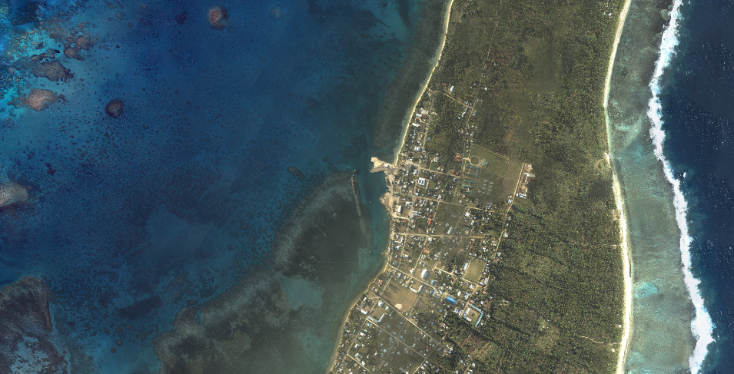
Progress on surveys
More than bathymetry
Notes:
But it’s not just bathymetry that’s been collected. In Tonga where the planes flight path took them over land, topographic LiDAR and imagery was collected
This can be used to assist with determining land use and tsunami inundation modelling
All the data collected will be provided too each country

Slide 14
Achievements
Surveys and Charting (contd.)
New Zealand progressed with surveys and charting nationally as well as in the region through the NZ Aid programme ‘Pacific Regional Navigation Initiative (PRNI)’. Hydrographic surveys comprising SDB, ALB and MBES were carried out in the Cook Islands, Niue, Tokelau and Tonga. Full ENC coverage of NZ waters was achieved and 45 ENCs for the PICs released.
Solomon Islands in collaboration with its PCA (Australia) has produced the inaugural Solomon Islands National Tide Tables consisting of tidal information for about 40 ports.
Papua New Guinea completed almost 95% of the hydrographic work in 30 coastal areas (under the ADB Maritime Waterways & Safety Project). In August 2018 commenced promulgating coastal warnings via weekly email using templates as per the S-53 format.
United Kingdom carried out considerable work as part of its CME Programme for providing surveys, charting and capacity building in the region – i.e. activities in Fiji, Tonga and Tuvalu.
United States of America produced six ENCs covering the waters surrounding the Palau Islands.

Slide 15
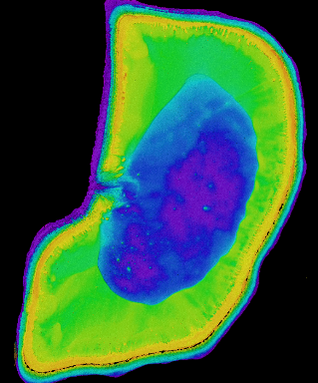
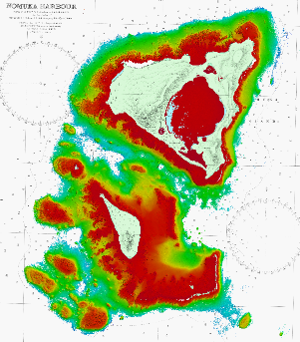
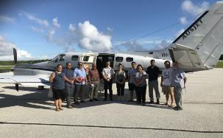
Surveys
Airborne Laser Bathymetry (ALB)
Nomuka, Tonga
Notes:
After the SDB was delivered, the ALB areas were reviewed.
This required referencing the fathoms chart to match the SDB and imagery, then refining the ALB areas

Slide 16
Achievements
GEBCO Seabed2030 South and West Pacific Centre (SaWPac)
New Zealand is the Seabed2030 Regional Data Assembly and Coordination Centre (RDACC) for the South and West Pacific Ocean, and operates the South and West Pacific Data Assembly Centre (SaWPac). The first batch of data from SaWPac was delivered to the Global GEBCO data centre in November 2018.
Marine Spatial Management Plan
Niue is committed to establishing 40% of its EEZ as a Marine Protected Area (MPA). Developing the Marine Spatial Management Plan (MSMP) and the compliance strategy and legal analysis to give effect to the MSMP and MPA.
Notes:
SaWPac Regional Mapping Committee held inaugural meeting on 4-6 March 2019, in Wellington. Representatives from countries in region discussed what bathymetry data their country has and learnt how they can contribute this data to the Seabed2030 project.

Slide 17
The South and West Pacific Centre
123,515,000 km² of ocean
67,000,000 km² outside national jurisdiction
39 countries and territories
~80% deeper than 3000 m
Includes the two deepest ocean trenches: Mariana Trench (10,994 m) Kermadec Trench (10,047 m)

Slide 18
Achievements
Governance
Cook Islands has appointed a MSI officer
Kiribati has appointed a new Hydrographer
Samoa has established a National Hydrographic Committee and its Ministry of Works, Transport and Infrastructure signed a Bilateral Arrangement on Hydrography with LINZ (New Zealand)
Tonga (Ministry of Infrastructure) has signed a Bilateral Arrangement on Hydrography with LINZ.

Slide 19
Lessons Learnt
The strategy of preceding SWPHC meetings with a CB workshop has proved very beneficial, with the February 2019 workshop and meeting attended by 50 persons, most of which were from PICTs. All participants were extremely active and contributed to collective and own knowledge of hydrography.
Regular communications between NAVAREA and National Coordinators and continued, targeted MSI training is key to improving the flow of MSI.

Slide 20
Challenges
The main challenges and/or obstructions faced in the region:
• Recruiting and retaining qualified and experienced staff
Distance – countries widely spread within region
• Resourcing to maintain level of engagement in SWP – competing national HO priorities

Slide 21
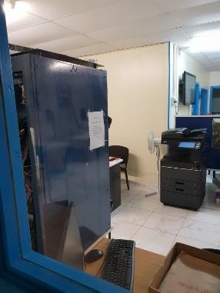
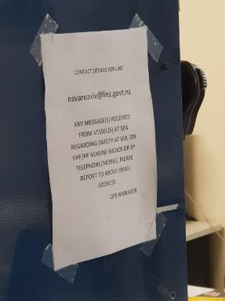
Niue MSI

Slide 22
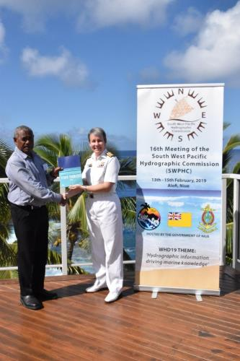
Actions required from IRCC
IRCC members are invited to:
note this report
note the value and effectiveness of preceding SWPHC meetings with a CB related workshop
2019 Solomon Islands National Tide Tables published by AHO in collaboration with SIHU

