Slide 1
Eleventh Meeting IHO Inter-Regional Coordination Committee (IRCC-11) MesoAmerican Caribbean Hydrographic Commission (MACHC) Report Chair: Kathryn Ries, USA Vice-Chair: Vice Admiral Antonio Fernando Garcez Faria, Brazil Members: Brazil, Cuba, Colombia, France, Guatemala, Guyana, Jamaica, Mexico, Netherlands, Suriname, Trinidad and Tobago, UK, USA, Venezuela Associate Members: Antigua y Barbuda, Belize, Costa Rica, Dominican Republic, El Salvador, Grenada, Honduras, Panama, St. Vincent and the Grenadines

Slide 2
Meetings
19th Meeting – November 26-December 1, 2018 in Cartagena de Indias, Colombia
20th Meeting – Scheduled for December 2-6, 2019 in Santo Domingo, Dominican Republic

Slide 3
Main Components
Three Primary Working Groups:
Integrated Charting Coordination Working Group
Capacity Building Committee
Marine Spatial Data Infrastructure Working Group

Slide 4
Capacity Building Activities 2017-19:
Main Components
Seminar on Raising Awareness of the Importance of Hydrography (2018)
Workshop on Dealing with Maritime Disasters (2018)
Multi-beam Echo Sounder Data Processing (2018)
Regional Maritime Safety Information training (2018)
Technical Visits to: Guatemala (Mar 2019), Dominican Republic (Jan 2018), and El Salvador (Dec 2017).

Slide 5
Status of IRCC Actions (relevant for MACHC)
3 | to submit draft IHO Resolution 2/1997 as amended (Annex C) to the RHC Members for comments and report back to IRCC (6.2) | RHC Chairs | MACHC submitted comments to IRCC Chair on 12/20/18
8 | to report the status of MSI in coastal States to the next IRCC meeting (7b) | WWNWS-SC Chair | MACHC is assessing the status of MSI and will be posting it to its working website (under development) for tracking purposes

Slide 6
MSI Status
Notes:
MACHC assessed the status of MSI (see Annex to this report) and will be posting it to its working website (under development) for tracking purposes

Slide 7
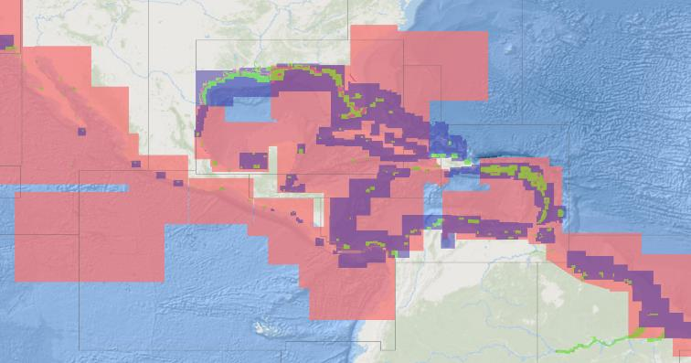
MACHC ENCs
914 ENCs available
ENC Online chart viewer:
https://www.iho-machc.org/#enconline
12 large scale ENC coverage of major cruise ship ports
Notes:
Charting collaboration is very effective in the MACHC. There are now 914 Electronic Navigation Charts available for the region, including increased large scale ENC coverage (12) of major cruise ship ports. Most of these be seen in the MACHC ENCOnline chart viewer: https://www.iho-machc.org/#enconline.
The MICC, as part of its workplan, will consider the request of the WEND WG 9/12 for ENC producers to provide their extracted bathymetric data from ENCs as a contribution to both Seabed 2030 and our MSDI effort.

Slide 8
Other Activities
Accomplishments:
Guyana is new member state!
Created new MSDI WG
Initiated Disaster Response Strategy for MACHC
Reinvigorated the International Bathymetric Chart of the Caribbean (IBCCA)
Initiated Collaboration with the Seabed 2030 Regional Data Center for the Atlantic, developing gap analysis
Notes:
Guyana is a new (90th) Member State of the IHO as of 18 April 2019 and will officially become a member of the MACHC in December 2019! All coastal states of South America are now IHO Members.

Slide 9
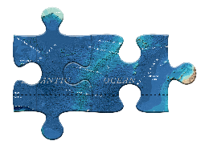
GEBCO 2019
Notes:
This is the GEBCO 2019 basemap (just released April 2019)---this web based interactive regional view is being developed by Dr. Vicki Ferrini, RDC
Coordinator for the Atlantic and Indian Ocean.

Slide 10
GEBCO 2019 Regional Coverage
Notes:
This is the GEBCO 2019 basemap with a "mask" overlain which highlights areas in the map that are supported by direct measurement. EEZs are overlaid in yellow. This includes all data from all sources. It does not show all data that are publicly available (or all known embargoed data) - it just highlights what's been synthesized into the product.

Slide 11
GEBCO 2019 Coverage + IHO DCDB
Multibeam = Green
CSB = other colors
Notes:
This is IHO DCDB raw bathy data holdings on top of the GEBCO data holdings
The green are the full holdings of IHO DCDB Multibeam holdings. These are mostly raw and most of the data have been included in the GEBCO 2019 grid (because they have been processed either by GMRT or synthesized into the SRTM15+ predicted bathymetry model. The Pastel lines along the East Coast and up the Mississippi (and in the Caribbean) are the raw, unprocessed CSB data at the IHO DCDB. These have not yet been included. One layer is not included here which is the single beam holdings at the IHO DCDB.

Slide 12
GEBCO 2019 Coverage + IHO DCDB + Embargoed Data
Multibeam = Green
CSB = other lines
Red = Known Embargoed Data
Notes:
This is the data from a private sector company, doing surveys under contract for customers in the region. They are actively approaching their customers about the potential of sharing these data - very likely at a decimated resolution.

Slide 13
Beta Dashboard: Subset of GEBCO 2019 Content
Notes:
This dashboard is still under development and the numbers are preliminary
The yellow primarily highlights Multibeam here, but the large survey area in the Gulf Of Mexico is the seismic-derived bathymetry that US BOEM released which came to as a grid.

Slide 14
Beta Dashboard: Highlighting French Contributions

Slide 15
Beta Dashboard: Highlighting French + US Contributions*
*Yellow areas do not account for all data contributions from these sources

Slide 16
Beta Dashboard: Highlighting Industry Contributions

Slide 17
FOR IRCC consideration
RHCs are a natural, major source of contributions to Seabed 2030
GEBCO is interested in providing regional contribution views
All RHCs could consider:
-liaising with the appropriate GEBCO Regional Data Center Coordinator
-reporting at each RHC meeting on the state of mapping in the region
-collecting leads on potentially-available data for follow-up with GEBCO
-encouraging national commitments for data sharing and new data collection
-developing joint regional campaign mapping plans

Slide 18
Cooperation with Stakeholders
Capacity Building-Joint training offerings and calendar
Tides and Water Levels Training for Spanish Speakers
IOCARIBE/Early Warning System for the Caribbean
COCATRAM
SEPRHC
SWAtHC
MMSDI WG
Caribbean Marine Atlas
IBCCA
Notes:
The value of increased collaboration across RHCs and regional partnerships for capacity building training requires concerted effort to identify the specific activities of common interest. The MACHC is doing this through development of a calendar of training opportunities to include offerings from both member states, regional organization and private sector partners. This will allow the MACHC to better coordinate and leverage resources and target capacity building efforts for mutual benefit. An example is the proposed in the Tides and Water Levels training course just recently approved by IHO CBC.
Central American Marine Transportation Commission. This strategy is linked to the Vision of Central America as: "A competitive region and integrated into world maritime trade ". The necessary actions to provoke the realization of this Vision are collected by the Mission that must persevere in the region: "Develop your Trade Maritime within the framework of the international regulations and standards that concern it. "

Slide 19
Challenges/Lessons Learned
Delivering regional MSDI data offerings to satisfy the regional demand for data layers derived from electronic navigation charts
Increasing the regional contributions of existing data and to catalyze collaboration to fill gaps for Seabed 2030.
Developing a Disaster Response Plan
Increase collaboration for capacity building
Notes:
For the newly established MACHC MSDI WG to determine how best to deliver regional MSDI data offerings. There is clearly a regional demand for data layers derived from ENCs for non-navigation purposes, to support activities such as the management of a regional marine protected area network, a regional risk assessment for maritime accidents (a project supported by the MACHC) and maritime disaster response. These efforts require common chart data layers such Bathymetry, Shoreline, Maritime Boundaries; Ports Facilities (i.e. piers); Aids to Navigation that are not readily available.
While contact has been established with the Head of Seabed 2030 Atlantic/ Indian Oceans Regional Data Center, the International Bathymetric Chart for the Caribbean and the MACHC, a challenge is how to increase the regional contributions of existing data and to catalyse collaboration to fill gaps. A gap analysis is being developed for the MACHC as a tool to help generate that momentum.
To develop a Disaster Response Plan with the appropriate level of detail, including ideally a GIS-based layer, that can most effectively support coordination and communication efforts before and after a maritime disaster event.

Slide 20
IRCC is invited to:
Take note of this report
Note specifically the challenges
Consider providing either common guidance and/or lessons learned and best practices on these topics to be shared across RHCs.

Slide 21
BACKGROUND SLIDES

Slide 22
Limits of the MACHC Region

Slide 23
Background
MesoAmerican Caribbean Hydrographic Commission:
Chair: United States
Vice Chair: Brazil
Membership:
14 Full Member States (New Member Guyana)
10 Associate Members
4 Observers
Numerous regional and private sector partners.
Notes:
MACHC is 1 of 14 regional arms of IHO
Meets annually

