Slide 1
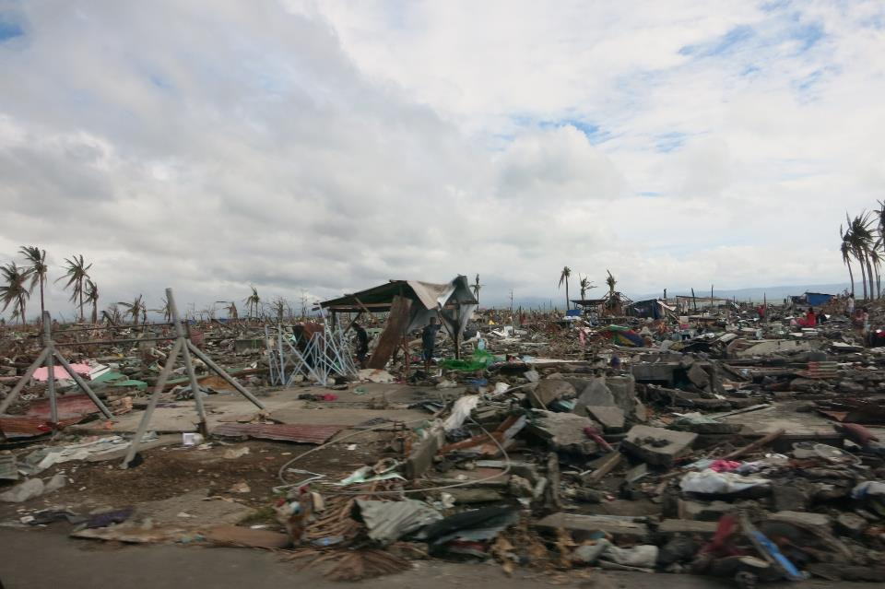
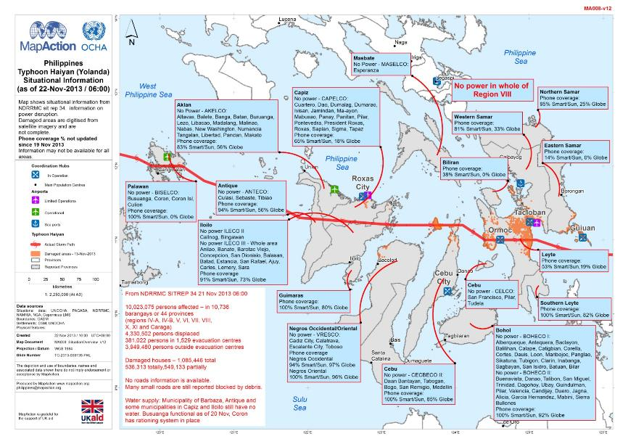
Tacloban, Philippines 2013
Notes:
So, there has been a natural disaster. Once there is a request for help many organisations rush in. There needs to be a structure -> next slide

Slide 2
An Introduction to MapAction Leading the way in response to humanitarian disasters
Nigel Press, Chairman of the Trustees
IHO –I RCC11, Genoa
4 June 2019

Slide 3
When disaster strikes -
Lives are lost
Livelihoods are destroyed
People are displaced, at further risk and in great need
Chaos rules
Time is of the essence
Geographical intelligence is crucial
MapAction help make order out of chaos

Slide 4
Coastal and Maritime zones
Are they more prone to disasters than inland?
Definitely for tsunami, but probably also for cyclone landfall and delta flooding.
The balance may be worsened by climate change.
There is a lot of offshore data that could be used for preparedness and mitigation, but currently the focus remains mainly onshore.
E.g. analysis of coastlines, bathymetry and offshore faults could catalogue tsunami amplifying gulfs.

Slide 5
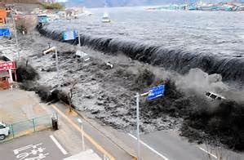
Japanese Tsunami Mar 11

Slide 6
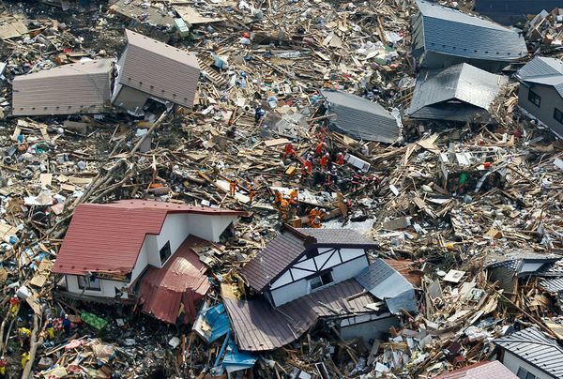

Slide 7
MapAction
Humanitarian mapping charity that works through skilled GIS volunteers.
In the immediate aftermath of a disaster our skill and experience is recognised as crucial in helping the UN and other charities target and coordinate the delivery of humanitarian aid.
Since 2002 we have responded on the ground to more than 90 emergencies
(plus many more remotely).
Notes:
Operational since 2002
Overseas rapid responses have included Boxing Day Tsunami (2004), Nepal earthquakes (2015), Ebola outbreak (2014) and recently, the Caribbean hurricanes.

Slide 8
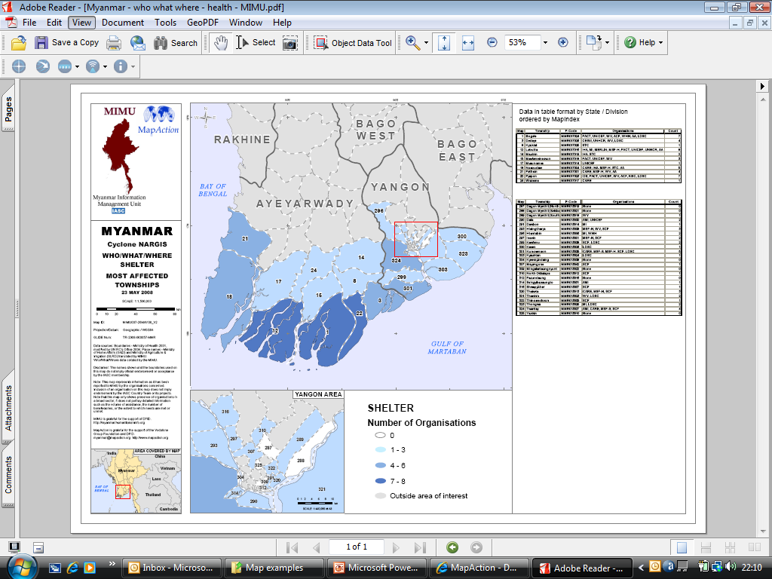
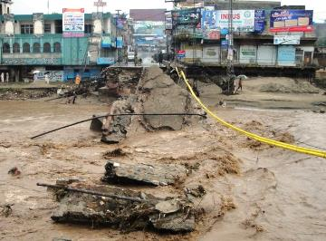
“Where are the affected areas?”

Slide 9
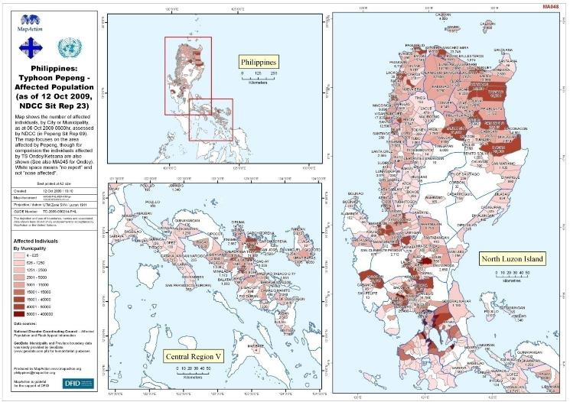
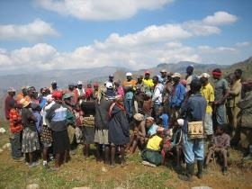
“Where are the affected people?”

Slide 10
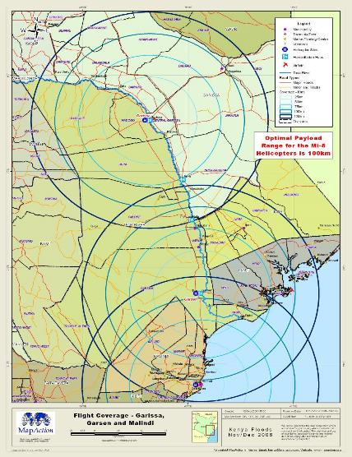
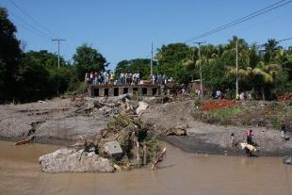
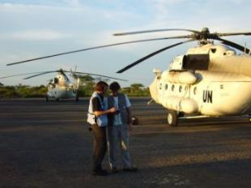
“Where are the access routes?”

Slide 11
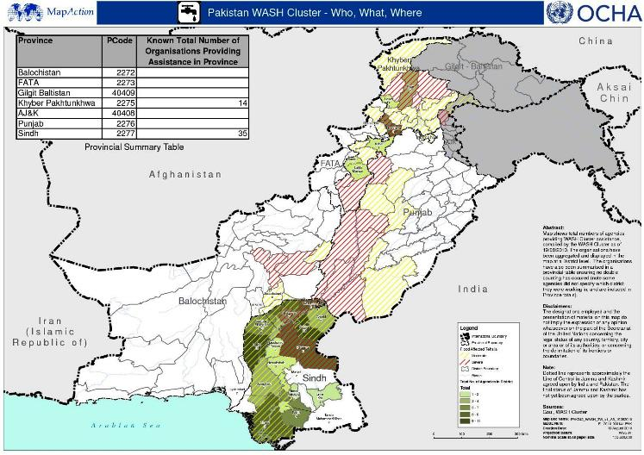
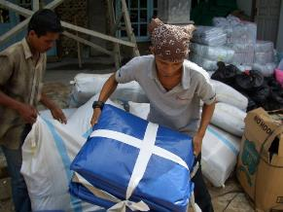
“Where are other relief agencies/teams working?”
3W – Who, What, Where

Slide 12
Overview
MapAction is a UK humanitarian relief charity that works through skilled & highly trained volunteers.
Our work helps prioritise, target and coordinate the delivery of humanitarian aid.
Since 2002 we have responded to more than 90 disasters or emergencies.
We help get the right aid to the right place.
Our results inform the scope and scale of the fundraising.
We help ensure the aid spend is correctly directed and efficiently used where it matters most.
We lead the way in the relief effort, from the field; our information is provided free to all users.
Notes:
Operational since 2002
Overseas rapid responses have included Boxing Day Tsunami (2004), Nepal earthquakes (2015), Ebola outbreak (2014) and Mediterranean refugee crisis.

Slide 13
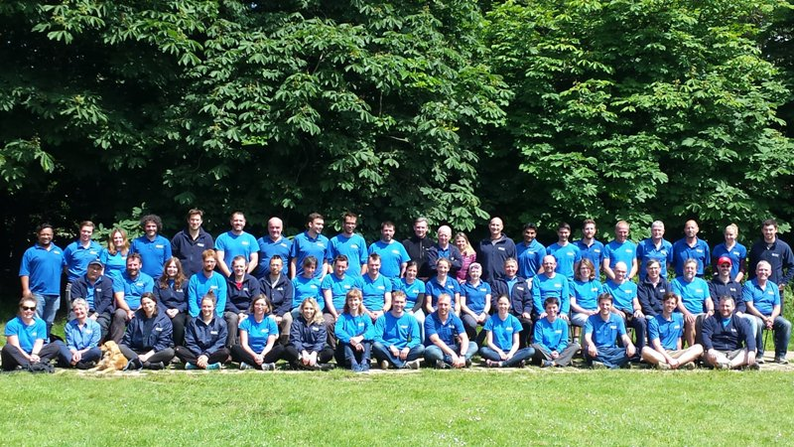
Our team – 1000+ years of GIS experience strengthened with intensive humanitarian-specific training
100 volunteers, 10 staff – Chief executive , heads of operations, logistics, training & fundraising
Notes:
We have 76 volunteers
Small staff team, most of whom are part time, based in Buckinghamshire
Volunteers are predominantly UK based in order to be able to attend regular training weekends. They attend regular monthly training and are ready to deploy to the scene of an emergency within hours of an alert.
Senior professionals working in GIS

Slide 14
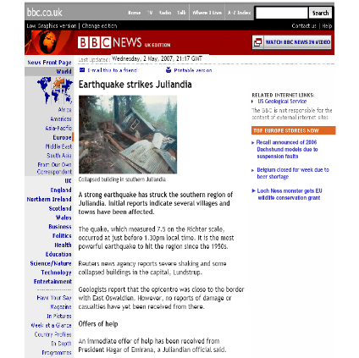
Training - the strong foundation
Monthly training weekends
Annual simulation exercise
Participation in other SIMEXs
Focus
Standard Operating Procedures
Data analysis & presentation
Consistent map product range
GIS, networks, satcomms
Security, first aid, survival
Humanitarian situations
Outcome analysis
Hand-over to local partners
Scenario preparation for SIMEX

Slide 15
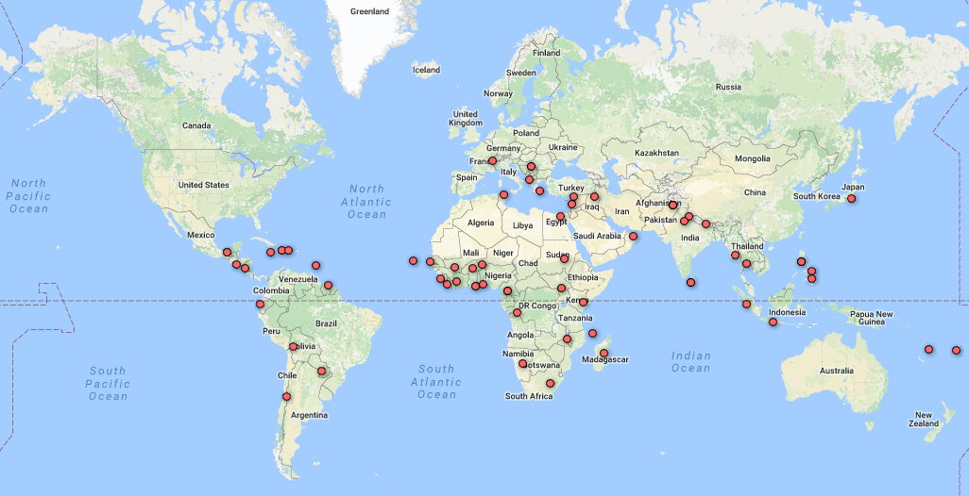
Where we work; experience from 90+ responses and the power of partnerships
CESTRR
Partners
UNDAC
OCHA
Unosat
UNGGIM
WFP Funders
Unicef DFID UK
Oxfam OFDA US
Save MFA NL
Red Cross
CDEMA
ASEAN
UN OCHA field offices
Regional response organisations
Notes:
Most of our volunteers are UK-based but we have a small section of volunteers based in the Caribbean and representatives in New Zealand, Australia, the Middle East and Europe.
We are ready to respond anywhere in the world where it is safe enough to send a team.

Slide 16










Operational
Kit
Head Office Call for
Rapid Move
Deployment
In the Field at
Rapid Speed
Data Scramble
Begins
Global Alert
Message
The True
Beneficiary
Under
Pressure
Working Together
Notes:
[build slide] When disaster strikes – the following takes place within 24-48 hours
Global Alert Message – MapAction moves to “Alert Active” notifying deployable volunteers via text and email to check for immediate availability.
Data Scramble Begins – All volunteers will begin to identify, collate and process map data relevant to the emergency. The team work against the clock producing an early reference map.
Head Office Call for Rapid Move – a field team is chosen and a well practised set of procedures are implemented.
Operational Kit – MapAction maintains mandatory equipment sets which are then ‘localised’ to overcome challenges of the region.
Deployment - The team take the first available plane and are already working as they travel to the disaster region.
In the Field at Rapid Speed - Within hours of the first alert, the MapAction team are in the field. Lives depend on their vital humanitarian and mapping information.
Under Pressure - Relief work continues. Backed by a support base team in the UK, MapAction continues to provide essential up to date information to agencies and search and rescue.
Working together - MapAction works with partners and humanitarian agencies to meet their information needs, to keep well informed and to prepare for handover once the initial urgencies begin to settle.
The True Beneficiary – people helped at their most vulnerable time. MapAction’s swift communication of quality and accurate information and data saves lives.

Slide 17
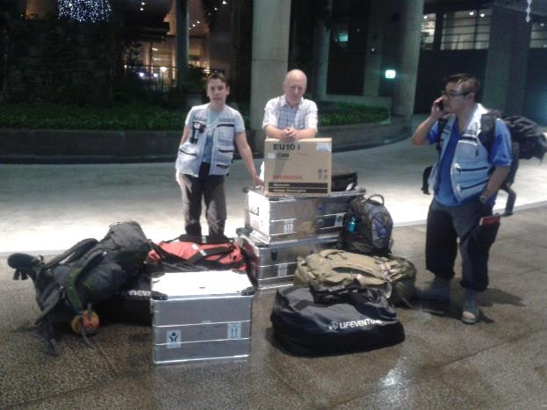
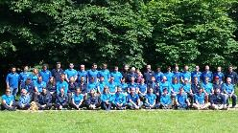
Field Team arrive in 24-48 hrs.

Slide 18
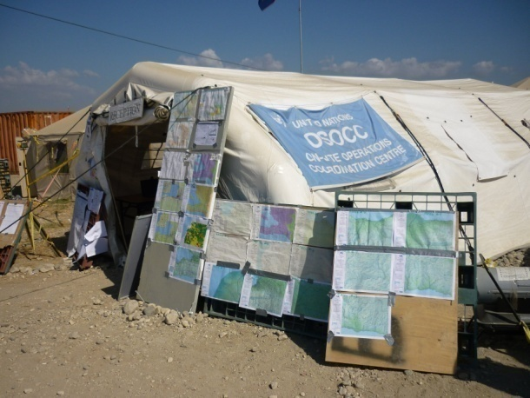
UN Coordination Centre

Slide 19
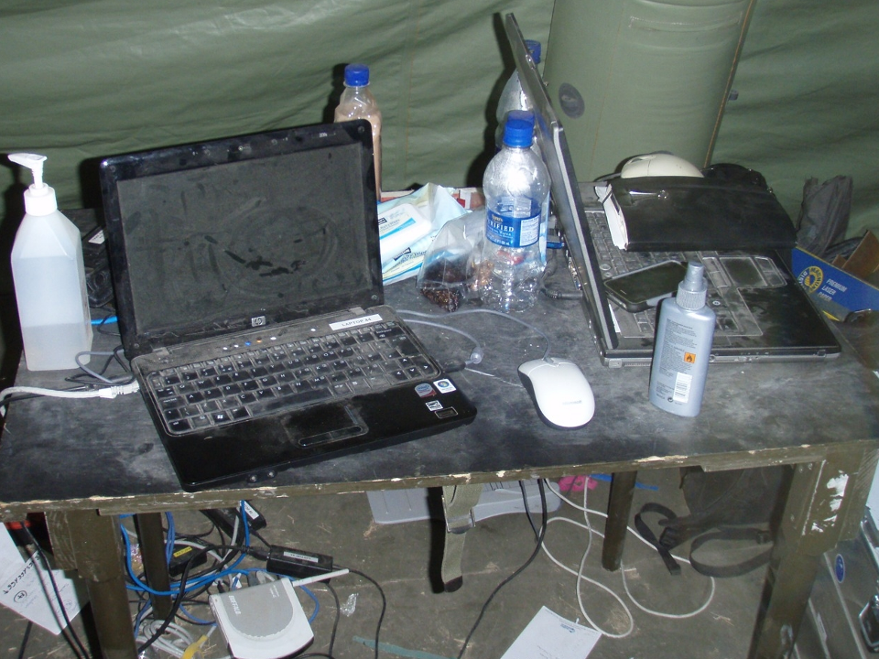

Slide 20
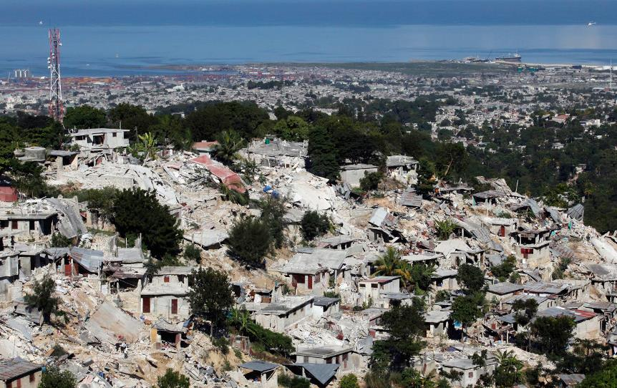
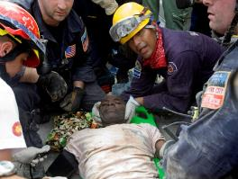

Earthquake: Haiti 2010 A pivotal role in coordination of search/rescue and relief teams

Slide 21
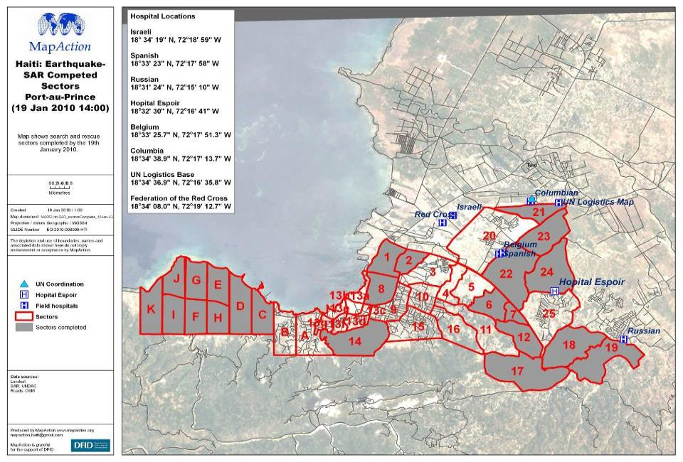

Slide 22
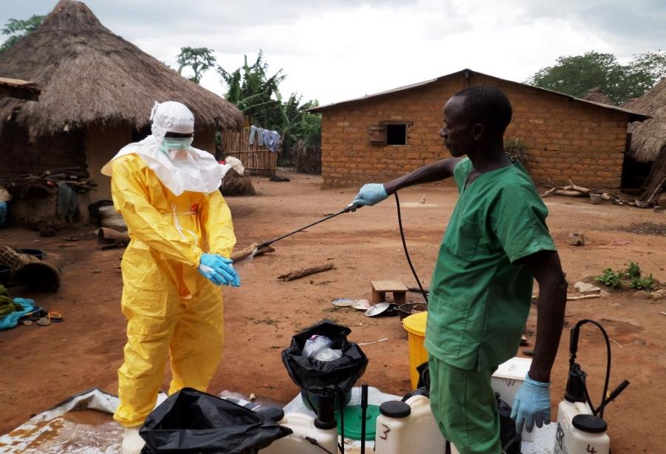
Notes:
Sierra Leone & Liberia 2014. Mapaction deployed to help decision makers

Slide 23
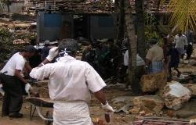
MapAction in the Disaster Cycle
Preparedness for possible future events
Training other humanitarians
Capacity building
Collating data
Primary -
DISASTER
RESPONSE
Notes:
This schematic will be well recognised by organisations working on all phases of what is called the disaster intervention cycle. The disaster response phase attracts the news cameras and indeed to a great extent the aid donors. It is about saving lives and meeting basic humanitarian needs in the aftermath of a natural disaster or man-made emergency.
In between hazardous events, such as major earthquakes, there is the opportunity to work on reducing the vulnerability of people to the next event. Remember that a disaster is only a disaster if people are severely impacted by it.
Other speakers today will rove across the use of maps and spatial data for disaster risk reduction. We are certainly very interested in that but our own core expertise is in disaster response. More specifically, MapAction’s role is to deploy to an affected country within hours after a disaster event, and to provide support during the search-and-rescue and early relief phases.
As we will argue, briefly this morning and in more depth in our workshop sessions, getting our collective acts together as a spatial information community can have a massive positive impact on our ability to assist disaster response agencies in an emergency. But the groundwork MUST be done BEFORE the disaster happens. The challenges are as much organisational – and political – as they are technical.

Slide 24
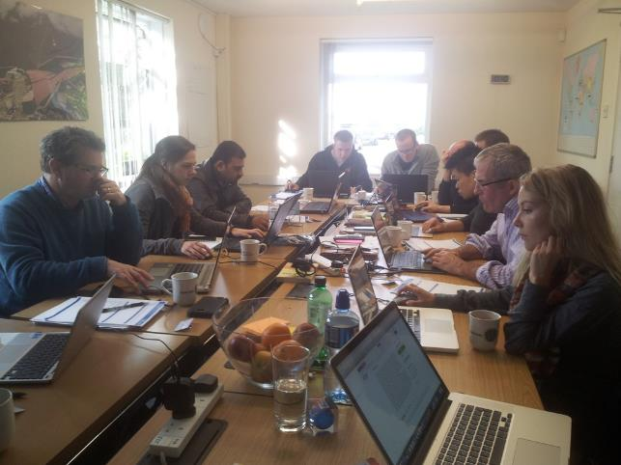
Working with partners in training & preparedness
Notes:
Training: we deliver specialist mapping and information management training for humanitarian partners including the UN and other NGOs. We also run our own humanitarian information mapping course in the UK.

Slide 25
MapAction 2018
5 DISASTER responses
6 Emergency responses
7 Simulation exercises
19 Partnership building missions
12 Training courses for partners

Slide 26
Funding MapAction
Annual budget of £1m supports 10 staff, HQ office,100 volunteers and all missions – so very cost effective.
Main funders are UK, Dutch & US governments plus a few grant giving bodies.
No funding comes from UN and little from our partner charities
Due to Brexit we are about to lose significant funding from the EU ECHO who have provided support over several years.

Slide 27

Where we work; experience from 90+ responses and the power of partnerships
CESTRR
Partners
UNDAC
OCHA
Unosat
UNGGIM
WFP Funders
Unicef DFID UK
Oxfam OFDA US
Save MFA NL
Red Cross
CDEMA
ASEAN
UN OCHA field offices
Regional response organisations
Notes:
Most of our volunteers are UK-based but we have a small section of volunteers based in the Caribbean and representatives in New Zealand, Australia, the Middle East and Europe.
We are ready to respond anywhere in the world where it is safe enough to send a team.

Slide 28
MapAction in Partnerships
For an organisation wishing to enhance its role in humanitarian response -
MapAction has the experience and contacts at the highest level of the humanitarian system to help develop and execute a programme that will optimise such a response capability.
But – MapAction is a charity and does not have independent funding resources to achieve this in addition to providing its own mainstream disaster response – given free to all.

Slide 29

mapaction.org

Slide 30
Notes:
Map shows predicted and actual storm track of Hurricane Maria

Slide 31

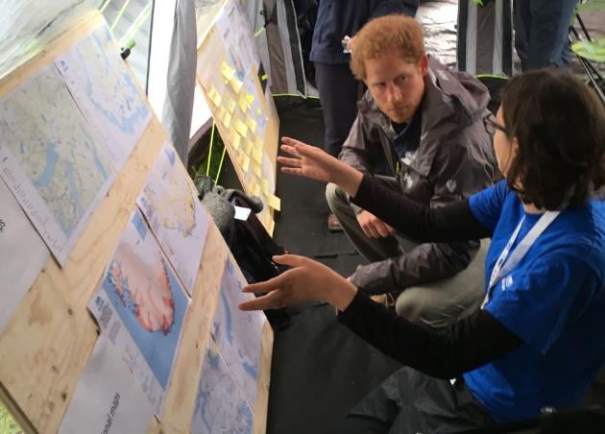
Our supporters
Notes:
Prince Harry has been our Royal Patron since 2007 and takes an active interest in our work. He takes part in an annual polo event to raise money for MapAction.
We are also very grateful for the support of a number of charitable trusts, companies and individuals who donate or fundraise for us including the thinkWhere team shown above.

