Slide 1
Status Report of the
SPRWG of the Council
Inter-Regional Coordination Committee
Comité de coordination inter-régional

Slide 2
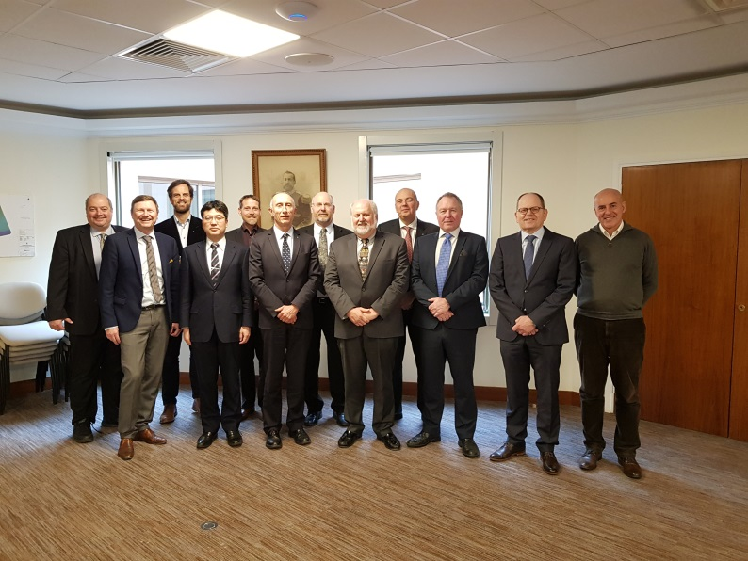
Background
Decision A1/03 (April 2017): review of the IHO SP
Decision C1/37 (October 2017): creation of SPRWG
IHO CL 20/2018 (February 2018): approval by MS of ToR & RoP
SPRWG report to the Council (August 2018) : recommended to prepare a revised strategic plan, with a simpler structure and a limited number of measurable targets
Decision C2/39 (October 2018): tasked the SPRWG to develop the Strategic Plan on the basis of three overarching goals endorsed by the Council
Decision C2/40: provide HSSC-11 & IRCC-11 with draft Strategic Targets and Performance Indicators, for their initial feedback on the possible implementation in the future
Drafting team (January 2019): draft submitted for comments to the SPRWG and HSSC (26/03/2019)

Slide 3
Strategic Goals
1 - Evolving the support of safety and efficiency of a transforming navigation
2 - Developing the use of hydrographic geospatial data for the benefit of society
3 - Participating actively in ocean-related activities

Slide 4
First feed-back on proposed indicators
SPRWG
  Check measurability
  Improve connection with the targets, avoid the implementation level
HSSC
  Considered Strategic Goals 1 & 2
  Made proposals for improving measurability and consistency
  Limits of responsibility with IRCC

Slide 5
Evolving the support of safety and efficiency of a transforming navigation (1/2)
1.1 Deliver standards for data formats and product specifications including accompanying transition and implementation support
  IHO-IMO common implementation strategy for S-1xx and data products
    Options: level of maturity, availability, monitor transition to S-101, degree of incorporation in IMO regulation?
  Refurbished standardisation of paper charts as “print-on-demand” based on ENC
    Change standardisation or establish an framework enabling “POD”?
  S-1xx caters for the requirements of autonomous shipping
    Requirements? Be more generic?

Slide 6
Evolving the support of safety and efficiency of a transforming navigation (2/2)
1.2 Develop standards and best practices in the areas of data assurance, including cyber security and data quality assessment
  Data products and service delivery certified cyber-secure
    Options: level of maturity of the IHO standards and procedures, or % of secure data products and services delivery?
  ENC overlaps
  Adequacy of hydrographic knowledge assessed for waters < 50 m
    Options: 50 m or 200 m (see C-55)?

Slide 7
Developing the use of hydrographic geospatial data for the benefit of society (1/2)
2.1 Build a digital platform to support and promote regional and international cooperation in marine spatial infrastructures (MSDI)
  Rate of hits on the platform
    Measure the use or the construction of the platform?
2.2 Adopt or promote new tools and methods to accelerate and increase coverage, consistency, quality of surveys in poorly surveyed areas, e.g. crowd-source bathymetry; satellite-derived bathymetry
  Quality indicators available and applied to all sorts of hydrographic data
    Identify tools and methods to be considered?
  New S-44, for all kind of applications, navigation and others, is promulgated
    Options: number of MS applying it, or number of users’ communities using it?

Slide 8
Developing the use of hydrographic geospatial data for the benefit of society (2/2)
2.3 Adopt and apply UN guiding principles for geospatial information management in order to ensure interoperability of hydrographic data with other marine-related data.
  S1XX data sets play a strong and recognized role in the global MSDI
    Alternative: number of UN-GGIM guiding principles (amongst 15) that are implemented at the IHO level (through resolutions, procedures …)

Slide 9
Participating actively in ocean-related activities (1/2)
3.1 Enhance existing capacity building programme and strategies, and collaborate with other bodies who deliver capacity building and training
  90% of Coastal States have reached Phase 1 (MSI)
    Alternative: level of coordination with other organizations involved in CB
3.2 Enhance knowledge of the world's seafloors through establishment of streamlined automated processes for acquisition, harmonization and ingestion of bathymetric data from any sources into the global data repository of the IHO Data Centre for Digital Bathymetry (DCDB)
  Accessible public bathymetric data of MS uploaded to & available from the DCDB
    Centralized uploading?
  More ingestion in DCDB of expert survey contributions from industry and CSB
    Ratio (received data/yr) / (annual average received in 2014-2020)?

Slide 10
Participating actively in ocean-related activities (2/2)
3.3 Enhance IHO digital communication and Web presence in order to maximize visibility and accessibility of standards and data provisions
  IHO is present on social media
    Number of followers? likes? RT?
  IHO web-site gives access to a fully traceable repository of all documents and incorporates GIS services
    Indicator on the level of improvement with regard with the current situation?

Slide 11
Action required of IRCC
The IRCC is invited to:
  a. note the list of targets and performance indicators
  b. examine the possibility of their implementation in the Work Programme
  c. make any proposal as appropriate
  d. instruct IRCC Chair to provide feedback to SPRWG

