Slide 1
Input report from HSSC11 to IRCC Cape Town, South Africa (6-9 May 2019)
IHO HYDROGRAPHIC SERVICES AND STANDARDS COMMITTEE
IRCC-11, Genoa, Italy, 3-5 June 2019
R.Admiral Luigi Sinapi – HSSC Chair

Slide 2
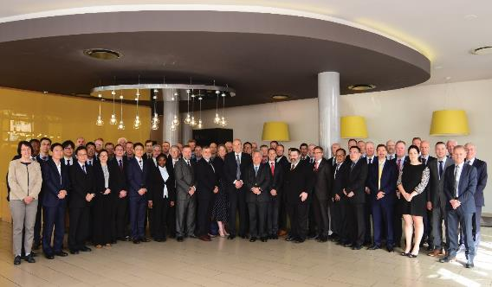
Introduction
HSSC work is guided by the IHO Work Programme 2 “Hydrographic Services and Standards” and by the Council key priorities
Meetings since IRCC-10:
Cape Town, South Africa (6-10 May 2019)
Next Meeting:
HSSC-12 Bristol, UK (11-15 May 2020)
IRCC-11, Genoa, Italy, 3-5 June 2019

Slide 3
HSSC-11 Key Priorities
Operational/strategic level
Final remarks of the Resolution 2/2007 as amended
Revised Strategic Plan
S-100 Implementation Strategy
Future of Paper charts
Technical level
Demonstration showcase of S-100 based products
Development of the S-1xx Product Specifications and operationalization of S-1xx framework
Priorities of IHO 2019 Work Plan 2
Hydrographic Dictionary S-32
Notes:
Main challenges

Slide 4
Analysis/Discussion – Resolution 2/2007
HSSC endorsed IHO Resolution 2/2007 as amended
Resolution 2/2007 applicable also to IRCC publications
HSSC request IRCC-11 endorsement
IHO Secretariat will send out a CL to the MSs seeking for the approval
IRCC-11, Genoa, Italy, 3-5 June 2019

Slide 5
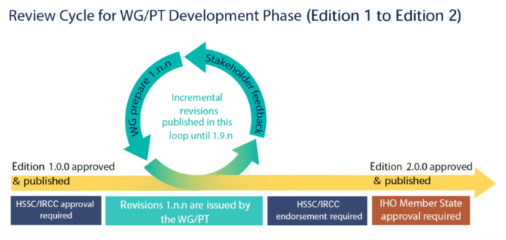
Analysis/Discussion – Resolution 2/2007
The Resolution 2/2007 as amended is structured as follows:
Main doc: updated review cycle for WGs/PTs for the development of PSs and standards
Appendix 1 and 2: lists of IHO standards that must be maintained in conformance with the IHO Resolution 2/2007 as amended
Appendix 3: guidance for conducting stakeholders impact study
IRCC-11, Genoa, Italy, 3-5 June 2019

Slide 6
Analysis/Discussion – IHO Strategic Plan
SPRWG provided a “Draft IHO Strategic Plan” (17th March 2019) where are defined:
Strategic Goals
Strategic Targets (ST)
Strategic Performance Indicators (SPI)
HSSC relevant elements of the Future IHO Strategic Plan to be considered
HSSC Chair provided comments on ST and SPI to SPRWG Chair info IRCC Chair (HSSC CL 2/2019 dated 31 March 2019)
IRCC-11, Genoa, Italy, 3-5 June 2019

Slide 7
Analysis/Discussion – IHO Strategic Plan
1. Safety and Efficiency of the "transforming navigation"
1.1. Deliver Standards for data formats, Product Specificatios, including accompanying transition and implementation support
1.1.1 XX% of the Member States have operationalized some S-1XX based products by XXXX (year)
1.1.2 “Complete and implement a refurbished standardisation of paper charts to enable advanced support for “print on demand” based on content of S-101 electronic nautical charts” or “Improved paper chart production based on ENCs S-101 data implemented and standardized"
1.2 Develop standards and best practices in the areas of data assurance, including cyber security and data quality assessment
1.2.1 % of certified cyber secure data products and services delivered by XXXX (year)
Strategic Goal 1
Strategic Targets (ST)
Strategic Performance Indicator (SPI)
1.1.3 Autonomous shipping requirement supported by S-1xx
1.2.3 XX % of CATZOC X (or QoBD level better than X) assessed by XXXX (year)
2. Developing hydrographical geospatial data use for the benefit of sociey
2.2 Adopt or promote new tools and methods to accelerate and increase coverage, consistency, quality of surveys in poorly surveyed areas, e.g. crowd-source bathymetry; satellite-derived bathymetry
2.2.2 New Edition of S-44 promulgated for all kind of applications and navigation by 2021, revised every 2 years, and fully implemented by all HOs by 2026
2.2..1 Quality indicators for all sorts of hydrographic data available and applied
2.3 Adopt and apply UN guiding principles for geospatial information management ensuring interoperability of Hydrographic data with ither marine related data
Strategic Goal 2
Strategic Targets (ST)
Strategic Performance Indicator (SPI)
2.3.1 % of S-1xx data sets in the regional and global MSDI
IRCC-11, Genoa, Italy, 3-5 June 2019

Slide 8
Analysis/Discussion – Implemetation Strategy
C-2 tasked IHO SG, COUNCIL, HSSC and IRCC Chairs to prepare the “S-100 implementation strategy” (action C2/31)
In March IHO provided a “Draft Skeleton”
Document composed by four main contributions:
IHO
HSSC (Technical)
COUNCIL
IRCC
WGs Chairs have been asked to provide their contribution
IRCC-11, Genoa, Italy, 3-5 June 2019

Slide 9
Analysis/Discussion –Implemetation Strategy
What should be in the plan from the HSSC point of view
Where does HSSC responsibility ends?
Provide Answers
Why the S-100
Why a strategy
Who will implement the strategy (actors)
How the strategy will be implemented
When it will be implemented
Which are the phases of the implementation
Easy document
IRCC-11, Genoa, Italy, 3-5 June 2019

Slide 10
Analysis/Discussion –Implemetation Strategy – HSSC contribution
Implementation levels definition | Transition phases, milestones, timeline | HSSC Chair, S-100 WG
 | Technical Readiness Levels | S-100 WG
Provision of standards | PS structure | S-100 WG
 | Interoperability aspects (S-98 development) and responsibility | S-100 WG, NIPWG
 | Harmonization and responsibility | DQWG, S-100 WG, NIPWG
 | Data management issue | ENC WG
Synchronization of standards and products | Design / Provision of synchronised products | NIPWG, S-100 WG
 | Industry level of readiness | NIPWG, S-100WG,
Operationalization of the data | Guidance for data producers / WENS? | IRCC (WEND WG)
 | Data protection | ENC WG
 | Service distribution (cloud service) | S-100WG, IRCC (RENCs + HOs)
Note: IRCC contribution
IRCC-11, Genoa, Italy, 3-5 June 2019

Slide 11
Analysis/Discussion – S-100 Readiness Level
Required product specification component | Level 1 v1.0.0 | Level 2 v1-2.0.0 | Level 3 >v2.0.0 | Level 4 >v2.0.0 | Level 5 >v2.0.0
Main Document | X | X | X | X | X
A Default Encoding | X | X | X | X | X
S-100 Compliant Feature Catalogue | X | X | X | X | X
DCEG | X | X | X | X | X
S-100 Compliant Portrayal Catalogue |  | X | X | X | X
Data Quality Checks |  | X | X | X | X
Test Data Sets |  | X | X | X | X
Data Validation (and test datasets) |  | X | X | X | X
Exchange Catalogue |  | X | X | X | X
Encryption / Digital Signatures |  |  | X | X | X
Interoperability |  |  |  | X | X¹
Alerts and Indications |  |  |  | X | X¹
Operationalization |  |  |  |  | X
IRCC-11, Genoa, Italy, 3-5 June 2019

Slide 12
Analysis/Discussion – Future of Paper Charts
Sales and use of paper nautical charts is declining
NCWG drafted a document about PC’s Future
Preliminary comments received from HOs
CL to be issued seaking for MS contribution
Document to be approved in 2020
Common needs:
Reallocate the resources currently dedicated to traditional paper
Ultimate goal is to fully automate the creation of paper products from fully populated ENC vector databases
IRCC-11, Genoa, Italy, 3-5 June 2019

Slide 13
Analysis/Discussion – Future of Paper Charts
PROPOSALS | CAN+UK | GER | AU | FR | US | NCWG
Full automating process from ENC to paper charts | X | X | X | X | X | X
Radical revision/Freezing of S4 | X | X (ENCWG) |  | X (No NCWG) |  | Only Revision
Limit investment on paper charts | X |  |  |  | X | X
Freezing of INT1 |  | X
IMO involvement |  |  | X |  | X | X
Task an HSSC WG to develop a WP to the “Future of paper charts” |  |  |  | X (NCWG) | X (ENCWG or NCWG) | X
IRCC-11, Genoa, Italy, 3-5 June 2019

Slide 14
Analysis/Discussion –Showcase of S-100 based products
C-2 tasked the HSSC (see action C2/29) :
“Consider the possibility to organize a demonstration showcase of S-100 based products and test beds as an embedded session at C-3 in October 2019”
HSSC-11 discussed showcase structure
MSs/WGs volunteered to provide expertise, test data and examples
S-100 WG Chair coordination
IRCC-11, Genoa, Italy, 3-5 June 2019

Slide 15
Analysis/Discussion – Showcase of S-100 based products
Showcase characteristics:
“Educational narrative”
Help the HOs to support and follow S-1xx framework concept development towards its operational phase
Highlighting front-of-bridge/back-of-bridge requirements
(topic to be reported to C-3 for IHO Secretariat involvement with IMO)
General need to work in connection with IRCC, especially concerning the dissemination of S-1xx PS and the role of RENCs
HSSC intention to reach a larger audience at the Assembly
(topic to be addressed to C-3)

Slide 16
Analysis/Discussion –Showcase of S-100 based products
 | Duration | Topic | Speaker
1 | 15/20’ | Point of situation of the new PSs and S-100 implementation strategy | HSSC Chair/IHO Secretariat (HSSC Report to C-3)
2 | 15’ | S-101 with examples of conversion from S-57 | S100WG/S101PT representative
3 | 15’ each PS | Examples of PSs at semi-operative stage (S-102, S-111, etc) | PTs/HOs
4 | 15’ each | Examples from the HOs/RENCs S-100 Service distribution | HOs, RENCs
Duration 2 hrs (including Q&A)
IRCC-11, Genoa, Italy, 3-5 June 2019

Slide 17
C=Council
A = Assembly
SR = Stakeholder Review
MS = IHO Member State
S-129 UKC
Development and Testing
SR
HSSC Approval
S-129 Edition 1.0.0 Released
S-128 Catalog of Catalogs
Development (TBD)
S-127 Sea Traffic Management
Development (TBD)
HSSC Approval
S-127 Edition 1.0.0 Released
Development and Testing
S-124 Nav Warnings
Development and Testing
IRCC Approval
S-124 Edition 1.0.0Released
S-123 Radio Services
Development and Testing
HSSC Approval
S-123 Edition 1.0.0 Released
S-122 MPAs
Development and Testing
HSSC Approval
S-122 Edition 1.0.0 Released
S-121 - MLB
Development and Testing
HSSC Approval
SR
S-121 Edition 1.0.0 Released
S-111 Surface Currents
Development and Testing
SR
HSSC Approval
S-111 Edition 1.0.0 Released
S-104 Water Levels
Development and Testing
HSSC Approval
S-104 Edition 1.0.0 Released
S-102 Bathy
Development and Testing
SR
HSSC Approval
MS Vote
S-102 Edition 2.0.0 Released
S-101 ENC
Development and Testing
SR
HSSC Approval
S-101 Edition 1.0.0 Released
S-101 Edition 1.X.X
2017
2019
2020
2018
A2
C2
HSSC11
C3
C4
HSSC10
HSSC12
S-100 Edition 4.0.0

Slide 18
Analysis/Discussion – HSSC Actions of interest
HSSC endorsed S-102 Ed. 2.0.0 – Bathymetric surface
HSSC approved Ed. 1.0.0 of S-97 – Guidance for PS developers
HSSC approved Ed.1.0.0 of S-127 – Marine Traffic Management
HSSC approved Edition 1.0.0 of S-129 – Under Keel Clearance Management Information
S-100 Ed. 5.0.0 shifted to 2021
S-98 to be submitted for endorsement in 2020/2021
IRCC-11, Genoa, Italy, 3-5 June 2019

Slide 19
Analysis/Discussion – HSSC Actions of interest
HSSC to seek the agreement of IRCC for a survey for the production of the following data sets (NIPWG coordination):
S-122 - Marine Protected Area
S-123 - Marine Radio Services
IRCC to evaluate to extend WENDWG scope to S-101 ENCs and other S-100 based products
Proposal of “Cloud distribution” of S-100 based products (Canada):
To be investigated by IRCC
IRCC-11, Genoa, Italy, 3-5 June 2019

Slide 20
Analysis/Discussion – HSSC Actions of interest
S-100 data protection scheme
RENCs to support HSSC WGs developing S-100 based products test data
RENC/IHO Sec. to act as S-100 Protection scheme administrator
RENC/IHO Sec. to prepare an implementation procedure
Test bed platform
HOs to provide KHOA with S-100 based products test data sets
New test bed platform operative
IRCC to support this initiative among RHCs
IRCC-11, Genoa, Italy, 3-5 June 2019

Slide 21
Analysis/Discussion – Priorities of IHO 2019 Work Plan 2
Develop an S-100 interoperability specification
Ed. 1.0.0. of S-98 final approval is part of S-100 Implementation Strategy
Ed. 1.0.0 of S-98 to be submitted for endorsement in 2020/2021
HSSC-11 agreed to organize a S-100 Test Strategy Meeting (TSM) in liaison with IEC
Develop S-121 Product Spec for Maritime Limits and Boundaries
HSSC encouraged the S-121PT to pursue the development of Ed. 1.0.0
HSSC encouraged the IHO Member States to participate in the S-100 WG review process of S-121
IRCC-11, Genoa, Italy, 3-5 June 2019

Slide 22
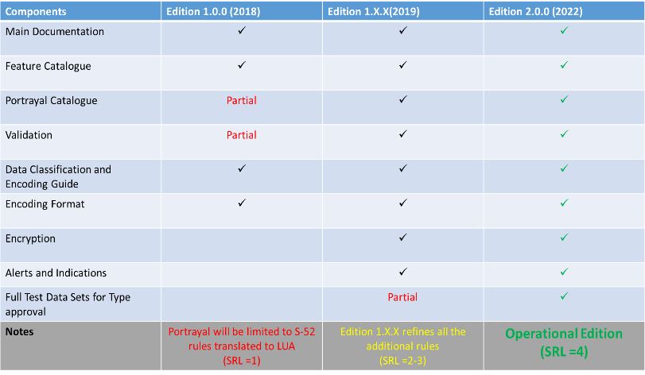
Analysis/Discussion – Priorities of IHO 2019 Work Plan 2
Develop all the components needed to make S-101 a reality:
Ed. 1.1.0 of S-101 to be expected in December 2020
Ed. 2.0.0 to be expected in December 2022
S-101 components for Encryption, Alerts and Indications to be fully developed
IRCC-11, Genoa, Italy, 3-5 June 2019

Slide 23
Analysis/Discussion – Priorities of IHO 2019 Work Plan 2
Consolidation and clarification of standards in relation to ECDIS/ENC:
ENCWG liaised with CIRM and IEC for updating S-63 for improved security for investigations and risk assessment
HSSC tasked ENCWG to develop a draft proposal for mitigation measures for cyber security and to make an impact assessment
HOs to review the current ENC production process and make changes where necessary to encode meaningful values of CATZOC
IRCC-11, Genoa, Italy, 3-5 June 2019

Slide 24

Analysis/Discussion – Priorities of IHO 2019 Work Plan 2
Prepare Ed. 6.0.0 of S-44:
May/June 2019 - HSPT: draft of the 6th Edition (v1.7.0) for review and comments by MSs and stakeholders
March 2020: S-44 6th Edition (v2.0.0) delivered to HSSC for endorsement
End 2020: Approval of the S-44 6th Edition
Contest for designing the cover page of Edition 6 of S-44 to be advertised among MSs
IRCC-11, Genoa, Italy, 3-5 June 2019

Slide 25
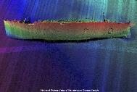
Analysis/Discussion – Priorities of IHO 2019 Work Plan 2
Consider data quality aspects in harmonized way for all S-100 based PSs:
Visualization methodology of Quality of Bathymetric Data
Method to depict the quality of the bathymetry and isolated features hazardous to the safety of navigation (wrecks, rocks, obstructions)
Also supportive for decision making and autonomous shipping
IRCC be aware of importance of QoBD
Navigable depth (95% confidence)
D < 17.1
C = 17.1
draft
A2, B = 18.7
A1 = 19.4
safe depth
20m contr
0.7m
1.4m
3.0m
>3.0m
A1
A2
B
C
D
CATZOC value
Charted depth = 20.1 m
IRCC-11, Genoa, Italy, 3-5 June 2019

Slide 26
Analysis/Discussion – Priorities of IHO 2019 Work Plan 2
“Good Data Quality does not mean that the quality of the data has to be good….
It means that the end user is well informed how good the Quality of the Data is”
(by DQWG)
Recommendations for HOs:
Provide meaningful values to Quality of Bathymetric Data (S-101)
(1, 2, 3, 4, 5 or Oceanic. Unassessed should not be used)
Provide horizontal/vertical uncertainty for isolated features
(UWTROC, WRECKS, OBSTRN, SOUNDG) hazardous to navigation
Be aware of vertical uncertainty when generating High-Density ENCs in areas of Quality of Bathymetric Data = 4 or 5 (CATZOC = C or D)
IRCC-11, Genoa, Italy, 3-5 June 2019

Slide 27
Analysis/Discussion – Priorities of IHO 2019 Work Plan 2
HSSC supported “conditional visualization methodology” concept to be further developed
HSSC encourage DQWG to involve other WGs and stakeholders
Raise IRCC awareness about:
Existence of the methodology of visualization of the QoBD
Correct compilation of S-101 QoBD
Correct CATZOC attribution
HSSC amended DQWG ToRs → DQWG to support IRCC WGs and sub-commitees on request (MSDI, CSBWG, S-124 PT)
IRCC-11, Genoa, Italy, 3-5 June 2019

Slide 28
Analysis/Discussion – Priorities of IHO 2019 Work Plan 2
An Initial Guidance on definition and harmonization of “Maritime Services in context of e-navigation” was produced:
WWNWS-SC → No. 5 - Maritime Safety Information Service (MSI);
NCWG, ENCWG → No. 11 - Nautical Chart Service;
NIPWG → No. 12 - Nautical Publications Service;
TWCWG →No. 15 - Real-time hydrographic and environmental information Service.
Need to maintain the Guidance up-to-dated under the IMO indications
IRCC/WWNWS-SC is invited to contribute
IRCC-11, Genoa, Italy, 3-5 June 2019

Slide 29
Analysis/Discussion – Hydrographic Dictionary (HD)
HSSC11 noted the work done in the development of S-32 IHO HD
Achievements:
The HD and the IHO GI Registry will share the same management system, use the same metadata and will be enriched and maintained by using the same procedure
Language improvements (New HDs)
HDWG template to be used by WGs when submitting new terms
IRCC-11, Genoa, Italy, 3-5 June 2019

Slide 30
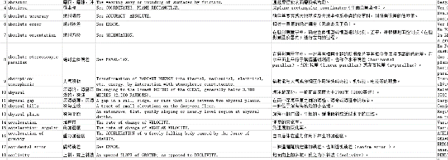


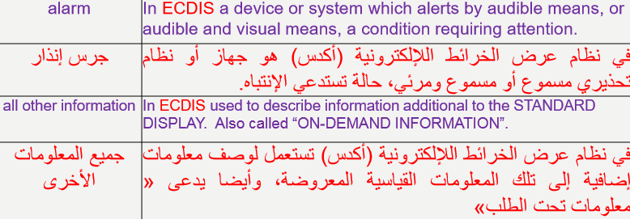
Analysis/Discussion – Hydrographic Dictionary (HD)
Chinese HD is now available on the IHO website
Arabic HD in progress
IRCC-11, Genoa, Italy, 3-5 June 2019

Slide 31
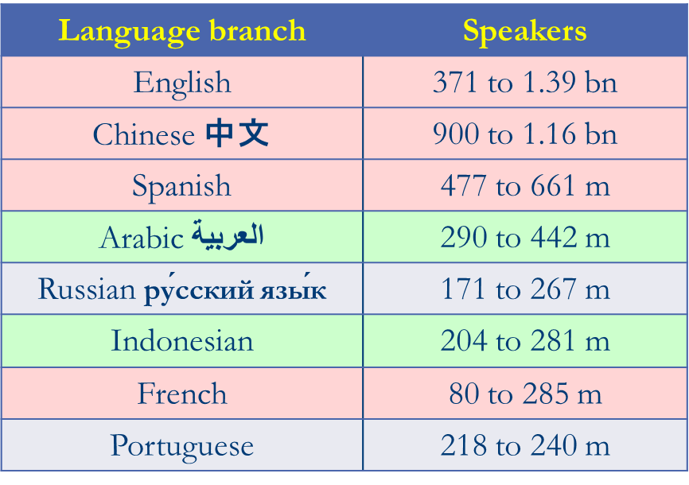
Analysis/Discussion – Hydrographic Dictionary (HD)
MS are invited to develop their National variants that will be made available on the IHO Website
HD members have been invited to act as HDWG (and GI Registry) ambassadors in RHCs
→RHCs to support the HD
HDWG Spanish and Russian representatives needed
IRCC-11, Genoa, Italy, 3-5 June 2019

Slide 32
Action requested of IRCC
The IRCC is invited to (1):
Note the report
Endorse Resolution 2/2007 as amended
Note the HSSC CL 2/2019
Coordinate with HSSC to draft “S-100 Implementation Strategy”
Support the production S-100 showcase (RENC/RHCs)
Contribute to S-122 and S-123 data set
Encourage MSs to participate in PSs development (eg. S-121)
Extend WENDWG scope to S-101 ENCs and other S-100 based products
Evaluate “Cloud distribution” concept
HSSC-11, Cape Town, South Africa, 6-9 May 2019

Slide 33
Action requested of IRCC
The IRCC is invited to (2):
Support the S-100 products test bed platform
Encourage the encoding of meaningful values of CATZOC
Note that DQWG can support IRCC WGs
Note the existence of the “conditional visualization methodology” of QoBD
Be aware of the importance of definition of QoBD for the conditional visualization
Contribute to up-to-date the “Maritime Services” Guidance
Encourage RHCs to support HDs development
Take any other action deemed necessary
HSSC-11, Cape Town, South Africa, 6-9 May 2019

