Slide 1


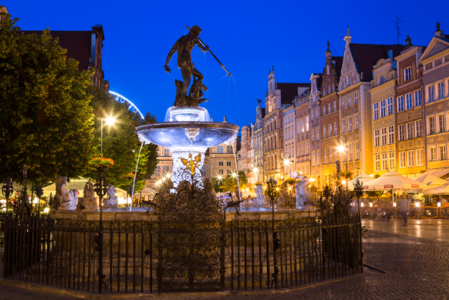

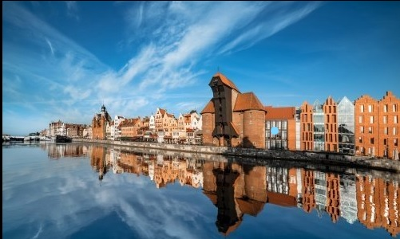
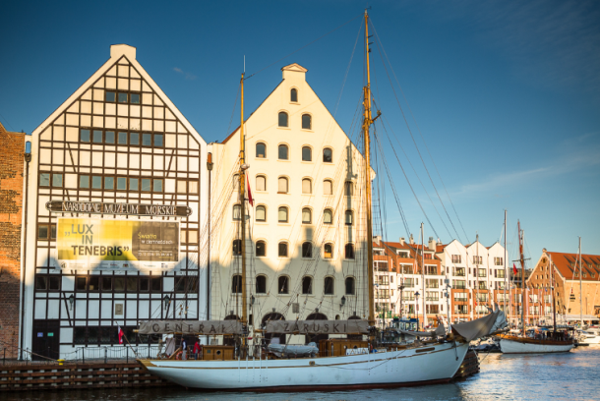
IHO INTER-REGIONAL COORDINATION COMMITTEE
IRCC12
GDAŃSK, POLAND
1-3 June 2020
HOSTED BY
HYDROGRAPHIC OFFICE OF THE POLISH NAVY
Captain Dariusz Kolator

Slide 2
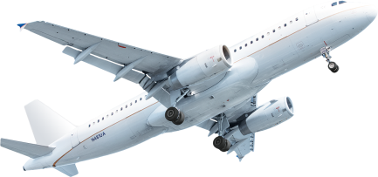
IRCC 12
GDAŃSK, POLAND 1-3 June 2020
Up to 2 hours
– in direct fly
GDAŃSK
GENOA

Slide 3
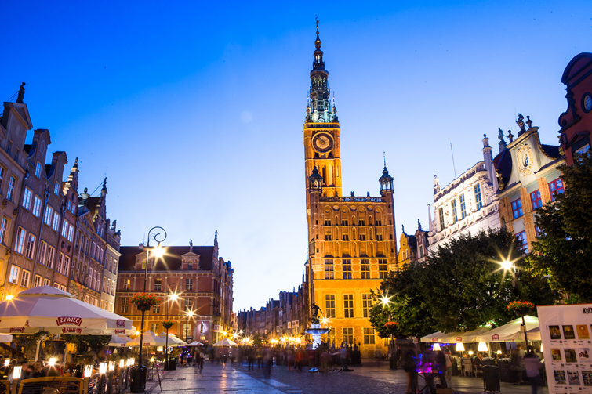
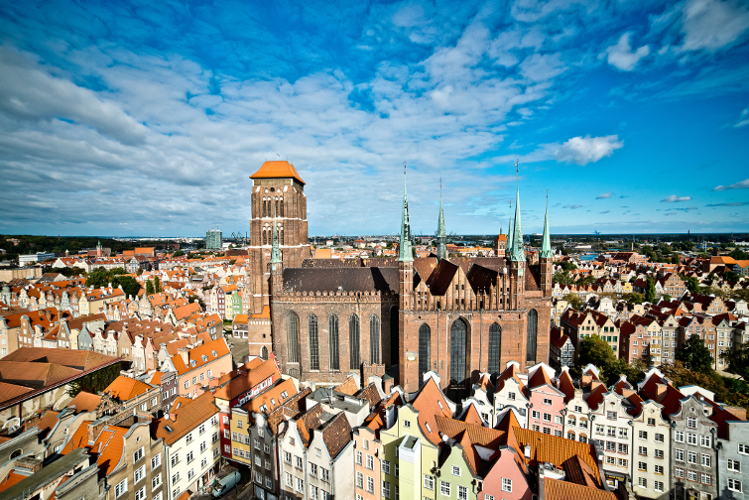

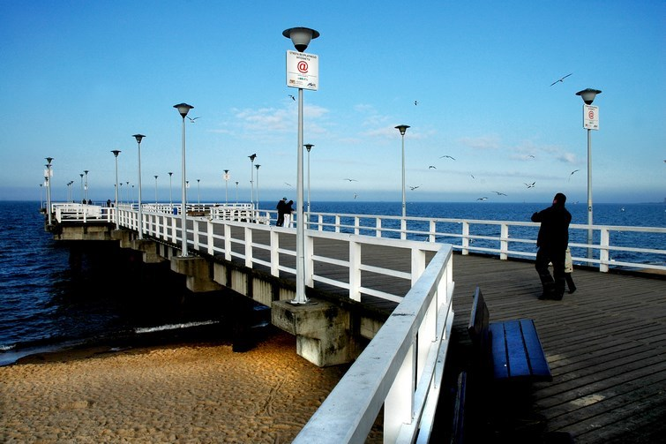


IRCC 12
GDAŃSK, POLAND 1-3 June 2020

Slide 4
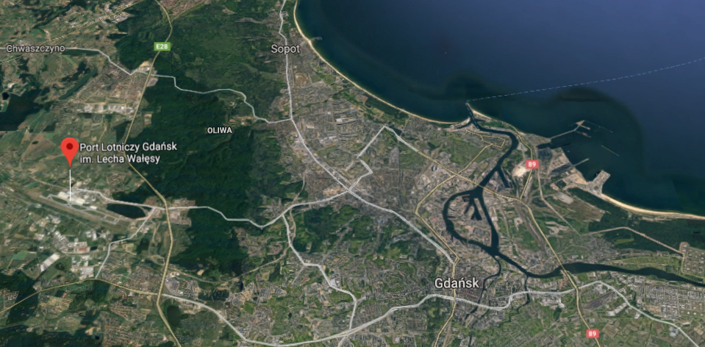
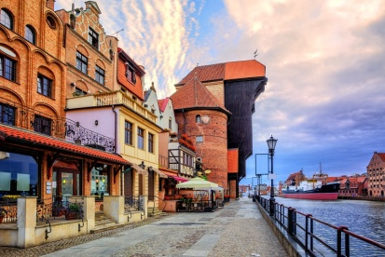
IRCC 12
GDAŃSK, POLAND 1-3 June 2020
From GDAŃSK LECH WAłęSA AIRPORT to GDANSK
By TRAIN, BY BUS, BY TAXI
The approximate time of trip 30 minutes

Slide 5
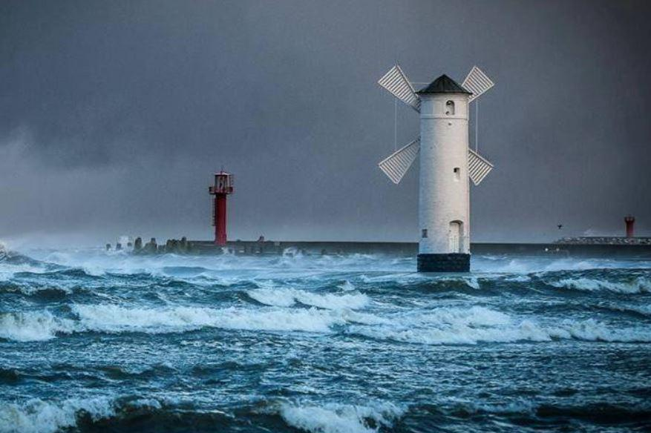
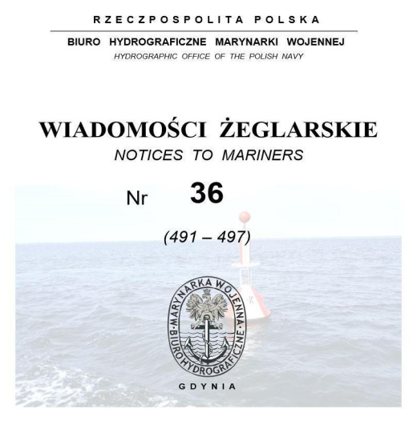
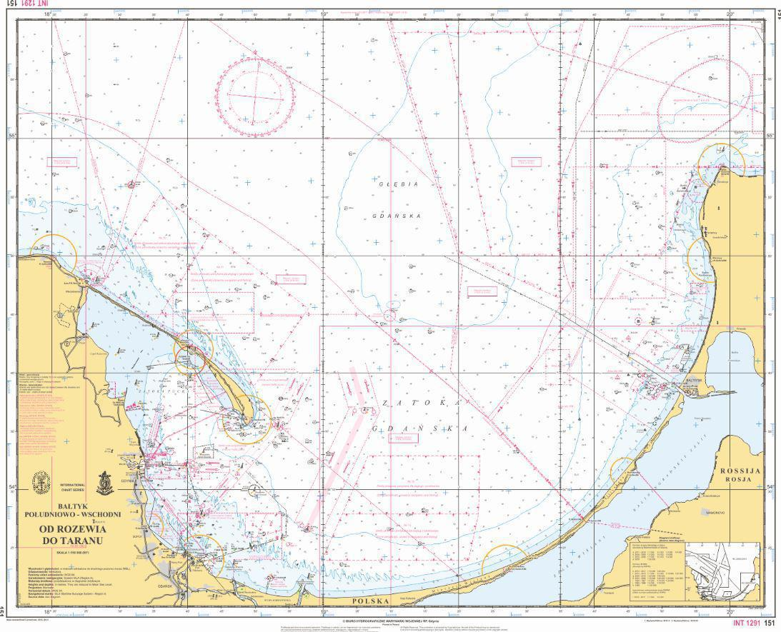
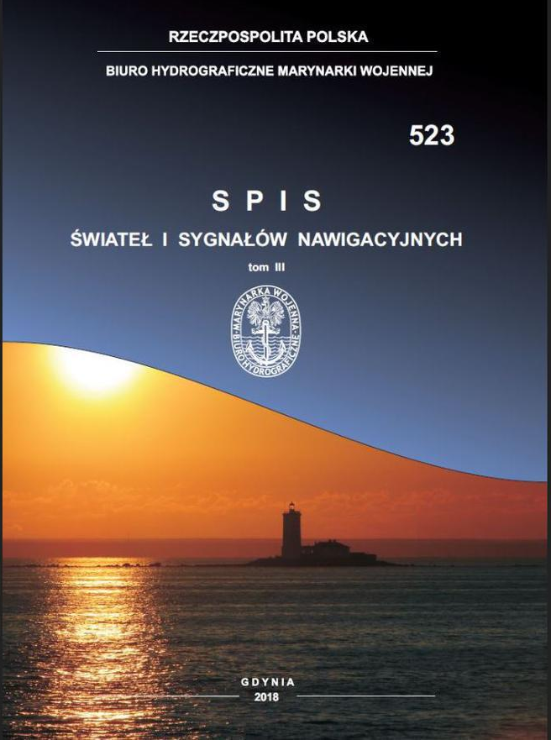
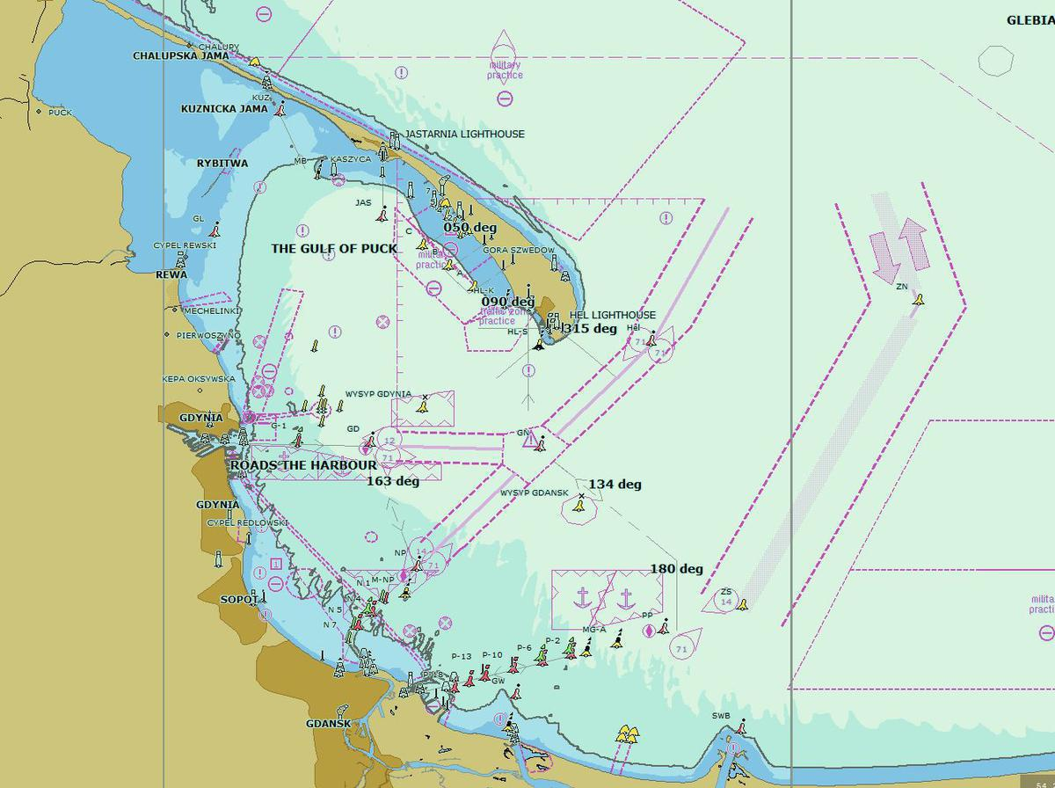
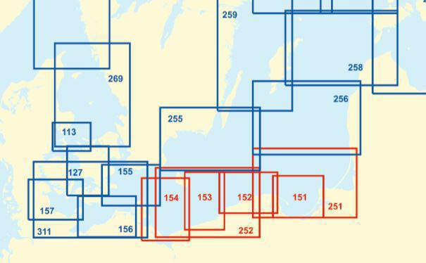
IRCC 12
GDAŃSK, POLAND 1-3 June 2020
In 2020, HOPN celebrates 100th anniversary of the foundation
https://www.bhmw.gov.pl/en/
Thank you for your attention

