Slide 1

NORDIC HYDROGRAPHIC COMMISSION (NHC)
NHC report to IRCC8
Abu Dhabi, UAE, 29-31 May 2016

Slide 2


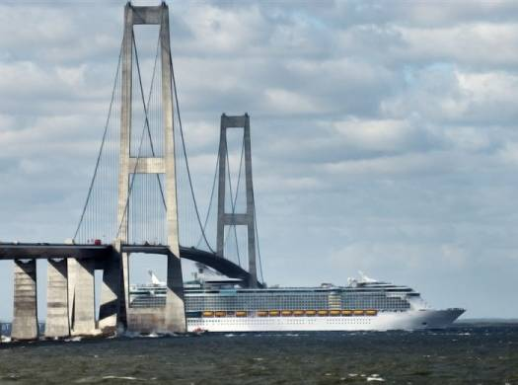
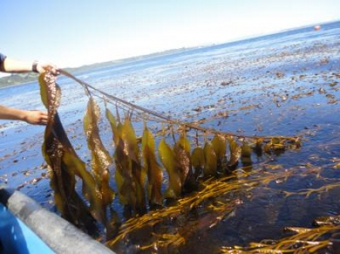
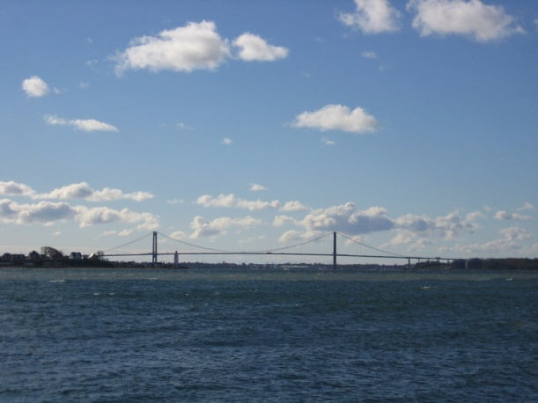
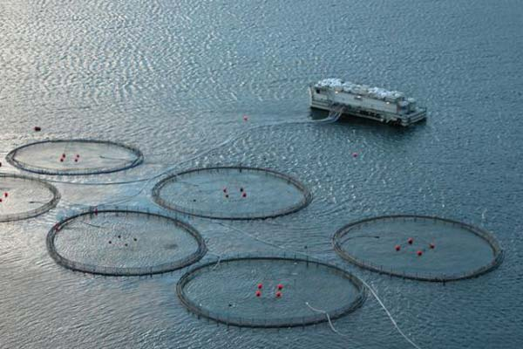
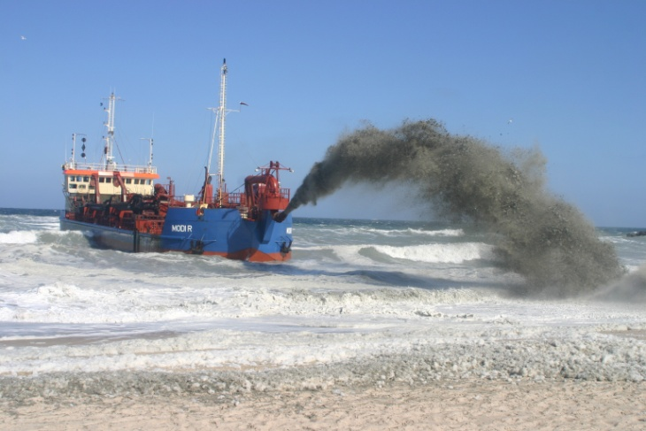

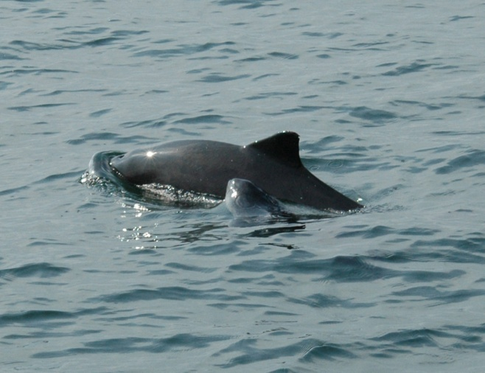


Nordic Hydrographic Commission
60th Conference - Stavanger - Norway
11-13 April 2016

Slide 3
Agenda item 1
Admiralty Information Overlay (AIO): The subject was discussed at NHC60 in April 2016.
The NHC MS agreed that the AIO service, used in waters were Member states have a national P/T-service, can have a negative impact on the safety of navigation.
The NHC Member states strongly supports the three proposals regarding AIO put forward by the WENDWG:
AIO should be withdrawn for the areas where the primary charting authority produces P/T
NtMs for their ENC AIO service should be provided only if and after a given ENC producer has provided its consent
Awareness and use of P/T updates should be improved. This should be taken into account in future S-101 based ECDIS and included in ENCWG work plans.

Slide 4
Agenda item 2
ENCs to leisure market: Both Denmark and Finland are working on solutions to make updated ENCs available to the leisure markets in order to enhance safety at sea.
Denmark has tested a solution for about one year, developed together with a private company, and invited other Nordic countries to participate to obtain a better coverage. Denmark will invite all NHC MS to participate in the future work.

Slide 5
Agenda item 3
Report on chart production systems: There are ongoing projects to renew nautical chart production systems in Denmark, Finland and Sweden.
Denmark is testing and refining a system for production of Greenlandic charts.
Finland is testing different solutions in order to renew the existing system.
Sweden has decided to go for a new system and is now implementing the new system.

Slide 6
Conclusions:
The NHC Member states strongly supports the three proposals regarding AIO put forward by the WENDWG
Exchange of experience for Satellite Derived Bathymetry
Development of solutions for updated ENCs for the leisure market
Actions required from the IRCC8:
The IRCC8 is invited to take note of the NHC report

