Slide 1
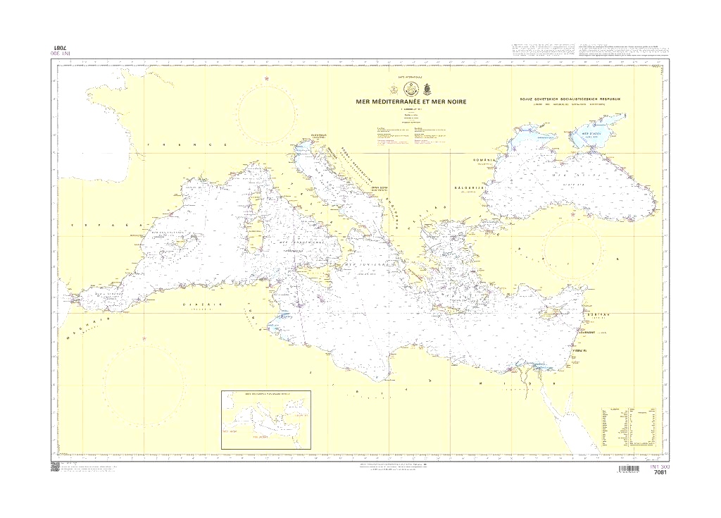
IRCC-9 Paramaribo – 12/06/2017
Mediterranean and Black Seas Hydrographic Commission
Commission hydrographique de la Méditerranée et de la mer Noire
(MBSHC - CHMMN)

Slide 2
Mediterranean and Black Seas Hydrographic Commission
Chair: Bruno Frachon (FR) - the vice-chair is only occupied during the Conference, by the representative of the host (statutes, article 6)
Members: Algeria, Croatia, Cyprus, Egypt, Spain, France, Georgia, Greece, Italy, Malta (2017), Morocco, Monaco, Montenegro, Romania, Russia, Serbia (suspended), Slovenia, Syria, Tunisia, Turkey, Ukraine
Associate Members: Palestinian Authority, Bulgaria, United States of America, Israel, United-Kingdom
Observers: Albania, Germany, Lebanon, DINMA, IOC, IC-ENC, PRIMAR
Working Groups: F-ICCWG (FR), Black and Azov Seas WG (TR)

Slide 3
MBSHC - IRCC actions
IRCC 8/13: work to reduce overlaps by applying the WEND Principles in defining approved ENC schemes
Undertaken by F-ICCWG, supported by the RENCs
Some members may be concerned by RENC overlap policy
IRCC 8/31: in coordination with MS, to be attentive to opportunities to raise awareness on the role of hydrography and the importance of improving mankind’s knowledge of the seas
Union for the Mediterranean: development of Blue Economy
European Union: Coastal Mapping (Marine Knowledge), Maritime Spatial Planning (European Blue Growth Initiative)

Slide 4
MBSHC - Agenda items
Cooperation with international organization: IALA - CIESM (Mediterranean Science Commission) – IOC (tsunami warning system)
Participation of non-member States: Lebanon, Israel, nations bordering the Caspian sea
Hydrographic survey status: synthetized through a regional GIS portal hosted by Spain
Capacity building programme
MSDI: European Marine Observation and Data Network
www.emodnet.eu/ www.emodnet-bathymetry.eu/

Slide 5
MBSHC - Difficulties and challenges (1/2)
INT chart schemes and ENC coverage coordination
Challenge of establishing consistent INT schemes in semi-closed basins of the Mediterranean and Black Seas
Some unresolved ENCs overlaps in small scale usage bands
IHO INT Chart Web Catalogue good way forward
On-going experimentation of risk assessment of ENC overlaps by the Region F ICCWG

Slide 6
MBSHC - Difficulties and challenges (2/2)
Critical area for maritime traffic: 1% of the world ocean, 25% of the global maritime traffic
Sustainable development of blue economy emphasizes the need for better knowledge of the maritime environment
➔ Development of interactions with organizations involved in improving the knowledge of the Mediterranean and Black Seas ((e.g. CIESM, EU, UfM, 5+5 dialogue)

Slide 7
Actions required from the IRCC
IRCC is invited to note this report

