Slide 1
IRCC-9
Agenda item 9
Relations with other International Organizations and IHO Stakeholders
IHO Secretariat

Slide 2
Contents
Status of relations with other International Organizations
UN Ocean Conference
IHO Stakeholders’ Forum and related activities
Calendar of future events 2017-2018
Action required of IRCC

Slide 3
Status of relations with other International Organizations
List of International Organizations with which the IHO maintains relations:
IHO Publication P-5 - Yearbook (Appendix 4)
IHO website at Home > External Liaisons
Recent developments:
Memorandum of Understanding (MoU) signed with:
Maritime Organisation of West and Central Africa (MOWCA)
International Seabed Authority (ISA)
Open Geospatial Consortium (OGC)
Mediterranean Science Commission (CIESM)
New observers:
International Association of Independent Tanker Owners (INTERTANKO)
World Ocean Council (WOC)
Association of Arctic Expedition Cruise Operators (AECO)

Slide 4
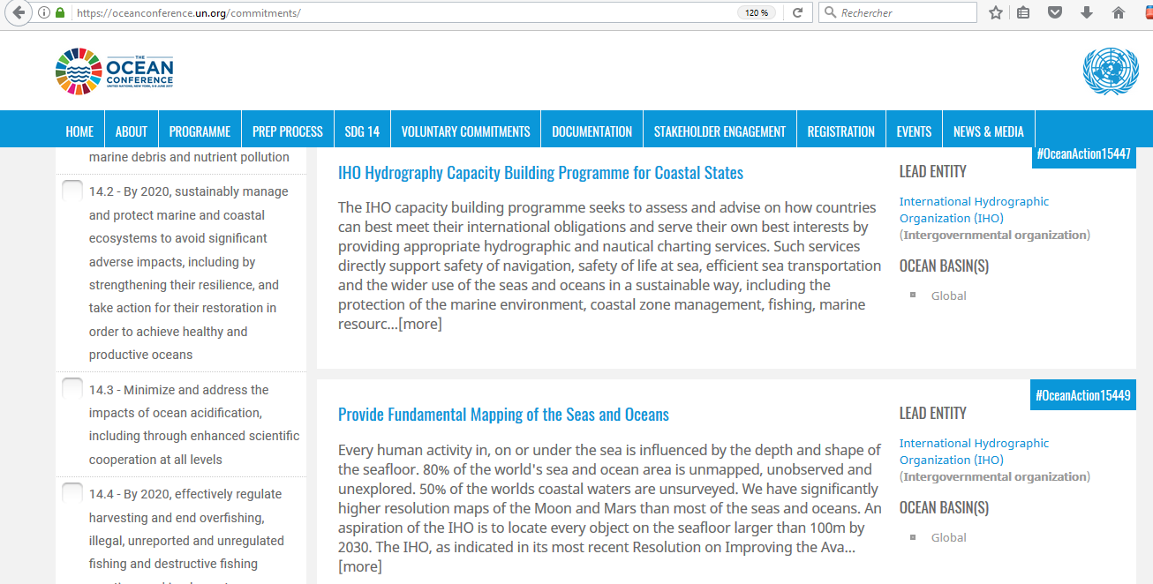

Slide 5
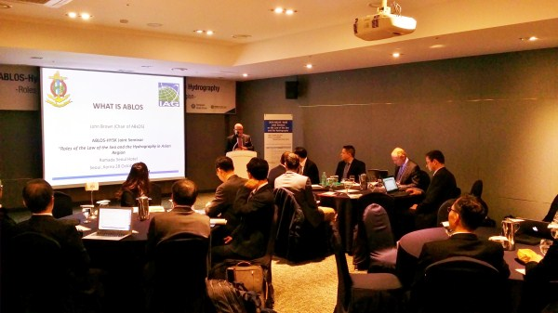
IHO Stakeholders’ Forum and related activities
No specific IHO Stakeholders’ Forum during the IRCC inter-sessional
Other events engaging IHO Stakeholders since IRCC-8:
Forum for Future Ocean Floor Mapping 15-17 June 2016
11th GEBCO Science Day 12 October 2016
ABLOS Seminar “Roles of the Law of the Sea and the Hydrography in Asian Region”, 28 October 2016

Slide 6
IHO Stakeholders’ Forum and related activities
IHO-led events during the next IRCC inter-sessional period:
9th ABLOS Conference “Pushing the limits of UNCLOS” - Monaco, 10-11 October 2017
12th GEBCO Science Day - Busan, Republic of Korea, 15 November 2017
MSDI Open Forum in conjunction with MSDIWG-9 - Niteroi, Brazil, 29 January 2018

Slide 7
Other future events 2017
See Annex A to IRCC9.09B - Items to note:
Task (WP2017) | Event / Meeting | Date (2017) | Location | Comments
1.1.8.3 | IALA Seminar on Arctic Navigation | 9-10 Nov | Saint-Germain-en-Laye, France
1.1.10.1 | 28th International Cartographic Conference | 02-07 Jul | Washington DC, USA | See IHO CL 9/2017
1.1.10.2 | Meeting of the Commission on SDI and Standards of the International Cartographic Association (ICA) - SDI Open 2017 | 01-02 Jul | Washington DC, USA
1.1.11 | Plenary Meeting of IEC Technical Committee TC80 | 29-30 Aug | Espoo, Finland | IHO represented by ENCWG Vice-Chair (Finland)
1.1.20 | 5th Sustainable Ocean Summit | 29 Nov - 01 Dec | Halifax, Nova Scotia, Canada | IHO represented by Canada
1.4.3 | Digital Ship Events
 | Maritime Cyber Resilience Forum | 10 Oct | Hamburg, Germany | Local MS to be invited to represent the IHO
 | Athens 2017 | 01-02 Nov | Athens, Greece | Local MS to be invited to represent the IHO
2.1.3 | World ECDIS Day | 20 Sep | Hamburg, Germany | Local MS to be invited to represent the IHO
2.1.3.1 | E-navigation Underway North America 2017 | 16-18 Oct | Saint-John’s, Newfoundland, Canada | Local MS to be invited to represent the IHO

Slide 8
Other future events 2018
See Annex B to IRCC9.09B - Items to note:
Task (WP2018) | Event / Meeting | Date (2018) | Location | Comments
1.1.4 | European Maritime Day | ?? May | Burgas, Bulgaria
1.1.8 | 2018 World Maritime Day | ?? Sep | London, UK | No IHO attendance anticipated
1.1.8 | 2018 World Maritime Day parallel event | ?? Nov | ?? Poland | No IHO attendance anticipated
1.1.15 | 19th session of the Asia-Pacific Heads of Maritime Safety Agencies (APHoMSA) forum | ?? April | Viña del Mar, Chile | Local MS to be invited to represent the IHO
1.1.15 | 4th Conference of the Association of African Maritime Administrations | ?? | ?? Egypt
1.1.15 | 24th Congress of the International Maritime Pilots’ Association (IMPA) | 23-27 Apr | Dakar, Senegal | No IHO attendance anticipated
2.1.6 | E-navigation Underway Asia-Pacific 2018 | ?? | ?? | Local MS to be invited to represent the IHO
2.1.6 | E-navigation Underway North America 2018 | ?? | ?? | Local MS to be invited to represent the IHO
2.1.6 | Shallow Survey 2018 | 01-03 Oct | Saint-John’s, Newfoundland, Canada

Slide 9
Action required of IRCC
IRCC is invited to:
Note the report
Note the list of events in Annexes A and B and consider how the IHO might be represented in those events that are considered relevant
Take any other actions as appropriate

