Slide 1
MSDI training courses feedback MSDIWG10 March 2019 Busan

Slide 2
Course material description
Two courses prepared
Orientation (half day) – Aimed at decision makers and high level managers
Fundamentals (full day) – Practitioners with marine geospatial data experience
Modelled on IHO syllabus, co-branded DGA/IHO
(Phase 1) Formatted as slides, with annotations in booklets, supported by e-learning courses (Phase 2)
To be hosted on IHO website
Audience - participants new to MSDI concepts and practice

Slide 3
Syllabus - Orientation
Drawn from IHO syllabus
Logical flow from definitions, to data reuse and impacts on implementing organisations

Slide 4
Syllabus - Fundamentals

Slide 5
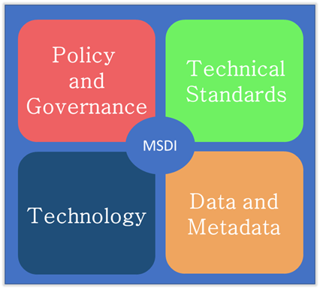
Approach
Simple definitions drive the material
Draw from wide variety of public domain information
Document current global drivers and existing structures
Emphasise core concepts
Definitions
Concentrate on four elements of MSDI
Introduce Data Reuse, Interoperability, Open Standards, implications for Institutions
That’s Enough!

Slide 6
Progress
Initial version of courses delivered to audience at DGA, Aalborg
Volume of material reduced and more focused
Stronger emphasis on core definitions and graphics
More emphasis on “What Is MSDI?”
Key Learning Points for all slides
Extra information to be included as annexes, with discussion/exercise topics
Booklets going through second revision and final update prior to engagement of e-learning courses
Grateful for feedback for final editions (1.0) before baseline
eLearning courses to be released prior to IRCC

Slide 7
Definitions
Technology
“The relevant base collection of
technologies
policies
institutional arrangements
that
facilitate the availability of and access to
spatial data”
Policy
Governance
Technical
Standards
Data and Metadata
Users
“Marine Spatial Data Infrastructure (MSDI)”:
MSDI – The focus on marine elements in any SDI
Governance, Standards, ICT and Content
Notes:
Break it apart.
SDI is a “Collection” of different factors which work together
These factors work together to make sure spatial data is accessible to those who need it.
MSDI – The focus on marine elements in any SDI
Governance, Standards, ICT and Content
What is “Spatial Data”?
Is it different from “Information”?

Slide 8
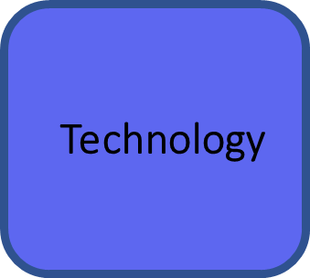
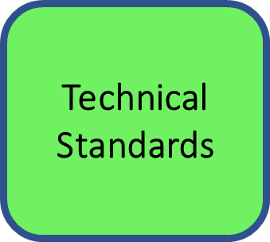
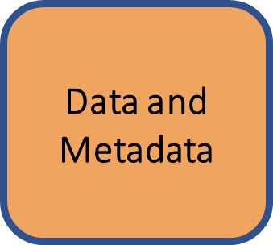
“Publish” – “Find” – “Bind”
Discover
Metadata
1
Search
3
Providers publish metadata of their services
Providers author and publish content
Users search and discover results
Users consume data from the providers.
Data Creation
MSDI
Users
Content
2
Publish
Access
4
Notes:
Key Messages: Technology provides the many “How” components – “How” the MSDI functions. As it becomes more capable the MSDI effectiveness grows. Sometimes it is hard to differentiate between technology specifically for MSDI and SDI and technology which has multiple applications (e.g. network infrastructure). It is important to make these distinctions and understand the immense effect different technology components have on the overall capabilities of the MSDI as it is constructed. It is also vital to remember that technology needs to be frequently be upgraded to satisfy emerging requirements and conformance with new and updated standards.
Network infrastructure
Spatial databases
Geo Processing for geodetic transformation.
Web Mapping services
Geospatial distribution technologies
Web Portals
Knowledge
Data Capture
Data delivery

Slide 9
Standards are technical documents that detail interfaces or encodings (OGC).
Software developers, cartographers and data engineers use these documents to build their products and services.
Standards span the collection, management, publication and use of geospatial data
Key to MSDI are open standards and standards interoperability
Open Standards can be used by anyone at little or no cost
Interoperability is being able to combine data and services from different sources without requiring specific efforts of humans or machines
Notes:
Key Messages: What standards are and why are they important for MSDI. The difference between open and closed standards, and what the important MSDI standards organisations are.
Important MSDI standards organisations:
ISO – define overarching global standards and frameworks for geospatial data
IHO – a detailed set of standards for hydrographic data content
OGC – an international consensus organisation leading development of open geospatial standards
Standards for data are “reusable agreements that make it easier for people and organisations to publish, access, share and use better-quality data” (UK Open Data institute)
Interoperability in INSPIRE means the possibility to combine spatial data and services from different sources across the European Community in a consistent way without involving specific efforts of humans or machines
Standards also describe the key metadata required to make data assets discoverable
Standards, like SDIs, can be defined at organisational, national, regional or global levels
Priorities for SDI/MSDI:
Open Standards can be used by anyone
Open Standards promote interoperability
If you’re new to standards:

