Slide 1
Report on Marine Regions Activities
Report for SCUFN-31, Wellington, October 2018
Paula Oset, Simon Claus, Britt Lonneville, Lennert Schepers, Bart Vanhoorne (VLIZ)

Slide 2
Outline
Marine Regions
Undersea features
GEBCO update
ACUF update
SCUFN30/140
Integration of New Zealand Gazetteer
Other gazetteer updates
Data products updates

Slide 3
Marine Regions is a standard list of marine georeferenced place names and areas.
One of the data systems being developed and managed by VLIZ.
Serves as the geographic backbone for large-scale integrated biogeographic databases.

Slide 4
Overview of the system
Marine Regions Geo-object
The identity of each feature or geo-object in the database is given by a unique and persistent Marine Regions Geographic IDentifier: MRGID.
Each geo-object is defined by a place type and its coordinates (vector) but can have multiple synonyms.
Geometry
Point
Line
Polygon

Slide 5
Undersea features

Slide 6
GEBCO update
130 new features added to Marine Regions, mainly from SCUFN-29 but also from SCUFN-24, 26, 27 and 28.
Issues found:
Polarstern Canyon: a duplicate in the gazetteer with mirror coordinates:
featureid: 28046-> LINESTRING (-27.3167 -74.3817, -26.195 -73.7817, -25.385 -72.52, -23.3833 -71.9867, -23.0883 -71.685)
featureid: 22984 -> LINESTRING (27.3167 -74.3817, 26.195 -73.7817, 25.385 -72.52, 23.3833 -71.9867, 23.0883 -71.685)
New multipoint features not yet in the WMS service: Wanhu Hills, Shuangfengxi Hills, Shixing Seamounts
Reinga Ridge not in the WFS service.

Slide 7
GEBCO update
Issues found (continued):
Pinne Marine Bank has been given a termination date by ACUF: bathymetry no longer indicates a feature in these coordinates.
Grand Banks of Newfoundland: this feature does not contain a value for the field typeid (no generic term).
E-W coordinates (3 cases):
Lee Seamount: current longitude coordinates are
SCUFN18 report -> Lee Seamount (41°06’S, 179°31’E)
Coordinates in GEBCO: POINT (-179.5333333333 -41.116666667)
Kaiwhata Bank
Hayes Bank
General instability with web services.

Slide 8
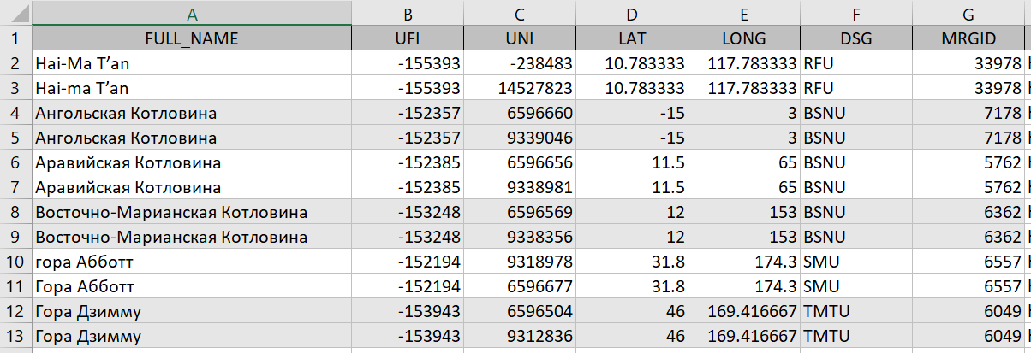
ACUF update
7 new features added
Tackling issues from previous updates:

Slide 9
ACUF update
Tackling issues from previous updates (continued):

Slide 10
SCUFN30/140. Action for MR to report by beginning of 2018 a full list of inconsistencies between ACUF and GEBCO gazetteer.

Slide 11
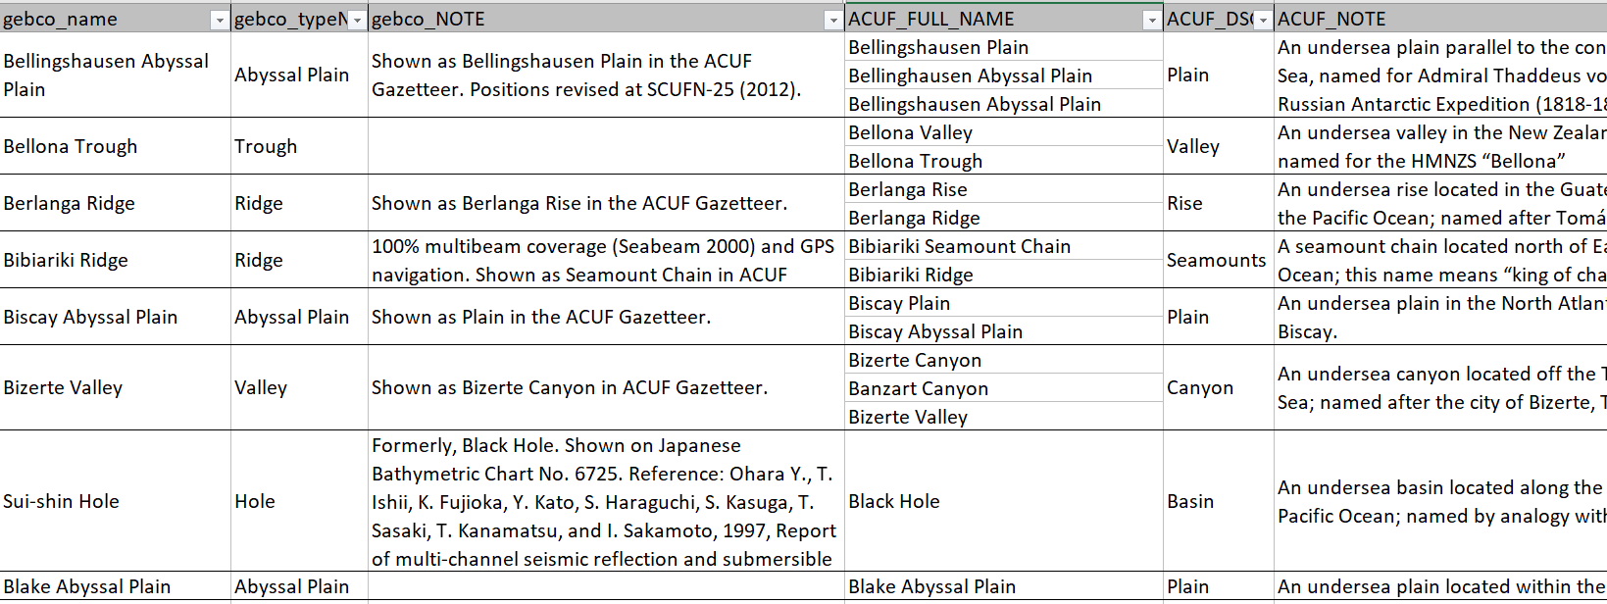
SCUFN30/140. Action for MR to report by beginning of 2018 a full list of inconsistencies between ACUF and GEBCO gazetteer.

Slide 12
SCUFN30/140. Action for MR to report by beginning of 2018 a full list of inconsistencies between ACUF and GEBCO gazetteer.

Slide 13
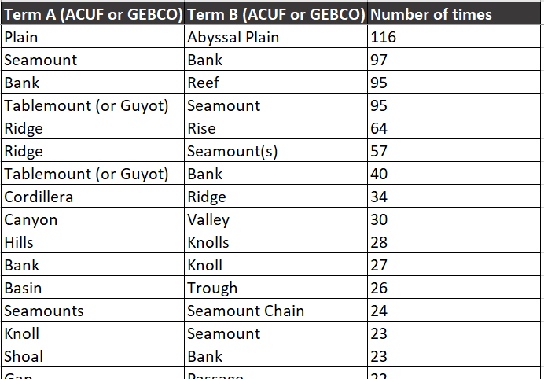
SCUFN30/140. Action for MR to report by beginning of 2018 a full list of inconsistencies between ACUF and GEBCO gazetteer.

Slide 14
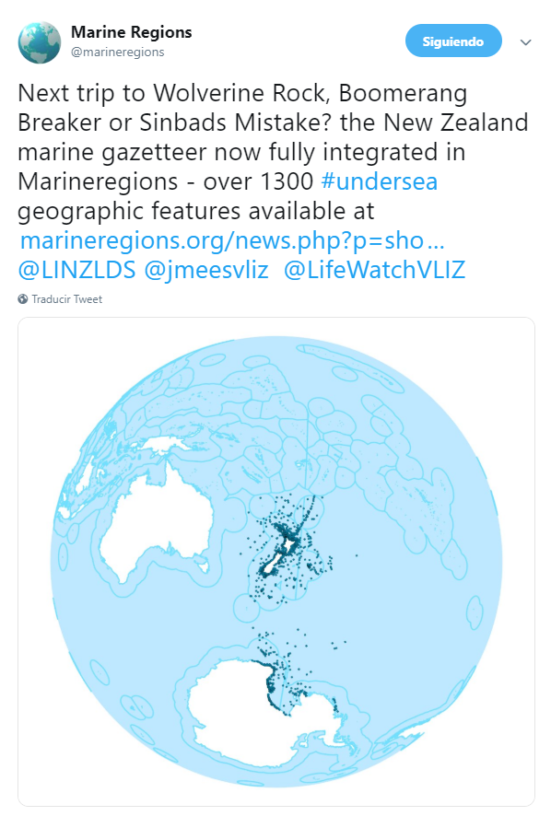
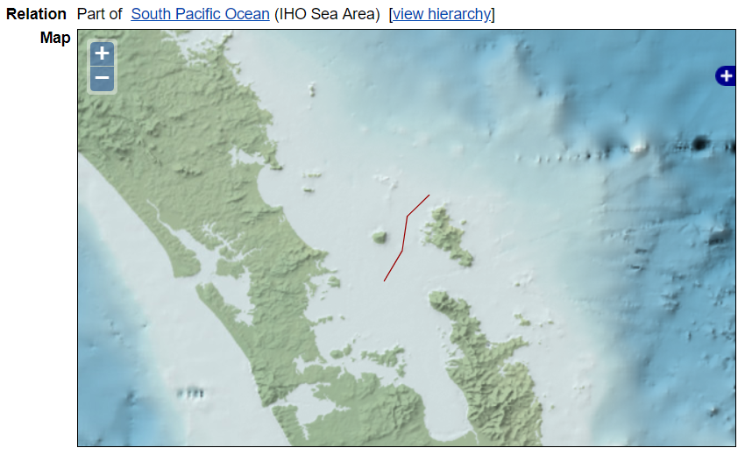
Integration of New Zealand gazetteer
1968 features have been integrated, of which 1356 features were new in Marine Regions. Records previously existing in MR are coming from GEBCO, ACUF and SCAR gazetteers.
Comments:
Use of “/”: Avon River/Ōtakaro vs. Kōhatupapā / Ranfurly Bay

Slide 15
General overview Undersea Features in Marine Regions
Thera are in total 8875 undersea features records in Marine Regions. The main sources for these features are GEBCO, ACUF, SCAR and New Zealand gazetteers. Some features belong into more than one context:
Gazetteer - context | Total
ACUF Gazetteer | 5289
GEBCO Gazetteer | 4222
SCAR-MarBIN | 765
New Zealand Gazetteer | 718
Other | 516

Slide 16
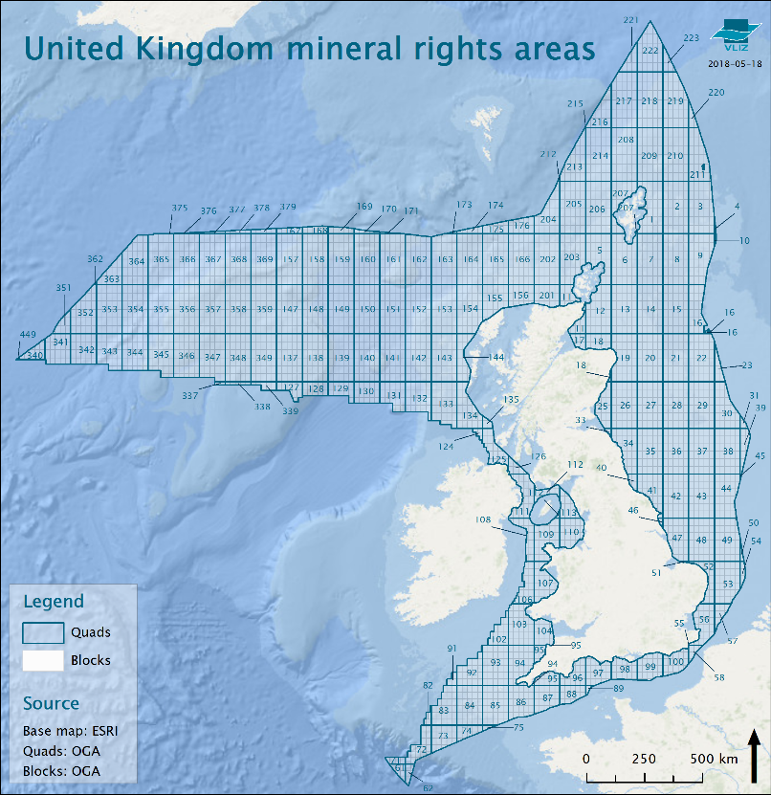
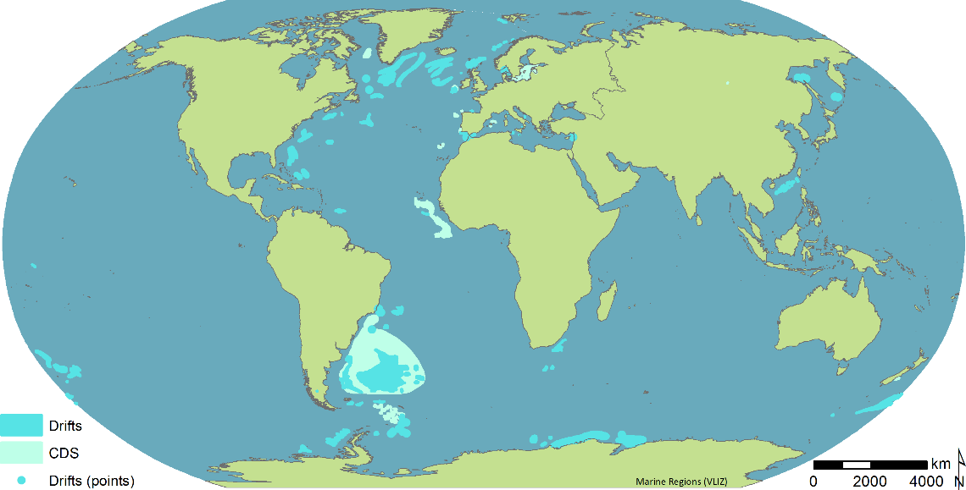
Other gazetteer updates
Mineral rights areas from UK and Norway:
Global contourite distribution:

Slide 17
Evolution of records in Marine Regions (2005-present)

Slide 18
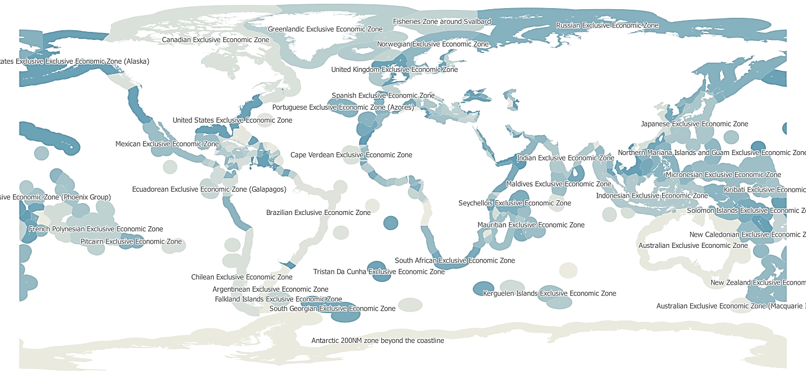
Data products updates
Maritime boundaries (v10); TS, CZ, IW, AW (v2)

Slide 19
Data products updates
IHO Sea Areas (v3): IHO S-23, Limits of Oceans and Seas (1953).

Slide 20
Data products updates
Intersection EEZ v10 – IHO v3

Slide 21
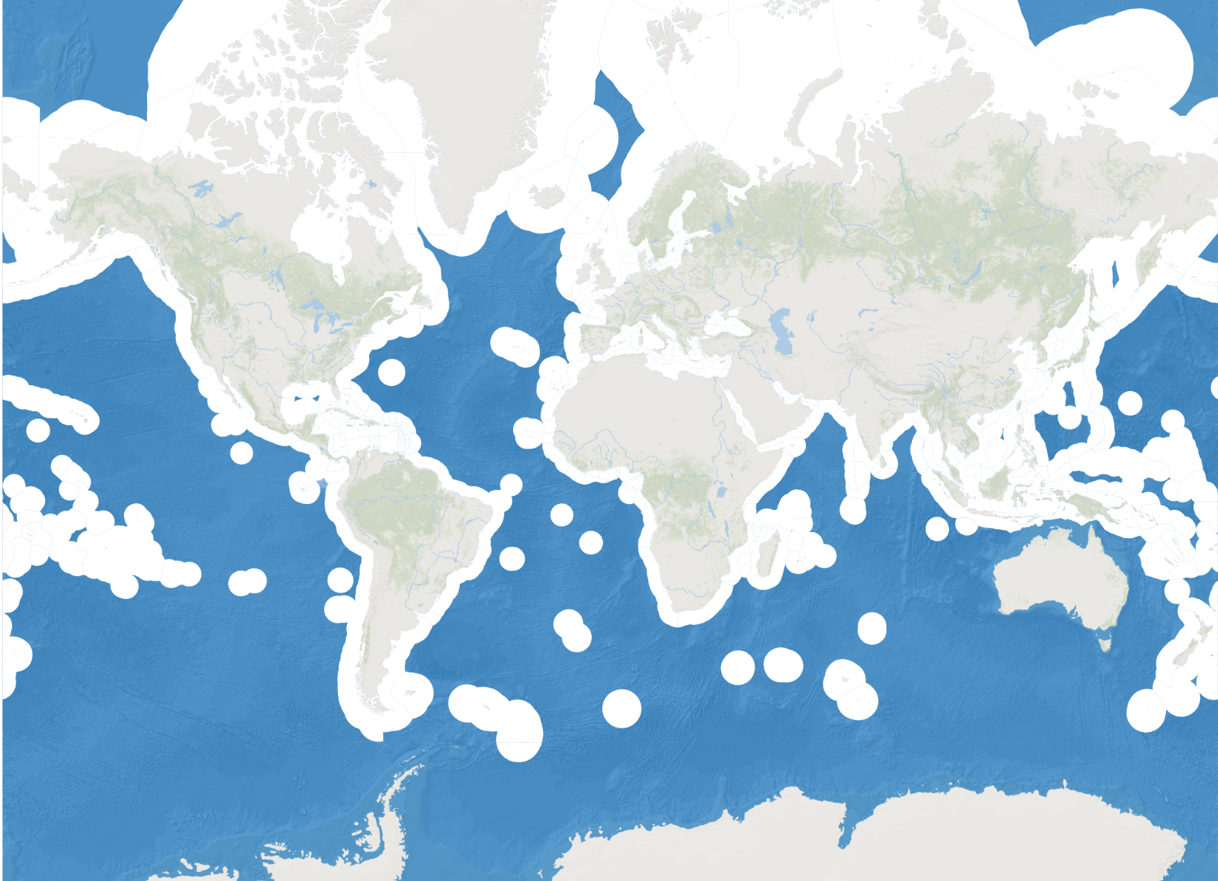
Short-term planned activities for Marine Regions
Undersea Features: Geographical Names Board of Canada
Areas Beyond National Jurisdiction

