Slide 1
Development of the IHO ENC Coverage Catalogue (Agenda WENDWG8-04.2H1) IHO Secretariat
WORLDWIDE ENC DATABASE WORKING GROUP (WENDWG)

Slide 2
Background information
Objective of the IHO ENC Catalogue
IMO NCSR 1/WP.8* “ECDIS – Guidance for Good Practice”
“…
The IHO provides an online chart catalogue that details the coverage of ENCs together with references to coastal state guidance on any requirements for paper charts (where this has been provided). The catalogue also provides links to IHO Member States’ websites where additional information may be found. The IHO online chart catalogue can be accessed from the IHO website.
…”
*now superseded by MSC.1/Circ. 1503/Rev.1, 16 June 2017

Slide 3
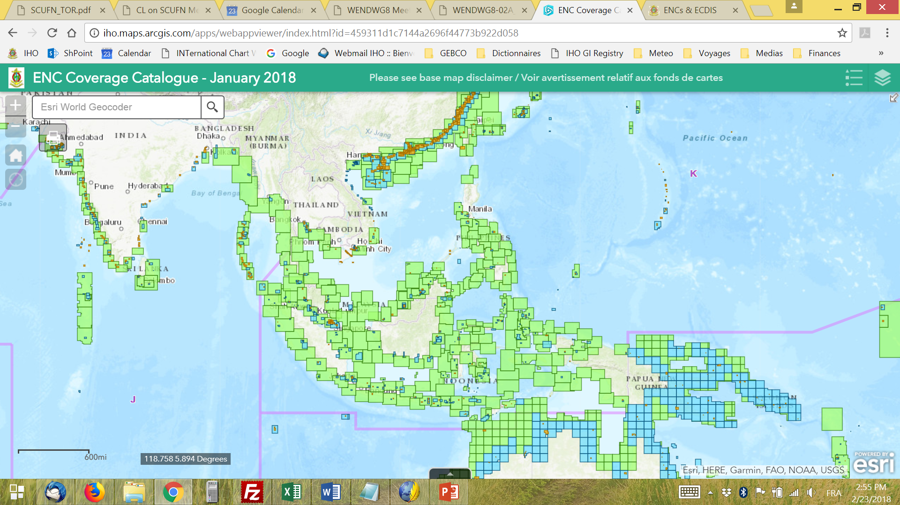
Background information
www.iho.int > ENCs & ECDIS > ENC Availability

Slide 4
Way ahead (as decided in 2016, obstacles to WEND Principles, etc…)
Link the IHO ENC Catalogue and the INT Chart Web Catalogue
→ In progress (Reference: INToGIS Phase II Project), Charting Regions, etc.
Improve the automated generation of IHO Performance Indicators and information to be reported to IMO (NCSR)
→ On hold, waiting for outcomes of the Strategic Plan Review WG
Improve display to align with ENC Data Flow Diagram
→ Beta-version developed by RENCs for 2 years in liaison with IHO Secretariat

Slide 5
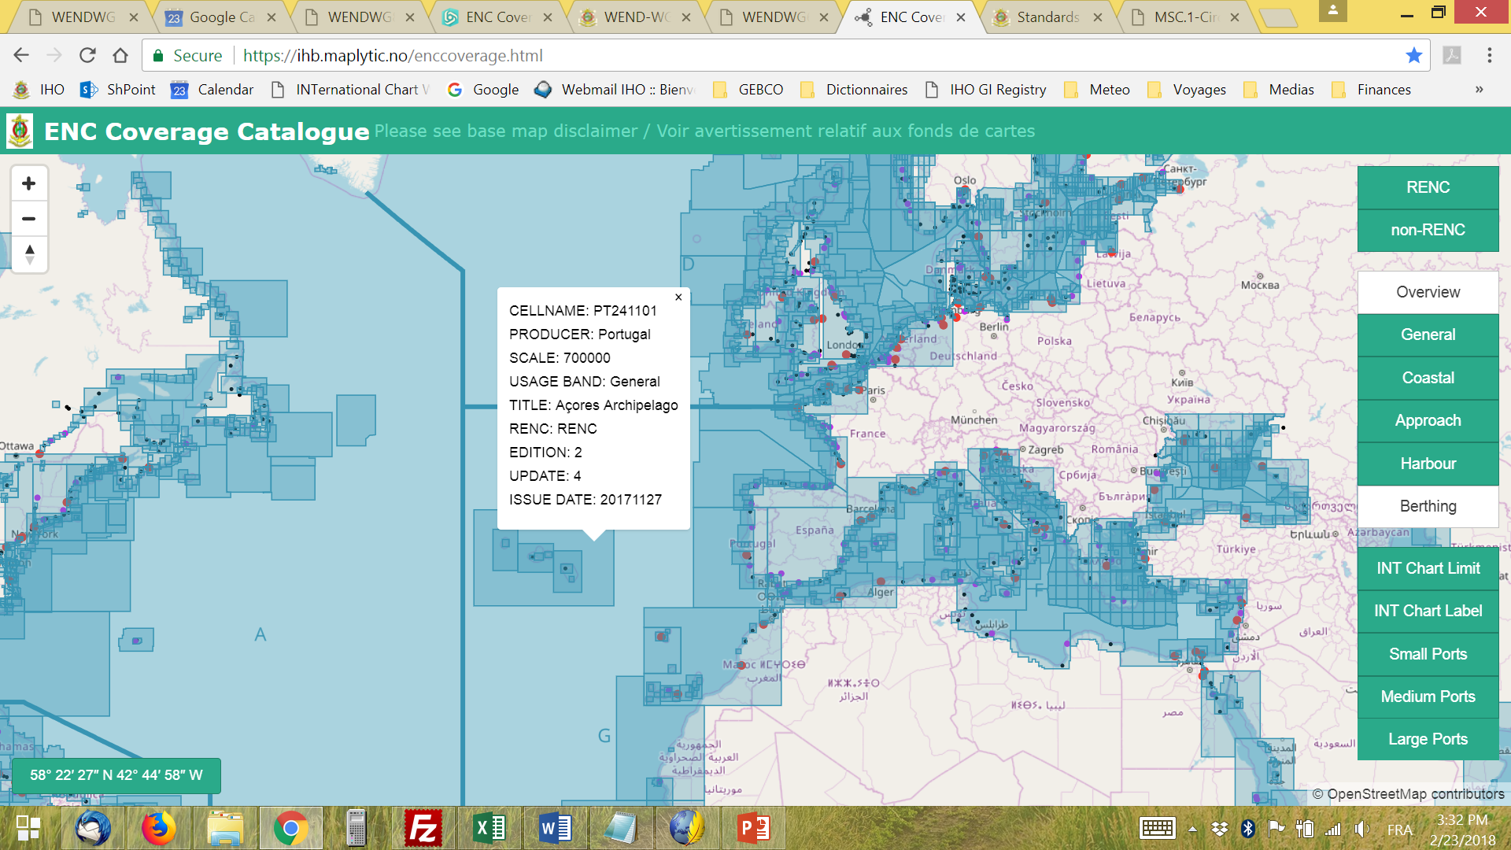
Action to be taken by WENDWG
To decide on the commissioning of the new version that will replace the current IHO ENC Coverage Catalogue
To consider the possibility that some WENDWG Members contribute to the testing of INToGIS Phase II, by submitting their ENC Schemes

