Slide 1
Report of the representative of the ARHC on the implementation of ENC Schemes in Region N
Evert Flier
Norwegian Mapping Authority
WORLDWIDE ENC DATABASE WORKING GROUP (WENDWG)

Slide 2

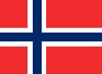
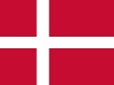
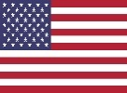

Background
Arctic Regional Hydrographic Commission (ARHC) established in October 2010.
Core Members: Canada, Denmark, Norway, Russian Federation, USA.
Associate Members: Finland, Iceland, Italy.
New INT Charting Region ‘N’ created 2011.
Arctic INT Chart Coordination Working Group (AICCWG) established October 2012.
AICCWG fully manned - Norway acting as regional charting coordinator.

Slide 3
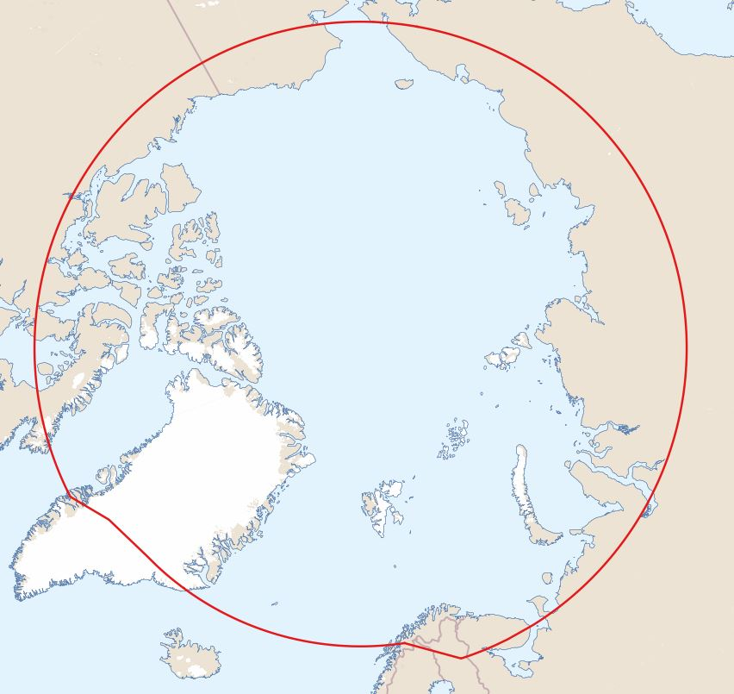
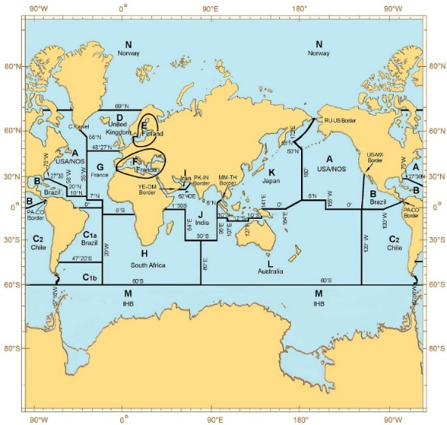
Overview of INT Region N
INT Region N covers the Arctic Ocean and adjacent seas north of the Bering Strait (line joining Mys Dezhneva and Cape Prince of Wales) and north of the 69°N parallel in the Nordic Seas.
INT Region N
INT Region N

Slide 4
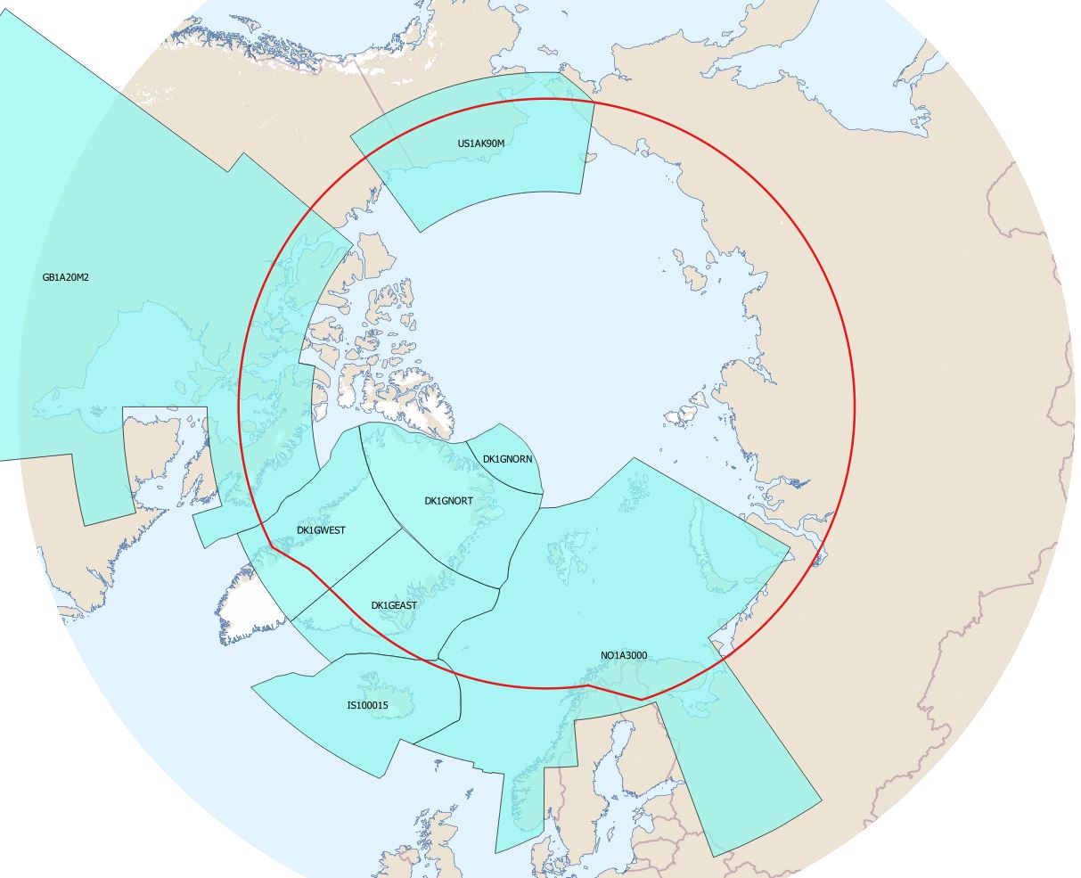
Status of the ENC Scheme UB1 in Region N
Number of ENC’s
UB1 Overview: 8
Figures as of Feb 2019

Slide 5
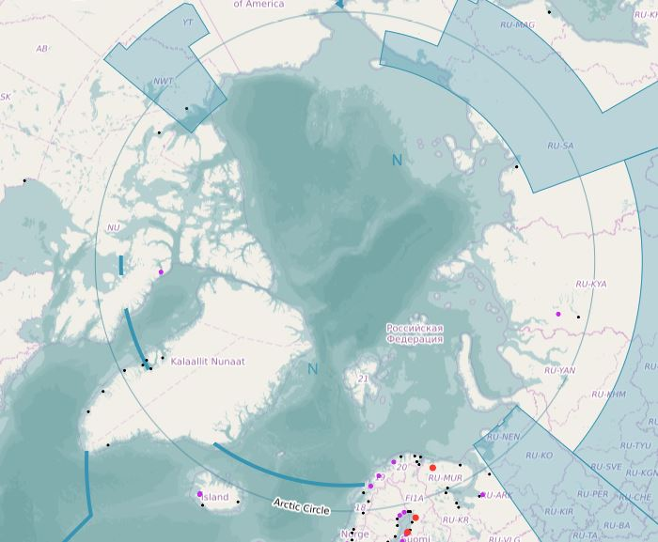
Status of the ENC Scheme UB1 in Region N
And three non-RENC exclusive UB1 ENC’s
Figures as of Feb 2019

Slide 6
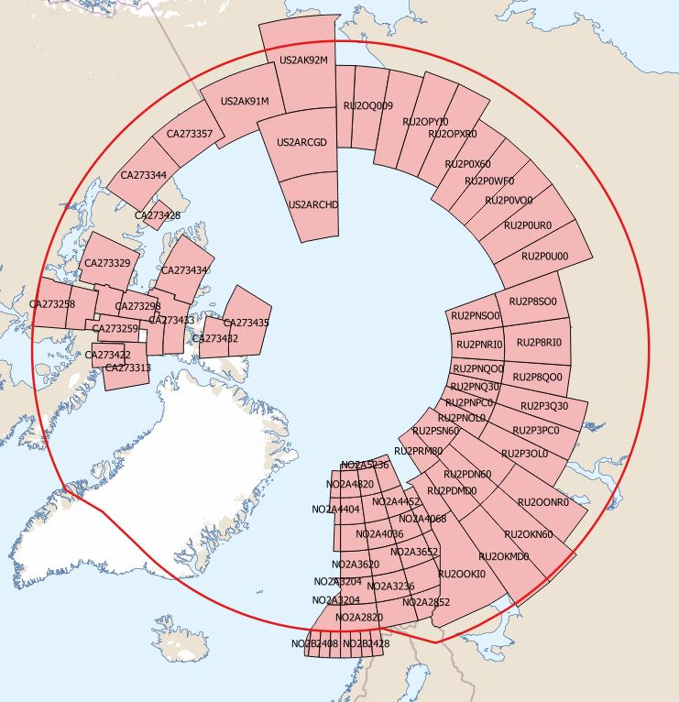
Status of the ENC Scheme UB2 in Region N
Number of ENC’s
UB2 General: 90
Figures as of Feb 2019

Slide 7
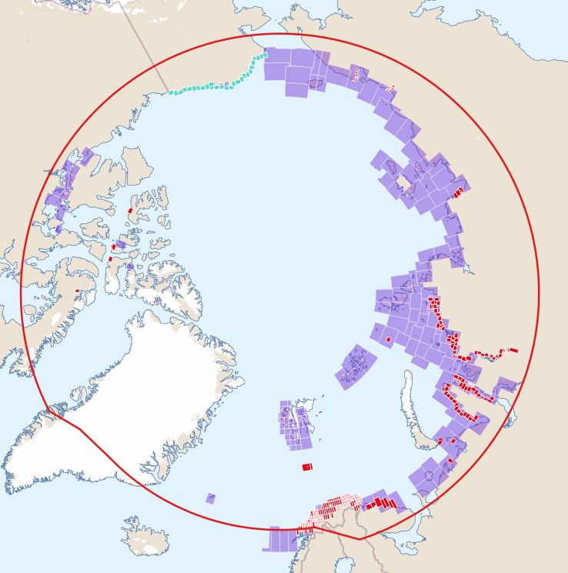
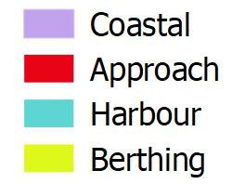
Status of the ENC Schemes UB 3/4/5/6 in Region N
Number of ENC’s
UB3 Coastal: 162
UB4 Approach: 350
UB5 Harbour: 122
UB6 Berthing: 23
Figures as of Feb 2019

Slide 8
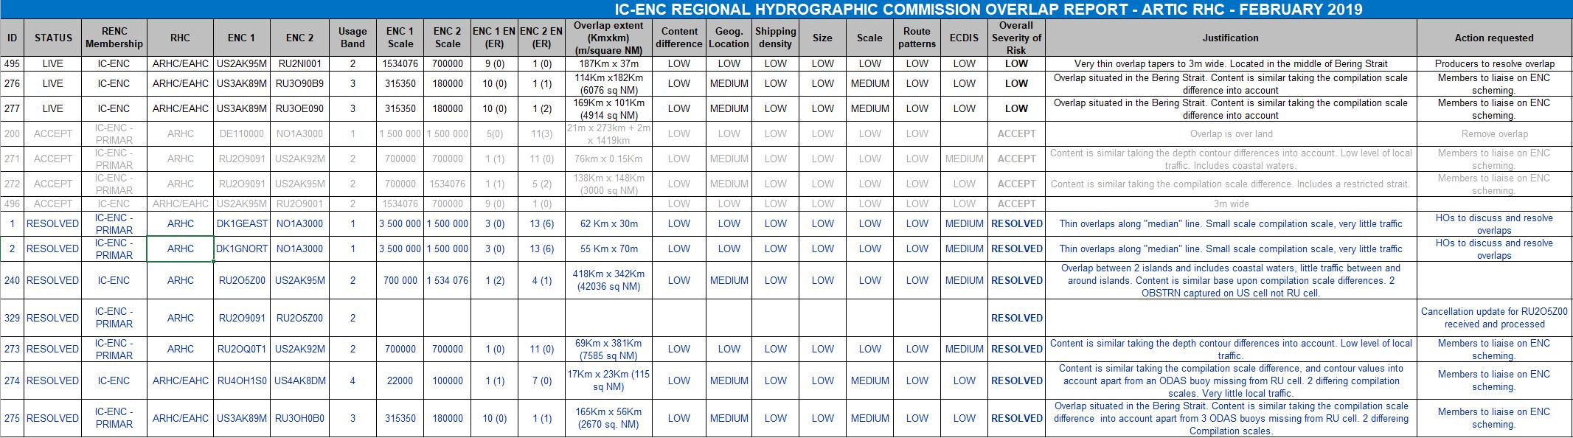
Existence of overlapping ENCs that may have a possible impact on safe navigation
IC-ENC Overlap report – all overlaps assessed as ‘low’risk.
Significant progress has been made in eliminating overlaps most notably the collabarative efforts of The United States and The Russian Federation.
Norway in collaboration with Denmark and Germany - eliminated overlaps with the NO1A3000 cell.
Work completed on all but three overlapping issues.

