Slide 1
ARMSDIWG Report
Current status and planned actions of the ARMSDIWG in its third full year of operation.
9th Arctic Regional Hydrographic Commission Meeting
17-19 SEP 2019

Slide 2
ARMSDIWG: Year 3
(ɑrmz - dē - wɪg)

Slide 3
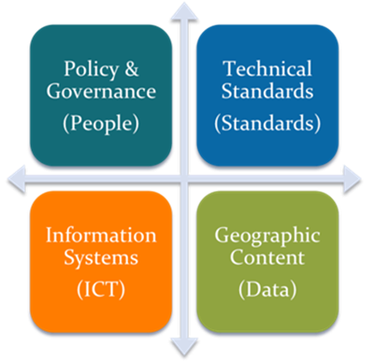
Marine Spatial Data Infrastructures
MSDI Pillars/Components
MSDI
Element of SDI focused on the marine input.
A MSDI is not a collection of hydrographic products, but an infrastructure that promotes interoperability of data at all levels (e.g., national, regional, international).
Discoverability
Accessibility
Interoperability
Data-centricity (Hydrographic Offices)
Supports wider, non-traditional user-base of marine data typically used for navigation.
MSDI Working Group (MSDIWG)
International Hydrographic Organization (IHO) working group to deliver IHO MSDI-related policy objectives.¹
M
Marine
1 - https://www.iho.int/mtg_docs/com_wg/MSDIWG/MSDIWG8/MSDIWG8-01.4.4b-MSDIWG_white_paper.pdf
Slide information and Image Credit - (DRAFT) IHO Publication C-17, Spatial Data Infrastructures: “The Marine Dimension” - Guidance for Hydrographic Offices, Ed 2.0, April 2016

Slide 4
ARMSDIWG3 - Reykjavík, Iceland
National MSDI Reports
Work Plan Update
Review of 2018 MSDI Questionnaire
Current: Arctic Voyage Planning Guide
Upcoming: Norwegian User Survey Report
Discussion of Arctic SDI technology usage or exploration of portal prototypes
Discussion of OGC-IHO MSDI-CDS Follow-on Pilot Arctic Use Cases
Arctic SDI Collaboration structure
Joint Meeting with Arctic SDI
Executive Secretary of the Arctic Council’s Conservation of Arctic Flora and Fauna (CAFF) working group
Modern approach to Organization of Work
ARMSDIWG 3rd meeting in Reykjavík, Iceland - April 2019

Slide 5
AVPG Initialization Survey
Discussed during ARMSDIWG 3.1
Immediate identification common web services, already available.
Identify web service/data gaps in the themes of the AVPG, upon response from each ARMSDIWG representative
Encourage completion of survey by 25 OCT 2019

Slide 6
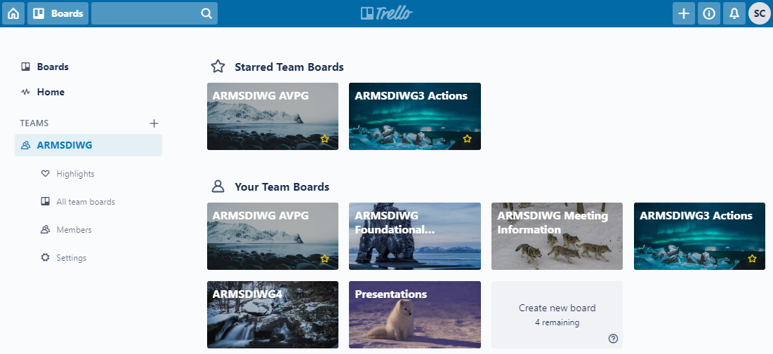
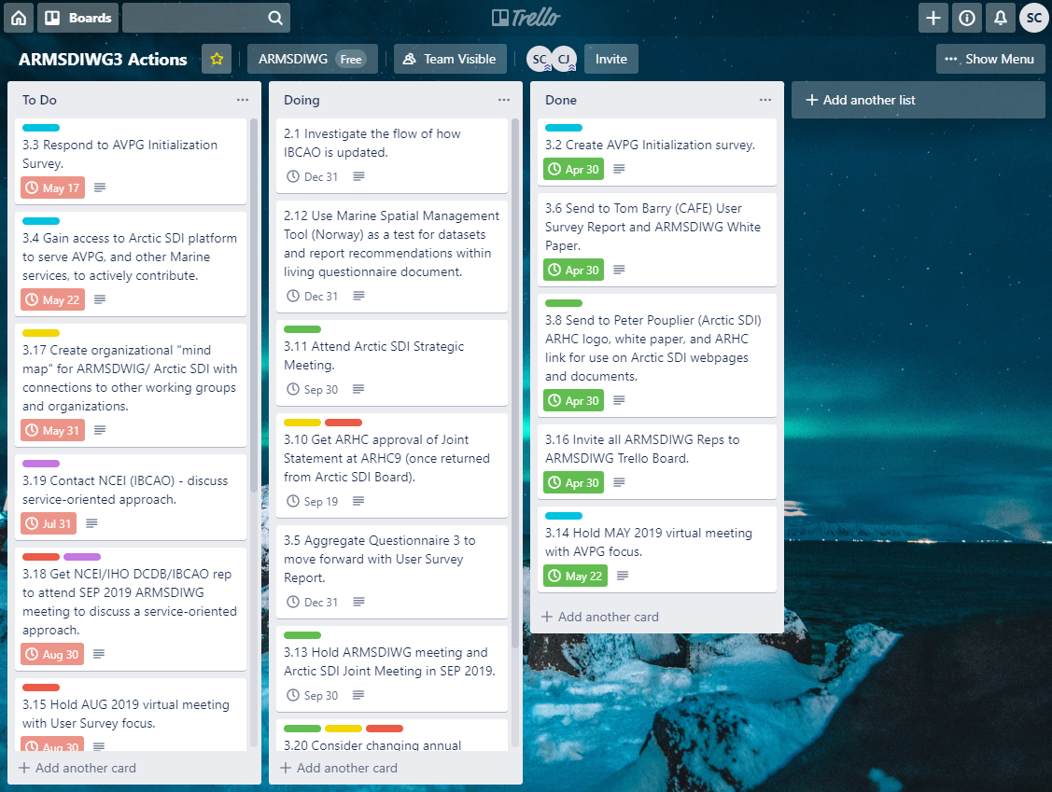
Organization of Work
Use of Trello boards as online platform to organize work.
Tracking ARMSDIWG progress on Meeting and Work Plan actions
Shared hub for communication and documents by ARMSDIWG participants.

Slide 7
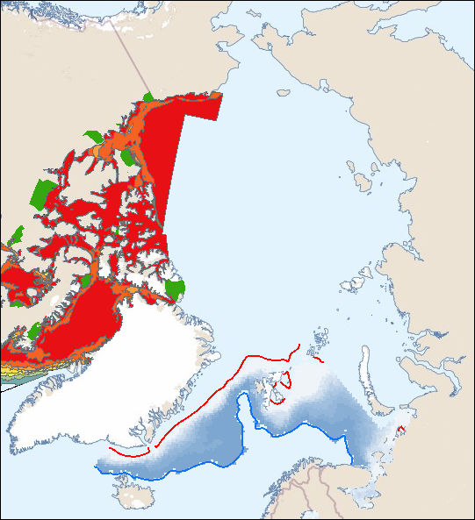
Hydrographic Office Data Reuse
Canadian Arctic Voyage Planning Guide (AVPG) web service displaying in Norway Marine Spatial Management Tool made possible by OGC WMX standards.

Slide 8
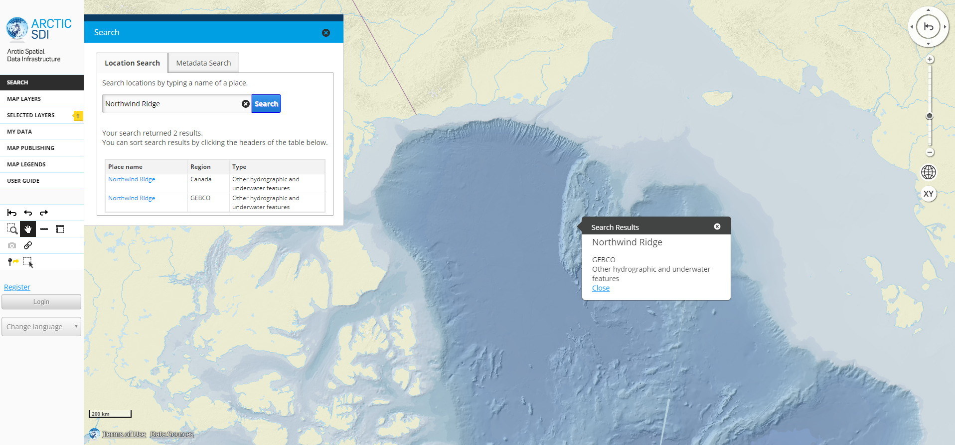
Arctic SDI & ARMSDIWG: Marine Networks Data Reuse
Arctic SDI Geoportal displaying Arctic SDI Basemap, utilizing International Bathymetric Chart of the Arctic Ocean (IBCAO), and the GEBCO Sub-Committee on Undersea Feature Names (SCUFN) digital gazetteer service of the names, generic feature type and geographic position of features on the seafloor.

Slide 9
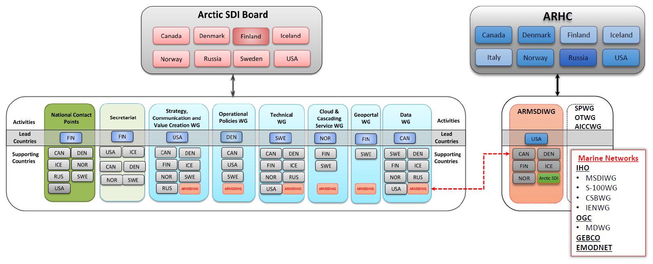
Proposed Arctic SDI & ARHC ARMSDIWG Cooperation Structure
WG-MGI

Slide 10
DRAFT Arctic SDI and ARHC Joint Statement of Intent
The Arctic Spatial Data Infrastructure cooperation (Arctic SDI), based on a Memorandum of Understanding between the National Mapping Agencies of the 8 Arctic countries, and the members of the Arctic Regional Hydrographic Commission (ARHC), maintain a collaborative partnership to provide both the terrestrial and marine foundations in a regional SDI. Together, Arctic SDI and the ARHC’s Arctic Regional Marine SDI Working Group (ARMSDIWG) will facilitate an infrastructure that connects users, across domains, to the spatial data valued to support research, planning and decision making in the Arctic.

Slide 11
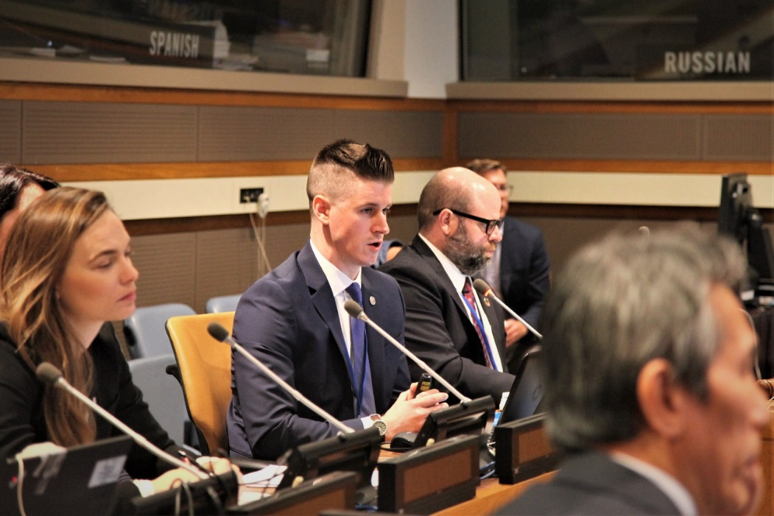
Joint Professional Outreach: ARMSDIWG and Arctic SDI
United Nations Headquarters, New York
9th Session UN-GGIM (AUG 2019)
Working Group on Marine Geospatial Information - Side Event
Panel: Readily available and accessible marine geospatial information – Regional Practices in the Arctic
Presentation: Cooperation between Arctic SDI and ARMSDIWG - access to land and marine data to face challenges in the Arctic
Working Group on Legal and Policy Frameworks for Geospatial Information Management - Side Event
Roundtable: Availability, accessibility, application, provenance, privacy and protection of geospatial information
Panel: Enabling regional collaboration and applications. Both Chairs of Arctic SDI and ARMSDIWG
Chair ARMSDIWG presenting during the panel “Readily available and accessible marine geospatial information – Regional Practices in the Arctic” at the UN-GGIM Working Group on Marine Geospatial Information Side Event – United Nations Headquarters, New York

Slide 12
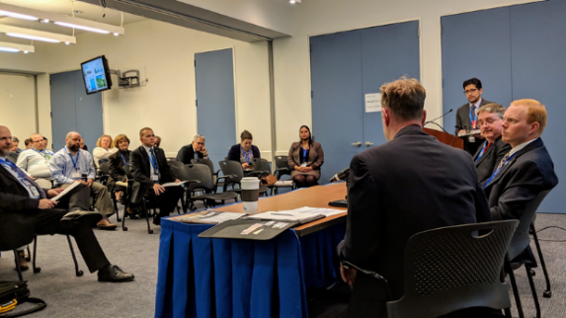
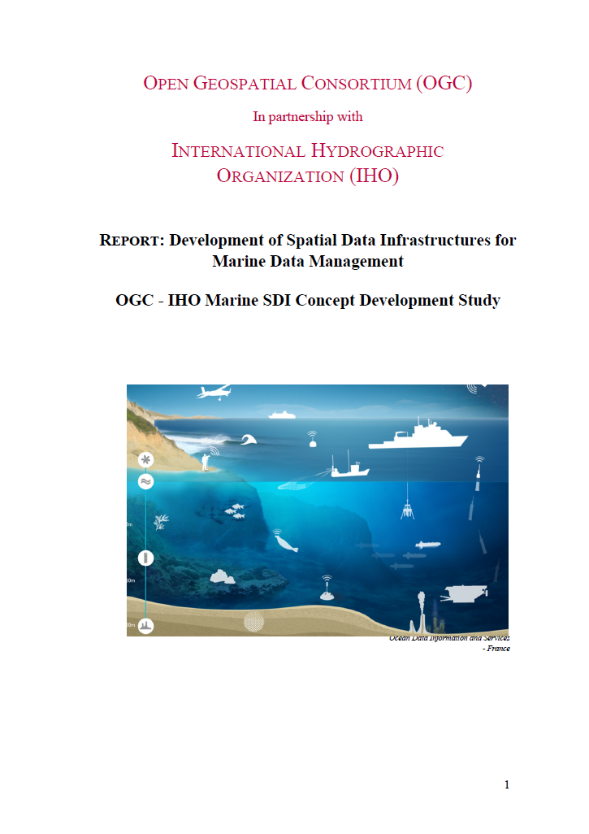
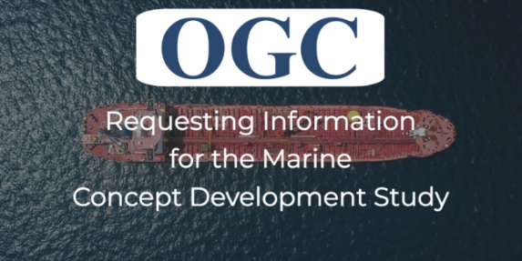
OGC-IHO Marine Spatial Data Infrastructure Concept Development Study (MSDI-CDS)
MSDI-CDS
Organized by OGC and is supported by the United States on behalf of the International Hydrographic Organization (IHO) and its MSDI focused work programs.
http://www.opengeospatial.org/projects/initiatives/msdi-cds-2018/
MSDI-CDS Workshop (23 OCT 2018)
Panels: Marine Uses of Spatial Data Infrastructures, Meeting U.S. Government Needs for Marine Spatial Data, MSDI Geospatial Technology, Standards and Services
Request For Information (RFI) (07 FEB 2018)
RFI posted on OGC’s website and distributed broadly throughout the international marine community.
MSDI-CDS Roundtable (27 MAR 2019)
Group of OGC members to review study findings and a draft of the final report.
Final Engineering Report is posted.
Development of Spatial Data Infrastructures for Marine Data Management
Direct download: https://portal.opengeospatial.org/files/?artifact_id=88037
ARHC/ARMSDIWG and Arctic SDI contributed to this report.
Notes:
Joint report furthers the collaboration and common interests of IHO and OGC, established in their Memorandum of Understanding (MOU), and contributes to the development of a foundational report for the development of MSDIs worldwide.

Slide 13
Invited Actions of ARHC
The ARHC members are invited to:
Take note of the report.
Take note of updated ARMSDIWG Work Plan provided under separate cover.
Take note of the Status of Actions since ARHC8 (Appendix A).
Request from ARHC Members and Associate Members named representatives to participate in ARMSDIWG in an effort to achieve total ARHC member organization representation.
Request from ARHC Members and Associate Members if they have a Socio-economic study or other relevant studies and best practices to feature on IHO MSDIWG Body of Knowledge (using the template).
Request from Members and Associate Members to complete the AVPG Initialization Survey by 25 OCT 2019 (survey link available from Chair/ARMSDIWG or national ARMSDIWG representative).
Approve “Arctic SDI and ARMSDIWG Joint Statement of Intent” (Appendix B).
Take action as seen appropriate.

