Slide 1
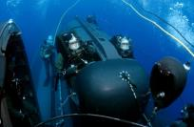
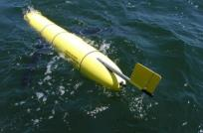
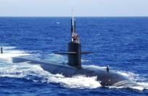
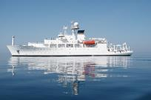
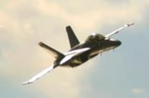
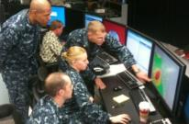
Naval Meteorology and Oceanography
Enabling the Navy to Fight and Win – Today and Tomorrow
This brief is UNCLASSIFIED

Slide 2
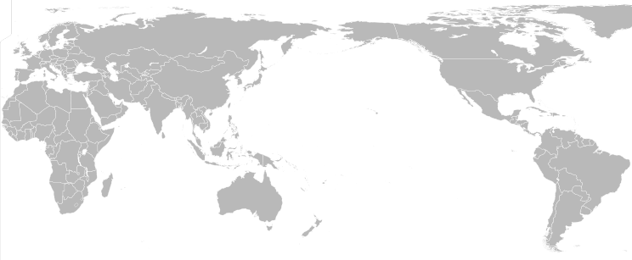
Chain of Command
CHIEF OF
NAVAL OPERATIONS
U.S. FLEET
FORCES COMMAND
NAVAL METEOROLOGY AND OCEANOGRAPHY COMMAND
NAVAL INFORMATION FORCES
OPCON
ADCON
FLEET NUMERICAL METEOROLOGY AND OCEANOGRAPHY CENTER
NAVAL OCEANOGRAPHIC OFFICE
U.S. NAVAL OBSERVATORY
NAVAL OCEANOGRAPHY OPERATIONS COMMAND
NAVAL METEOROLOGY AND OCEANOGRAPHY PROFESSIONAL DEVELOPMENT CENTER
FLEET WEATHER CENTER
NORFOLK
FLEET WEATHER CENTER
SAN DIEGO
Notes:
2

Slide 3
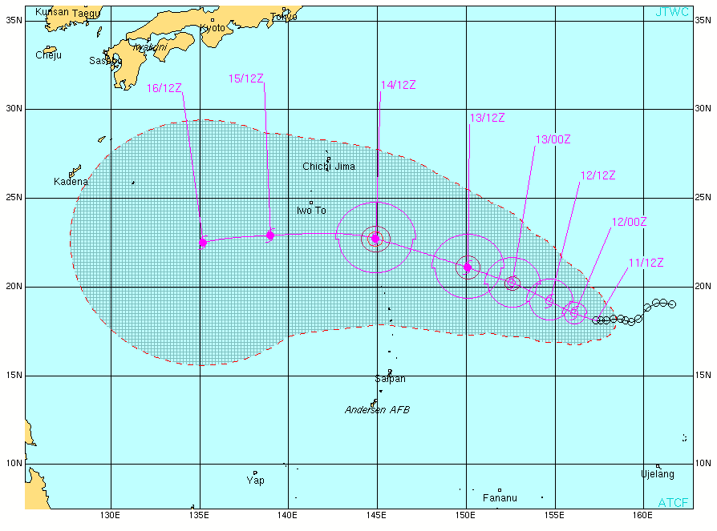
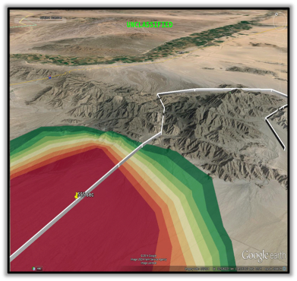
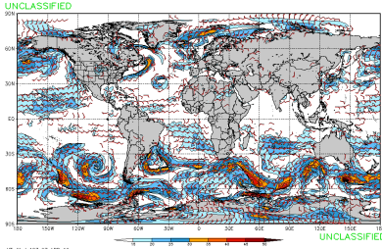
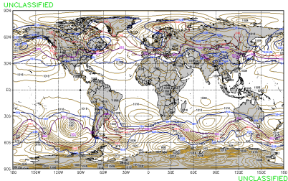
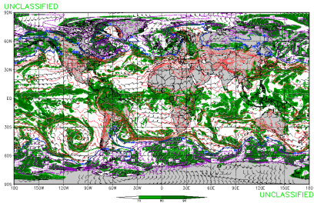
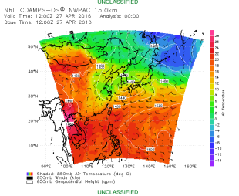
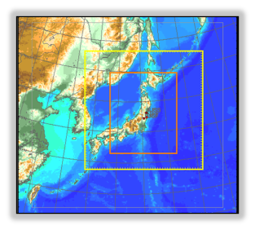
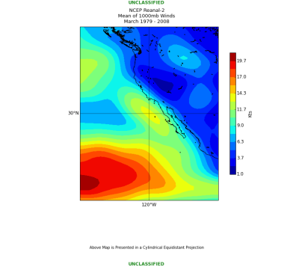
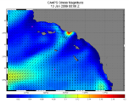
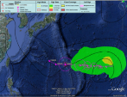
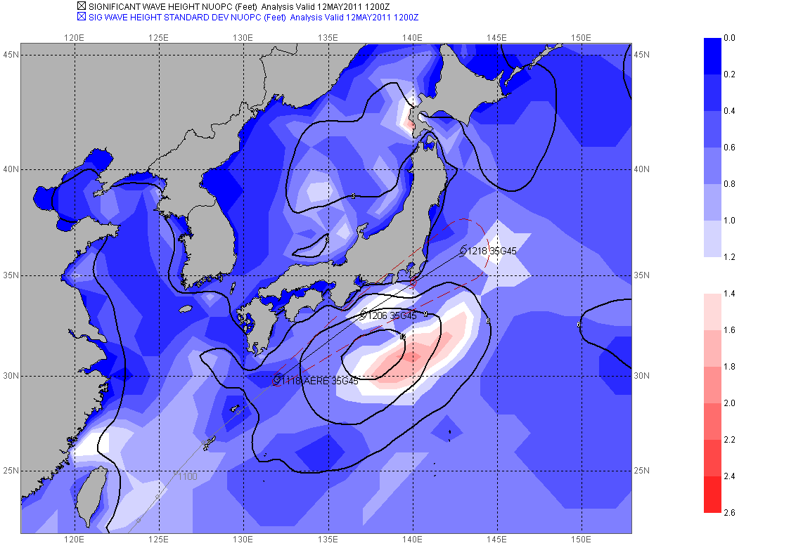
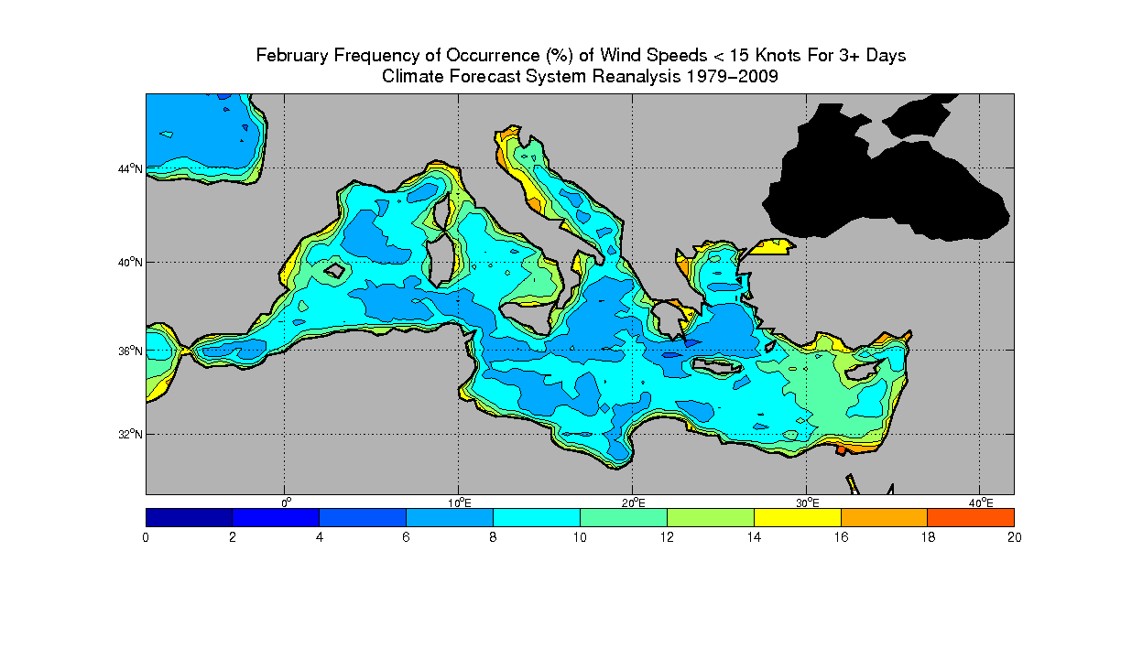
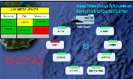
Fleet Numerical Meteorology and Oceanography Center
Global & Ensembles
Regional
State-of-the-art weather, ocean wave, aerosol models, and ensembles to quantify forecast uncertainty.
High-resolution, relocatable weather/ocean models run on-demand
5KM
1.67KM
Regional NCOM
Climate Support
Future Improved model accuracy, GI&S services, C4I System
Integration, JWICS Support to IC.
Dedicated team providing state of the science climate-related and forensic METOC support.
Notes:
3

Slide 4
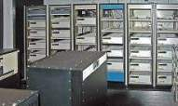
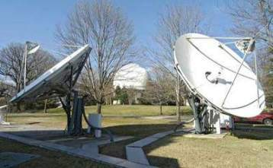
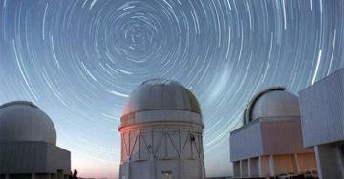
U.S. Naval Observatory (USNO)
Single DoD source for precise timing and astrometric information for:
Navigation
Targeting
Weapons guidance
Communications, etc.

Slide 5
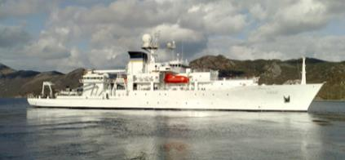
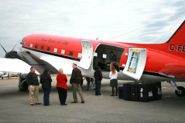
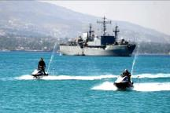
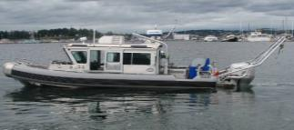
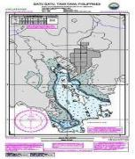
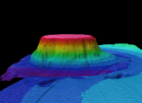
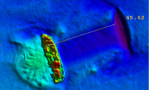
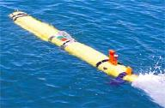
Naval Oceanographic Office
6 Multi-purpose Survey Ships
Fleet Survey Team
Airborne LIDAR Bathymetry
Autonomous Underwater Vehicles
Cooperative Hydrography
Survey operations in support of physical battlespace awareness, safety of navigation, and theater security cooperation

Slide 6
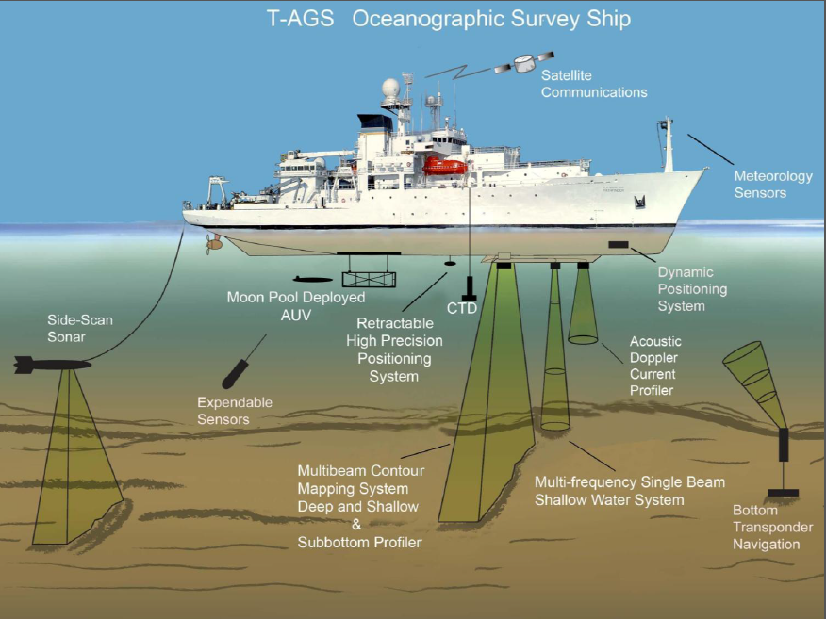
Backup
T-AGS 60/66 survey vessels
Length: 100 / 109 m
Beam: 18 m
Draft: 8 m
Displacement: 500/550 tons

Slide 7
T-AGS 60/66 survey equipment
Multibeam Echo Systems
Kongsberg EM-122
Kongsberg EM-122
Kongsberg EM-600
Kongsberg EM-710
Single Beam Echo System
Kongsberg EA-600
Sub-Bottom Profiler:
Kongsberg SBP-120
Acoustic Doppler Current Profiler
RDI/0S38
RDI/WHM 300
Side Scan Sonars
Klein 3000
Klein 5520
Klein 5900
EdgeTech 4200

Slide 8
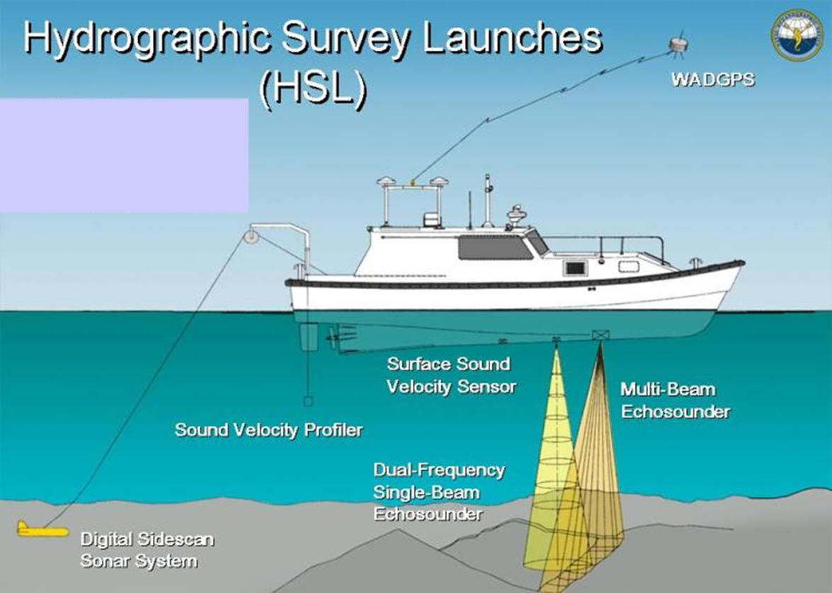
T-AGS 60/66 survey vessels
Davits for 2 HSLs on 3 T-AGS
Multibeam Echo Systems
Simrad EM-3002
Kongsberg EM 2040
Singlebeam Echo Systems
Simrad EA-502

Slide 9
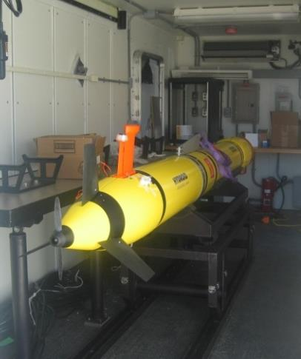
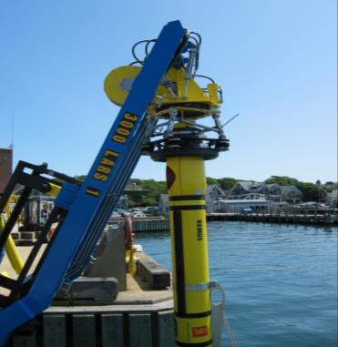
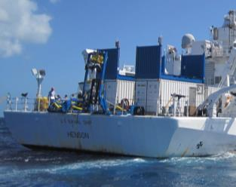
REMUS 6000 AUV

Slide 10
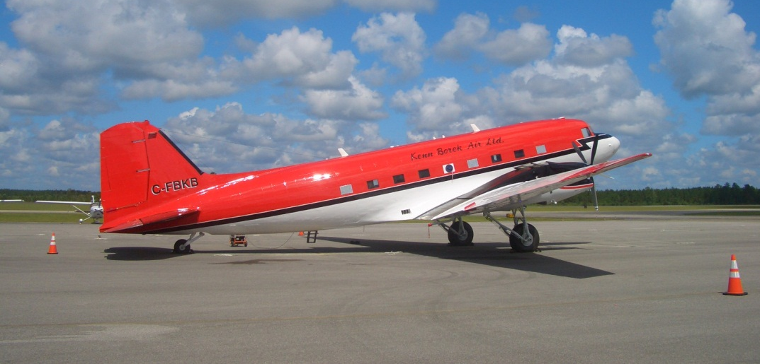
Airborne Coastal Survey (ACS)
HSL slide

Slide 11
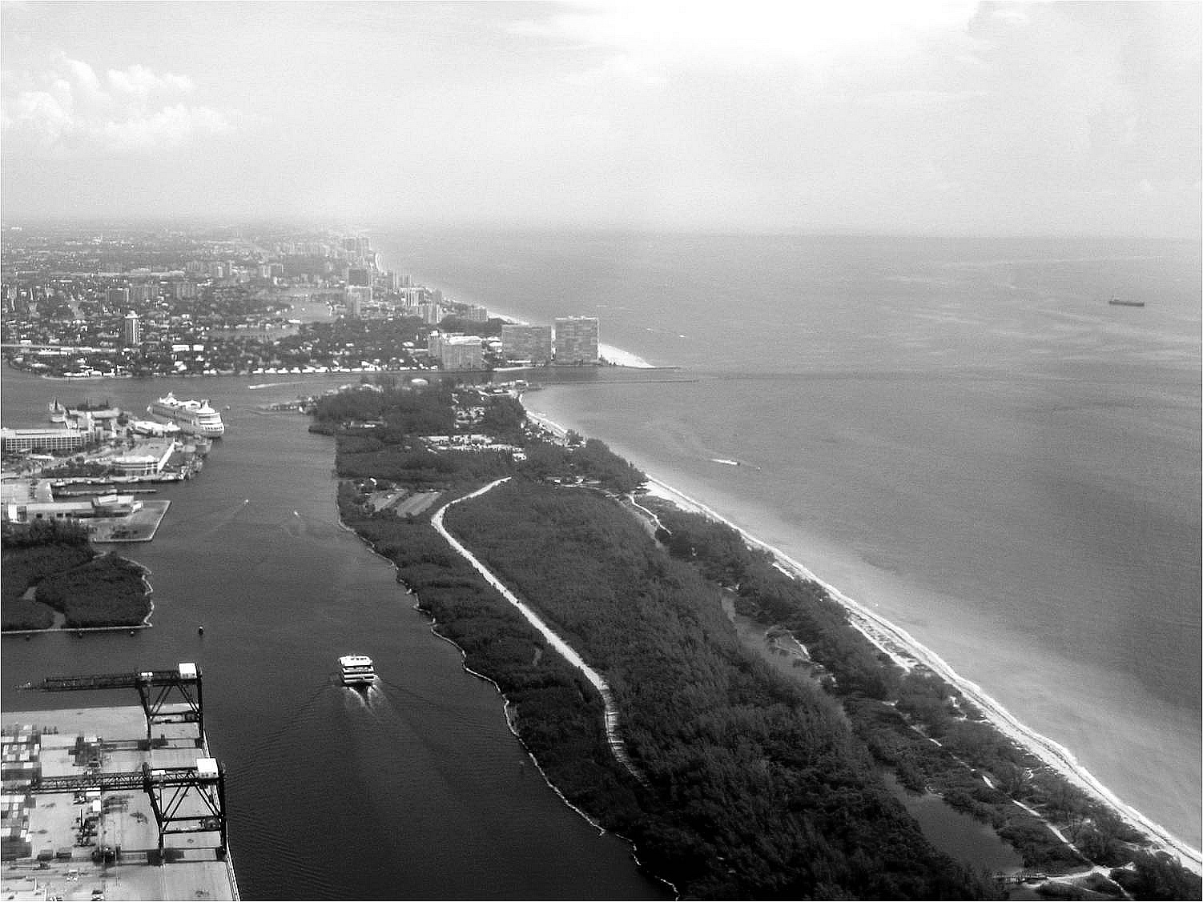
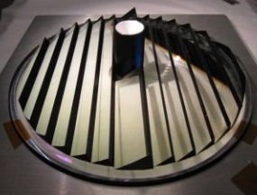
Airborne Coastal Survey (ACS)
10,000 Hz Pulse Rate (hydro / topo)
0.4 Hz / 16 MP Digital camera (~5 cm pixel)
CASI-1500 Hyperspectral Imager
1500 pixels
380 – 1050 nm wavelength
288 possible bands
IHO Order 1B Surveys capable
Shot spacing:
0.7 X 0.7 meter topo / shallow hydro
2.0 X 2.0 meter deep hydro
300 - 400 m op altitude (hydro)
300 - 1200 m op altitude (topo)
400 m
Dia: 290 m
Shorter laser pulse length and receiver response for increased accuracy, especially in shallow (<2m) water
Large field-of-view afforded by prism, and more sensitive receivers, increase signal-to-noise ratio.
Improved depth detection in shallow turbid water

Slide 12
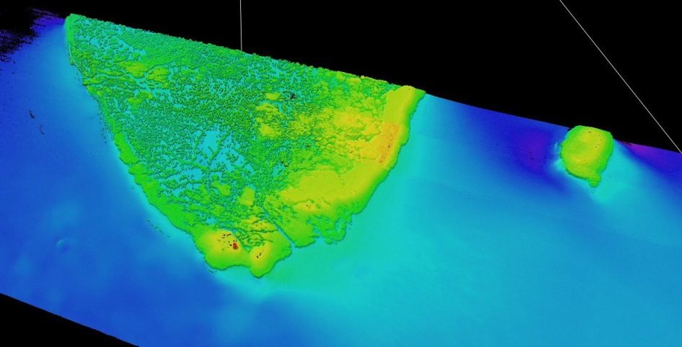
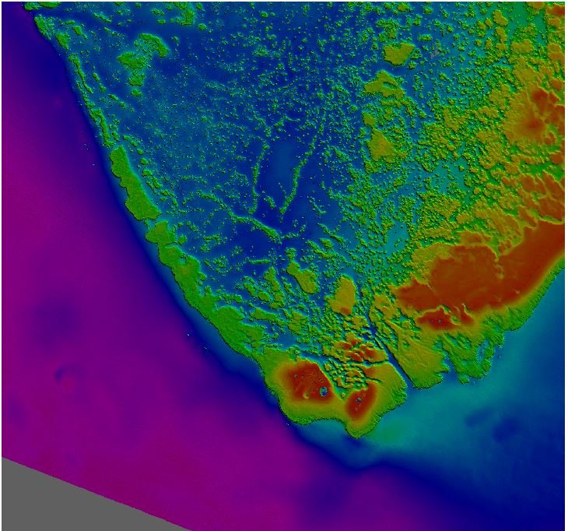
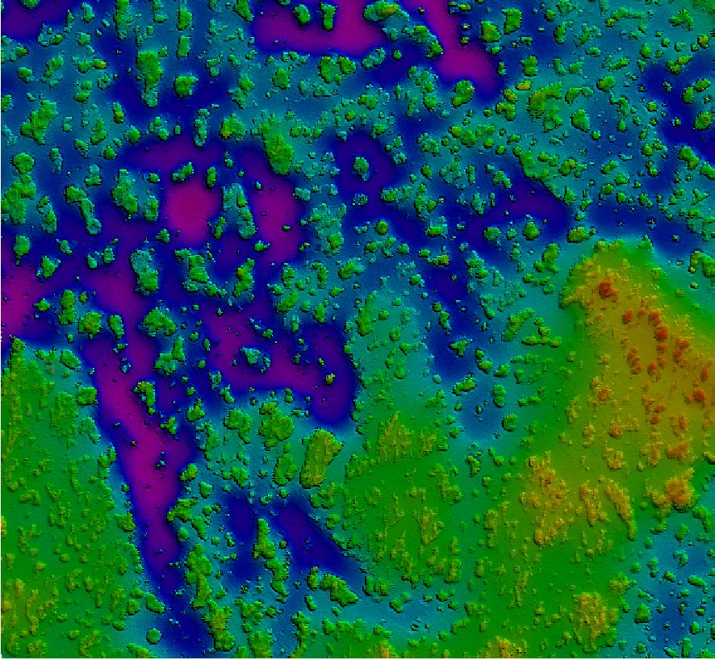
Airborne Coastal Survey (ACS)

Slide 13
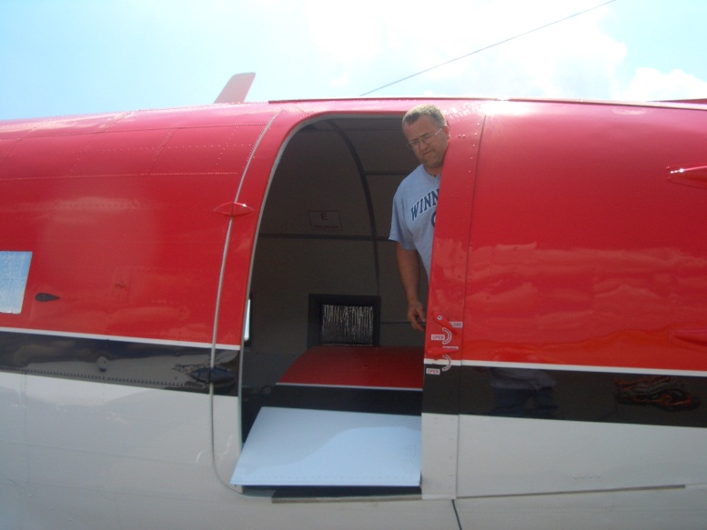
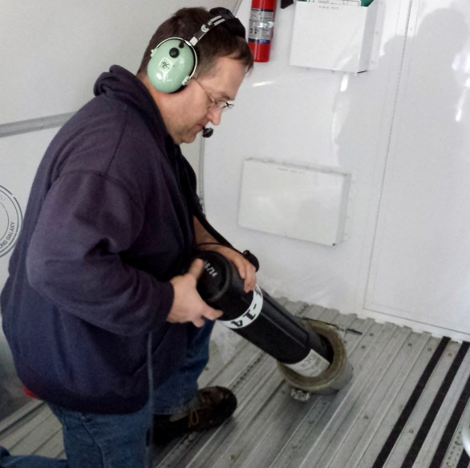
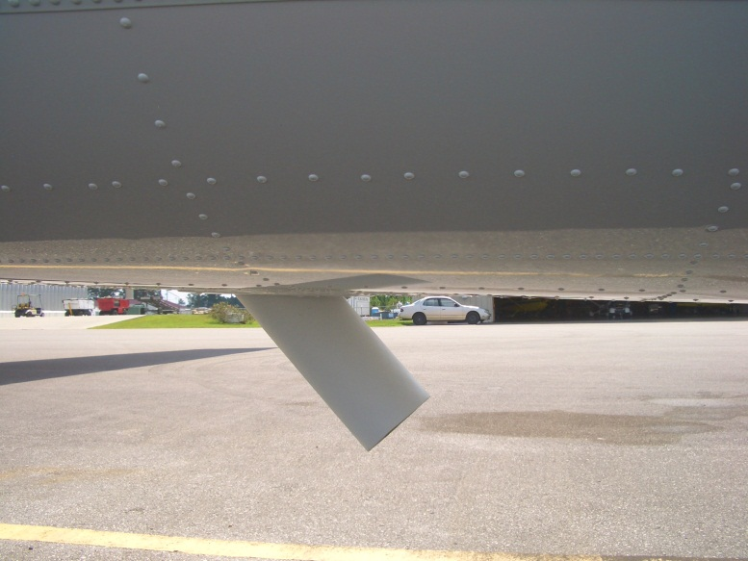
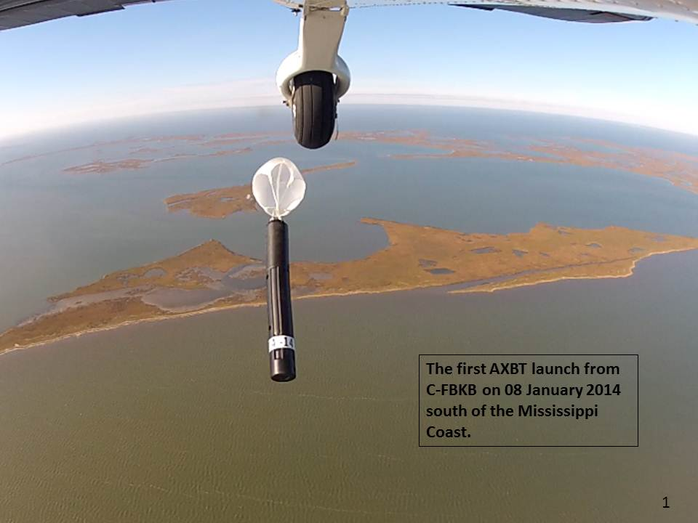
Airborne Coastal Survey (ACS)
A or B-sized sensors can be dropped via the Navy-issued sonobuoy chute installed at rear of aircraft.
Larger packages can be deployed from passenger door that hinges into aircraft during flight or via full cargo door if removed prior to flight.

Slide 14
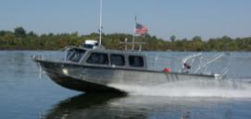
Fleet Survey Team (FST)
IHO 1A Safety of Navigation surveys
Singlebeam / multibeam bathymetry
Sidescan sonar imagery
Ancillary data (shoreline, NAVAIDS, bottom samples)
Ports, harbors, approaches
Depths ~5-200m
< 10 nm from shore
Typical footprint:
5-7 person team
1 x 9m vessel on trailer and survey equipment
Bi-lateral survey projects with host nation hydro organization (Port Auth, Navy, etc.)
All survey data and documentation provided exclusively to partner nation and NGA

Slide 15
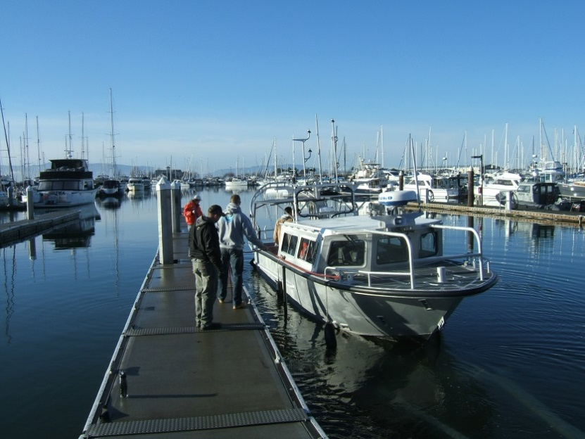
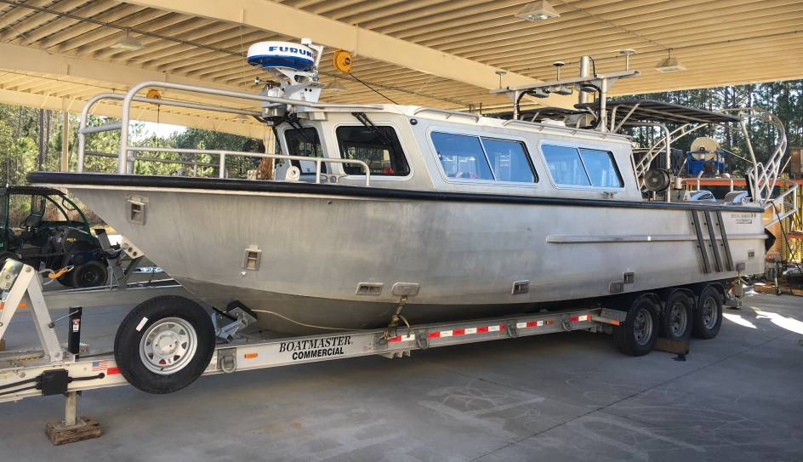
Primary Survey Assets
(2) 9-m SeaArk
(2) 9-m Work Skiff
IHO / Navigation quality survey
SBES/MBES/SSS Configurable
C-130 Transportable
Shore based operations
5-7 person team
Airlift via C-130 or larger aircraft

Slide 16
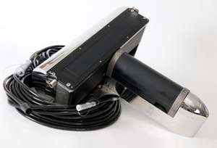
Survey Equipment
Unmanned Underwater Vehicle (UUV)
(2) IVER3
Singlebeam Echosounders
Odom CV 100 and CV200
Cee Echo
Multibeam Echosounders
R2 Sonic 2024
Reson 7125 (dual freq)
Reson 8125 (shallow water)
Reson 8101 (deep water)
Side Scan Sonars
Klein 3000
EdgeTech 4125
GPS
NAVCOM
Sensors & Measuring Devices
POS/MV v4
TSS DMS 25
Tide Gauges
IXSEA Hydrins
CTDs
ADCPs
Digibar SVP

Slide 17
Rapid Littoral Survey Assets
(4) Sea-Doo GTS
(4) Yamaha FX Cruiser
- Rapid Environmental Assessment of Littorals
- SBES/SSS Configurable
- C-130 Transportable
- Shore or ship based operations
- 4-5 person team
Notes:
17

Slide 18
NAVMETOCCOM SAIHC surveys
T-AGS
Tanzania (Dar Es Salaam)
Mozambique (Maputo)
FST
Kenya (Lamu)
ACS
Kenya (Lamu, Northern Coast)

Slide 19
NAVMETOCCOM training
International Hydrographic Applied Science Program (IHASP)
University of Southern Mississippi, John C. Stennis Space Center
1-year program (2-year option)
Masters of Science in Hydrographic Science
IHO Category “A” certification
International Hydrographic Management and Engineering Program (IHMEP)
NAVMETOCCOM Professional Development Center
6-month program
IHO Category “B” certification
SAIHC students
IHSAP: Sweden, United Kingdom
IHMEP: Denmark, Estonia, Poland, Sweden

Slide 20
Questions?

