Slide 2
MACHC16
Agenda item 7.2 - “RENC”
RENCs…what to cover?

Slide 3
Agenda
RENCs; IC-ENC and PRIMAR
IC-ENC focus on the MACHC region:
  ENC Production Support
  ENC Validation
    Why? The need for regional co-operation
    How? IC-ENC Regional Office developments
3

Slide 4
But…..
Forget the agenda!
ENC tour of the MACHC region with real life examples with the people in this room!

Slide 5
What is a RENC?
Regional ENC Co-ordinating Centre
An organisation that helps ENC producers to manufacture ENCs, and to make them available to users
Envisaged within the WEND Principles…
Why??

Slide 6
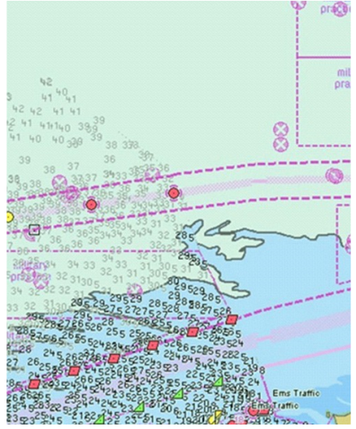
The importance of regional co-ordination…

Slide 7
IC-ENC’s Mission
  To provide services, at a low cost, to national Hydrographic Offices that ensure their ENCs are:
  compliant to the international standards,
  consistent across the global dataset,
  and readily available for use.

Slide 8
IC-ENC Core Services
ENC Production Support
ENC Validation
ENC Distribution
Revenue Management & Financial Reporting
8

Slide 9
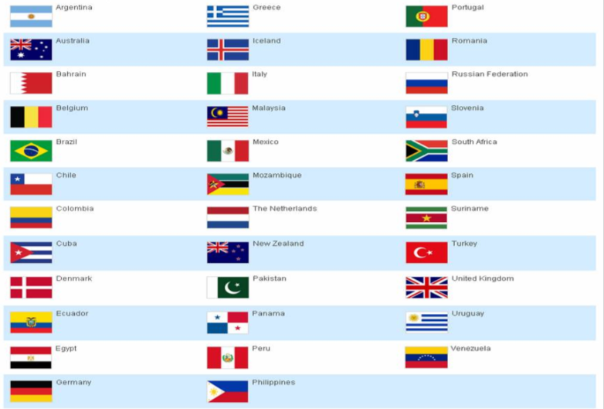

IC-ENC Members
Oman
Israel
9

Slide 10
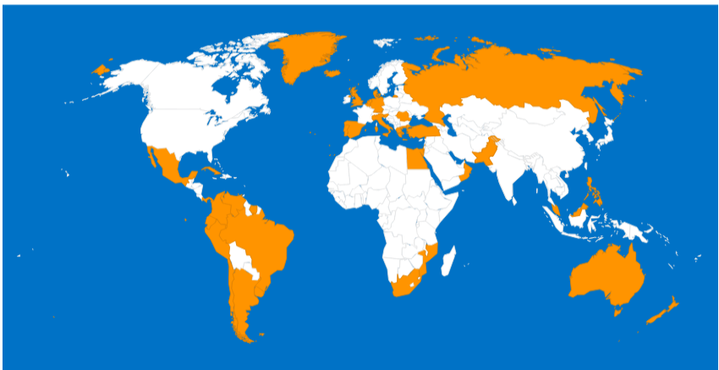
Membership & Offices
Introduction to IC-ENC
10

Slide 11
Around the room today…

Slide 12



Production Support: IC-ENC ENC Validation Training Course
2 weeks duration
3 training courses in 2015
  UK, Australia, Panama
  46 delegates from 29 HOs
Budget approval for three
more during 2016

Slide 13

The Latin American course…September 2015

Slide 14
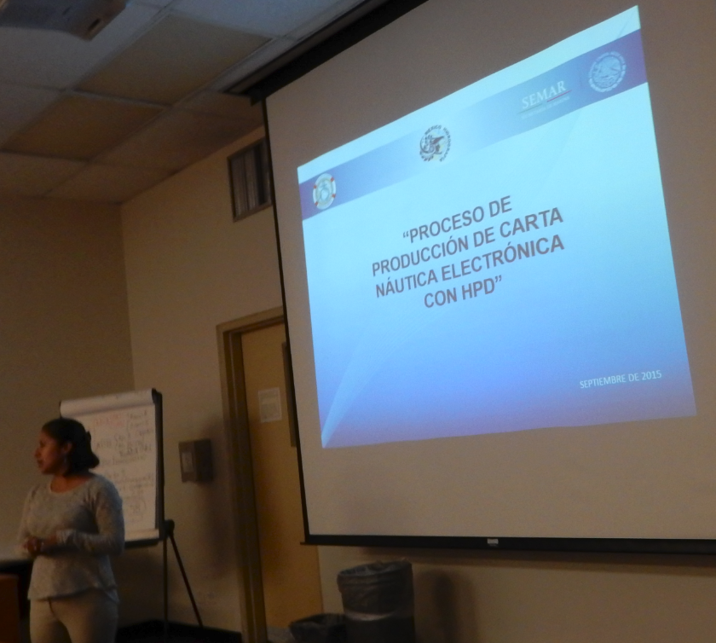

Supported by SEMAR…

Slide 15
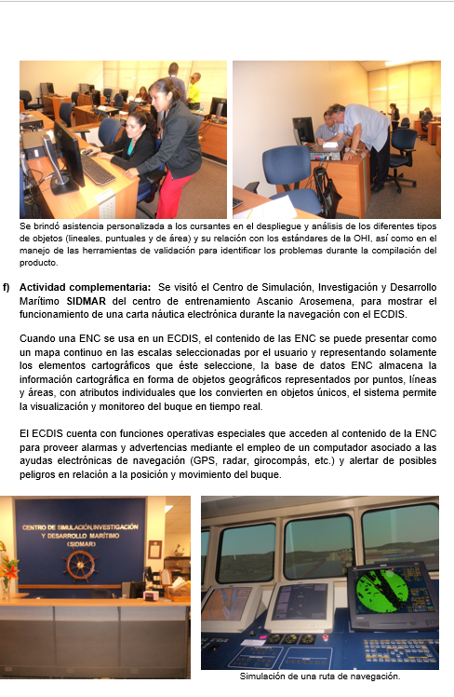
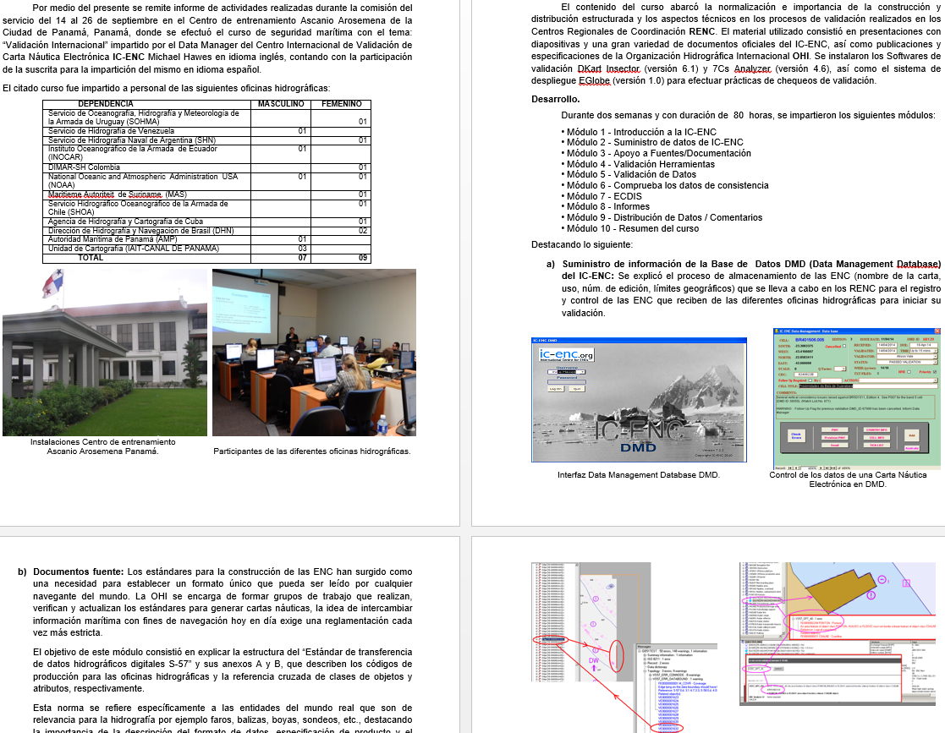
SEMAR report: MACHC16-07.2B

Slide 16
IC-ENC Regional Offices
Production Support and Validation Services
  Regional knowledge and considerations
  Training and production support base in the region
  Communication advantages
    Time Zone
    Languages: English, Spanish, Portuguese
IC-ENC operations are structured on central (UK-based) systems and processes: training, technology, quality management
Why is regional co-ordination important?

Slide 17

IC-ENC Latin America: Project Team

Slide 18

IC-ENC Latin America - Validators

Slide 19


Training in the UK office…
Stage 1 training completes today!

Slide 20
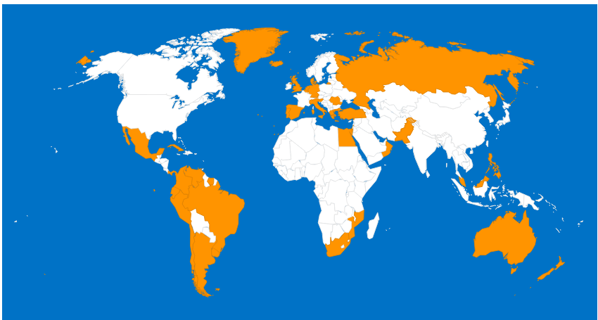
US: New Member & New IC-ENC Regional Office
Introduction to IC-ENC
20

Slide 21
Summary
IC-ENC is nearly 40 Member HOs, 6000 ENCs
Finalisation of the US membership will bring this total to about 7000…half of the world’s ENCs
Very strong membership in the MACHC region…gives even more advantages, including a new regional presence (2016)
Critical mass reached, giving significant economies of scale
21

Slide 22
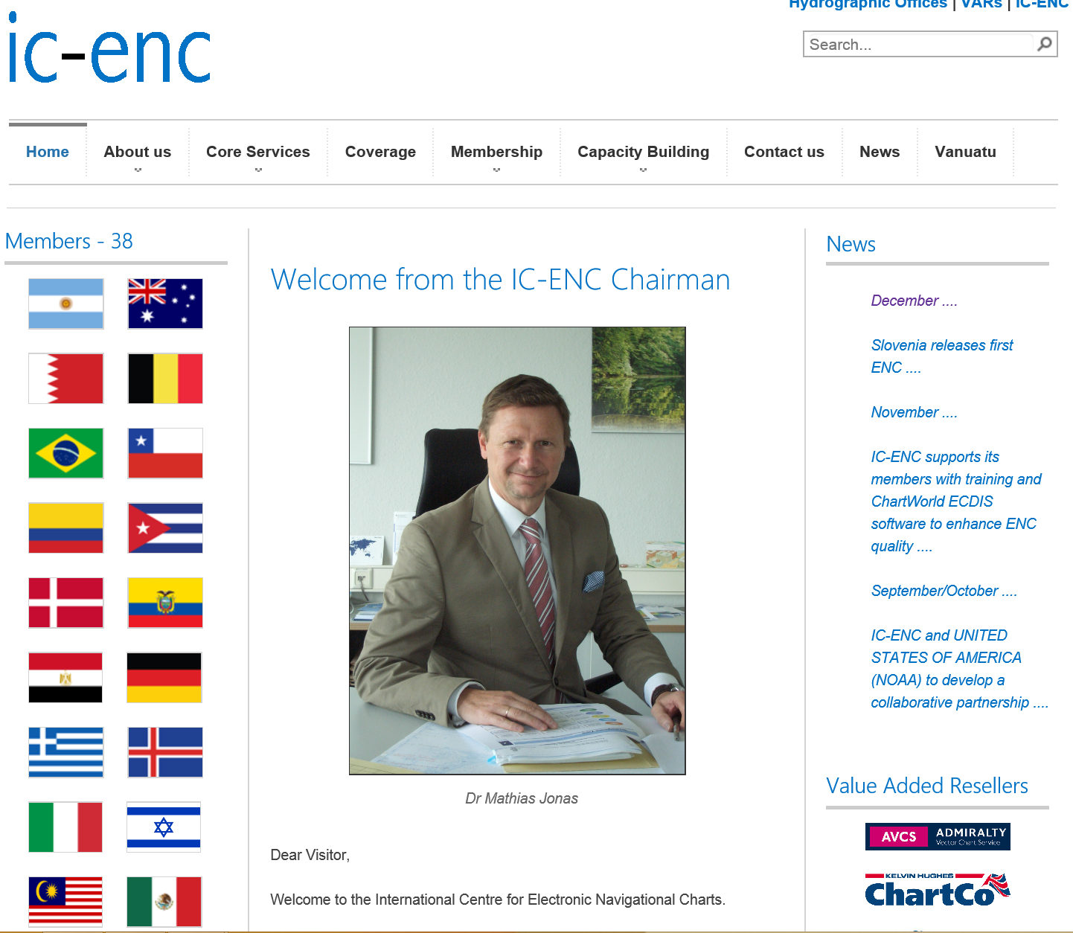
www.ic-enc.org

Slide 23
Introduction to IC-ENC
23

