Slide 1

Hydrographic Certification in Canada
Derrick R. Peyton, P.Eng
IIC Technologies Inc

Slide 2
Overview
Overview of IBSC Cat A & B … S5 & S8 Program
Recognition of Individual Hydrographic Surveyors
Canadian Certification Scheme
Case Studies
Papua New Guinea
New Zealand
Brazil
Summary

Slide 3

IBSC Cat A & Cat B Overview
Category A
S5 (Hydrographic Operations)
S8 (Nautical Cartography)
Category B
S5 (Hydrographic Operations)
S8 (Nautical Cartography)
S8 (Nautical Cartography)
Portable: Deliverable at customer site
(Marine Geospatial Information Program)

Slide 4
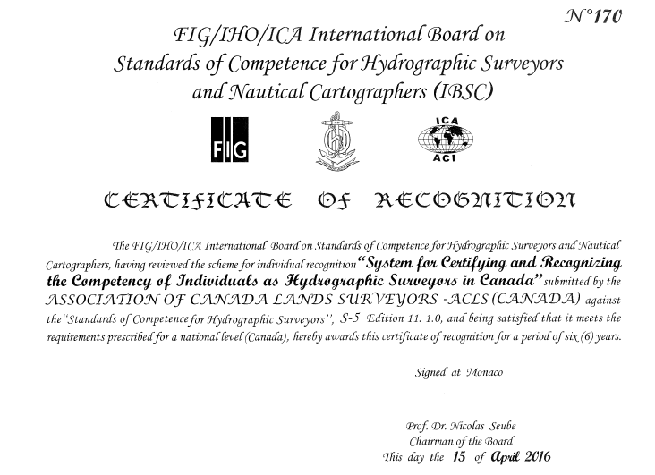
Certificate of Recognition

Slide 5
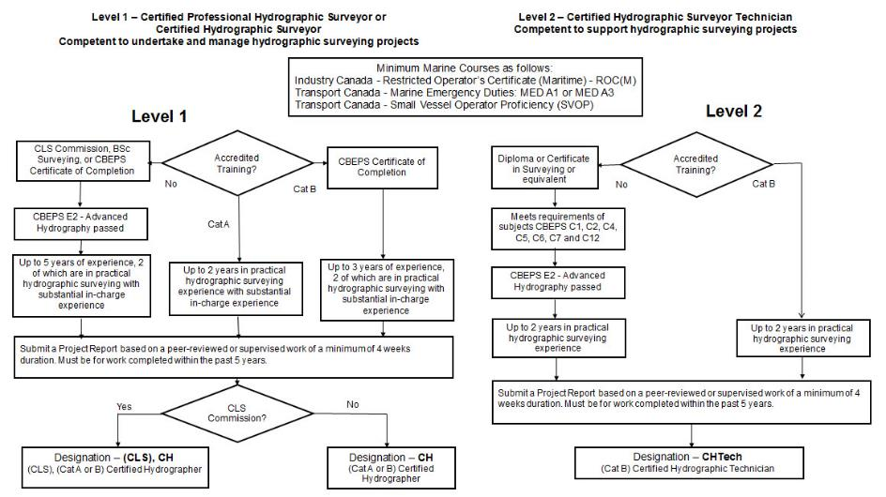
Certification Scheme for Individuals

Slide 6

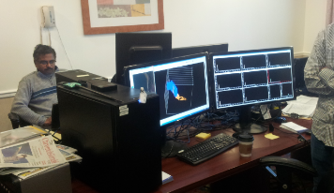
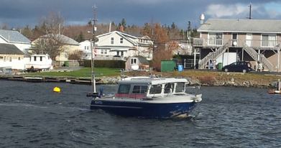
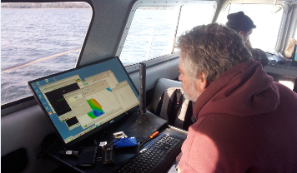
Continuous Professional Development
In all cases mandatory CPD required:
  Focused on hydrographic and/or offshore surveying.
  45 hours over 3 calender years.
  Minimum of 5 hours per year of formal Courses and Seminars.

Slide 7
Canadian Hydrographic Surveyor
Certification Panel.
Denis Hains | CHS (Permanent Position) | Government Hydrographic Surveys
Dr. Jonathan Beaudoin | Industry | Academia, Industry
Dr. David Dodd | Industry | Academia, Industry
Julian Goodyear | Private Consultant | Government, Hydrography, Seafarer
Robert Lyall | Industry | Legal Surveys
Andre Roy | Marine Institute (Cat B S5) | Academia
Richard Sanfacon | Industry | Government Hydrographic Surveys
Dr. Ian Church | University of New Brunswick Academia
Dr. Jose M'Bala | Natural Resources Canada | Legal Surveys, Oil and Gas Surveys
David Matthews | Public Works Canada | Ports and Harbours

Slide 8
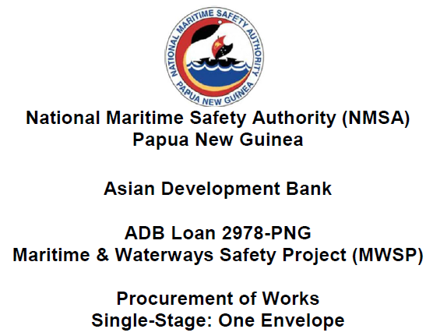
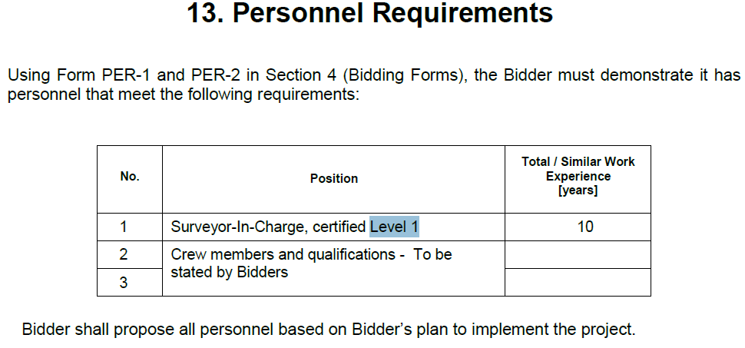
Papua New Guinea $13M

Slide 9


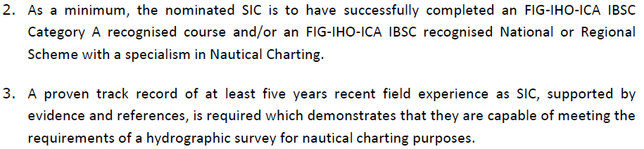

Slide 10

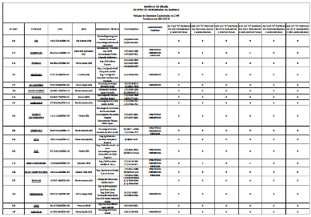
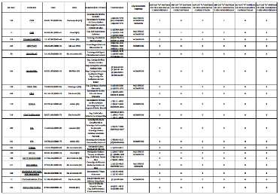
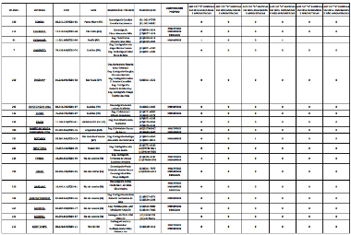
80+ Registered Companies
Brazil

Slide 11
Take Home Message
Education and Training should be accompanied by work experience under a mentor
To provide assurances to clients that companies, and individuals, have hydrographic competencies and provide quality of work, as well as provide career paths for aspiring hydrographers, the IHO IBSC has facilitated
recognition of Cat A and B academic programs for S5 and S8
recognition of schemes for the certification of individual hydrographic surveyors
Regions are adopting this approach therefore forming a commonality amongst regions and thus facilitating labour mobility.
Way Forward
Approach SSSI of Australia for possible collaboration
Query from the UK Hydrographic Society about this approach

Slide 12
