Slide 1
Report of the Hydrographic Services and Standards Committee (HSSC9)
DIRECTORATE OF HYDROGRAPHY AND NAVIGATION/BR AGENDA ITEM 2.3 / DOC MACHC 18-02.3
Meso-American - Caribbean Sea Hydrographic Commission (MACHC)

Slide 2
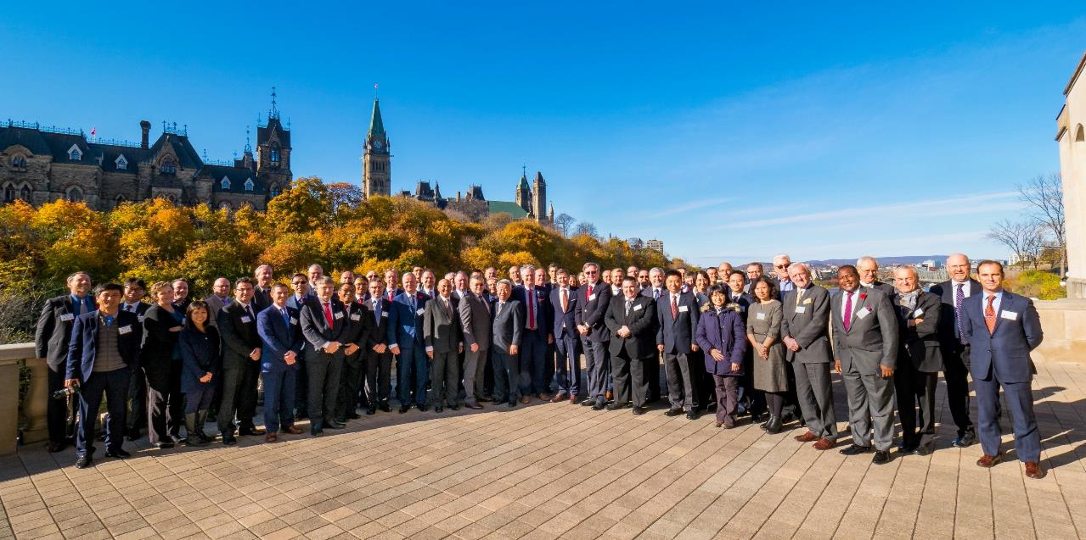
Principal activities and achievements

Slide 3
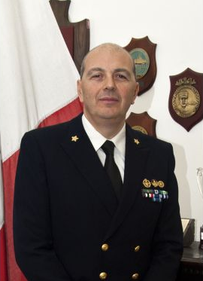
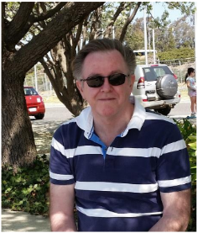
Principal activities and achievements
Election for HSSC Chair and Vice-Chair:
Nominations were: For the position of Chair: Captain Luigi Sinapi (Italy). For the position of Vice-Chair: Captain Ayodeji Olumide Olugbode (Nigeria), Mr. Mike Prince (Australia) and Mr. Louis Maltais (Canada).

Slide 4
Principal activities and achievements
S-100 Working Group (S-100WG):
Month/Year | Action | Notes
April 2018 | Final Consideration of proposals for the next edition of S-100 | S100WG3
May 2018 | Notification to HSSC10 of a new edition of S-100
Early 2019 | Publication of next edition of S-100 | Edition 4.0.0 (have proposals that extend S-100)
March/April 2020 | Final Consideration of proposal for next edition
May 2020 | Notification to HSSC12 of a new edition of S-100
Early 2021 | Publication of the next edition of S-100

Slide 5
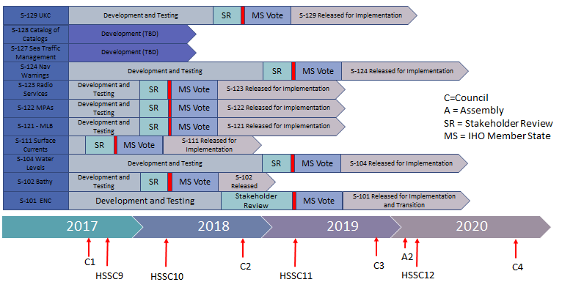
Principal activities and achievements
S-100WG:

Slide 6
Principal activities and achievements
ENC Standards Maintenance Working Group (ENCWG):
S-52 Specifications for Chart Content and Display Aspects of ECDIS ed. 4.0.2, published July 2017 / S-58 ENC Validation Checks ed. 6, published May 2017 / S-64 Test Data Sets (TDS) for Electronic Chart and Display Information System (ECDIS) ed. 3.0.2, published July 2017 / S-65 Test Data Sets (TDS) for Electronic Chart and Display Information System (ECDIS) ed. 2.1.0, published May 2017. Seeking approval: S-57 Use of the Object Catalogue, ed. 4.1.0 (CL 61/2017), S-66 Facts about Electronic Charts and Carriage Requirements, ed. 1.1 (CL 60/2017).

Slide 7
Principal activities and achievements
ENCWG:
Development of Bathymetric ENC: the integration of high-density bathymetry into electronic navigational charts (ENCs) has become a major issue (users requirement). For this purpose, after acquiring, cleaning and modelling the hydrographic survey data, contours at metre (or sub-metre) intervals are generated. The contouring results are then converted into S-57 (the IHO exchange format for ENCs) and encoded accordingly. The next step is the definition and attribution of depth areas, i.e. areas enclosed by adjacent contour lines. The result is a sort of electronic fair-sheet containing bathymetric data in S-57 format.

Slide 8
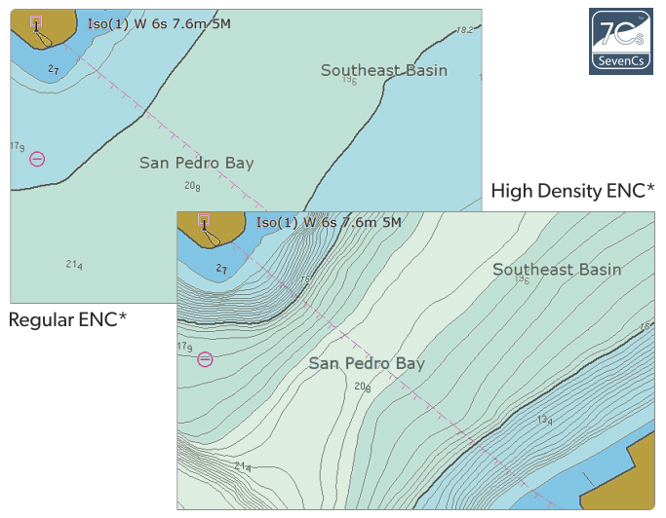
Principal activities and achievements
ENCWG:
Discussion over the issue of S-57 ENC Prod Spec could support HR bathymetry. Further investigation needed.

Slide 9
Principal activities and achievements
Nautical Cartography WG (NCWG):
Maintain and extend S-4, Development of new (and revised) symbology. Edition 4.7.0 published, July 2017.
Future of the paper chart.
Maintain and extend S-11 Part A - Guidance for the Preparation and Maintenance of International (INT) Chart and ENC Schemes:
Edition 3.0.0 published, June 2017
Edition 3.1.0 ready for MS approval (CL 59/2017) [B4]
Introduces the ’Basic quality assurance check-list for review of INT charts’

Slide 10
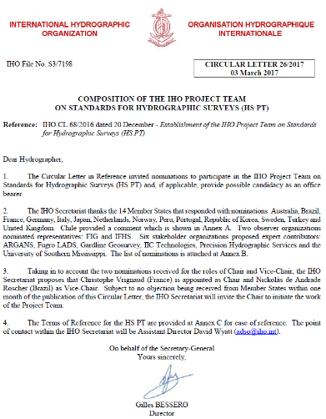
Principal activities and achievements
Hydrographic Surveys Project Team (HSPT):
Circular Letter 26/2017 March 2017: HSPT is tasked by the IHO HSSC “…review the existing edition (5th) of the IHO publication S-44 Standards for Hydrographic Surveys, identify deficiencies…” and “…when undertaking this task, to consider, as a minimum,…” the need to prepare a draft for the 6th ed. “…in support of safety of navigation data products and services…” (HSPT TORs).
44 members (16 States + Observers + Expert Contributors + IHO)

Slide 11
Principal activities and achievements
HSPT: discussions about S-44 limitations:
Does the S-44 have to deal exclusively with safety of navigation or take into account other hydrographic needs?
Questionnaire (available at IHO homepage until end NOV): designed to gauge the views of S-44 users, stakeholders and the wider hydrographic community on a range of topics. By 8th November → 251 replies (62% involved in Navigation and Charting sector).

Slide 12
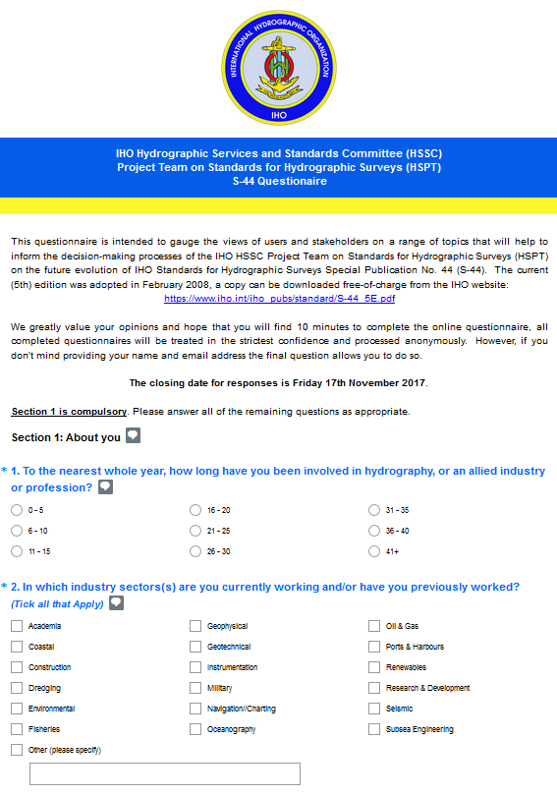
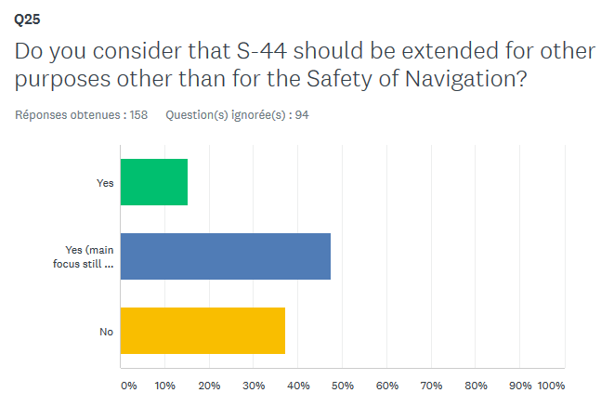
Principal activities and achievements
HSPT:

Slide 13
Principal activities and achievements
Crowd Sourcing Bathymetry (CSBWG):
Draft edition 1.0.0 of B-12 - IHO Guidance Document on CSB - available on IHO website for review and comments. MS, observers and stakeholders are invited to review/provide comments on CL 49/17 to IHO Secretariat by 24 Nov2017.
International Cable Protection Committee (ICPC):
ICPC supports the principle of CSB collected as part of cable route surveys. However, bathymetric data collected during a cable route survey is a proprietary information and requires the consent of the cable owner for it to be included in a crowd sourced data set (jurisdictional waters → HO). Opinions during last ICPC Plenary indicates that some cable owners would approve the release of data after cable installation.

Slide 14
Future work programme
Improvement on S-11 Part B (KHOA/IHO):
Base map for Polar regions (Artic & Antarctic)
ENC scheme management procedures (S-11)
Additional layers for 500 world ports and AIS traffic information
Connection between IHO ENC catalogue and INToGIS systems
Improve the chart display functions
User Feedbacks from HO, regional coordinator
And other improvements …
Tests will be conducted until JAN2018. Operational: early 2018.

Slide 15
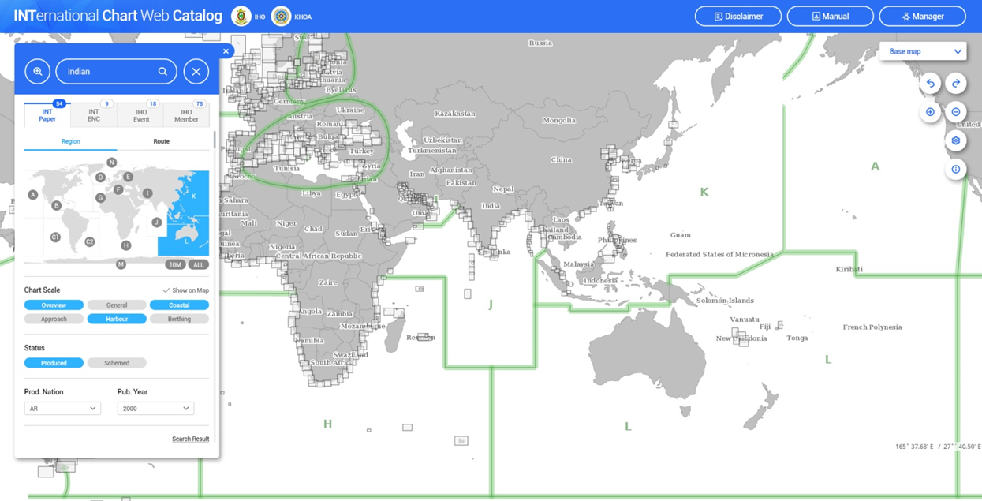

Slide 16
Future work programme
Next HSSC subsidiary WG meetings:

Slide 17
Future work programme
Next HSSC meetings:
HSSC-10 (2018, Rostock, Germany)
HSSC-11 (2019, Cape Town, South Africa)
HSSC-12 (2020, Taunton, UK ).

Slide 18
Action requested of MACHC
Note this report;
Encourage Member States to participate in HSSC meetings;
Encourage Member States to participate in HSSC subsidiary WG.

