Slide 1
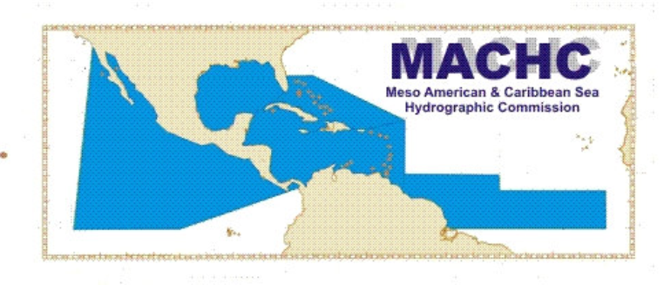
18th MACHC Conference
National report of the Kingdom of the Netherlands
Captain Marc van der Donck
Director Netherlands Hydrographic Office
November/December 2017

Slide 2
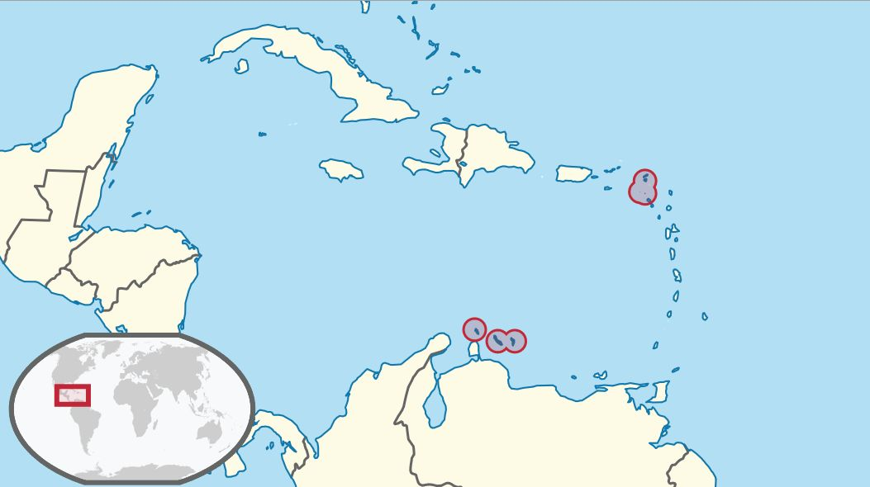
A quick recap: responsibilities of NLHO in Caribbean
windward islands
leeward islands

Slide 3
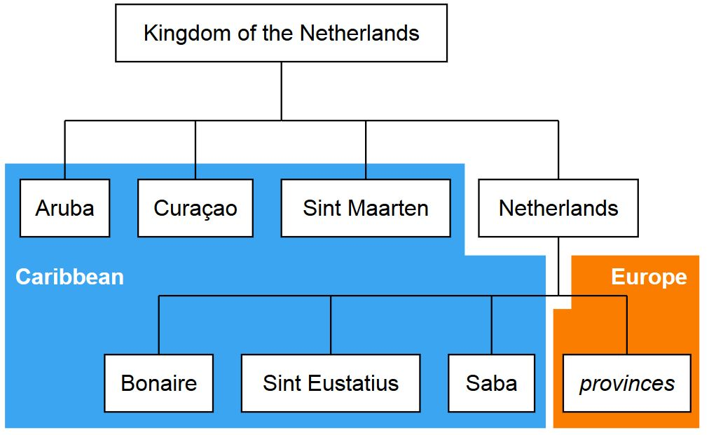
A quick recap: responsibilities of NLHO in Caribbean
leeward islands
windward islands

Slide 4
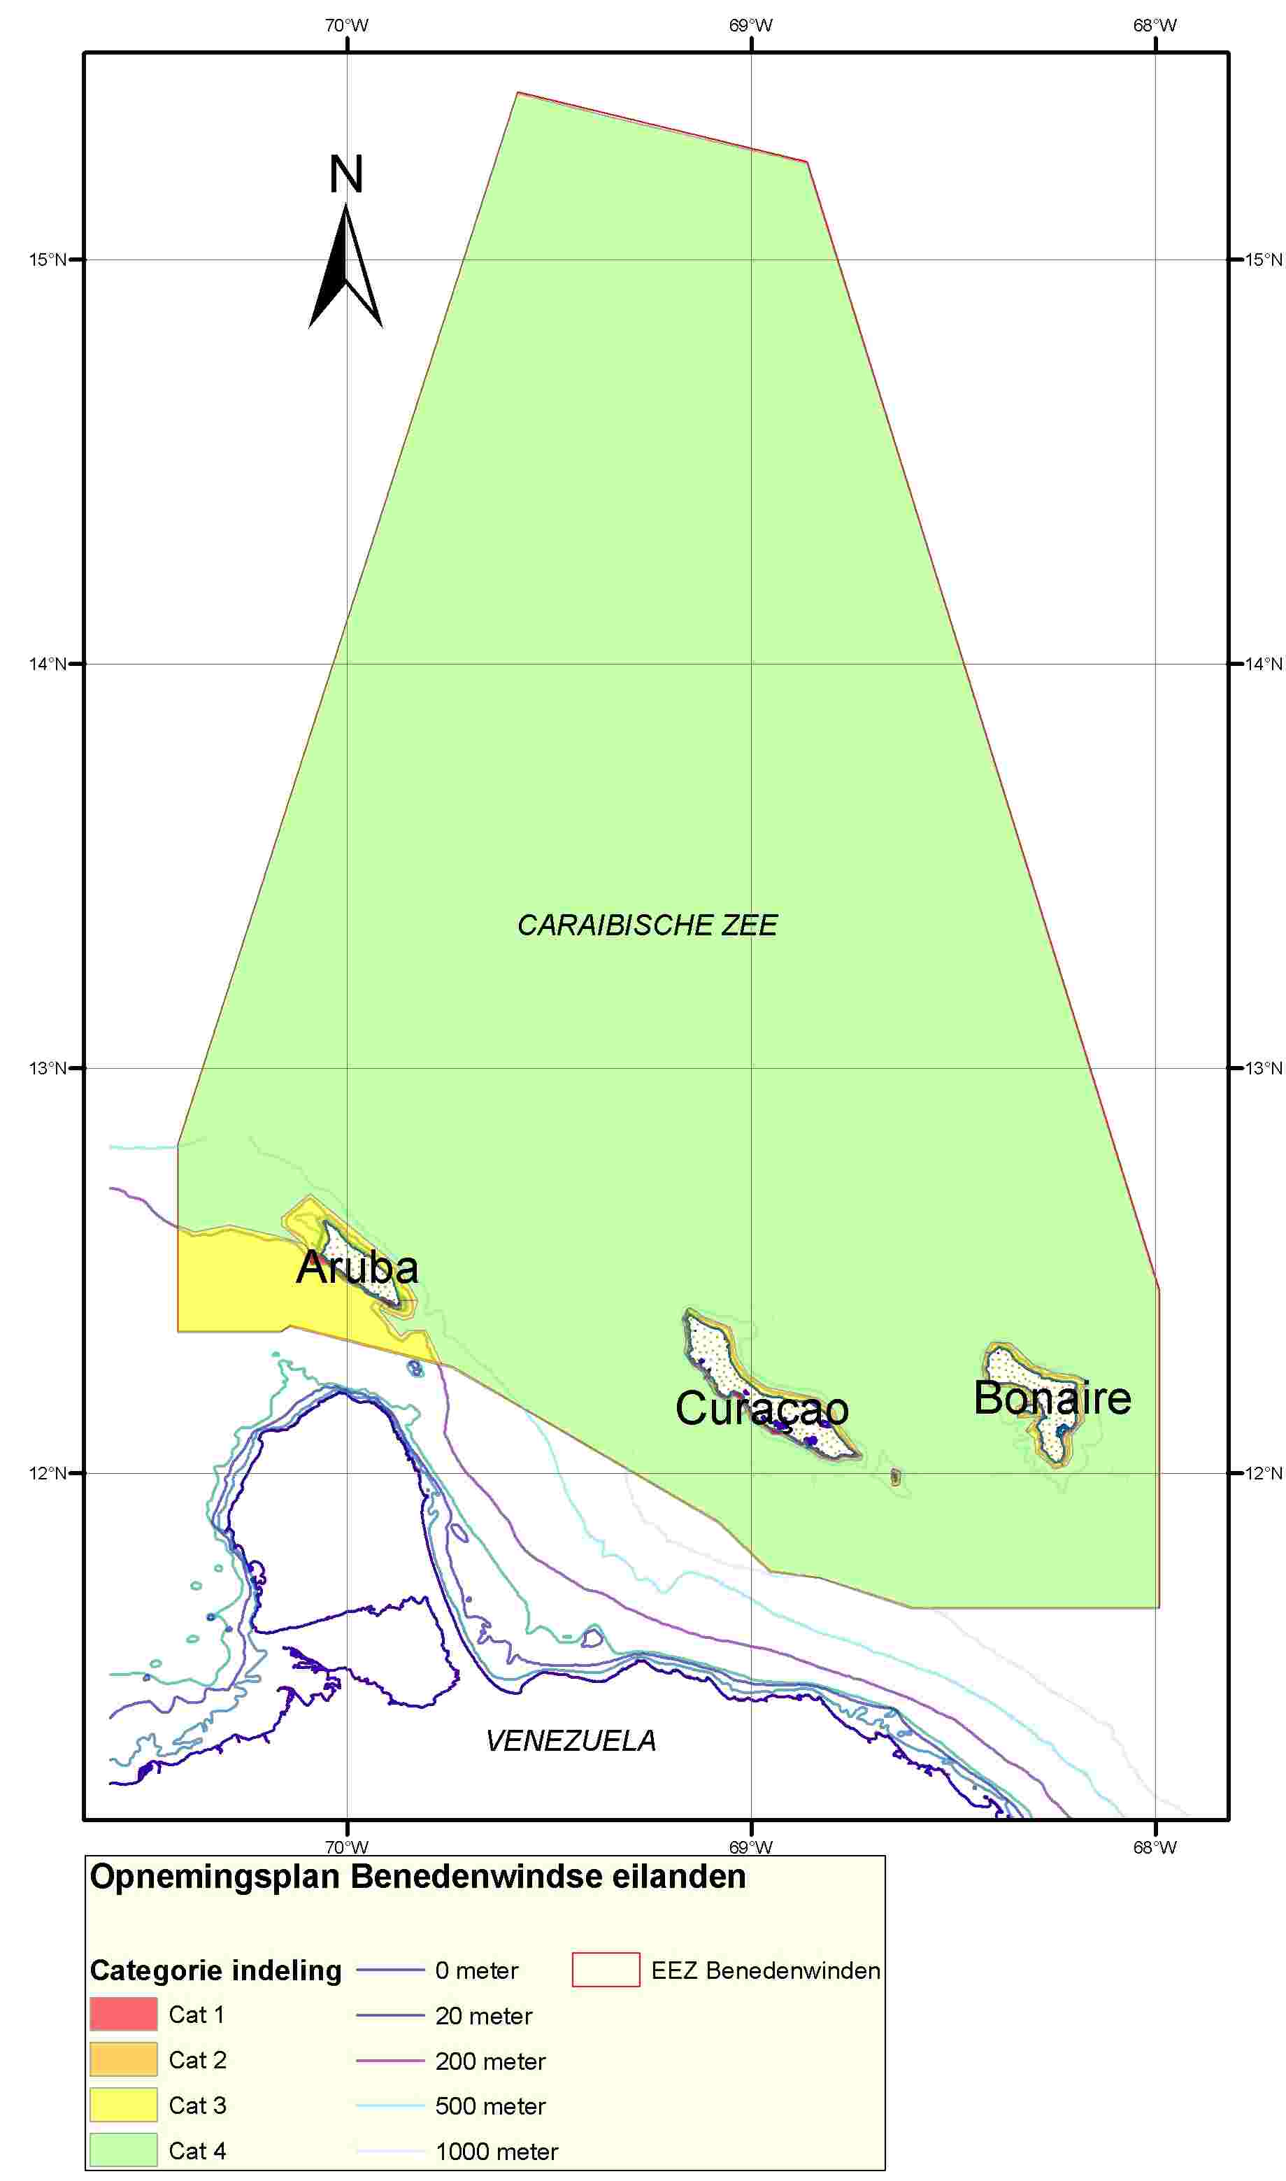
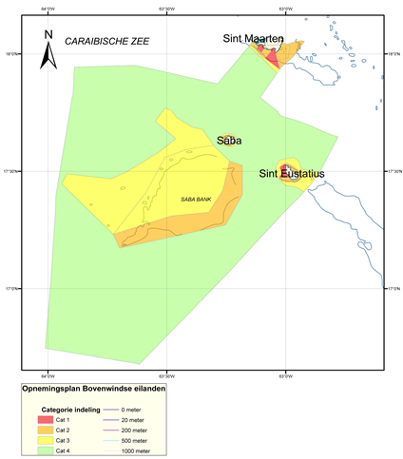
(Re) survey policy
C-55
No change
Resurvey frequencies:
4 years (Cat.1)
12 years (Cat. 2)
24 years (Cat. 3)
50 years (Cat. 4)

Slide 5
New Charts and updates
Full ENC coverage for all appropriate usage bands.
As of August 2017, Venezuela has produced own Cells VE300100 and VE300200.
Cell NL302023 has been clipped accordingly

Slide 6
MSDI Progress
INSPIRE in Caribbean sea
INSPIRE-compliant web services for:
gridded bathymetric data and
geographic names
Start additional INSPIRE web services for:
administrative units (maritime zones) and
area management (PSSA Sababank)
See the National Report for the URLs
All NL ENC’s for the Caribbean sea are available for online viewing in the MACHC on line application

Slide 7
Other Activities: General
Participated in 1th IHO Council as elected member from the MACHC
Details in separate briefing
NL became a member of the UN-GGIM WG-MGI
DNLHO intends to participate coming August
NL became Chair of the DQWG

Slide 8
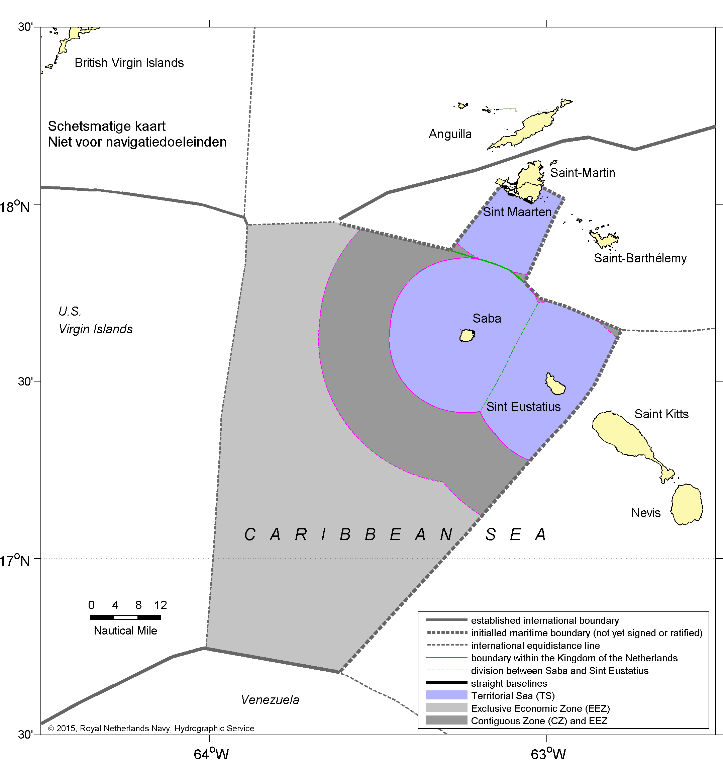
Other activities: Maritime boundaries
Agreement on new Caribbean all-purpose boundary with France,
now awaiting ratification

Slide 9
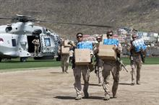
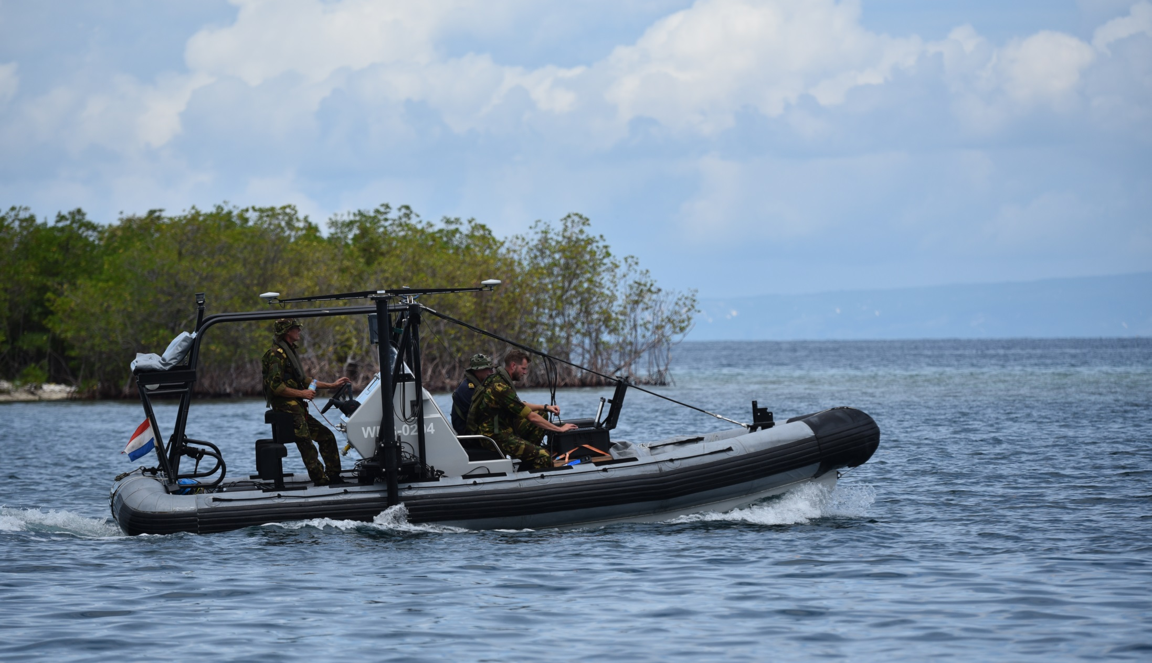
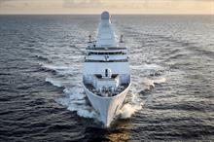
Other Activities: Post-Irma disaster response
See separate presentation.

Slide 10
Conclusion
Satisfactory status for surveying and nautical charting in the MACHC area.
The national implementation of INSPIRE will gradually make our open data sets available as harmonized web services.
Continued efforts to establish maritime boundaries.

