Slide 1
The IMO
(Adapted from the presentation made by Mr Colin Young at MACHC18)

Slide 2
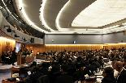
Main Actors
IMO has the responsibility to develop technical safety, security and pollution prevention standards related to maritime transport;
GOVERNMENTS have the duty to implement and enforce these standards;
RECOGNIZED ORGANIZATIONS have a duty to be impartial and exercise due diligence;

Slide 3
Main Actors
SHIPPING COMPANIES are responsible for applying the same standards to individual ships; and
SHIPBOARD PERSONNEL have the task of putting into operation the various safety and anti-pollution measures applicable to the ship.

Slide 4
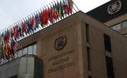
Flag State
Regulatory and enforcement responsibilities
to the satisfaction of the Administration
equivalency and exemption provisions
unrestrained powers to delegate statutory work
Considerable variance in implementation of instruments leading to:
partial or full delegation of statutory work to non-State entities
different degrees of implementation and enforcement
absence of State accountability makes ship registration an attractive and legitimate State business
lack of uniform flag State enforcement creates varying economic advantage to shipowners

Slide 5
Recognized Organizations (ROs)
Act on behalf of flag States, form part of a State's enforcement mechanism
Commercial pressures have intensified the conflict between the ROs' role as certifier and inspector on behalf of flag States and their commercial relationship with owner/clients
The ultimate sanction for non-compliance with the classification rules is the loss of class
No independent international mechanism to evaluate and confirm the competence of ROs

Slide 6
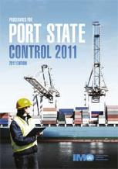
Port State Control (PSC)
All of the critical conventions, including UNCLOS, include provisions for port State control
Right of intervention is conditional, a small measure to protect the notion of SOVEREIGNTY
To unify the application of port State control, strict guidelines and procedures have been developed by IMO for the conduct of port State control

Slide 7
Port State Control (PSC)
Has and continues to work in enforcing standards
Reduces risk of sub-standard shipping
Statistics and detention information are made public

Slide 8
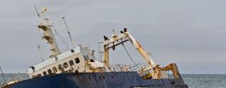
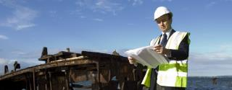
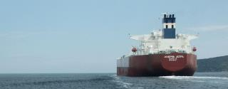
IMO Role
The IMO Convention excludes provisions for an enforcement and monitoring role
With the drive for greater transparency and accountability, it has often been said that IMO needs teeth to ensure compliance
Need for measuring the effectiveness of IMO standards
MARITIME SAFETY DIVISION

Slide 9
IMO Role
No authoritative methodology for Member States to measure their contribution towards improving maritime safety and pollution prevention.
FSI Sub-Committee (renamed III Sub-Committee) established to review implementation and enforcement issues by Member States.
MARITIME SAFETY DIVISION

Slide 10
Development of the Audit Scheme
In 2002, Member States proposed:
FSI Sub-Committee to review resolution A.847(20) – Guidelines on Implementation of Mandatory instruments to make it a Flag State Code; and
Council to develop an IMO Model Audit Scheme
In November 2003, the Assembly adopted Resolution A.946(23) – the Voluntary IMO Member State Audit Scheme (VIMSAS)

Slide 11
Development of the Audit Scheme
Two Resolutions adopted at the 24th regular session in November/December 2005
Resolution A.973(24) – Code for the implementation of mandatory IMO instruments
Resolution A.974(24) – Framework and Procedures for the Voluntary IMO Member State Audit Scheme
At its 26th regular session in November/December 2009 the Assembly adopted resolution A.1018(26) for the institutionalization of the Scheme

Slide 12
Development of the Audit Scheme
Amendments to:
Majority of amendments to enter into force in January 2016, making the auditing of Member States using the III Code mandatory.
SOLAS 1974 MARPOL STCW 1978 LL 66 LL PROT 1988 Tonnage 1969 COLREG 1972 | resolution MSC.366(93) resolution MEPC.246(66) – annexes I - V resolution MEPC.247(66) – annex VI resolution MSC.373(93) [resolution MSC.374(93) - STCW Code] resolution A.1083(28) resolution MSC.375(93) resolution A.1084(28) resolution A.1085(28)

Slide 13
Development of the Audit Scheme
9 instruments included in the scope of the scheme:
SOLAS 1974
SOLAS PROTOCOL 1988
MARPOL 73/78
MARPOL PROTOCOL 1997
STCW 1978
LOAD LINES 1966 (LL66)
LL 66 PROT 1988
TONNAGE 1969
COLREG 1972

Slide 14
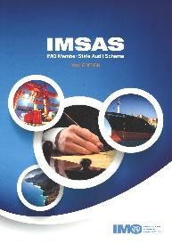
Audit Scheme Results
No objection or refusal to circulate the findings from audits to all Member States has been received
Audits have been able to identify areas for improvement in all States audited
Preparation for audits by Member States have identified gaps in existing maritime administration structures
Audit results have led to the commitment of additional resources by States to their maritime administrations

Slide 15
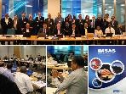
Auditors
Continue to nominate persons as auditors
Their details should be input using the E-roster of experts and consultants
Procedure is available through Circular Letter No.3547

Slide 16
twitter.com/imohq
facebook.com/imohq
youtube.com/imohq
flickr.com/photos/ imo-un/collections

