Slide 1
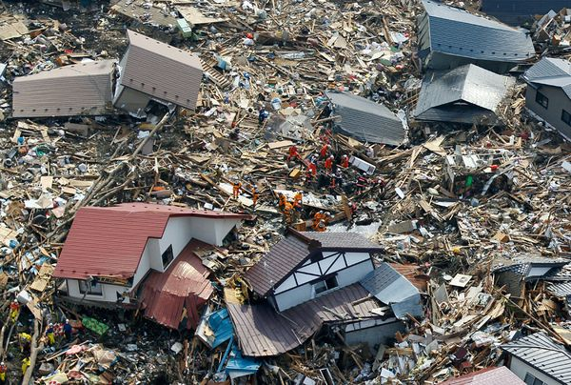
MapAction:
Humanitarian Aid in the Right Place

Slide 2
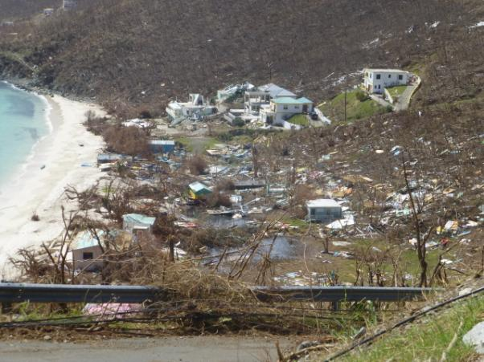
British Virgin Islands
Hurricane IRMA 2017

Slide 3
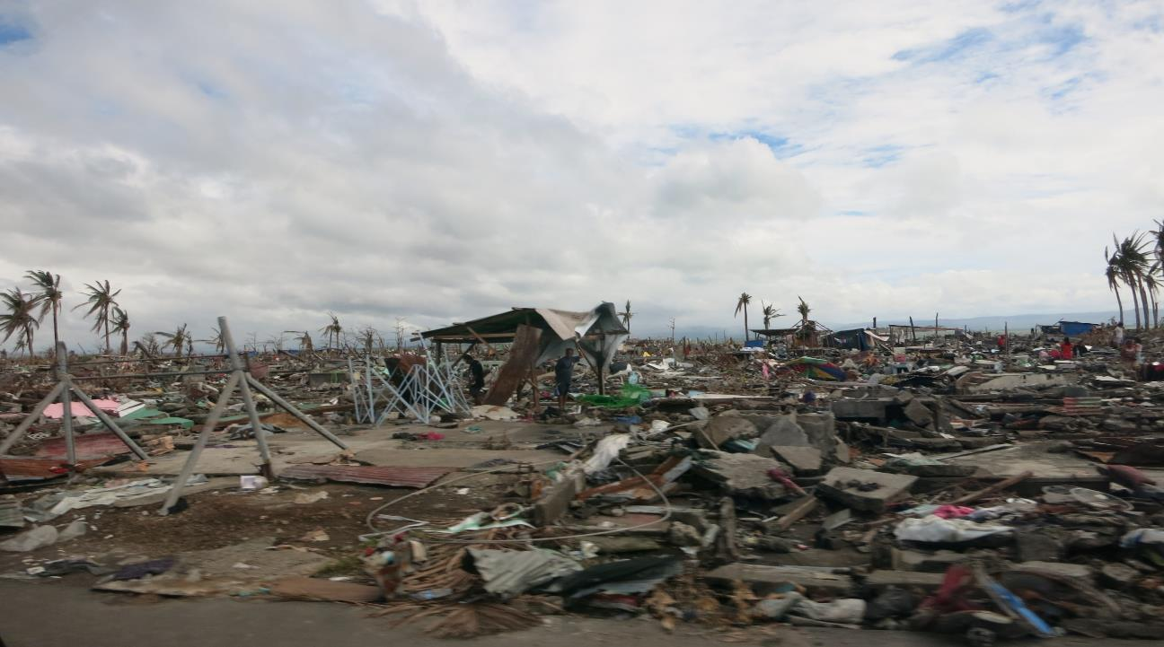
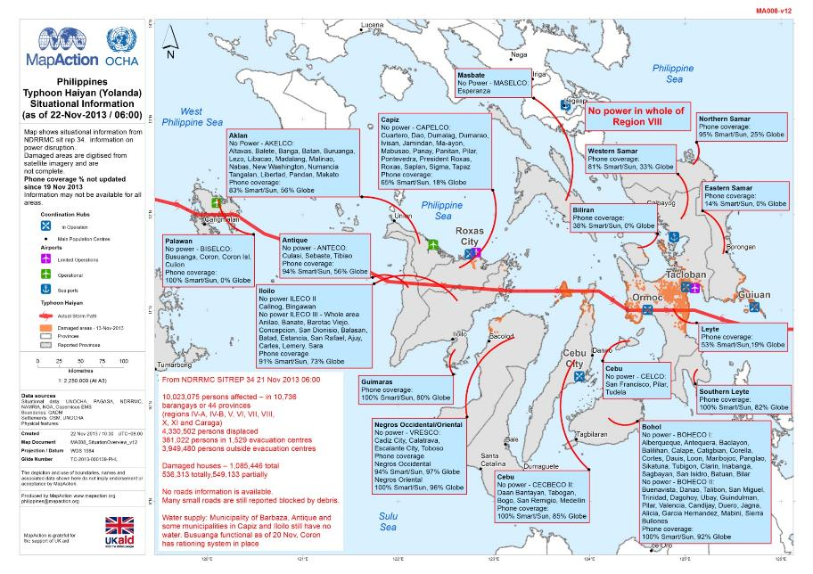
Tacloban, Philippines 2013
Notes:
So, there has been a natural disaster. Once there is a request for help many organisations rush in. There needs to be a structure -> next slide

Slide 4
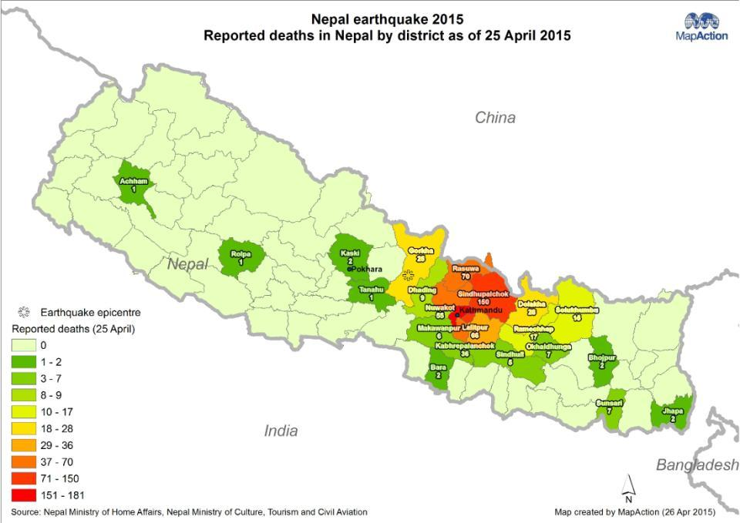

Slide 5
Our team
Notes:
We have 76 volunteers
Small staff team, most of whom are part time, based in Buckinghamshire
Volunteers are predominantly UK based in order to be able to attend regular training weekends. They attend regular monthly training and are ready to deploy to the scene of an emergency within hours of an alert.
Senior professionals working in GIS

Slide 6
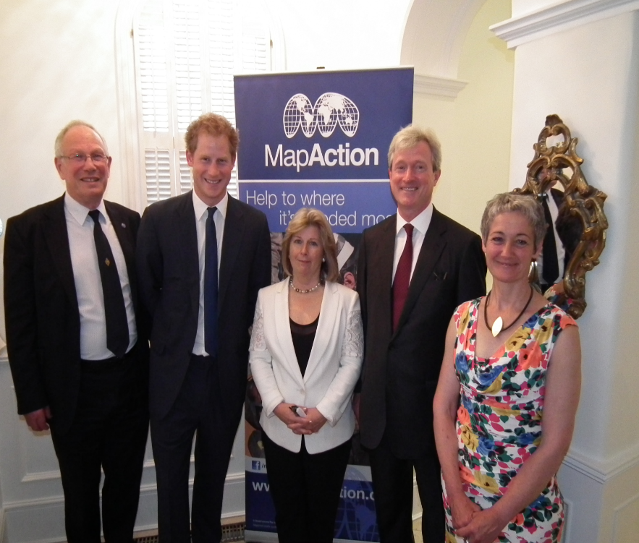
Patron: HRH Prince Harry
Notes:
Delighted to have PH as a Patron.

Slide 7
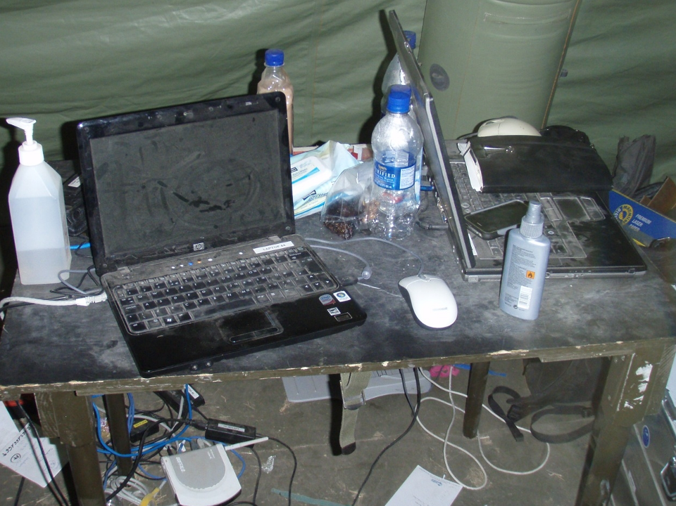

Slide 8
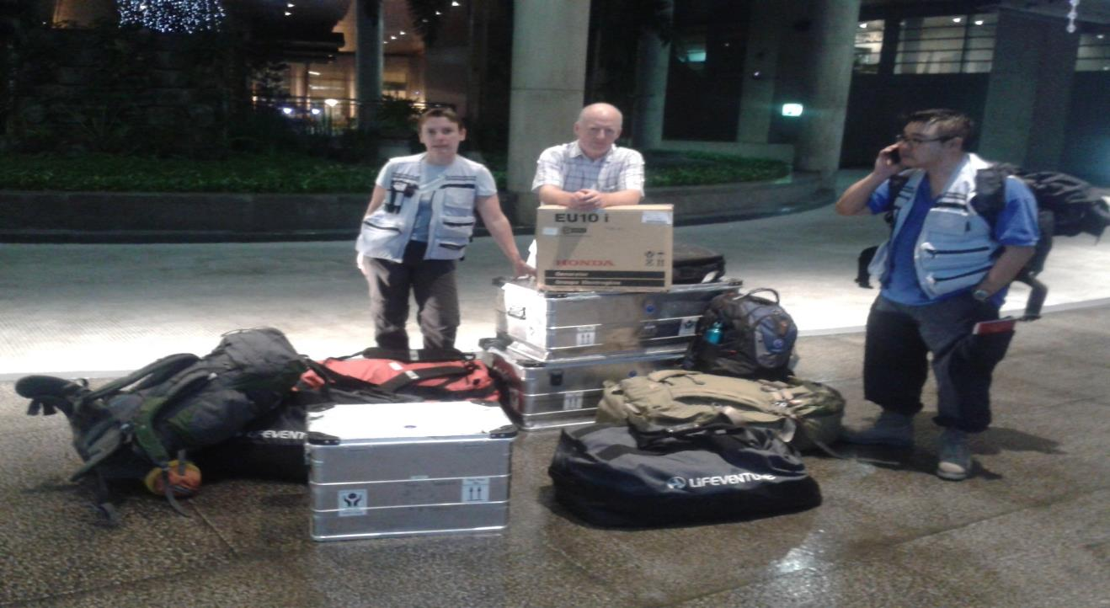

Slide 9
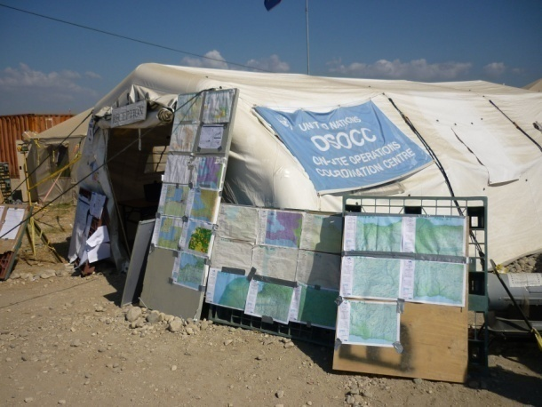
UN Coordination Centre

Slide 10
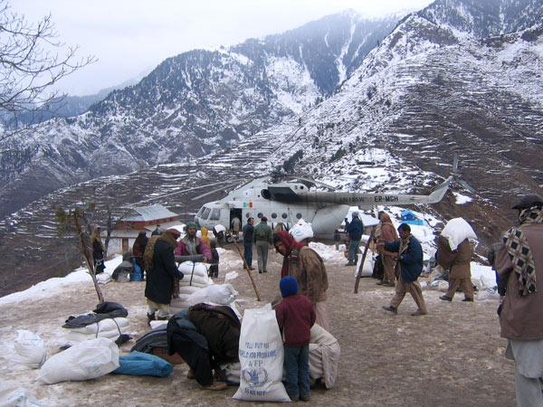
Pakistan earthquake October 2005

Slide 11
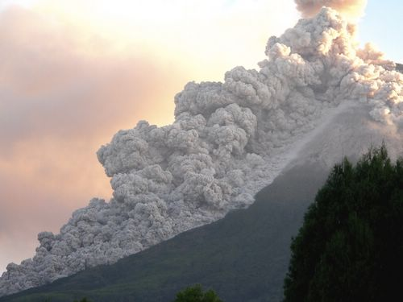
Mt Merapi,
Java, erupting
Indonesian
Earthquake / Volcano
June 2006

Slide 12
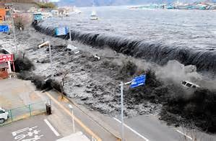
Japanese Tsunami March 2011

Slide 13
MapAction Emergency Deployments
2003 Lesotho food crisis
2004 Asian tsunami
2005 Niger famine
Pakistan earthquake
2006 Suriname floods
Java earthquake
Dominica hurricane
Kenya floods
2007 Ghana floods
Jamaica hurricane
2008 Bolivia floods
Myanmar cyclone
Haiti hurricanes
2009 Namibia floods
Pakistan IDP
Sri Lanka post conflict
Benin floods
Burkina Faso floods
Sumatra earthquake
El Salvador floods
Philippines cyclones
2010 Albania floods
Haiti earthquake
Pakistan floods
Saint Lucia hurricane
2011 Libya refugees
Japan earthquake
Cote d’Ivoire refugees
Nicaragua floods
Philippines floods
Sahel food crisis
Congo ammo dump
Madagascar floods
Comoros floods
Paraguay floods
2014 - Iraq ISIS refugees
Liberia Ebola
Sierra Leone Ebola
Ghana Ebola
Mali Ebola
2015 Malawi floods
Vanuatu cyclone
Chile floods
South Sudan
Nepal earthquake
Yemen cyclone
Mediterranean refugees
Dominica cyclone
2016 Fiji Cyclone
Paraguay floods
Ecuador earthquake
Cape Verde seismics
Tanzania
Jamaica/Haiti hurricane
N Nigeria refugees
2017 Chile forest fires
Madagascar cyclone
Peru floods
Sierra Leone floods
Caribbean hurricanes
2013 CAR refugees
Lebanon/Turkey
India flooding
Myanmar cyclone
India cyclone
Philippines cyclone
2014 Lebanon
South Sudan
Serbia floods
Paraguay floods
Notes:
The emergency deployments so far. Colour code Green food/medical, Red earthquakes, Blue floods, Yellow winds, Black “complex”

Slide 14
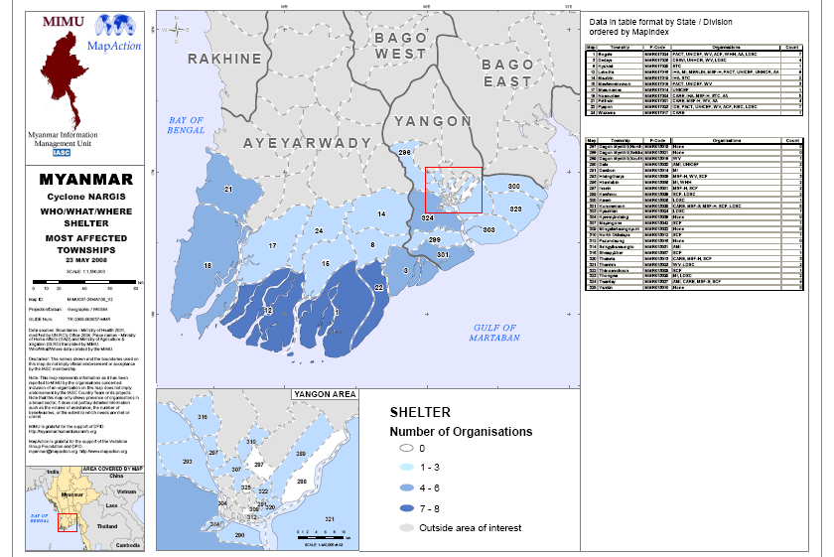
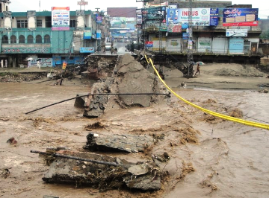
“Where are the affected areas?”

Slide 15
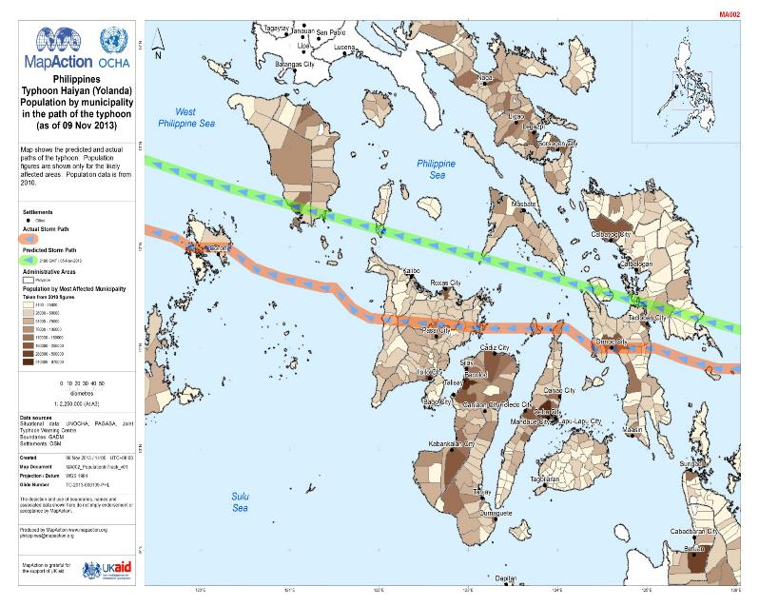
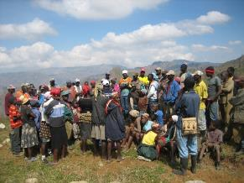
“Where are the affected people?”

Slide 16
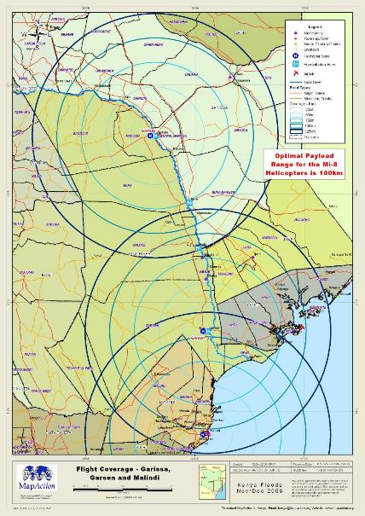
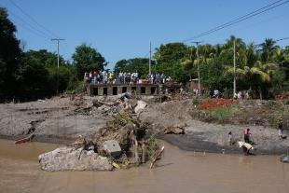
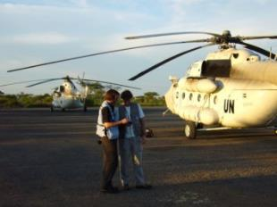
“Where are the access routes?”

Slide 17
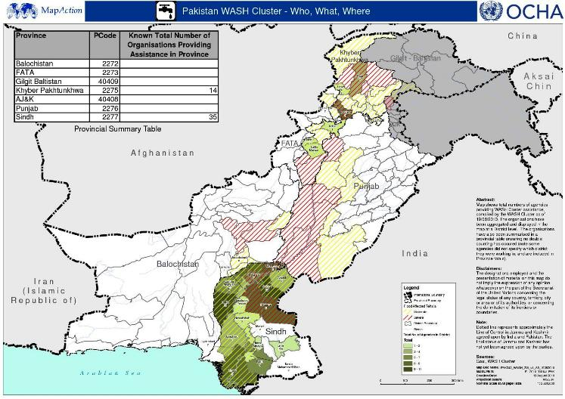
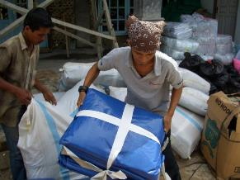
“Where are other relief agencies/teams working?”
3W – Who, What, Where

Slide 18
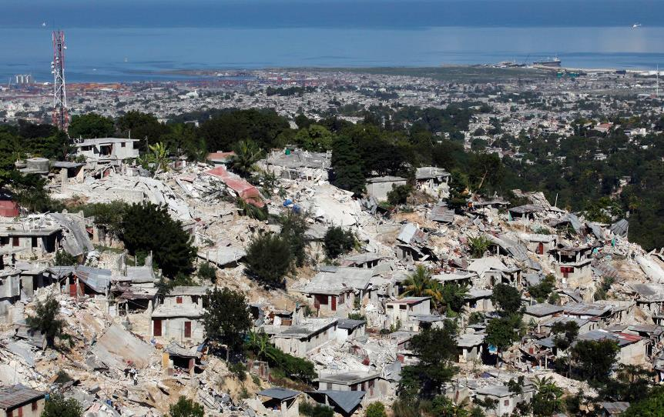
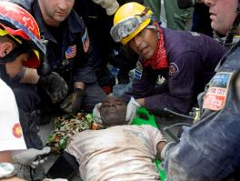
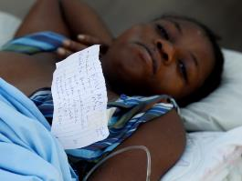
Earthquake: Haiti 2010 A pivotal role in coordination of search/rescue and relief teams

Slide 19
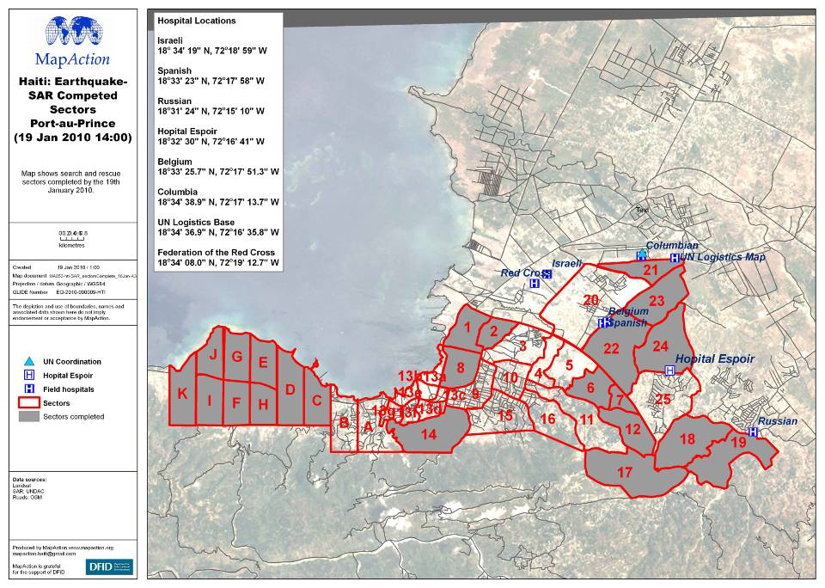

Slide 20
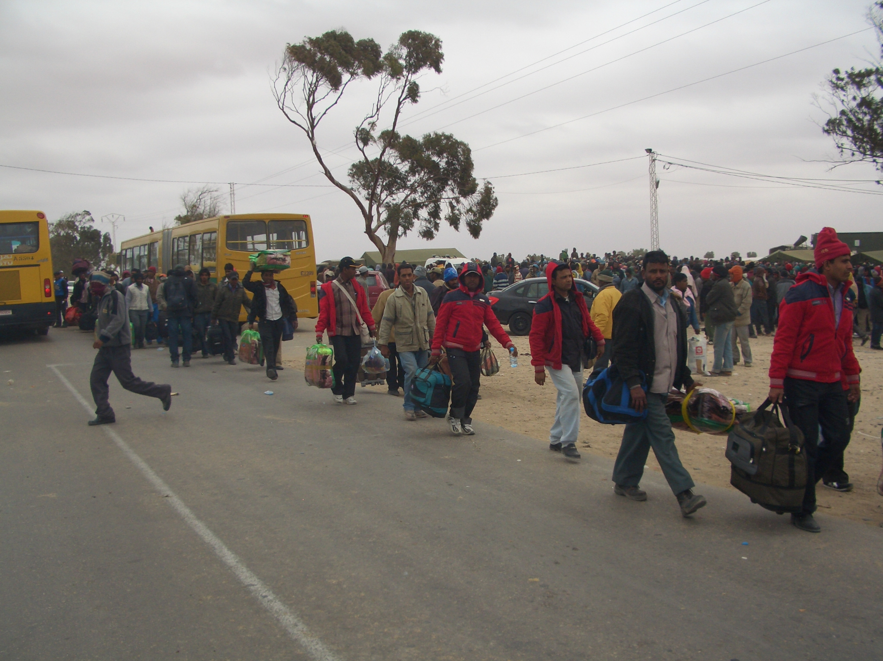
Libyan Refugees 2011

Slide 22
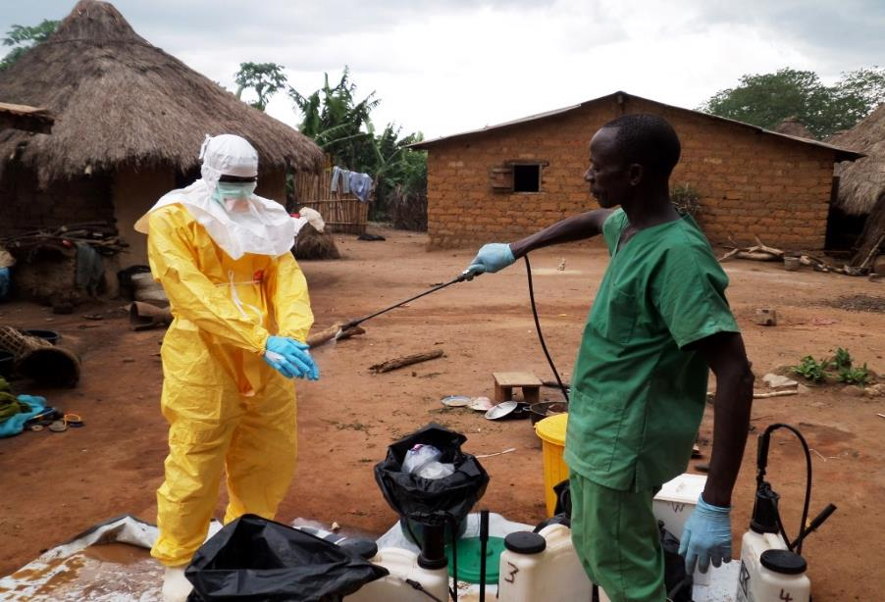
Notes:
Sierra Leone & Liberia 2014. Mapaction deployed to help decision makers

Slide 23
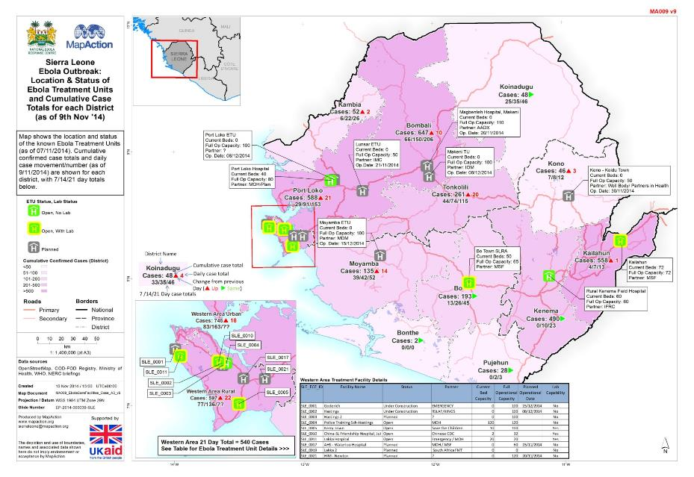

Slide 24
Data preparedness
Kathmandu Valley 2010

Slide 25
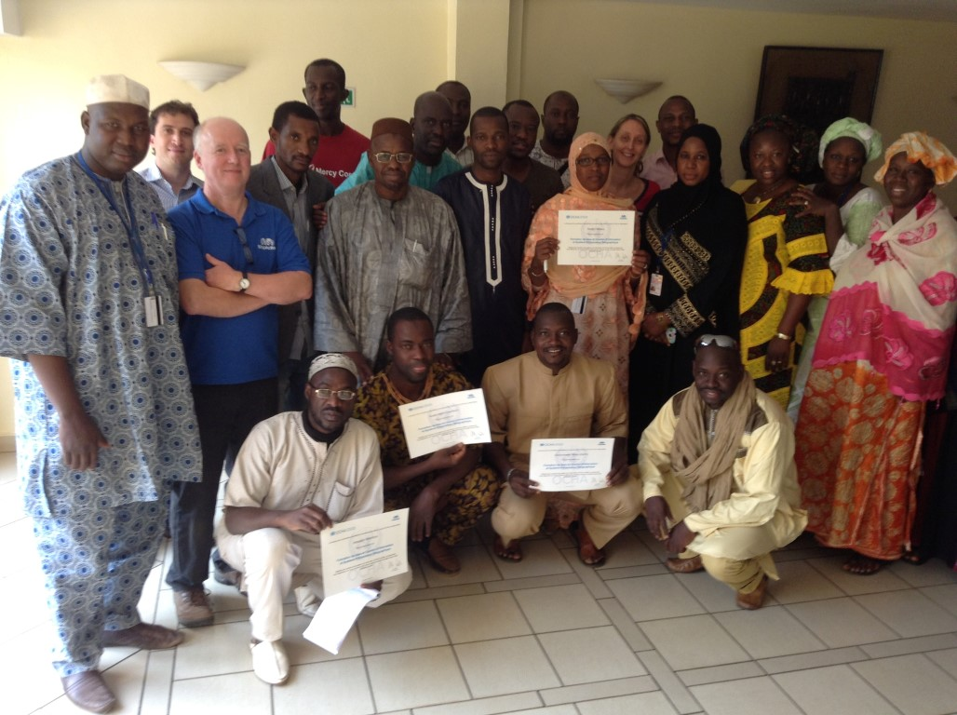
Training
Notes:
Training: we deliver specialist mapping and information management training for humanitarian partners including the UN and other NGOs. We also run our own humanitarian information mapping course in the UK.

Slide 26
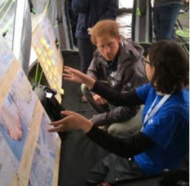
From our Patron
“To see highly-skilled individuals give up their time like this is remarkable. Considering how few people there are, it is unbelievable how much they achieve. It’s the glue that binds everyone together.”
Prince Harry on visiting MapAction’s work at an international simulation exercise, September 2016

Slide 27
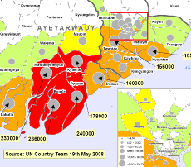
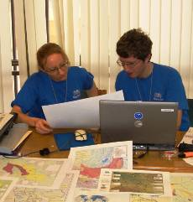
What the United Nations says:
“MapAction’s maps are in every UN, NGO and donor office. They have informed our decision making and proved essential to the planning of the humanitarian response.”
Daniel Baker, UN Humanitarian Coordinator
“I witnessed outstanding teamwork, cooperation, and willingness to go the extra mile. The performance displayed by your team speaks volumes of your organization’s commitment and dedication.”
UNDAC Team Leader

Slide 28
Funding MapAction - £1 million p/a
Significant funders 2018
UK Dept for International Development
Dutch Foreign Assistance Ministry
US Foreign Disaster Assistance
Trusts, commercial & private donors
Some projects funded by industry
Little or no funding from the UN
No support from the UK Disaster Emergency Committee
www.mapaction.org

Slide 29
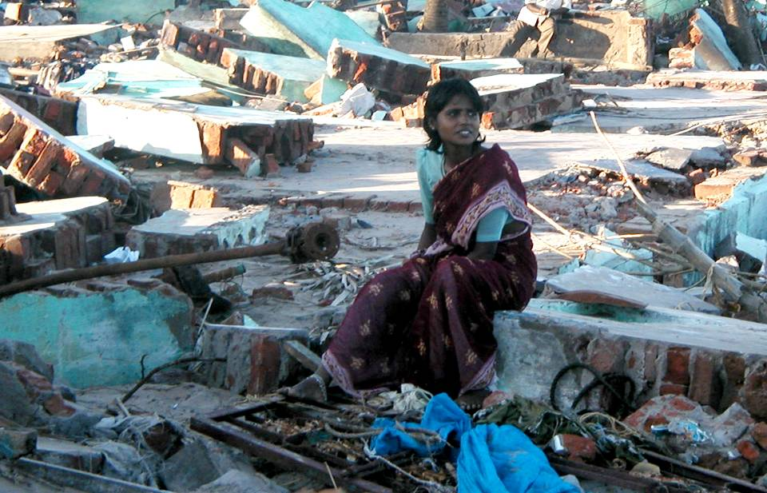
MapAction’s work helps to get aid to the right place and help people in the greatest need
www.mapaction.org

