Slide 1

UNESCO-IOC Intergovernmental Coordination Group for Tsunamis and Other Coastal Hazards Warning System for the Caribbean and Adjacent Regions (ICG/CARIBE-EWS)
Tsunami Warning System
Christa von Hillebrandt-Andrade
NOAA Caribbean Tsunami Warning Program
November 27, 2018

Slide 2
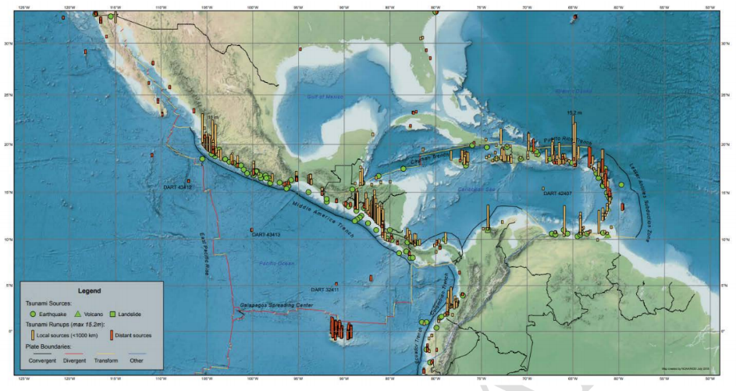
Map of Historical Tsunami (1530 to 2018) Caribbean, Central America,
Mexico and Adjacent Regions (NGDC)

Slide 3
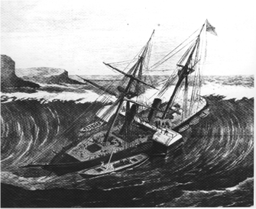
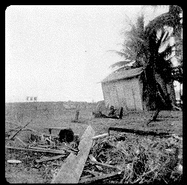
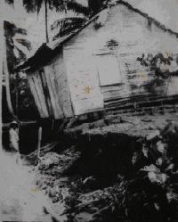
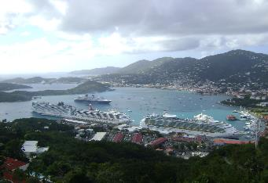
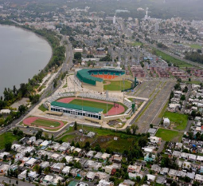
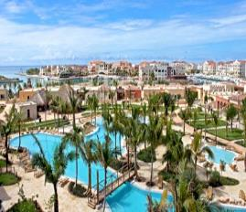
Then and Now
1867- US Virgin Islands
30 deaths
1946- Dominican Republic
1790 deaths
1918- Puerto Rico
140 deaths
Notes:
The most recent tsunami occurred as a consequence of the devastating Haiti earthquake in 2010 when tsunamis with waves up to 3 meters killed 7 people, but before that much bigger tsunamis occurred in the Virgin Islands, Puerto Rico and the Dominican Republic. In these three tsunamis alone over 2000 people lost their lives. But these tsunamis occurred decades ago, before cruise ships arrived, population increased, infrastructure, including hundreds of hotels were built along our beaches. Several hundred thousands of people would be at risk WHEN, not IF the next tsunami strikes.

Slide 4
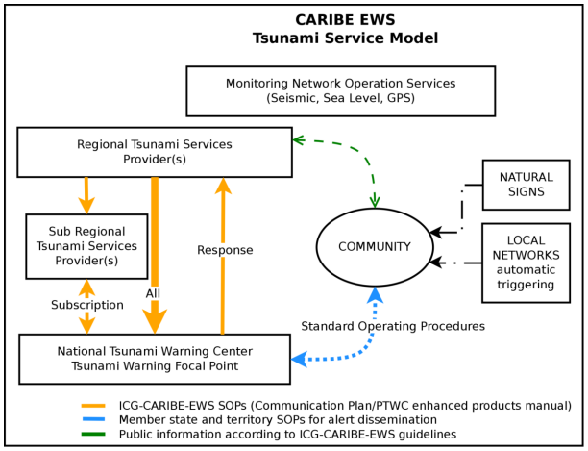
CARIBE-EWS Tsunami Service Model (ICG-X 2015)

Slide 5
Terms and Definitions
  National Tsunami Warning Centre (NTWC):
  A centre officially designated by the government to monitor and issue tsunami warnings and other related statements within their country according to established National Standard Operation Procedures (SOPs)
  Tsunami Warning Focal Point (TWFP):
  A 24 x 7 point of contact (office, operational unit or position, not a person) officially designated by the NTWC or the government to receive and disseminate tsunami information from an ICG Tsunami Service Provider according to established National Standard Operation Procedures. The TWFP may or not be the NTWC.
  Tsunami Service Provider (TSP):
  A Tsunami Service Provider (TSP) is a Centre that monitors seismic and sea level activity and issues timely tsunami threat information within an ICG framework to National Tsunami Warning Centres/Tsunami Warning Focal Points and other TSPs operating within an ocean basin. The NTWCs/TWFPs may use these products to develop and issue tsunami warning for their countries. TSPs may also issue Public messages for an ocean basin and act as National Tsunami Warning Centres providing tsunami warnings for their own countries. Several ICG Tsunami Service Providers have been established.
  Bi-lateral, multi-lateral and subregional arrangements may also exist to provide products for a sub set of Member States within an ICG. The criteria may or may not be established by the ICG.
  In the case of the CARIBE EWS, the TSP is the US Pacific Tsunami Warning Center.
Notes:
Please see Summary Report of IOC Working Group on Tsunamis and Other Hazards Related to Sea-Level Warning and Mitigation Systems (TOWS-WG) Seventh Meeting, Paris, France, 12-13 February 2014
Available for download at:
http://ioc-unesco.org/index.php?option=com_oe&task=viewEventRecord&eventID=1417

Slide 6
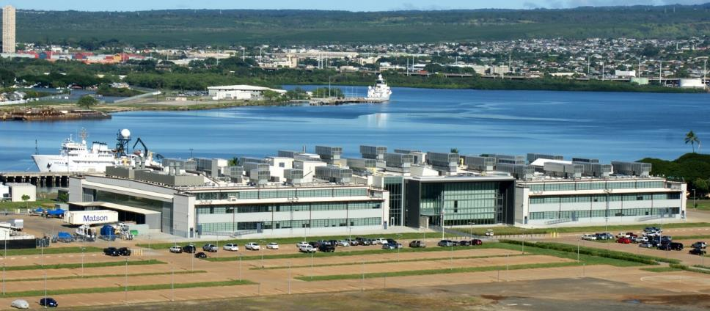
Pacific Tsunami Warning Center (PTWC)
NOAA Inouye Regional Center, Ford Island, Pearl Harbor, Hawaii
NOAA Inouye Regional Center, Ford Island, Pearl Harbor, Hawaii

Slide 7
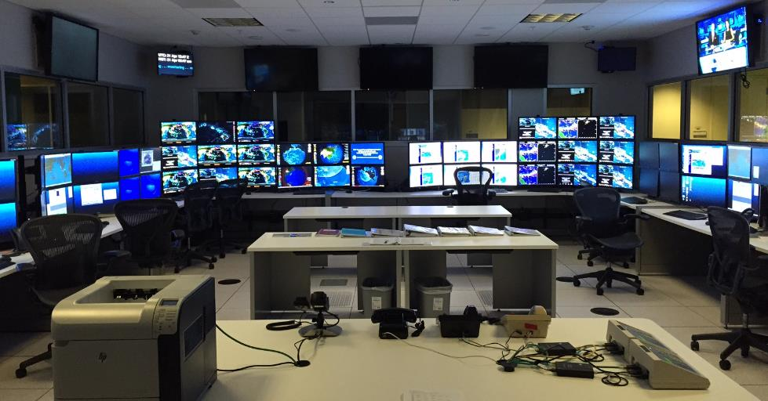
PTWC Operations Center

Slide 8
PTWC Activity:
3300+ Alarms/year (~275/mo, M4+) by EQs worldwide
~335 Observatory Msgs/year (~32/mo, M5.8+) (=> CISN)
      FROM PACIFIC TSUNAMI WARNING CENTER
      THIS IS PRELIMINARY DATA, NOT FOR PUBLIC DISSEMINATION.
      COMPLETE INFORMATION CAN BE OBTAINED FROM THE USGS/NEIC
      TELEPHONE (303) 273-8500.
      H 08:24:47Z MAY 24 2014Z LAT 16.3N LONG 98.2W DEPTH 16.2km Mwp 5.7 (5 STATIONS)
      NEAR THE COAST OF GUERRERO, MEXICO
      PNIG P 082452.2 PNIG S 082456.7 UNM P 082535.0 CUIG P 082535.0
      LVIG P 082542.5 PCIG P 082600.1 TGIG P 082600.5 ZAIG P 082638.8
      LNIG P 082650.0 TEIG P 082713.5 TGUH P 082722.7 HKT P 082808.5
~10 CARIBE-EWS Tsunami Information Statements/year (most for Atlantic earthquakes)
~50 PTWS Tsunami Information Statements/year

Slide 9
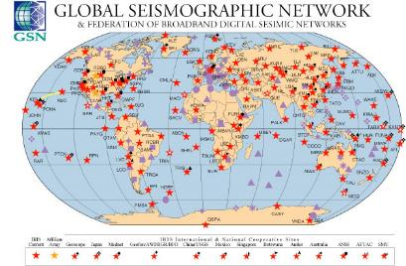
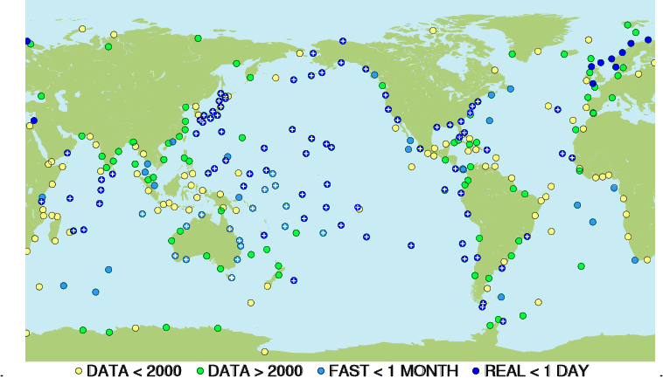
For Tsunami Warning - 3 Basic Needs
Very Rapid Earthquake Evaluation (sec-min)
Very Rapid Tsunami Wave Forecast, Detection and Measurement (min-hr)
Very Reliable Communications
e.g., Multi-national,
global data networks
with real-time transmission
and free/open data sharing
ALL ARE REQUIRED FOR TIMELY WARNING
IOC GLOSS Network, incl real-time, non-real time, archive

Slide 10

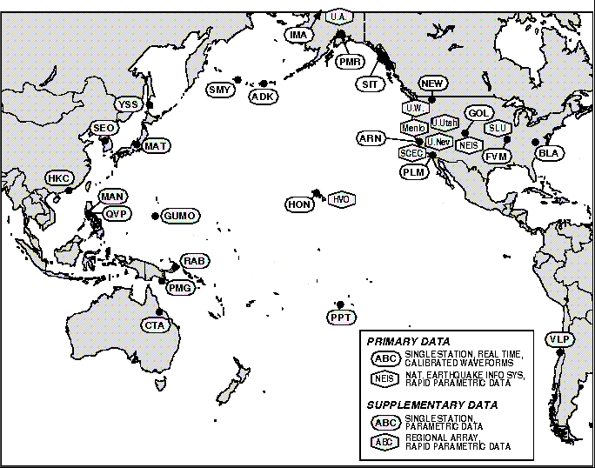
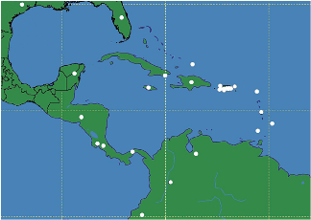
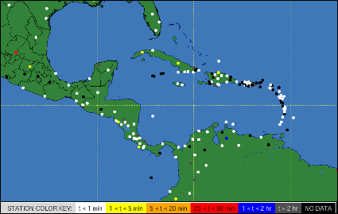
Core Seismic Network - PTWC
2010
1999
In 2018, PTWC receiving data from ~ 600 broadband stations in real time
Earthquake location & magnitude in 10s of seconds to minutes
2018

Slide 11
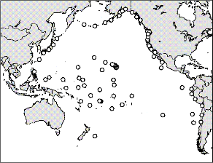
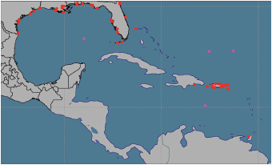
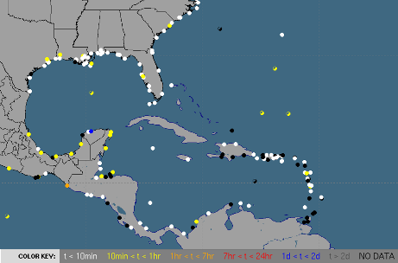
Core Sea Level Network - PTWC
2010
1999
In 2018, PTWC receiving data from > 600 stations (coastal, deep-ocean) in real time
=> Confirm tsunami within 1 hr locally
2018
2014

Slide 12
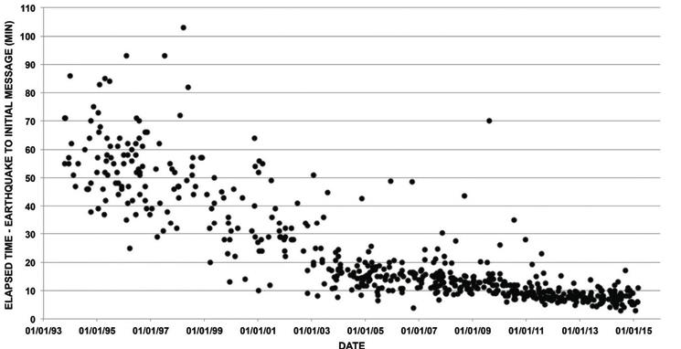
PTWC Pacific Response Time, 1993-2015
Earthquakes: Denser Networks, Higher Quality Data, Better and Faster Methods => Faster Detection & Response
Average:
2005 ~ 15 min
mid-2015 ~ 7 min
Notes:
12

Slide 13
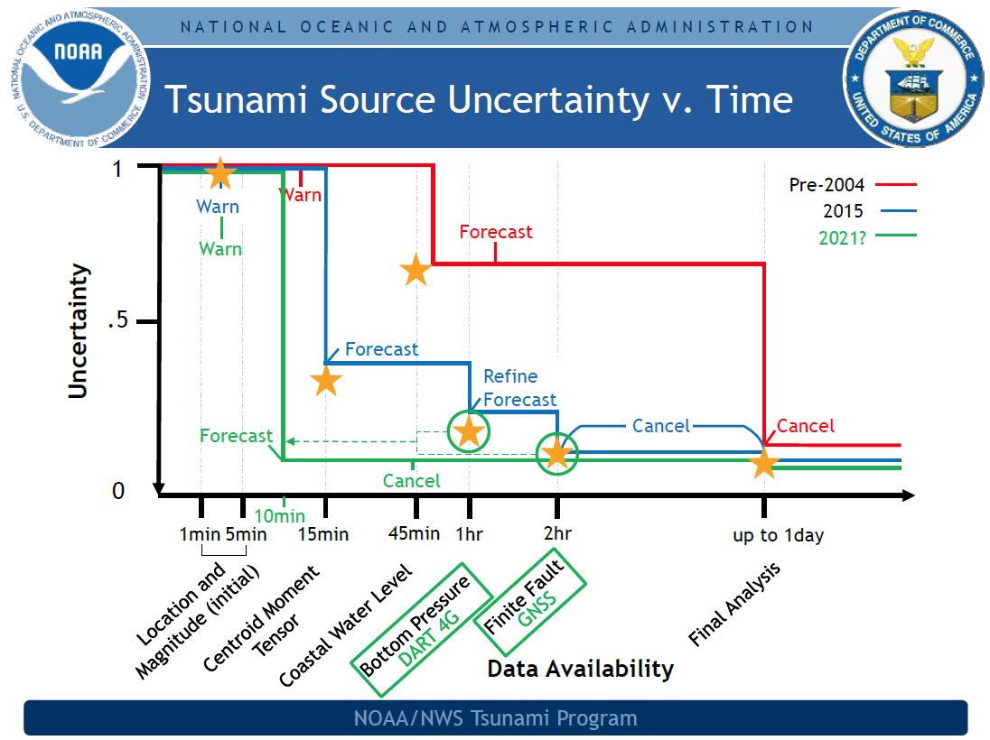
Notes:
13

Slide 14



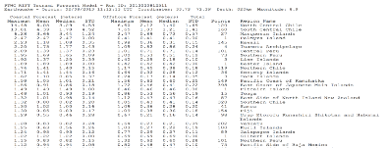


PTWC – Procedures, Products
Base threat on wave forecast models, not on pre-determined magnitude threshold
Forecasts constrained by EQ mechanism (W-CMT) and sea level readings
Public Text Message – Summary Information
Graphical Forecasts and Statistics Table only sent to Country Tsunami Warning Focal Points (TWFPs) and National Tsunami Warning Centers (NTWCs):
  Coastal Tsunami Amplitude Forecast Polygon Map - Overview
  Deep-Ocean Tsunami Amplitude Forecast Map – Pacific-wide
  Coastal Tsunami Amplitude Forecast Map – Pacific-wide and Regional, with Tsunami Travel Times
  Coastal Tsunami Amplitude Forecast KMZ– input to Google Earth
  Table of Forecast Statistics for Regional Polygons
Notes:
Please see explanation in:
Users Guide for the Pacific Tsunami Warning Center Enhanced Products for the Pacific Tsunami Warning System. IOC Technical Series No 105, Revised edition. UNESCO/IOC, 2014 (English; Spanish)
Available for download at http://ptws-ptwcnewproducts.info

Slide 15
Review of Criteria for Initial CARIBE EWS Messages
PRODUCT | CARIBBEAN EQ | ATLANTIC EQ
Information Statement | Mw: 6.0 – 9.9 Deep or Inland | Mw: 6.5 – 9.9 Deep or Inland
Information Statement | Mw: 6.0 – 7.0 Shallow, Undersea | Mw: 6.5 – 7.8 Shallow, Undersea
Local (300 km) Tsunami threat | Mw: 7.1 – 7.5 Shallow, Undersea | N/A
Regional (1000 km) Tsunami threat | Mw: 7.6 – 7.8 Shallow, Undersea | N/A
Caribbean-Wide Tsunami threat | Mw: 7.9 – 9.9 Shallow, Undersea | Mw: 7.9 – 9.9 Shallow, Undersea
Notes:
This is just a review of the current message procedures for PTWC’s Caribbean products – a Tsunami Information Statement, a Local Tsunami Watch, a wider Regional Tsunami Watch, and a Caribbean-wide Tsunami Watch.
15

Slide 16
Threat Levels – as of second message
4 Threat Levels: based forecast maximum coastal tsunami wave amplitudes
Forecast Tsunami Amplitude | Suggested Meaning
< 0.3m | No Threat
0.3m - 1m | Dangerous Currents, Harbor Surges, Minor Flooding
1m - 3m | Land Inundation
>3m | Major Destruction and Inundation
Other | Forecast Not Computed
Notes:
Please see explanation in:
Users Guide for the Pacific Tsunami Warning Center Enhanced Products for the Pacific Tsunami Warning System. IOC Technical Series No 105, Revised edition. UNESCO/IOC, 2014 (English; Spanish)
Available for download at http://ptws-ptwcnewproducts.info

Slide 17
TSUNAMI INFORMATION STATEMENT NUMBER 1
NWS PACIFIC TSUNAMI WARNING CENTER EWA BEACH HI
2058 UTC FRI NOV 13 2015
...PTWC TSUNAMI INFORMATION STATEMENT...
**** NOTICE **** NOTICE **** NOTICE **** NOTICE **** NOTICE *****
THIS STATEMENT IS ISSUED FOR INFORMATION ONLY IN SUPPORT OF THE
UNESCO/IOC PACIFIC TSUNAMI WARNING AND MITIGATION SYSTEM AND IS
MEANT FOR NATIONAL AUTHORITIES IN EACH COUNTRY OF THAT SYSTEM.
NATIONAL AUTHORITIES WILL DETERMINE THE APPROPRIATE LEVEL OF
ALERT FOR EACH COUNTRY AND MAY ISSUE ADDITIONAL OR MORE REFINED
INFORMATION.
**** NOTICE **** NOTICE **** NOTICE **** NOTICE **** NOTICE *****
PRELIMINARY EARTHQUAKE PARAMETERS - FROM JMA
--------------------------------------------
* MAGNITUDE 7.0
* ORIGIN TIME 2051 UTC NOV 13 2015
* COORDINATES 30.9 NORTH 128.7 EAST
* DEPTH 10 KM / 6 MILES
* LOCATION NORTHWEST OF THE RYUKYU ISLANDS
EVALUATION
----------
* AN EARTHQUAKE WITH A PRELIMINARY MAGNITUDE OF 7.0 OCCURRED
NORTHWEST OF THE RYUKYU ISLANDS AT 2051 UTC ON FRIDAY NOVEMBER
13 2015.
* BASED ON ALL AVAILABLE DATA... THERE IS NO TSUNAMI THREAT
FROM THIS EARTHQUAKE.
RECOMMENDED ACTIONS
-------------------
* NO ACTION IS REQUIRED.
NEXT UPDATE AND ADDITIONAL INFORMATION
--------------------------------------
* THIS WILL BE THE ONLY STATEMENT ISSUED FOR THIS EVENT UNLESS
ADDITIONAL DATA ARE RECEIVED OR THE SITUATION CHANGES.
* AUTHORITATIVE INFORMATION ABOUT THE EARTHQUAKE FROM THE U.S.
GEOLOGICAL SURVEY CAN BE FOUND ON THE INTERNET AT
EARTHQUAKE.USGS.GOV/EARTHQUAKES -ALL LOWER CASE-.
* FURTHER INFORMATION ABOUT THIS EVENT MAY BE FOUND AT
PTWC.WEATHER.GOV AND AT WWW.TSUNAMI.GOV.
* COASTAL REGIONS OF HAWAII... AMERICAN SAMOA... GUAM... AND
CNMI SHOULD REFER TO PACIFIC TSUNAMI WARNING CENTER MESSAGES
SPECIFICALLY FOR THOSE PLACES THAT CAN BE FOUND AT
PTWC.WEATHER.GOV.
* COASTAL REGIONS OF CALIFORNIA... OREGON... WASHINGTON...
BRITISH COLUMBIA AND ALASKA SHOULD ONLY REFER TO U.S. NATIONAL
TSUNAMI WARNING CENTER MESSAGES THAT CAN BE FOUND AT
NTWC.ARH.NOAA.GOV.
$$
TSUNAMI INFORMATION STATEMENT NUMBER 1
NWS PACIFIC TSUNAMI WARNING CENTER EWA BEACH HI
2058 UTC FRI NOV 13 2015
...TSUNAMI INFORMATION STATEMENT...
**** NOTICE **** NOTICE **** NOTICE **** NOTICE **** NOTICE *****
THIS STATEMENT IS ISSUED FOR INFORMATION ONLY IN SUPPORT OF THE
UNESCO/IOC TSUNAMI AND OTHER COASTAL HAZARDS WARNING SYSTEM FOR
THE CARIBBEAN AND ADJACENT REGIONS AND IS MEANT FOR NATIONAL
AUTHORITIES IN EACH COUNTRY OF THAT SYSTEM..
NATIONAL AUTHORITIES WILL DETERMINE THE APPROPRIATE LEVEL OF
ALERT FOR EACH COUNTRY AND MAY ISSUE ADDITIONAL OR MORE REFINED
INFORMATION.
**** NOTICE **** NOTICE **** NOTICE **** NOTICE **** NOTICE *****
PRELIMINARY EARTHQUAKE PARAMETERS - FROM JMA
--------------------------------------------
* MAGNITUDE 6.4
* ORIGIN TIME 2051 UTC NOV 13 2015
* COORDINATES 19.5 NORTH 64.5 WEST
* DEPTH 10 KM / 6 MILES
* LOCATION VIRGIN ISLANDS
EVALUATION
----------
* AN EARTHQUAKE WITH A PRELIMINARY MAGNITUDE OF 6.4 OCCURRED IN
THE VIRGIN ISLANDS AT 2051 UTC ON FRIDAY NOVEMBER 13 2015.
* BASED ON ALL AVAILABLE DATA... THERE IS NO TSUNAMI THREAT
FROM THIS EARTHQUAKE.
RECOMMENDED ACTIONS
-------------------
* NO ACTION IS REQUIRED.
NEXT UPDATE AND ADDITIONAL INFORMATION
--------------------------------------
* THIS WILL BE THE ONLY STATEMENT ISSUED FOR THIS EVENT UNLESS
ADDITIONAL DATA ARE RECEIVED OR THE SITUATION CHANGES.
* AUTHORITATIVE INFORMATION ABOUT THE EARTHQUAKE FROM THE U.S.
GEOLOGICAL SURVEY CAN BE FOUND ON THE INTERNET AT
EARTHQUAKE.USGS.GOV/EARTHQUAKES -ALL LOWER CASE-.
* FURTHER INFORMATION ABOUT THIS EVENT MAY BE FOUND AT
PTWC.WEATHER.GOV AND AT WWW.TSUNAMI.GOV.
* COASTAL REGIONS OF PUERTO RICO... THE U.S. VIRGIN ISLANDS...
AND THE BRITISH VIRGIN ISLANDS SHOULD REFER TO U.S. NATIONAL
TSUNAMI WARNING CENTER MESSAGES SPECIFICALLY FOR THOSE
PLACES THAT CAN BE FOUND AT NTWC.ARH.NOAA.GOV..
* COASTAL REGIONS OF THE US GULF COAST... US EAST COAST... AND
THE MARITIME PROVINCES OF CANADA SHOULD REFER TO U.S.
NATIONAL TSUNAMI WARNING CENTER MESSAGES THAT CAN BE FOUND
AT NTWC.ARH.NOAA.GOV.
$$
Public Text message
Information
Statement
No Threat
No Action
PTWC guidance information to Country TWFP/NTWC
Posted on Tsunami.gov
Notes:
Please see explanation in:
Users Guide for the Pacific Tsunami Warning Center Enhanced Products for the Pacific Tsunami Warning System. IOC Technical Series No 105, Revised edition. UNESCO/IOC, 2014 (English; Spanish)
Available for download at http://ptws-ptwcnewproducts.info

Slide 18
Public Text message – Threat Message
TSUNAMI MESSAGE NUMBER 1
NWS PACIFIC TSUNAMI WARNING CENTER EWA BEACH HI
0005 UTC TUE SEP 8 2015
...TSUNAMI THREAT MESSAGE...
**** NOTICE **** NOTICE **** NOTICE **** NOTICE **** NOTICE *****
THIS MESSAGE IS ISSUED FOR INFORMATION ONLY IN SUPPORT OF THE
UNESCO/IOC PACIFIC TSUNAMI WARNING AND MITIGATION SYSTEM AND IS
MEANT FOR NATIONAL AUTHORITIES IN EACH COUNTRY OF THAT SYSTEM.
NATIONAL AUTHORITIES WILL DETERMINE THE APPROPRIATE LEVEL OF
ALERT FOR EACH COUNTRY AND MAY ISSUE ADDITIONAL OR MORE REFINED
INFORMATION.
**** NOTICE **** NOTICE **** NOTICE **** NOTICE **** NOTICE *****
PRELIMINARY EARTHQUAKE PARAMETERS
---------------------------------
* MAGNITUDE 8.2
* ORIGIN TIME 0000 UTC SEP 8 2015
* COORDINATES 10.0 SOUTH 165.0 EAST
* DEPTH 20 KM / 12 MILES
* LOCATION SANTA CRUZ ISLANDS
EVALUATION
----------
* AN EARTHQUAKE WITH A PRELIMINARY MAGNITUDE OF 9.0 OCCURRED IN
THE SANTA CRUZ ISLANDS AT 0000 UTC ON TUESDAY SEPTEMBER 8
2015.
* BASED ON THE PRELIMINARY EARTHQUAKE PARAMETERS... WIDESPREAD
HAZARDOUS TSUNAMI WAVES ARE POSSIBLE.
TSUNAMI THREAT FORECAST
---------------------------------
* HAZARDOUS TSUNAMI WAVES FROM THIS EARTHQUAKE ARE POSSIBLE
WITHIN THE NEXT THREE HOURS ALONG SOME COASTS OF
SOLOMON ISLANDS... VANUATU... NAURU... PAPUA NEW GUINEA...
TUVALU... KOSRAE... NEW CALEDONIA... MARSHALL ISLANDS...
WALLIS AND FUTUNA AND HOWLAND AND BAKER
RECOMMENDED ACTIONS
-------------------
* GOVERNMENT AGENCIES RESPONSIBLE FOR THREATENED COASTAL AREAS
SHOULD TAKE ACTION TO INFORM AND INSTRUCT ANY COASTAL
POPULATIONS AT RISK IN ACCORDANCE WITH THEIR OWN
EVALUATION... PROCEDURES AND THE LEVEL OF THREAT.
* PERSONS LOCATED IN THREATENED COASTAL AREAS SHOULD STAY ALERT
FOR INFORMATION AND FOLLOW INSTRUCTIONS FROM NATIONAL AND
LOCAL AUTHORITIES.
ESTIMATED TIMES OF ARRIVAL
--------------------------
* ESTIMATED TIMES OF ARRIVAL -ETA- OF THE INITIAL TSUNAMI WAVE
FOR PLACES WITH A POTENTIAL TSUNAMI THREAT. ACTUAL ARRIVAL
TIMES MAY DIFFER AND THE INITIAL WAVE MAY NOT BE THE LARGEST.
A TSUNAMI IS A SERIES OF WAVES AND THE TIME BETWEEN WAVES
CAN BE FIVE MINUTES TO ONE HOUR.
LOCATION REGION COORDINATES ETA(UTC)
------------------------------------------------------------
KIRAKIRA SOLOMON ISLANDS 10.4S 161.9E 0033 09/08
SANTA CRUZ ISLA SOLOMON ISLANDS 10.9S 165.9E 0037 09/08
ESPERITU SANTO VANUATU 15.1S 167.3E 0056 09/08
AUKI SOLOMON ISLANDS 8.8S 160.6E 0108 09/08
GHATERE SOLOMON ISLANDS 7.8S 159.2E 0115 09/08
HONIARA SOLOMON ISLANDS 9.3S 160.0E 0120 09/08
PANGGOE SOLOMON ISLANDS 6.9S 157.2E 0129 09/08
NAURU NAURU 0.5S 166.9E 0137 09/08
MUNDA SOLOMON ISLANDS 8.4S 157.2E 0138 09/08
FALAMAE SOLOMON ISLANDS 7.4S 155.6E 0142 09/08
KIETA PAPUA NEW GUINEA 6.1S 155.6E 0150 09/08
ANATOM ISLAND VANUATU 20.2S 169.9E 0152 09/08
AMUN PAPUA NEW GUINEA 6.0S 154.7E 0201 09/08
WOODLARK ISLAND PAPUA NEW GUINEA 9.0S 152.9E 0201 09/08
FUNAFUTI ISLAND TUVALU 7.9S 178.5E 0205 09/08
RABAUL PAPUA NEW GUINEA 4.2S 152.3E 0219 09/08
KOSRAE ISLAND KOSRAE 5.5N 163.0E 0232 09/08
NOUMEA NEW CALEDONIA 22.3S 166.5E 0238 09/08
MAJURO MARSHALL ISLANDS 7.1N 171.4E 0255 09/08
ULAMONA PAPUA NEW GUINEA 5.0S 151.3E 0255 09/08
LAE PAPUA NEW GUINEA 6.8S 147.0E 0255 09/08
KWAJALEIN MARSHALL ISLANDS 8.7N 167.7E 0259 09/08
FUTUNA ISLAND WALLIS AND FUTUN 14.3S 178.2W 0301 09/08
HOWLAND ISLAND HOWLAND AND BAKE 0.6N 176.6W 0303 09/08
KAVIENG PAPUA NEW GUINEA 2.5S 150.7E 0305 09/08
POTENTIAL IMPACTS
-----------------
* A TSUNAMI IS A SERIES OF WAVES. THE TIME BETWEEN WAVE CRESTS
CAN VARY FROM 5 MINUTES TO AN HOUR. THE HAZARD MAY PERSIST
FOR MANY HOURS OR LONGER AFTER THE INITIAL WAVE.
* IMPACTS CAN VARY SIGNIFICANTLY FROM ONE SECTION OF COAST TO
THE NEXT DUE TO LOCAL BATHYMETRY AND THE SHAPE AND ELEVATION
OF THE SHORELINE.
* IMPACTS CAN ALSO VARY DEPENDING UPON THE STATE OF THE TIDE AT
THE TIME OF THE MAXIMUM TSUNAMI WAVES.
* PERSONS CAUGHT IN THE WATER OF A TSUNAMI MAY DROWN... BE
CRUSHED BY DEBRIS IN THE WATER... OR BE SWEPT OUT TO SEA.
NEXT UPDATE AND ADDITIONAL INFORMATION
--------------------------------------
* THE NEXT MESSAGE WILL BE ISSUED IN ONE HOUR... OR SOONER IF
THE SITUATION WARRANTS.
* AUTHORITATIVE INFORMATION ABOUT THE EARTHQUAKE FROM THE U.S.
GEOLOGICAL SURVEY CAN BE FOUND ON THE INTERNET AT
EARTHQUAKE.USGS.GOV/EARTHQUAKES -ALL LOWER CASE-.
* FURTHER INFORMATION ABOUT THIS EVENT MAY BE FOUND AT
PTWC.WEATHER.GOV AND AT WWW.TSUNAMI.GOV.
* COASTAL REGIONS OF HAWAII... AMERICAN SAMOA... GUAM... AND
CNMI SHOULD REFER TO PACIFIC TSUNAMI WARNING CENTER MESSAGES
SPECIFICALLY FOR THOSE PLACES THAT CAN BE FOUND AT
PTWC.WEATHER.GOV.
* COASTAL REGIONS OF CALIFORNIA... OREGON... WASHINGTON...
BRITISH COLUMBIA AND ALASKA SHOULD ONLY REFER TO U.S.
NATIONAL TSUNAMI WARNING CENTER MESSAGES THAT CAN BE FOUND
AT NTWC.ARH.NOAA.GOV.
$$
TSUNAMI MESSAGE NUMBER 1
NWS PACIFIC TSUNAMI WARNING CENTER EWA BEACH HI
0005 UTC TUE SEP 8 2015
...TSUNAMI THREAT MESSAGE...
**** NOTICE **** NOTICE **** NOTICE **** NOTICE **** NOTICE *****
THIS MESSAGE IS ISSUED FOR INFORMATION ONLY IN SUPPORT OF THE
UNESCO/IOC PACIFIC TSUNAMI WARNING AND MITIGATION SYSTEM AND IS
MEANT FOR NATIONAL AUTHORITIES IN EACH COUNTRY OF THAT SYSTEM.
NATIONAL AUTHORITIES WILL DETERMINE THE APPROPRIATE LEVEL OF
ALERT FOR EACH COUNTRY AND MAY ISSUE ADDITIONAL OR MORE REFINED
INFORMATION.
**** NOTICE **** NOTICE **** NOTICE **** NOTICE **** NOTICE *****
PRELIMINARY EARTHQUAKE PARAMETERS
---------------------------------
* MAGNITUDE 8.2
* ORIGIN TIME 0000 UTC SEP 8 2015
* COORDINATES 10.0 SOUTH 165.0 EAST
* DEPTH 20 KM / 12 MILES
* LOCATION SANTA CRUZ ISLANDS
EVALUATION
----------
* AN EARTHQUAKE WITH A PRELIMINARY MAGNITUDE OF 9.0 OCCURRED IN
THE SANTA CRUZ ISLANDS AT 0000 UTC ON TUESDAY SEPTEMBER 8
2015.
* BASED ON THE PRELIMINARY EARTHQUAKE PARAMETERS... WIDESPREAD
HAZARDOUS TSUNAMI WAVES ARE POSSIBLE.
TSUNAMI THREAT FORECAST
---------------------------------
* HAZARDOUS TSUNAMI WAVES FROM THIS EARTHQUAKE ARE POSSIBLE
WITHIN THE NEXT THREE HOURS ALONG SOME COASTS OF
SOLOMON ISLANDS... VANUATU... NAURU... PAPUA NEW GUINEA...
TUVALU... KOSRAE... NEW CALEDONIA... MARSHALL ISLANDS...
WALLIS AND FUTUNA AND HOWLAND AND BAKER
RECOMMENDED ACTIONS
-------------------
* GOVERNMENT AGENCIES RESPONSIBLE FOR THREATENED COASTAL AREAS
SHOULD TAKE ACTION TO INFORM AND INSTRUCT ANY COASTAL
POPULATIONS AT RISK IN ACCORDANCE WITH THEIR OWN
EVALUATION... PROCEDURES AND THE LEVEL OF THREAT.
* PERSONS LOCATED IN THREATENED COASTAL AREAS SHOULD STAY ALERT
FOR INFORMATION AND FOLLOW INSTRUCTIONS FROM NATIONAL AND
LOCAL AUTHORITIES.
ESTIMATED TIMES OF ARRIVAL
--------------------------
* ESTIMATED TIMES OF ARRIVAL -ETA- OF THE INITIAL TSUNAMI WAVE
FOR PLACES WITH A POTENTIAL TSUNAMI THREAT. ACTUAL ARRIVAL
TIMES MAY DIFFER AND THE INITIAL WAVE MAY NOT BE THE LARGEST.
A TSUNAMI IS A SERIES OF WAVES AND THE TIME BETWEEN WAVES
CAN BE FIVE MINUTES TO ONE HOUR.
LOCATION REGION COORDINATES ETA(UTC)
------------------------------------------------------------
KIRAKIRA SOLOMON ISLANDS 10.4S 161.9E 0033 09/08
SANTA CRUZ ISLA SOLOMON ISLANDS 10.9S 165.9E 0037 09/08
ESPERITU SANTO VANUATU 15.1S 167.3E 0056 09/08
AUKI SOLOMON ISLANDS 8.8S 160.6E 0108 09/08
GHATERE SOLOMON ISLANDS 7.8S 159.2E 0115 09/08
HONIARA SOLOMON ISLANDS 9.3S 160.0E 0120 09/08
PANGGOE SOLOMON ISLANDS 6.9S 157.2E 0129 09/08
NAURU NAURU 0.5S 166.9E 0137 09/08
MUNDA SOLOMON ISLANDS 8.4S 157.2E 0138 09/08
FALAMAE SOLOMON ISLANDS 7.4S 155.6E 0142 09/08
KIETA PAPUA NEW GUINEA 6.1S 155.6E 0150 09/08
ANATOM ISLAND VANUATU 20.2S 169.9E 0152 09/08
AMUN PAPUA NEW GUINEA 6.0S 154.7E 0201 09/08
WOODLARK ISLAND PAPUA NEW GUINEA 9.0S 152.9E 0201 09/08
FUNAFUTI ISLAND TUVALU 7.9S 178.5E 0205 09/08
RABAUL PAPUA NEW GUINEA 4.2S 152.3E 0219 09/08
KOSRAE ISLAND KOSRAE 5.5N 163.0E 0232 09/08
NOUMEA NEW CALEDONIA 22.3S 166.5E 0238 09/08
MAJURO MARSHALL ISLANDS 7.1N 171.4E 0255 09/08
ULAMONA PAPUA NEW GUINEA 5.0S 151.3E 0255 09/08
LAE PAPUA NEW GUINEA 6.8S 147.0E 0255 09/08
KWAJALEIN MARSHALL ISLANDS 8.7N 167.7E 0259 09/08
FUTUNA ISLAND WALLIS AND FUTUN 14.3S 178.2W 0301 09/08
HOWLAND ISLAND HOWLAND AND BAKE 0.6N 176.6W 0303 09/08
KAVIENG PAPUA NEW GUINEA 2.5S 150.7E 0305 09/08
POTENTIAL IMPACTS
-----------------
* A TSUNAMI IS A SERIES OF WAVES. THE TIME BETWEEN WAVE CRESTS
CAN VARY FROM 5 MINUTES TO AN HOUR. THE HAZARD MAY PERSIST
FOR MANY HOURS OR LONGER AFTER THE INITIAL WAVE.
* IMPACTS CAN VARY SIGNIFICANTLY FROM ONE SECTION OF COAST TO
THE NEXT DUE TO LOCAL BATHYMETRY AND THE SHAPE AND ELEVATION
OF THE SHORELINE.
* IMPACTS CAN ALSO VARY DEPENDING UPON THE STATE OF THE TIDE AT
THE TIME OF THE MAXIMUM TSUNAMI WAVES.
* PERSONS CAUGHT IN THE WATER OF A TSUNAMI MAY DROWN... BE
CRUSHED BY DEBRIS IN THE WATER... OR BE SWEPT OUT TO SEA.
NEXT UPDATE AND ADDITIONAL INFORMATION
--------------------------------------
* THE NEXT MESSAGE WILL BE ISSUED IN ONE HOUR... OR SOONER IF
THE SITUATION WARRANTS.
* AUTHORITATIVE INFORMATION ABOUT THE EARTHQUAKE FROM THE U.S.
GEOLOGICAL SURVEY CAN BE FOUND ON THE INTERNET AT
EARTHQUAKE.USGS.GOV/EARTHQUAKES -ALL LOWER CASE-.
* FURTHER INFORMATION ABOUT THIS EVENT MAY BE FOUND AT
PTWC.WEATHER.GOV AND AT WWW.TSUNAMI.GOV.
* COASTAL REGIONS OF HAWAII... AMERICAN SAMOA... GUAM... AND
CNMI SHOULD REFER TO PACIFIC TSUNAMI WARNING CENTER MESSAGES
SPECIFICALLY FOR THOSE PLACES THAT CAN BE FOUND AT
PTWC.WEATHER.GOV.
* COASTAL REGIONS OF CALIFORNIA... OREGON... WASHINGTON...
BRITISH COLUMBIA AND ALASKA SHOULD ONLY REFER TO U.S.
NATIONAL TSUNAMI WARNING CENTER MESSAGES THAT CAN BE FOUND
AT NTWC.ARH.NOAA.GOV.
$$
TSUNAMI MESSAGE NUMBER 1
NWS PACIFIC TSUNAMI WARNING CENTER EWA BEACH HI
0005 UTC TUE SEP 8 2015
...TSUNAMI THREAT MESSAGE...
**** NOTICE **** NOTICE **** NOTICE **** NOTICE **** NOTICE *****
THIS MESSAGE IS ISSUED FOR INFORMATION ONLY IN SUPPORT OF THE
UNESCO/IOC PACIFIC TSUNAMI WARNING AND MITIGATION SYSTEM AND IS
MEANT FOR NATIONAL AUTHORITIES IN EACH COUNTRY OF THAT SYSTEM.
NATIONAL AUTHORITIES WILL DETERMINE THE APPROPRIATE LEVEL OF
ALERT FOR EACH COUNTRY AND MAY ISSUE ADDITIONAL OR MORE REFINED
INFORMATION.
**** NOTICE **** NOTICE **** NOTICE **** NOTICE **** NOTICE *****
PRELIMINARY EARTHQUAKE PARAMETERS
---------------------------------
* MAGNITUDE 8.2
* ORIGIN TIME 0000 UTC SEP 8 2015
* COORDINATES 10.0 SOUTH 165.0 EAST
* DEPTH 20 KM / 12 MILES
* LOCATION SANTA CRUZ ISLANDS
EVALUATION
----------
* AN EARTHQUAKE WITH A PRELIMINARY MAGNITUDE OF 9.0 OCCURRED IN
THE SANTA CRUZ ISLANDS AT 0000 UTC ON TUESDAY SEPTEMBER 8
2015.
* BASED ON THE PRELIMINARY EARTHQUAKE PARAMETERS... WIDESPREAD
HAZARDOUS TSUNAMI WAVES ARE POSSIBLE.
TSUNAMI THREAT FORECAST
---------------------------------
* HAZARDOUS TSUNAMI WAVES FROM THIS EARTHQUAKE ARE POSSIBLE
WITHIN THE NEXT THREE HOURS ALONG SOME COASTS OF
SOLOMON ISLANDS... VANUATU... NAURU... PAPUA NEW GUINEA...
TUVALU... KOSRAE... NEW CALEDONIA... MARSHALL ISLANDS...
WALLIS AND FUTUNA AND HOWLAND AND BAKER
RECOMMENDED ACTIONS
-------------------
* GOVERNMENT AGENCIES RESPONSIBLE FOR THREATENED COASTAL AREAS
SHOULD TAKE ACTION TO INFORM AND INSTRUCT ANY COASTAL
POPULATIONS AT RISK IN ACCORDANCE WITH THEIR OWN
EVALUATION... PROCEDURES AND THE LEVEL OF THREAT.
* PERSONS LOCATED IN THREATENED COASTAL AREAS SHOULD STAY ALERT
FOR INFORMATION AND FOLLOW INSTRUCTIONS FROM NATIONAL AND
LOCAL AUTHORITIES.
ESTIMATED TIMES OF ARRIVAL
--------------------------
* ESTIMATED TIMES OF ARRIVAL -ETA- OF THE INITIAL TSUNAMI WAVE
FOR PLACES WITH A POTENTIAL TSUNAMI THREAT. ACTUAL ARRIVAL
TIMES MAY DIFFER AND THE INITIAL WAVE MAY NOT BE THE LARGEST.
A TSUNAMI IS A SERIES OF WAVES AND THE TIME BETWEEN WAVES
CAN BE FIVE MINUTES TO ONE HOUR.
LOCATION REGION COORDINATES ETA(UTC)
------------------------------------------------------------
KIRAKIRA SOLOMON ISLANDS 10.4S 161.9E 0033 09/08
SANTA CRUZ ISLA SOLOMON ISLANDS 10.9S 165.9E 0037 09/08
ESPERITU SANTO VANUATU 15.1S 167.3E 0056 09/08
AUKI SOLOMON ISLANDS 8.8S 160.6E 0108 09/08
GHATERE SOLOMON ISLANDS 7.8S 159.2E 0115 09/08
HONIARA SOLOMON ISLANDS 9.3S 160.0E 0120 09/08
PANGGOE SOLOMON ISLANDS 6.9S 157.2E 0129 09/08
NAURU NAURU 0.5S 166.9E 0137 09/08
MUNDA SOLOMON ISLANDS 8.4S 157.2E 0138 09/08
FALAMAE SOLOMON ISLANDS 7.4S 155.6E 0142 09/08
KIETA PAPUA NEW GUINEA 6.1S 155.6E 0150 09/08
ANATOM ISLAND VANUATU 20.2S 169.9E 0152 09/08
AMUN PAPUA NEW GUINEA 6.0S 154.7E 0201 09/08
WOODLARK ISLAND PAPUA NEW GUINEA 9.0S 152.9E 0201 09/08
FUNAFUTI ISLAND TUVALU 7.9S 178.5E 0205 09/08
RABAUL PAPUA NEW GUINEA 4.2S 152.3E 0219 09/08
KOSRAE ISLAND KOSRAE 5.5N 163.0E 0232 09/08
NOUMEA NEW CALEDONIA 22.3S 166.5E 0238 09/08
MAJURO MARSHALL ISLANDS 7.1N 171.4E 0255 09/08
ULAMONA PAPUA NEW GUINEA 5.0S 151.3E 0255 09/08
LAE PAPUA NEW GUINEA 6.8S 147.0E 0255 09/08
KWAJALEIN MARSHALL ISLANDS 8.7N 167.7E 0259 09/08
FUTUNA ISLAND WALLIS AND FUTUN 14.3S 178.2W 0301 09/08
HOWLAND ISLAND HOWLAND AND BAKE 0.6N 176.6W 0303 09/08
KAVIENG PAPUA NEW GUINEA 2.5S 150.7E 0305 09/08
POTENTIAL IMPACTS
-----------------
* A TSUNAMI IS A SERIES OF WAVES. THE TIME BETWEEN WAVE CRESTS
CAN VARY FROM 5 MINUTES TO AN HOUR. THE HAZARD MAY PERSIST
FOR MANY HOURS OR LONGER AFTER THE INITIAL WAVE.
* IMPACTS CAN VARY SIGNIFICANTLY FROM ONE SECTION OF COAST TO
THE NEXT DUE TO LOCAL BATHYMETRY AND THE SHAPE AND ELEVATION
OF THE SHORELINE.
* IMPACTS CAN ALSO VARY DEPENDING UPON THE STATE OF THE TIDE AT
THE TIME OF THE MAXIMUM TSUNAMI WAVES.
* PERSONS CAUGHT IN THE WATER OF A TSUNAMI MAY DROWN... BE
CRUSHED BY DEBRIS IN THE WATER... OR BE SWEPT OUT TO SEA.
NEXT UPDATE AND ADDITIONAL INFORMATION
--------------------------------------
* THE NEXT MESSAGE WILL BE ISSUED IN ONE HOUR... OR SOONER IF
THE SITUATION WARRANTS.
* AUTHORITATIVE INFORMATION ABOUT THE EARTHQUAKE FROM THE U.S.
GEOLOGICAL SURVEY CAN BE FOUND ON THE INTERNET AT
EARTHQUAKE.USGS.GOV/EARTHQUAKES -ALL LOWER CASE-.
* FURTHER INFORMATION ABOUT THIS EVENT MAY BE FOUND AT
PTWC.WEATHER.GOV AND AT WWW.TSUNAMI.GOV.
* COASTAL REGIONS OF HAWAII... AMERICAN SAMOA... GUAM... AND
CNMI SHOULD REFER TO PACIFIC TSUNAMI WARNING CENTER MESSAGES
SPECIFICALLY FOR THOSE PLACES THAT CAN BE FOUND AT
PTWC.WEATHER.GOV.
* COASTAL REGIONS OF CALIFORNIA... OREGON... WASHINGTON...
BRITISH COLUMBIA AND ALASKA SHOULD ONLY REFER TO U.S.
NATIONAL TSUNAMI WARNING CENTER MESSAGES THAT CAN BE FOUND
AT NTWC.ARH.NOAA.GOV.
$$
TSUNAMI MESSAGE NUMBER 1
NWS PACIFIC TSUNAMI WARNING CENTER EWA BEACH HI
0005 UTC WED DEC 2 2015
...TSUNAMI THREAT MESSAGE...
**** NOTICE **** NOTICE **** NOTICE **** NOTICE **** NOTICE *****
THIS MESSAGE IS ISSUED FOR INFORMATION ONLY IN SUPPORT OF THE
UNESCO/IOC TSUNAMI AND OTHER COASTAL HAZARDS WARNING SYSTEM FOR
THE CARIBBEAN AND ADJACENT REGIONS AND IS MEANT FOR NATIONAL
AUTHORITIES IN EACH COUNTRY OF THAT SYSTEM.
NATIONAL AUTHORITIES WILL DETERMINE THE APPROPRIATE LEVEL OF
ALERT FOR EACH COUNTRY AND MAY ISSUE ADDITIONAL OR MORE REFINED
INFORMATION.
**** NOTICE **** NOTICE **** NOTICE **** NOTICE **** NOTICE *****
PRELIMINARY EARTHQUAKE PARAMETERS
---------------------------------
* MAGNITUDE 8.2
* ORIGIN TIME 0000 UTC DEC 2 2015
* COORDINATES 10.0 NORTH 78.5 WEST
* DEPTH 20 KM / 12 MILES
* LOCATION NORTH OF PANAMA
EVALUATION
----------
* AN EARTHQUAKE WITH A PRELIMINARY MAGNITUDE OF 8.4 OCCURRED
NORTH OF PANAMA AT 0000 UTC ON WEDNESDAY DECEMBER 2 2015.
* BASED ON THE PRELIMINARY EARTHQUAKE PARAMETERS... WIDESPREAD
HAZARDOUS TSUNAMI WAVES ARE POSSIBLE.
TSUNAMI THREAT FORECAST
---------------------------------
* HAZARDOUS TSUNAMI WAVES FROM THIS EARTHQUAKE ARE POSSIBLE
WITHIN THE NEXT THREE HOURS ALONG SOME COASTS OF
PANAMA... COLOMBIA... SAN ANDRES PROVID... COSTA RICA...
HAITI... ARUBA... NICARAGUA... CAYMAN ISLANDS...
JAMAICA... CUBA... BONAIRE... DOMINICAN REP... PUERTO
RICO... CURACAO... BAHAMAS... US VIRGIN ISLANDS... TURKS N
CAICOS... VENEZUELA... SABA... SAINT KITTS...
MONTSERRAT... SINT EUSTATIUS... GUADELOUPE... DOMINICA...
MEXICO... HONDURAS... SAINT LUCIA... SINT MAARTEN... SAINT
VINCENT AND MARTINIQUE
RECOMMENDED ACTIONS
-------------------
* GOVERNMENT AGENCIES RESPONSIBLE FOR THREATENED COASTAL AREAS
SHOULD TAKE ACTION TO INFORM AND INSTRUCT ANY COASTAL
POPULATIONS AT RISK IN ACCORDANCE WITH THEIR OWN
EVALUATION... PROCEDURES AND THE LEVEL OF THREAT.
* PERSONS LOCATED IN THREATENED COASTAL AREAS SHOULD STAY ALERT
FOR INFORMATION AND FOLLOW INSTRUCTIONS FROM NATIONAL AND
LOCAL AUTHORITIES.
ESTIMATED TIMES OF ARRIVAL
--------------------------
* ESTIMATED TIMES OF ARRIVAL -ETA- OF THE INITIAL TSUNAMI WAVE
FOR PLACES WITHIN THE REGION IDENTIFIED WITH A POTENTIAL
TSUNAMI THREAT. ACTUAL ARRIVAL TIMES MAY DIFFER AND THE
INITIAL WAVE MAY NOT BE THE LARGEST. A TSUNAMI IS A SERIES
OF WAVES AND THE TIME BETWEEN WAVES CAN BE FIVE MINUTES TO
ONE HOUR.
LOCATION REGION COORDINATES ETA(UTC)
------------------------------------------------------------
ALIGANDI PANAMA 9.2N 78.0W 0019 12/02
PUERTO CARRETO PANAMA 8.8N 77.6W 0034 12/02
CARTAGENA COLOMBIA 10.4N 75.6W 0040 12/02
PUERTO OBALDIA PANAMA 8.7N 77.4W 0048 12/02
PROVIDENCIA SAN ANDRES PROVI 12.6N 81.7W 0049 12/02
SAN ANDRES SAN ANDRES PROVI 13.4N 81.4W 0052 12/02
COLON PANAMA 9.4N 79.9W 0054 12/02
PUNTA CARIBANA COLOMBIA 8.6N 76.9W 0056 12/02
PUERTO LIMON COSTA RICA 10.0N 83.0W 0100 12/02
SANTA MARTA COLOMBIA 11.2N 74.2W 0101 12/02
BOCAS DEL TORO PANAMA 9.4N 82.2W 0112 12/02
BARRANQUILLA COLOMBIA 11.1N 74.9W 0115 12/02
JACAMEL HAITI 18.1N 72.5W 0136 12/02
ORANJESTAD ARUBA 12.5N 70.0W 0148 12/02
RIOHACHA COLOMBIA 11.6N 72.9W 0153 12/02
JEREMIE HAITI 18.6N 74.1W 0154 12/02
PUNTA GORDA NICARAGUA 11.4N 83.8W 0154 12/02
CAYMAN BRAC CAYMAN ISLANDS 19.7N 79.9W 0156 12/02
KINGSTON JAMAICA 17.9N 76.9W 0156 12/02
SANTIAGO D CUBA CUBA 19.9N 75.8W 0157 12/02
ONIMA BONAIRE 12.3N 68.3W 0158 12/02
GRAND CAYMAN CAYMAN ISLANDS 19.3N 81.3W 0204 12/02
SANTO DOMINGO DOMINICAN REP 18.5N 69.9W 0206 12/02
BARACOA CUBA 20.4N 74.5W 0216 12/02
PONCE PUERTO RICO 18.0N 66.6W 0217 12/02
MONTEGO BAY JAMAICA 18.5N 77.9W 0220 12/02
WILLEMSTAD CURACAO 12.1N 68.9W 0222 12/02
GREAT INAGUA BAHAMAS 20.9N 73.7W 0223 12/02
CIENFUEGOS CUBA 22.0N 80.5W 0224 12/02
MAYAGUEZ PUERTO RICO 18.2N 67.2W 0224 12/02
CAP HAITEN HAITI 19.8N 72.2W 0228 12/02
CABO ENGANO DOMINICAN REP 18.6N 68.3W 0229 12/02
ST CROIX US VIRGIN ISLAND 17.8N 64.7W 0231 12/02
WEST CAICOS TURKS N CAICOS 21.7N 72.5W 0232 12/02
MAIQUETIA VENEZUELA 10.6N 67.0W 0235 12/02
GIBARA CUBA 21.1N 76.1W 0236 12/02
MAYAGUANA BAHAMAS 22.3N 73.0W 0236 12/02
PUERTO PLATA DOMINICAN REP 19.8N 70.7W 0239 12/02
SAN JUAN PUERTO RICO 18.5N 66.2W 0242 12/02
GRAND TURK TURKS N CAICOS 21.5N 71.1W 0247 12/02
SABA SABA 17.6N 63.2W 0251 12/02
BASSETERRE SAINT KITTS 17.3N 62.7W 0253 12/02
PLYMOUTH MONTSERRAT 16.7N 62.2W 0254 12/02
LONG ISLAND BAHAMAS 23.3N 75.1W 0256 12/02
SINT EUSTATIUS SINT EUSTATIUS 17.5N 63.0W 0256 12/02
BASSE TERRE GUADELOUPE 16.0N 61.7W 0256 12/02
SAN SALVADOR BAHAMAS 24.1N 74.5W 0256 12/02
ST THOMAS US VIRGIN ISLAND 18.3N 64.9W 0257 12/02
PORT AU PRINCE HAITI 18.5N 72.4W 0257 12/02
ROSEAU DOMINICA 15.3N 61.4W 0258 12/02
COZUMEL MEXICO 20.5N 87.0W 0259 12/02
PUERTO CORTES HONDURAS 15.9N 88.0W 0259 12/02
CASTRIES SAINT LUCIA 14.0N 61.0W 0300 12/02
SIMPSON BAAI SINT MAARTEN 18.0N 63.1W 0301 12/02
KINGSTOWN SAINT VINCENT 13.1N 61.2W 0301 12/02
POTENTIAL IMPACTS
-----------------
* A TSUNAMI IS A SERIES OF WAVES. THE TIME BETWEEN WAVE CRESTS
CAN VARY FROM 5 MINUTES TO AN HOUR. THE HAZARD MAY PERSIST
FOR MANY HOURS OR LONGER AFTER THE INITIAL WAVE.
* IMPACTS CAN VARY SIGNIFICANTLY FROM ONE SECTION OF COAST TO
THE NEXT DUE TO LOCAL BATHYMETRY AND THE SHAPE AND ELEVATION
OF THE SHORELINE.
* IMPACTS CAN ALSO VARY DEPENDING UPON THE STATE OF THE TIDE AT
THE TIME OF THE MAXIMUM TSUNAMI WAVES.
* PERSONS CAUGHT IN THE WATER OF A TSUNAMI MAY DROWN... BE
CRUSHED BY DEBRIS IN THE WATER... OR BE SWEPT OUT TO SEA.
NEXT UPDATE AND ADDITIONAL INFORMATION
--------------------------------------
* THE NEXT MESSAGE WILL BE ISSUED IN ONE HOUR... OR SOONER IF
THE SITUATION WARRANTS.
* AUTHORITATIVE INFORMATION ABOUT THE EARTHQUAKE FROM THE U.S.
GEOLOGICAL SURVEY CAN BE FOUND ON THE INTERNET AT
EARTHQUAKE.USGS.GOV/EARTHQUAKES -ALL IN LOWERCASE LETTERS-.
* FURTHER INFORMATION ABOUT THIS EVENT MAY BE FOUND AT
PTWC.WEATHER.GOV AND AT WWW.TSUNAMI.GOV.
* COASTAL REGIONS OF PUERTO RICO... THE U.S. VIRGIN ISLANDS...
AND THE BRITISH VIRGIN ISLANDS SHOULD REFER TO U.S. NATIONAL
TSUNAMI WARNING CENTER MESSAGES SPECIFICALLY FOR THOSE
PLACES THAT CAN BE FOUND AT NTWC.ARH.NOAA.GOV.
* COASTAL REGIONS OF THE US GULF COAST... US EAST COAST... AND
THE MARITIME PROVINCES OF CANADA SHOULD REFER TO U.S.
NATIONAL TSUNAMI WARNING CENTER MESSAGES THAT CAN BE FOUND
AT NTWC.ARH.NOAA.GOV.
$$
1st Message
Threat
Take Action
EQ-based
PTWC guidance information to Country TWFP/NTWC
Posted on Tsunami.gov
Notes:
Please see explanation in:
Users Guide for the Pacific Tsunami Warning Center Enhanced Products for the Pacific Tsunami Warning System. IOC Technical Series No 105, Revised edition. UNESCO/IOC, 2014 (English; Spanish)
Available for download at http://ptws-ptwcnewproducts.info

Slide 19
Public Text message – Threat Message
EVALUATION
----------
* AN EARTHQUAKE WITH A PRELIMINARY MAGNITUDE OF 8.4 OCCURRED
NORTH OF PANAMA AT 0000 UTC ON WEDNESDAY DECEMBER 2 2015.
* BASED ON THE PRELIMINARY EARTHQUAKE PARAMETERS... WIDESPREAD
HAZARDOUS TSUNAMI WAVES ARE POSSIBLE.
TSUNAMI THREAT FORECAST
---------------------------------
* HAZARDOUS TSUNAMI WAVES FROM THIS EARTHQUAKE ARE POSSIBLE
WITHIN THE NEXT THREE HOURS ALONG SOME COASTS OF
PANAMA... COLOMBIA... SAN ANDRES PROVID... COSTA RICA...
HAITI... ARUBA... NICARAGUA... CAYMAN ISLANDS...
JAMAICA... CUBA... BONAIRE... DOMINICAN REP... PUERTO
RICO... CURACAO... BAHAMAS... US VIRGIN ISLANDS... TURKS N
CAICOS... VENEZUELA... SABA... SAINT KITTS...
MONTSERRAT... SINT EUSTATIUS... GUADELOUPE... DOMINICA...
MEXICO... HONDURAS... SAINT LUCIA... SINT MAARTEN... SAINT
VINCENT AND MARTINIQUE
RECOMMENDED ACTIONS
-------------------
* GOVERNMENT AGENCIES RESPONSIBLE FOR THREATENED COASTAL AREAS
SHOULD TAKE ACTION TO INFORM AND INSTRUCT ANY COASTAL
POPULATIONS AT RISK IN ACCORDANCE WITH THEIR OWN
EVALUATION... PROCEDURES AND THE LEVEL OF THREAT.
* PERSONS LOCATED IN THREATENED COASTAL AREAS SHOULD STAY ALERT
FOR INFORMATION AND FOLLOW INSTRUCTIONS FROM NATIONAL AND
LOCAL AUTHORITIES.
ESTIMATED TIMES OF ARRIVAL
--------------------------
* ESTIMATED TIMES OF ARRIVAL -ETA- OF THE INITIAL TSUNAMI WAVE
FOR PLACES WITHIN THE REGION IDENTIFIED WITH A POTENTIAL
TSUNAMI THREAT. ACTUAL ARRIVAL TIMES MAY DIFFER AND THE
INITIAL WAVE MAY NOT BE THE LARGEST. A TSUNAMI IS A SERIES
OF WAVES AND THE TIME BETWEEN WAVES CAN BE FIVE MINUTES TO
ONE HOUR.
LOCATION REGION COORDINATES ETA(UTC)
------------------------------------------------------------
ALIGANDI PANAMA 9.2N 78.0W 0019 12/02
PUERTO CARRETO PANAMA 8.8N 77.6W 0034 12/02
CARTAGENA COLOMBIA 10.4N 75.6W 0040 12/02
PUERTO OBALDIA PANAMA 8.7N 77.4W 0048 12/02
PROVIDENCIA SAN ANDRES PROVI 12.6N 81.7W 0049 12/02
SAN ANDRES SAN ANDRES PROVI 13.4N 81.4W 0052 12/02
COLON PANAMA 9.4N 79.9W 0054 12/02
PUNTA CARIBANA COLOMBIA 8.6N 76.9W 0056 12/02
PUERTO LIMON COSTA RICA 10.0N 83.0W 0100 12/02
SANTA MARTA COLOMBIA 11.2N 74.2W 0101 12/02
BOCAS DEL TORO PANAMA 9.4N 82.2W 0112 12/02
BARRANQUILLA COLOMBIA 11.1N 74.9W 0115 12/02
JACAMEL HAITI 18.1N 72.5W 0136 12/02
ORANJESTAD ARUBA 12.5N 70.0W 0148 12/02
RIOHACHA COLOMBIA 11.6N 72.9W 0153 12/02
JEREMIE HAITI 18.6N 74.1W 0154 12/02
PUNTA GORDA NICARAGUA 11.4N 83.8W 0154 12/02
CAYMAN BRAC CAYMAN ISLANDS 19.7N 79.9W 0156 12/02
KINGSTON JAMAICA 17.9N 76.9W 0156 12/02
SANTIAGO D CUBA CUBA 19.9N 75.8W 0157 12/02
ONIMA BONAIRE 12.3N 68.3W 0158 12/02
GRAND CAYMAN CAYMAN ISLANDS 19.3N 81.3W 0204 12/02
SANTO DOMINGO DOMINICAN REP 18.5N 69.9W 0206 12/02
BARACOA CUBA 20.4N 74.5W 0216 12/02
PONCE PUERTO RICO 18.0N 66.6W 0217 12/02
MONTEGO BAY JAMAICA 18.5N 77.9W 0220 12/02
WILLEMSTAD CURACAO 12.1N 68.9W 0222 12/02
GREAT INAGUA BAHAMAS 20.9N 73.7W 0223 12/02
CIENFUEGOS CUBA 22.0N 80.5W 0224 12/02
MAYAGUEZ PUERTO RICO 18.2N 67.2W 0224 12/02
CAP HAITEN HAITI 19.8N 72.2W 0228 12/02
CABO ENGANO DOMINICAN REP 18.6N 68.3W 0229 12/02
ST CROIX US VIRGIN ISLAND 17.8N 64.7W 0231 12/02
WEST CAICOS TURKS N CAICOS 21.7N 72.5W 0232 12/02
MAIQUETIA VENEZUELA 10.6N 67.0W 0235 12/02
GIBARA CUBA 21.1N 76.1W 0236 12/02
MAYAGUANA BAHAMAS 22.3N 73.0W 0236 12/02
PUERTO PLATA DOMINICAN REP 19.8N 70.7W 0239 12/02
SAN JUAN PUERTO RICO 18.5N 66.2W 0242 12/02
GRAND TURK TURKS N CAICOS 21.5N 71.1W 0247 12/02
SABA SABA 17.6N 63.2W 0251 12/02
BASSETERRE SAINT KITTS 17.3N 62.7W 0253 12/02
PLYMOUTH MONTSERRAT 16.7N 62.2W 0254 12/02
LONG ISLAND BAHAMAS 23.3N 75.1W 0256 12/02
SINT EUSTATIUS SINT EUSTATIUS 17.5N 63.0W 0256 12/02
BASSE TERRE GUADELOUPE 16.0N 61.7W 0256 12/02
SAN SALVADOR BAHAMAS 24.1N 74.5W 0256 12/02
ST THOMAS US VIRGIN ISLAND 18.3N 64.9W 0257 12/02
PORT AU PRINCE HAITI 18.5N 72.4W 0257 12/02
ROSEAU DOMINICA 15.3N 61.4W 0258 12/02
COZUMEL MEXICO 20.5N 87.0W 0259 12/02
PUERTO CORTES HONDURAS 15.9N 88.0W 0259 12/02
CASTRIES SAINT LUCIA 14.0N 61.0W 0300 12/02
SIMPSON BAAI SINT MAARTEN 18.0N 63.1W 0301 12/02
KINGSTOWN SAINT VINCENT 13.1N 61.2W 0301 12/02
POTENTIAL IMPACTS
-----------------
* A TSUNAMI IS A SERIES OF WAVES. THE TIME BETWEEN WAVE CRESTS
CAN VARY FROM 5 MINUTES TO AN HOUR. THE HAZARD MAY PERSIST
FOR MANY HOURS OR LONGER AFTER THE INITIAL WAVE.
* IMPACTS CAN VARY SIGNIFICANTLY FROM ONE SECTION OF COAST TO
THE NEXT DUE TO LOCAL BATHYMETRY AND THE SHAPE AND ELEVATION
OF THE SHORELINE.
* IMPACTS CAN ALSO VARY DEPENDING UPON THE STATE OF THE TIDE AT
THE TIME OF THE MAXIMUM TSUNAMI WAVES.
* PERSONS CAUGHT IN THE WATER OF A TSUNAMI MAY DROWN... BE
CRUSHED BY DEBRIS IN THE WATER... OR BE SWEPT OUT TO SEA.
NEXT UPDATE AND ADDITIONAL INFORMATION
--------------------------------------
* THE NEXT MESSAGE WILL BE ISSUED IN ONE HOUR... OR SOONER IF
THE SITUATION WARRANTS.
* AUTHORITATIVE INFORMATION ABOUT THE EARTHQUAKE FROM THE U.S.
GEOLOGICAL SURVEY CAN BE FOUND ON THE INTERNET AT
EARTHQUAKE.USGS.GOV/EARTHQUAKES -ALL IN LOWERCASE LETTERS-.
* FURTHER INFORMATION ABOUT THIS EVENT MAY BE FOUND AT
PTWC.WEATHER.GOV AND AT WWW.TSUNAMI.GOV.
* COASTAL REGIONS OF PUERTO RICO... THE U.S. VIRGIN ISLANDS...
AND THE BRITISH VIRGIN ISLANDS SHOULD REFER TO U.S. NATIONAL
TSUNAMI WARNING CENTER MESSAGES SPECIFICALLY FOR THOSE
PLACES THAT CAN BE FOUND AT NTWC.ARH.NOAA.GOV.
* COASTAL REGIONS OF THE US GULF COAST... US EAST COAST... AND
THE MARITIME PROVINCES OF CANADA SHOULD REFER TO U.S.
NATIONAL TSUNAMI WARNING CENTER MESSAGES THAT CAN BE FOUND
AT NTWC.ARH.NOAA.GOV.
$$
1st Message
Threat
Take Action
EQ-based
PTWC guidance information to Country TWFP/NTWC
Posted on Tsunami.gov
Notes:
Please see explanation in:
Users Guide for the Pacific Tsunami Warning Center Enhanced Products for the Pacific Tsunami Warning System. IOC Technical Series No 105, Revised edition. UNESCO/IOC, 2014 (English; Spanish)
Available for download at http://ptws-ptwcnewproducts.info

Slide 20
Public Text message – Threat Message
TSUNAMI MESSAGE NUMBER 2
NWS PACIFIC TSUNAMI WARNING CENTER EWA BEACH HI
0030 UTC WED DEC 2 2015
...TSUNAMI THREAT MESSAGE...
**** NOTICE **** NOTICE **** NOTICE **** NOTICE **** NOTICE ****
THIS MESSAGE IS ISSUED FOR INFORMATION ONLY IN SUPPORT OF THE
UNESCO/IOC TSUNAMI AND OTHER COASTAL HAZARDS WARNING SYSTEM FOR
THE CARIBBEAN AND ADJACENT REGIONS AND IS MEANT FOR NATIONAL
AUTHORITIES IN EACH COUNTRY OF THAT SYSTEM.
NATIONAL AUTHORITIES WILL DETERMINE THE APPROPRIATE LEVEL OF
ALERT FOR EACH COUNTRY AND MAY ISSUE ADDITIONAL OR MORE REFINED
INFORMATION.
**** NOTICE **** NOTICE **** NOTICE **** NOTICE **** NOTICE ****
PRELIMINARY EARTHQUAKE PARAMETERS
---------------------------------
* MAGNITUDE 8.4
* ORIGIN TIME 0000 UTC DEC 2 2015
* COORDINATES 10.0 NORTH 78.5 WEST
* DEPTH 20 KM / 12 MILES
* LOCATION NORTH OF PANAMA
EVALUATION
----------
* AN EARTHQUAKE WITH A PRELIMINARY MAGNITUDE OF 8.4 OCCURRED
NORTH OF PANAMA AT 0000 UTC ON WEDNESDAY DECEMBER 2 2015.
* TSUNAMI WAVES HAVE BEEN OBSERVED.
* BASED ON ALL AVAILABLE DATA... HAZARDOUS TSUNAMI WAVES ARE
FORECAST FOR SOME COASTS.
TSUNAMI THREAT FORECAST
---------------------------------
* TSUNAMI WAVES REACHING MORE THAN 3 METERS ABOVE THE TIDE
LEVEL ARE POSSIBLE ALONG SOME COASTS OF
CUBA... DOMINICAN REPUBLIC... HAITI... PANAMA... AND
JAMAICA.
* TSUNAMI WAVES REACHING 1 TO 3 METERS ABOVE THE TIDE LEVEL ARE
POSSIBLE ALONG SOME COASTS OF
COLOMBIA... COSTA RICA... NICARAGUA... VENEZUELA...
ARUBA... BAHAMAS... CURACAO... PUERTO RICO AND VIRGIN
ISLANDS... AND SAN ANDRES AND PROVIDENCIA.
* TSUNAMI WAVES REACHING 0.3 TO 1 METERS ABOVE THE TIDE LEVEL
ARE POSSIBLE FOR SOME COASTS OF
BELIZE... HONDURAS... MEXICO... ANGUILLA... ANTIGUA AND
BARBUDA... BARBADOS... BONAIRE... CAYMAN ISLANDS...
DOMINICA... GRENADA... GUADELOUPE... MARTINIQUE...
MONTSERRAT... SABA AND SAINT EUSTATIUS... SAINT
BARTHELEMY... SAINT KITTS AND NEVIS... SAINT LUCIA... SINT
MAARTEN... SAINT MARTIN... SAINT VINCENT AND THE
GRENADINES... AND TURKS AND CAICOS ISLANDS.
* ACTUAL AMPLITUDES AT THE COAST MAY VARY FROM FORECAST
AMPLITUDES DUE TO UNCERTAINTIES IN THE FORECAST AND LOCAL
FEATURES. IN PARTICULAR MAXIMUM TSUNAMI AMPLITUDES ON ATOLLS
OR SMALL ISLANDS AND AT LOCATIONS WITH FRINGING OR BARRIER
REEFS WILL LIKELY BE MUCH SMALLER THAN THE FORECAST
INDICATES.
* FOR ALL OTHER AREAS COVERED BY THIS MESSAGE... THERE IS NO
TSUNAMI THREAT ALTHOUGH SMALL SEA LEVEL CHANGES MAY OCCUR.
RECOMMENDED ACTIONS
-------------------
* GOVERNMENT AGENCIES RESPONSIBLE FOR THREATENED COASTAL AREAS
SHOULD TAKE ACTION TO INFORM AND INSTRUCT ANY COASTAL
POPULATIONS AT RISK IN ACCORDANCE WITH THEIR OWN
EVALUATION... PROCEDURES AND THE LEVEL OF THREAT.
* PERSONS LOCATED IN THREATENED COASTAL AREAS SHOULD STAY ALERT
FOR INFORMATION AND FOLLOW INSTRUCTIONS FROM NATIONAL AND
LOCAL AUTHORITIES.
ESTIMATED TIMES OF ARRIVAL
--------------------------
* ESTIMATED TIMES OF ARRIVAL -ETA- OF THE INITIAL TSUNAMI WAVE
FOR PLACES WITHIN THREATENED REGIONS ARE GIVEN BELOW. ACTUAL
ARRIVAL TIMES MAY DIFFER AND THE INITIAL WAVE MAY NOT BE THE
LARGEST. A TSUNAMI IS A SERIES OF WAVES AND THE TIME BETWEEN
WAVES CAN BE FIVE MINUTES TO ONE HOUR.
LOCATION REGION COORDINATES ETA(UTC)
------------------------------------------------------------
ALIGANDI PANAMA 9.2N 78.0W 0019 12/02
PUERTO CARRETO PANAMA 8.8N 77.6W 0034 12/02
CARTAGENA COLOMBIA 10.4N 75.6W 0040 12/02
PUERTO OBALDIA PANAMA 8.7N 77.4W 0048 12/02
PROVIDENCIA SAN ANDRES PROVI 12.6N 81.7W 0049 12/02
SAN ANDRES SAN ANDRES PROVI 13.4N 81.4W 0052 12/02
COLON PANAMA 9.4N 79.9W 0054 12/02
PUNTA CARIBANA COLOMBIA 8.6N 76.9W 0056 12/02
PUERTO LIMON COSTA RICA 10.0N 83.0W 0100 12/02
SANTA MARTA COLOMBIA 11.2N 74.2W 0101 12/02
BOCAS DEL TORO PANAMA 9.4N 82.2W 0112 12/02
BARRANQUILLA COLOMBIA 11.1N 74.9W 0115 12/02
JACAMEL HAITI 18.1N 72.5W 0136 12/02
ORANJESTAD ARUBA 12.5N 70.0W 0148 12/02
RIOHACHA COLOMBIA 11.6N 72.9W 0153 12/02
JEREMIE HAITI 18.6N 74.1W 0154 12/02
PUNTA GORDA NICARAGUA 11.4N 83.8W 0154 12/02
CAYMAN BRAC CAYMAN ISLANDS 19.7N 79.9W 0156 12/02
KINGSTON JAMAICA 17.9N 76.9W 0156 12/02
SANTIAGO D CUBA CUBA 19.9N 75.8W 0157 12/02
ONIMA BONAIRE 12.3N 68.3W 0158 12/02
GRAND CAYMAN CAYMAN ISLANDS 19.3N 81.3W 0204 12/02
SANTO DOMINGO DOMINICAN REP 18.5N 69.9W 0206 12/02
BARACOA CUBA 20.4N 74.5W 0216 12/02
PONCE PUERTO RICO 18.0N 66.6W 0217 12/02
MONTEGO BAY JAMAICA 18.5N 77.9W 0220 12/02
WILLEMSTAD CURACAO 12.1N 68.9W 0222 12/02
GREAT INAGUA BAHAMAS 20.9N 73.7W 0223 12/02
CIENFUEGOS CUBA 22.0N 80.5W 0224 12/02
MAYAGUEZ PUERTO RICO 18.2N 67.2W 0224 12/02
CAP HAITEN HAITI 19.8N 72.2W 0228 12/02
CABO ENGANO DOMINICAN REP 18.6N 68.3W 0229 12/02
ST CROIX US VIRGIN ISLAND 17.8N 64.7W 0231 12/02
WEST CAICOS TURKS N CAICOS 21.7N 72.5W 0232 12/02
MAIQUETIA VENEZUELA 10.6N 67.0W 0235 12/02
GIBARA CUBA 21.1N 76.1W 0236 12/02
MAYAGUANA BAHAMAS 22.3N 73.0W 0236 12/02
PUERTO PLATA DOMINICAN REP 19.8N 70.7W 0239 12/02
SAN JUAN PUERTO RICO 18.5N 66.2W 0242 12/02
GRAND TURK TURKS N CAICOS 21.5N 71.1W 0247 12/02
SABA SABA 17.6N 63.2W 0251 12/02
BASSETERRE SAINT KITTS 17.3N 62.7W 0253 12/02
PLYMOUTH MONTSERRAT 16.7N 62.2W 0254 12/02
LONG ISLAND BAHAMAS 23.3N 75.1W 0256 12/02
SINT EUSTATIUS SINT EUSTATIUS 17.5N 63.0W 0256 12/02
BASSE TERRE GUADELOUPE 16.0N 61.7W 0256 12/02
SAN SALVADOR BAHAMAS 24.1N 74.5W 0256 12/02
ST THOMAS US VIRGIN ISLAND 18.3N 64.9W 0257 12/02
PORT AU PRINCE HAITI 18.5N 72.4W 0257 12/02
ROSEAU DOMINICA 15.3N 61.4W 0258 12/02
COZUMEL MEXICO 20.5N 87.0W 0259 12/02
PUERTO CORTES HONDURAS 15.9N 88.0W 0259 12/02
CASTRIES SAINT LUCIA 14.0N 61.0W 0300 12/02
SIMPSON BAAI SINT MAARTEN 18.0N 63.1W 0301 12/02
KINGSTOWN SAINT VINCENT 13.1N 61.2W 0301 12/02
FORT DE FRANCE MARTINIQUE 14.6N 61.1W 0305 12/02
EXUMA BAHAMAS 23.6N 75.9W 0306 12/02
CUMANA VENEZUELA 10.5N 64.2W 0307 12/02
THE VALLEY ANGUILLA 18.3N 63.1W 0309 12/02
SAINT GEORGES GRENADA 12.0N 61.8W 0311 12/02
CROOKED ISLAND BAHAMAS 22.7N 74.1W 0311 12/02
CAT ISLAND BAHAMAS 24.4N 75.5W 0315 12/02
FAJARDO PUERTO RICO 18.3N 65.6W 0322 12/02
BAIE LUCAS SAINT MARTIN 18.1N 63.0W 0323 12/02
ELEUTHERA ISLAN BAHAMAS 25.2N 76.1W 0323 12/02
LA HABANA CUBA 23.2N 82.4W 0325 12/02
BAIE GRAND CASE SAINT MARTIN 18.1N 63.1W 0326 12/02
BRIDGETOWN BARBADOS 13.1N 59.6W 0327 12/02
SAINT BARTHELEM SAINT BARTHELEMY 17.9N 62.8W 0328 12/02
ANDROS ISLAND BAHAMAS 25.0N 77.9W 0332 12/02
SAINT JOHNS ANTIGUA 17.1N 61.9W 0333 12/02
PALMETTO POINT BARBUDA 17.6N 61.9W 0336 12/02
BAIE BLANCHE SAINT MARTIN 18.1N 63.0W 0342 12/02
NASSAU BAHAMAS 25.1N 77.4W 0344 12/02
TRUJILLO HONDURAS 15.9N 86.0W 0345 12/02
ST JOHN US VIRGIN ISLAND 18.3N 64.8W 0346 12/02
FREEPORT BAHAMAS 26.5N 78.8W 0356 12/02
TORTOLA BR VIRGIN ISLAND 18.4N 64.6W 0357 12/02
ABACO ISLAND BAHAMAS 26.6N 77.1W 0401 12/02
PUNTO FIJO VENEZUELA 11.7N 70.2W 0408 12/02
BELIZE CITY BELIZE 17.5N 88.2W 0409 12/02
BIMINI BAHAMAS 25.8N 79.3W 0409 12/02
SANTA CRZ D SUR CUBA 20.7N 78.0W 0458 12/02
GOLFO VENEZUELA VENEZUELA 11.4N 71.2W 0507 12/02
PUERTO CABEZAS NICARAGUA 14.0N 83.4W 0542 12/02
NUEVA GERONA CUBA 21.9N 82.8W 0615 12/02
PORLAMAR VENEZUELA 10.9N 63.8W 0631 12/02
POTENTIAL IMPACTS
-----------------
* A TSUNAMI IS A SERIES OF WAVES. THE TIME BETWEEN WAVE CRESTS
CAN VARY FROM 5 MINUTES TO AN HOUR. THE HAZARD MAY PERSIST
FOR MANY HOURS OR LONGER AFTER THE INITIAL WAVE.
* IMPACTS CAN VARY SIGNIFICANTLY FROM ONE SECTION OF COAST TO
THE NEXT DUE TO LOCAL BATHYMETRY AND THE SHAPE AND ELEVATION
OF THE SHORELINE.
* IMPACTS CAN ALSO VARY DEPENDING UPON THE STATE OF THE TIDE AT
THE TIME OF THE MAXIMUM TSUNAMI WAVES.
* PERSONS CAUGHT IN THE WATER OF A TSUNAMI MAY DROWN... BE
CRUSHED BY DEBRIS IN THE WATER... OR BE SWEPT OUT TO SEA.
TSUNAMI OBSERVATIONS
--------------------
* THE FOLLOWING ARE TSUNAMI WAVE OBSERVATIONS FROM COASTAL
AND/OR DEEP-OCEAN SEA LEVEL GAUGES AT THE INDICATED
LOCATIONS. THE MAXIMUM TSUNAMI HEIGHT IS MEASURED WITH
RESPECT TO THE NORMAL TIDE LEVEL.
GAUGE TIME OF MAXIMUM WAVE
COORDINATES MEASURE TSUNAMI PERIOD
GAUGE LOCATION LAT LON (UTC) HEIGHT (MIN)
-------------------------------------------------------------
EL PORVENIR PM 9.6N 78.9W 0027 7.27M/23.9FT 16
NEXT UPDATE AND ADDITIONAL INFORMATION
--------------------------------------
* THE NEXT MESSAGE WILL BE ISSUED IN ONE HOUR... OR SOONER IF
THE SITUATION WARRANTS.
* AUTHORITATIVE INFORMATION ABOUT THE EARTHQUAKE FROM THE U.S.
GEOLOGICAL SURVEY CAN BE FOUND ON THE INTERNET AT
EARTHQUAKE.USGS.GOV/EARTHQUAKES -ALL IN LOWERCASE LETTERS-.
* FURTHER INFORMATION ABOUT THIS EVENT MAY BE FOUND AT
PTWC.WEATHER.GOV AND AT WWW.TSUNAMI.GOV.
* COASTAL REGIONS OF PUERTO RICO... THE U.S. VIRGIN ISLANDS...
AND THE BRITISH VIRGIN ISLANDS SHOULD REFER TO U.S. NATIONAL
TSUNAMI WARNING CENTER MESSAGES SPECIFICALLY FOR THOSE
PLACES THAT CAN BE FOUND AT NTWC.ARH.NOAA.GOV.
* COASTAL REGIONS OF THE US GULF COAST... US EAST COAST... AND
THE MARITIME PROVINCES OF CANADA SHOULD REFER TO U.S.
NATIONAL TSUNAMI WARNING CENTER MESSAGES THAT CAN BE FOUND
AT NTWC.ARH.NOAA.GOV.
$$
2nd-3rd + Messages
Threat
Take Actions
Magnitude update ?
Wave Forecasts
Tsunami readings
2nd-3rd Message
Threat
Take Action
PTWC guidance information to Country TWFP/NTWC
Posted on Tsunami.gov
Notes:
Please see explanation in:
Users Guide for the Pacific Tsunami Warning Center Enhanced Products for the Pacific Tsunami Warning System. IOC Technical Series No 105, Revised edition. UNESCO/IOC, 2014 (English; Spanish)
Available for download at http://ptws-ptwcnewproducts.info

Slide 21
Public Text message – Threat Message
TSUNAMI THREAT FORECAST
---------------------------------
* TSUNAMI WAVES REACHING MORE THAN 3 METERS ABOVE THE TIDE
LEVEL ARE POSSIBLE ALONG SOME COASTS OF
CUBA... DOMINICAN REPUBLIC... HAITI... PANAMA... AND
JAMAICA.
* TSUNAMI WAVES REACHING 1 TO 3 METERS ABOVE THE TIDE LEVEL ARE
POSSIBLE ALONG SOME COASTS OF
COLOMBIA... COSTA RICA... NICARAGUA... VENEZUELA...
ARUBA... BAHAMAS... CURACAO... PUERTO RICO AND VIRGIN
ISLANDS... AND SAN ANDRES AND PROVIDENCIA.
* TSUNAMI WAVES REACHING 0.3 TO 1 METERS ABOVE THE TIDE LEVEL
ARE POSSIBLE FOR SOME COASTS OF
BELIZE... HONDURAS... MEXICO... ANGUILLA... ANTIGUA AND
BARBUDA... BARBADOS... BONAIRE... CAYMAN ISLANDS...
DOMINICA... GRENADA... GUADELOUPE... MARTINIQUE...
MONTSERRAT... SABA AND SAINT EUSTATIUS... SAINT
BARTHELEMY... SAINT KITTS AND NEVIS... SAINT LUCIA... SINT
MAARTEN... SAINT MARTIN... SAINT VINCENT AND THE
GRENADINES... AND TURKS AND CAICOS ISLANDS.
* ACTUAL AMPLITUDES AT THE COAST MAY VARY FROM FORECAST
AMPLITUDES DUE TO UNCERTAINTIES IN THE FORECAST AND LOCAL
FEATURES. IN PARTICULAR MAXIMUM TSUNAMI AMPLITUDES ON ATOLLS
OR SMALL ISLANDS AND AT LOCATIONS WITH FRINGING OR BARRIER
REEFS WILL LIKELY BE MUCH SMALLER THAN THE FORECAST
INDICATES.
* FOR ALL OTHER AREAS COVERED BY THIS MESSAGE... THERE IS NO
TSUNAMI THREAT ALTHOUGH SMALL SEA LEVEL CHANGES MAY OCCUR.
RECOMMENDED ACTIONS
-------------------
* GOVERNMENT AGENCIES RESPONSIBLE FOR THREATENED COASTAL AREAS
SHOULD TAKE ACTION TO INFORM AND INSTRUCT ANY COASTAL
POPULATIONS AT RISK IN ACCORDANCE WITH THEIR OWN
EVALUATION... PROCEDURES AND THE LEVEL OF THREAT.
* PERSONS LOCATED IN THREATENED COASTAL AREAS SHOULD STAY ALERT
FOR INFORMATION AND FOLLOW INSTRUCTIONS FROM NATIONAL AND
LOCAL AUTHORITIES.
ESTIMATED TIMES OF ARRIVAL
--------------------------
* ESTIMATED TIMES OF ARRIVAL -ETA- OF THE INITIAL TSUNAMI WAVE
FOR PLACES WITHIN THREATENED REGIONS ARE GIVEN BELOW. ACTUAL
ARRIVAL TIMES MAY DIFFER AND THE INITIAL WAVE MAY NOT BE THE
LARGEST. A TSUNAMI IS A SERIES OF WAVES AND THE TIME BETWEEN
WAVES CAN BE FIVE MINUTES TO ONE HOUR.
LOCATION REGION COORDINATES ETA(UTC)
------------------------------------------------------------
ALIGANDI PANAMA 9.2N 78.0W 0019 12/02
PUERTO CARRETO PANAMA 8.8N 77.6W 0034 12/02
CARTAGENA COLOMBIA 10.4N 75.6W 0040 12/02
PUERTO OBALDIA PANAMA 8.7N 77.4W 0048 12/02
PROVIDENCIA SAN ANDRES PROVI 12.6N 81.7W 0049 12/02
SAN ANDRES SAN ANDRES PROVI 13.4N 81.4W 0052 12/02
COLON PANAMA 9.4N 79.9W 0054 12/02
PUNTA CARIBANA COLOMBIA 8.6N 76.9W 0056 12/02
PUERTO LIMON COSTA RICA 10.0N 83.0W 0100 12/02
SANTA MARTA COLOMBIA 11.2N 74.2W 0101 12/02
BOCAS DEL TORO PANAMA 9.4N 82.2W 0112 12/02
BARRANQUILLA COLOMBIA 11.1N 74.9W 0115 12/02
JACAMEL HAITI 18.1N 72.5W 0136 12/02
ORANJESTAD ARUBA 12.5N 70.0W 0148 12/02
RIOHACHA COLOMBIA 11.6N 72.9W 0153 12/02
JEREMIE HAITI 18.6N 74.1W 0154 12/02
PUNTA GORDA NICARAGUA 11.4N 83.8W 0154 12/02
CAYMAN BRAC CAYMAN ISLANDS 19.7N 79.9W 0156 12/02
KINGSTON JAMAICA 17.9N 76.9W 0156 12/02
SANTIAGO D CUBA CUBA 19.9N 75.8W 0157 12/02
ONIMA BONAIRE 12.3N 68.3W 0158 12/02
GRAND CAYMAN CAYMAN ISLANDS 19.3N 81.3W 0204 12/02
SANTO DOMINGO DOMINICAN REP 18.5N 69.9W 0206 12/02
BARACOA CUBA 20.4N 74.5W 0216 12/02
PONCE PUERTO RICO 18.0N 66.6W 0217 12/02
MONTEGO BAY JAMAICA 18.5N 77.9W 0220 12/02
WILLEMSTAD CURACAO 12.1N 68.9W 0222 12/02
GREAT INAGUA BAHAMAS 20.9N 73.7W 0223 12/02
CIENFUEGOS CUBA 22.0N 80.5W 0224 12/02
MAYAGUEZ PUERTO RICO 18.2N 67.2W 0224 12/02
CAP HAITEN HAITI 19.8N 72.2W 0228 12/02
CABO ENGANO DOMINICAN REP 18.6N 68.3W 0229 12/02
ST CROIX US VIRGIN ISLAND 17.8N 64.7W 0231 12/02
WEST CAICOS TURKS N CAICOS 21.7N 72.5W 0232 12/02
MAIQUETIA VENEZUELA 10.6N 67.0W 0235 12/02
GIBARA CUBA 21.1N 76.1W 0236 12/02
MAYAGUANA BAHAMAS 22.3N 73.0W 0236 12/02
PUERTO PLATA DOMINICAN REP 19.8N 70.7W 0239 12/02
SAN JUAN PUERTO RICO 18.5N 66.2W 0242 12/02
GRAND TURK TURKS N CAICOS 21.5N 71.1W 0247 12/02
SABA SABA 17.6N 63.2W 0251 12/02
BASSETERRE SAINT KITTS 17.3N 62.7W 0253 12/02
PLYMOUTH MONTSERRAT 16.7N 62.2W 0254 12/02
LONG ISLAND BAHAMAS 23.3N 75.1W 0256 12/02
SINT EUSTATIUS SINT EUSTATIUS 17.5N 63.0W 0256 12/02
BASSE TERRE GUADELOUPE 16.0N 61.7W 0256 12/02
SAN SALVADOR BAHAMAS 24.1N 74.5W 0256 12/02
ST THOMAS US VIRGIN ISLAND 18.3N 64.9W 0257 12/02
PORT AU PRINCE HAITI 18.5N 72.4W 0257 12/02
ROSEAU DOMINICA 15.3N 61.4W 0258 12/02
COZUMEL MEXICO 20.5N 87.0W 0259 12/02
PUERTO CORTES HONDURAS 15.9N 88.0W 0259 12/02
CASTRIES SAINT LUCIA 14.0N 61.0W 0300 12/02
SIMPSON BAAI SINT MAARTEN 18.0N 63.1W 0301 12/02
KINGSTOWN SAINT VINCENT 13.1N 61.2W 0301 12/02
FORT DE FRANCE MARTINIQUE 14.6N 61.1W 0305 12/02
EXUMA BAHAMAS 23.6N 75.9W 0306 12/02
CUMANA VENEZUELA 10.5N 64.2W 0307 12/02
THE VALLEY ANGUILLA 18.3N 63.1W 0309 12/02
SAINT GEORGES GRENADA 12.0N 61.8W 0311 12/02
CROOKED ISLAND BAHAMAS 22.7N 74.1W 0311 12/02
CAT ISLAND BAHAMAS 24.4N 75.5W 0315 12/02
FAJARDO PUERTO RICO 18.3N 65.6W 0322 12/02
BAIE LUCAS SAINT MARTIN 18.1N 63.0W 0323 12/02
ELEUTHERA ISLAN BAHAMAS 25.2N 76.1W 0323 12/02
LA HABANA CUBA 23.2N 82.4W 0325 12/02
BAIE GRAND CASE SAINT MARTIN 18.1N 63.1W 0326 12/02
BRIDGETOWN BARBADOS 13.1N 59.6W 0327 12/02
SAINT BARTHELEM SAINT BARTHELEMY 17.9N 62.8W 0328 12/02
ANDROS ISLAND BAHAMAS 25.0N 77.9W 0332 12/02
SAINT JOHNS ANTIGUA 17.1N 61.9W 0333 12/02
PALMETTO POINT BARBUDA 17.6N 61.9W 0336 12/02
BAIE BLANCHE SAINT MARTIN 18.1N 63.0W 0342 12/02
NASSAU BAHAMAS 25.1N 77.4W 0344 12/02
TRUJILLO HONDURAS 15.9N 86.0W 0345 12/02
ST JOHN US VIRGIN ISLAND 18.3N 64.8W 0346 12/02
FREEPORT BAHAMAS 26.5N 78.8W 0356 12/02
TORTOLA BR VIRGIN ISLAND 18.4N 64.6W 0357 12/02
ABACO ISLAND BAHAMAS 26.6N 77.1W 0401 12/02
PUNTO FIJO VENEZUELA 11.7N 70.2W 0408 12/02
BELIZE CITY BELIZE 17.5N 88.2W 0409 12/02
BIMINI BAHAMAS 25.8N 79.3W 0409 12/02
SANTA CRZ D SUR CUBA 20.7N 78.0W 0458 12/02
GOLFO VENEZUELA VENEZUELA 11.4N 71.2W 0507 12/02
PUERTO CABEZAS NICARAGUA 14.0N 83.4W 0542 12/02
NUEVA GERONA CUBA 21.9N 82.8W 0615 12/02
PORLAMAR VENEZUELA 10.9N 63.8W 0631 12/02
POTENTIAL IMPACTS
-----------------
* A TSUNAMI IS A SERIES OF WAVES. THE TIME BETWEEN WAVE CRESTS
CAN VARY FROM 5 MINUTES TO AN HOUR. THE HAZARD MAY PERSIST
FOR MANY HOURS OR LONGER AFTER THE INITIAL WAVE.
* IMPACTS CAN VARY SIGNIFICANTLY FROM ONE SECTION OF COAST TO
THE NEXT DUE TO LOCAL BATHYMETRY AND THE SHAPE AND ELEVATION
OF THE SHORELINE.
* IMPACTS CAN ALSO VARY DEPENDING UPON THE STATE OF THE TIDE AT
THE TIME OF THE MAXIMUM TSUNAMI WAVES.
* PERSONS CAUGHT IN THE WATER OF A TSUNAMI MAY DROWN... BE
CRUSHED BY DEBRIS IN THE WATER... OR BE SWEPT OUT TO SEA.
TSUNAMI OBSERVATIONS
--------------------
* THE FOLLOWING ARE TSUNAMI WAVE OBSERVATIONS FROM COASTAL
AND/OR DEEP-OCEAN SEA LEVEL GAUGES AT THE INDICATED
LOCATIONS. THE MAXIMUM TSUNAMI HEIGHT IS MEASURED WITH
RESPECT TO THE NORMAL TIDE LEVEL.
GAUGE TIME OF MAXIMUM WAVE
COORDINATES MEASURE TSUNAMI PERIOD
GAUGE LOCATION LAT LON (UTC) HEIGHT (MIN)
-------------------------------------------------------------
EL PORVENIR PM 9.6N 78.9W 0027 7.27M/23.9FT 16
NEXT UPDATE AND ADDITIONAL INFORMATION
--------------------------------------
* THE NEXT MESSAGE WILL BE ISSUED IN ONE HOUR... OR SOONER IF
THE SITUATION WARRANTS.
* AUTHORITATIVE INFORMATION ABOUT THE EARTHQUAKE FROM THE U.S.
GEOLOGICAL SURVEY CAN BE FOUND ON THE INTERNET AT
EARTHQUAKE.USGS.GOV/EARTHQUAKES -ALL IN LOWERCASE LETTERS-.
* FURTHER INFORMATION ABOUT THIS EVENT MAY BE FOUND AT
PTWC.WEATHER.GOV AND AT WWW.TSUNAMI.GOV.
* COASTAL REGIONS OF PUERTO RICO... THE U.S. VIRGIN ISLANDS...
AND THE BRITISH VIRGIN ISLANDS SHOULD REFER TO U.S. NATIONAL
TSUNAMI WARNING CENTER MESSAGES SPECIFICALLY FOR THOSE
PLACES THAT CAN BE FOUND AT NTWC.ARH.NOAA.GOV.
* COASTAL REGIONS OF THE US GULF COAST... US EAST COAST... AND
THE MARITIME PROVINCES OF CANADA SHOULD REFER TO U.S.
NATIONAL TSUNAMI WARNING CENTER MESSAGES THAT CAN BE FOUND
AT NTWC.ARH.NOAA.GOV.
$$
2nd-3rd + Messages
Threat
Take Actions
Magnitude update ?
Wave Forecasts
Tsunami readings
2nd-3rd Message
Threat
Take Action
PTWC guidance information to Country TWFP/NTWC
Posted on Tsunami.gov
Notes:
Please see explanation in:
Users Guide for the Pacific Tsunami Warning Center Enhanced Products for the Pacific Tsunami Warning System. IOC Technical Series No 105, Revised edition. UNESCO/IOC, 2014 (English; Spanish)
Available for download at http://ptws-ptwcnewproducts.info

Slide 22
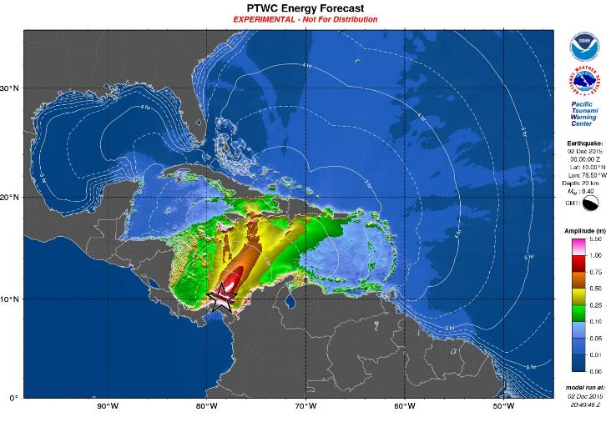
Graphical Product: Deep-Ocean Forecast
Tsunami Travel Time contours (assumes point source)
Color range scaled so red / white show maxima
Shaded textures show energy distribution
This map should not be used to estimate coastal amplitudes or impacts. Deep-ocean amplitudes are usually much smaller than coastal amplitudes
Notes:
Please see explanation in:
Users Guide for the Pacific Tsunami Warning Center Enhanced Products for the Pacific Tsunami Warning System. IOC Technical Series No 105, Revised edition. UNESCO/IOC, 2014 (English; Spanish)
Available for download at http://ptws-ptwcnewproducts.info

Slide 23
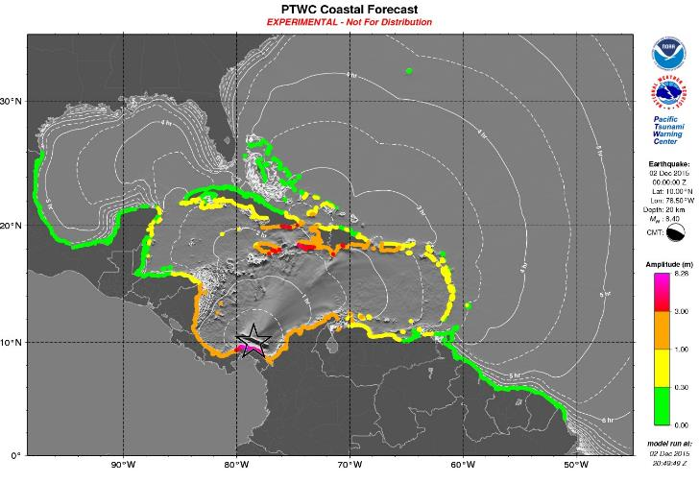
Graphical Product: Coastal Forecast
Green’s Law used to propagate off-shore, deep-ocean to coast
Tsunami Travel Time contours (assumes point source)
Tsunami Wave Amplitudes at designated coastal forecast points (Green’s Law)
Shaded textures show energy distribution
Caribbean-wide, sub-region plot
Actual amplitudes at the coast may vary from forecast amplitudes due to uncertainties in the forecast and local features. In particular, maximum tsunami amplitudes on atolls will likely be much smaller than the forecast indicates.
Notes:
Please see explanation in:
Users Guide for the Pacific Tsunami Warning Center Enhanced Products for the Pacific Tsunami Warning System. IOC Technical Series No 105, Revised edition. UNESCO/IOC, 2014 (English; Spanish)
Available for download at http://ptws-ptwcnewproducts.info

Slide 24
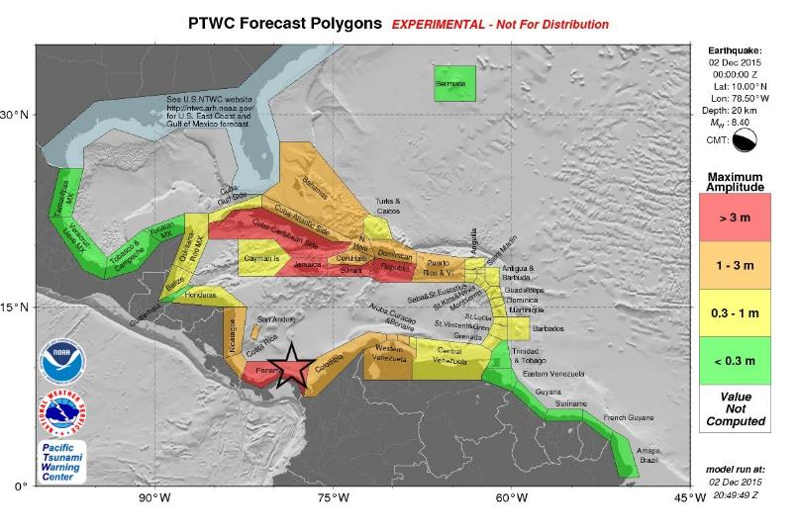
Graphical Product: Coastal Forecast Polygon
Threat level for designated forecast zones (based on geographical, geopolitical)
Grey-shaded textures shows bathymetry
Actual amplitudes at the coast may vary from forecast amplitudes due to uncertainties in the forecast and local features. In particular, maximum tsunami amplitudes on atolls will likely be much smaller than the forecast indicates.
Notes:
Please see explanation in:
Users Guide for the Pacific Tsunami Warning Center Enhanced Products for the Pacific Tsunami Warning System. IOC Technical Series No 105, Revised edition. UNESCO/IOC, 2014 (English; Spanish)
Available for download at http://ptws-ptwcnewproducts.info

Slide 25

Text File: Forecast Polygon Table
Coastal and Deep-Ocean Forecasts for polygons
Includes statistics giving uncertainty / quality estimate.
E.g., for each polygon (comprised of # forecast points), max / mean / median / standard deviation of coastal and offshore (deep-ocean) wave amplitude for that polygon
Complements GoogleEarth .kmz tool - can show value variation from point-to-point.
PTWC TABLE OF FORECAST STATISTICS FOR REGIONAL POLYGONS - RUN ID 20151202204949
(for internal use only - not for distribution)
Earthquake - Origin: 12/02/2015 00:00:00 UTC Coordinates: 10.0N 78.5W Depth: 020km Magnitude: 8.4
This table is issued for information only in support the UNESCO/IOC Tsunami and Other Coastal Hazards
Warning System for the Caribbean and Adjacent Regions and is meant for national authorities in each
country of that system. National authorities will determine the appropriate level of alert for each
country and may issue additional or more refined information.
Actual amplitudes at the coast may vary from forecast amplitudes due to uncertainties in the forecast and
local features. In particular, maximum tsunami amplitudes on small islands will likely be much smaller
than the forecast indicates.
Coastal Forecast (meters) Offshore Forecast (meters) Total
Region_Name Maximum Mean Median STD Maximum Mean Median STD Points
Caribbean_Coast_of_Panama 8.3 3.50 2.50 2.30 5.1 1.90 1.50 1.20 179
Caribbean_Coast_of_Haiti 4.9 2.90 2.90 0.70 2.0 0.92 0.85 0.33 89
Caribbean_Coast_of_Cuba 3.5 0.85 0.53 0.84 1.9 0.26 0.17 0.24 472
Jamaica 3.4 1.80 1.50 0.73 2.8 0.79 0.71 0.43 146
Caribbean_Coast_of_Dominican_Republic 3.2 2.20 2.20 0.53 3.2 1.20 1.00 0.60 148
Caribbean_Coast_of_Colombia 2.6 1.90 1.90 0.32 2.7 1.20 1.20 0.39 255
Puerto_Rico_and_Virgin_Islands 2.1 0.81 0.67 0.39 1.5 0.44 0.34 0.29 189
Gulf_of_Gonave_Coast_of_Haiti 2.1 1.40 1.40 0.29 1.9 0.54 0.46 0.31 139
Bahamas 1.9 0.16 0.06 0.27 1.1 0.09 0.03 0.15 442
Caribbean_Coast_of_Costa_Rica 1.5 1.30 1.30 0.15 1.2 0.82 0.79 0.18 48
Western_Coast_of_Venezuela 1.4 0.77 0.72 0.19 0.86 0.48 0.50 0.15 100
Atlantic_Coast_of_Haiti 1.4 0.84 0.73 0.27 0.99 0.33 0.29 0.15 66
Caribbean_Coast_of_Nicaragua 1.4 1.20 1.20 0.11 0.81 0.43 0.42 0.13 139
Curacao 1.2 0.77 0.66 0.23 0.62 0.29 0.27 0.11 27
Atlantic_Coast_of_Dominican_Republic 1.1 0.35 0.32 0.17 1.8 0.24 0.16 0.27 129
Aruba 1.1 0.98 0.99 0.11 0.80 0.46 0.39 0.17 8
San_Andres_and_Providencia 1.1 1.10 1.10 0.02 0.50 0.50 0.50 0.00 4
Atlantic_Coast_of_Cuba 1.0 0.18 0.11 0.21 0.47 0.07 0.03 0.09 267
Bonaire 0.88 0.70 0.67 0.08 0.67 0.40 0.38 0.16 15
Saint_Lucia 0.85 0.53 0.54 0.18 0.42 0.21 0.19 0.09 26
Saba_and_Saint_Eustatius 0.83 0.49 0.42 0.14 0.24 0.14 0.12 0.05 8
Saint_Vincent_and_the_Grenadines 0.77 0.62 0.62 0.09 0.48 0.25 0.23 0.10 33
Martinique 0.75 0.48 0.49 0.14 0.52 0.21 0.20 0.09 41
Saint_Kitts_and_Nevis 0.74 0.54 0.53 0.16 0.47 0.21 0.19 0.10 29
Guadeloupe 0.70 0.48 0.48 0.14 0.69 0.20 0.17 0.10 71
Anguilla 0.69 0.50 0.50 0.10 0.99 0.51 0.45 0.20 8
Montserrat 0.64 0.53 0.55 0.08 0.43 0.22 0.16 0.10 11
Central_Coast_of_Venezuela 0.62 0.34 0.32 0.13 0.70 0.17 0.15 0.09 244
Grenada 0.62 0.42 0.45 0.14 0.72 0.26 0.23 0.15 29
Dominica 0.61 0.47 0.48 0.09 0.30 0.13 0.13 0.05 31
Cayman_Islands 0.61 0.54 0.53 0.07 0.44 0.30 0.24 0.12 5
Gulf_of_Mexico_Coast_of_Cuba 0.52 0.07 0.05 0.06 0.09 0.02 0.02 0.02 119
Antigua_and_Barbuda 0.51 0.32 0.25 0.12 0.54 0.23 0.19 0.13 28
Turks_and_Caicos_Islands 0.49 0.25 0.23 0.10 0.34 0.13 0.12 0.06 46
Quintana_Roo_Mexico 0.49 0.24 0.28 0.12 0.81 0.12 0.11 0.10 166
Sint_Maarten 0.47 0.43 0.42 0.02 0.60 0.35 0.27 0.18 6
Saint_Barthelemy 0.45 0.37 0.42 0.09 0.36 0.29 0.26 0.05 6
Saint_Martin 0.42 0.42 0.42 0.00 0.42 0.34 0.32 0.06 3
Caribbean_Coast_of_Honduras 0.40 0.27 0.24 0.08 0.64 0.16 0.13 0.10 185
Barbados 0.34 0.22 0.22 0.05 0.16 0.09 0.09 0.03 22
Belize 0.31 0.23 0.23 0.03 0.38 0.08 0.07 0.05 90
Trinidad_and_Tobago 0.21 0.15 0.16 0.05 0.19 0.09 0.08 0.04 77
Bermuda 0.18 0.17 0.16 0.01 0.17 0.08 0.06 0.04 7
Caribbean_Coast_of_Guatemala 0.18 0.18 0.18 0.01 0.20 0.07 0.06 0.04 13
Yucatan_Mexico 0.14 0.04 0.01 0.05 0.08 0.01 0.01 0.01 59
Guyana 0.14 0.09 0.09 0.02 0.08 0.02 0.02 0.01 101
Atlantic_Coast_of_Venezuela 0.13 0.10 0.12 0.02 0.07 0.03 0.03 0.01 82
Mainland-Gulf 0.10 0.03 0.02 0.02 0.09 0.01 0.01 0.01 1147
Suriname 0.08 0.07 0.07 0.00 0.03 0.01 0.01 0.00 109
French_Guyane 0.08 0.02 0.02 0.01 0.02 0.01 0.01 0.00 84
Amapa_Brazil 0.02 0.02 0.02 0.00 0.01 0.01 0.01 0.00 45
Tamaulipas_Mexico 0.01 0.01 0.01 0.00 126
Veracruz_Mexico 0.01 0.01 0.01 0.00 152
Tabasco_and_Campeche_Mexico 0.01 0.01 0.01 0.00 183
Notes:
Please see explanation in:
Users Guide for the Pacific Tsunami Warning Center Enhanced Products for the Pacific Tsunami Warning System. IOC Technical Series No 105, Revised edition. UNESCO/IOC, 2014 (English; Spanish)
Available for download at http://ptws-ptwcnewproducts.info

Slide 26
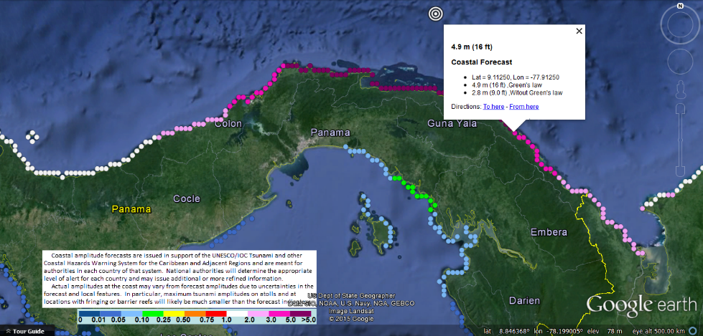
kmz file in Google Earth
Mouse-over balloon gives value of forecast point.
Forecast computed for model grid points nearest the coast.
Color-scale indicates values of forecast points.
Zoom in to area of interest
Trends more important than individual pts
Notes:
Please see explanation in:
Users Guide for the Pacific Tsunami Warning Center Enhanced Products for the Pacific Tsunami Warning System. IOC Technical Series No 105, Revised edition. UNESCO/IOC, 2014 (English; Spanish)
Available for download at http://ptws-ptwcnewproducts.info

Slide 27
Typical Timeline of PTWC Activities for an Earthquake / Tsunami
Earthquake
Alarm sounds
Seismic analyses
Initial product
0 1 2 3 4 5 6 7 8
elapsed minutes since Earthquake
0 min | A large earthquake occurs.
1 - 3 min Detect | Vibrations from the earthquake reach seismic stations near the earthquake epicenter, triggering event alarms at PTWC. PTWC duty analysts respond to the operations center and begin to analyze the event. [PTWC currently monitors ~ 600 seismic stations from around the world, with data collected at most of those stations reaching PTWC within a minute of when it is collected.]
2 - 6 min EQ Analyzed | Using a combination of automatic and interactive analyses, duty analysts complete their preliminary determination of the earthquake epicenter, depth, and magnitude.
5 - 8 min 1st Product | If criteria are met, then an initial product is issued that is either a Tsunami Information Statement or a Tsunami Threat Message.

Slide 28
Typical Timeline of PTWC Activities for an Earthquake / Tsunami
5 – 8 min 1st Product | Initial text products are generated and issued according to the following general procedures. Some deviation from these procedures may occur based upon the scientific judgments of the duty staff. A quantitative forecast is not issued yet due to having too little information this early on to properly constrain such a forecast.
Criteria for Initial Product | Initial Product Type
The EQ is deep (≥100km depth) or is located far inland with a magnitude ≥ 6.0/6.5*. | Tsunami Information Statement (TIS)
The EQ is shallow (<100km depth) and undersea with a magnitude of 6.0/6.5* to 7.0.
The EQ is shallow (<100km depth) and undersea and has a magnitude of 7.1 to 7.5. | Tsunami Threat Message (TTM) for coasts within 300 km of epicenter.
The EQ is shallow (<100km depth) and undersea and has a magnitude of 7.6 to 7.8. | Tsunami Threat Message (TTM) for coasts within 1000 km of epicenter.
The EQ is shallow (<100km depth) and undersea and has a magnitude ≥ 7.9. | Tsunami Threat Message (TTM) for coasts within 3 hours of tsunami ETA.
* Caribbean/Atlantic

Slide 29
Typical Timeline of PTWC Activities for an Earthquake / Tsunami
15 – 20 min continue analyses | Seismic analyses continue as data from additional seismic stations arrive and are processed. If the earthquake parameters change significantly based on these analyses then the appropriate supplemental text product will be issued, using the procedures described above.
20 – 30 min Forecast Issued | For earthquakes with a tsunami threat, the W-phase Centroid Moment Tensor (WCMT) analysis is triggered with results typically available about 20 - 30 minutes after the earthquake. The WCMT analysis not only gives a more accurate estimate of the earthquake’s location, depth and magnitude, but also an estimate of the earthquake’s faulting mechanism – the strike angle of the fault, the dip angle of the fault, and the direction and amount of slip along the fault. These parameters are critical to constrain the estimate of seafloor deformation that is the tsunami source. They are used to drive a run of the tsunami forecast model covering the region nearest the epicenter. For events with forecast coastal amplitudes above 0.3 m anywhere within the PTWC area of responsibility, a Tsunami Threat Message (TTM) is issued along with accompanying graphical maps, statistics table, and KMZ file that covers the affected region.

Slide 30
Typical Timeline of PTWC Activities for an Earthquake / Tsunami
15 min to 2 hours Detect Tsunami | Sea level gauges are monitored for tsunami signals. Within the first 30 minutes to an hour the tsunami may arrive on the nearest one or two coastal gauges and one or two deep-ocean gauges. Tsunami amplitudes are measured and compared, when possible, with forecast amplitudes produced by the models. The model forecast may be adjusted to be more consistent with observations.
Beyond 2 hours Monitor Tsunami | The process of refining the earthquake parameters and collecting additional sea level observations continues, with that information used to constrain the forecast if necessary. The tsunami is monitored as it advances. When it is likely that there is no longer a significant continuing tsunami threat for most areas then a final product is issued. Due to resonances in enclosed bays, and to tsunami energy that gets trapped around islands and along continental shelves or is re-energized by reflections, some areas may continue to experience hazardous sea level oscillations. It is up to local officials to determine when coasts are safe, persons can return to evacuated areas, and normal activities may resume.

Slide 31
PTWC Timeline for Jan 10 Honduras Tsunami
Time (UTC) | Elapsed Time | Event
02:51:31 | 00:00:00 | Earthquake occurs at 17.5°N, 83.6°W
02:52:09 | 00:01:38 | PTWC duty staff paged
02:55:40 | 00:04:09 | Observatory Message issued with preliminary earthquake location, depth, and magnitude (Mw=7.8)
02:57:02 | 00:05:31 | Message #1 - Tsunami Threat Potential threat within 1000 km of earthquake - Cayman Islands, Jamaica, Mexico, Honduras, Cuba, Belize, San Andres and Providencia, Costa Rica, Panama, Nicaragua, and Guatemala
03:20:09 | 00:28:38 | RIFT tsunami forecast #1 from PTWC WCMT, nodal plane 1. Mw=7.56, strike-slip, max=17cm
03:21:52 | 00:30:21 | RIFT tsunami forecast #2 from USGS WCMT, nodal plane 1. Mw=7.56, strike-slip, max=73cm
03:22:28 | 00:30:57 | RIFT tsunami forecast #3 from USGS WCMT, nodal plane 1. Mw=7.56, strike-slip, max=87cm

Slide 32
PTWC Timeline for Jan 10 Honduras Tsunami
Time (UTC) | Elapsed Time | Event
03:23:05 | 00:31:34 | Message #2 - Tsunami Threat Forecast is 0.3 to 1m for Belize, Cuba, Honduras, Mexico, Cayman Islands, and Jamaica
03:40:00 | 00:49:00 | 19 cm Tsunami Amplitude: George Town, Cayman Is.
03:51:00 | 01:00:00 | 2 cm Tsunami Reading: Carrie Bow Cay, Belize
04:08:15 | 01:16:44 | Message #3 - Tsunami Threat Revised forecast is 0.3 to 1m forecast only for Belize
04:48:30 | 01:56:59 | Message #4 - Final Tsunami Threat

Slide 33
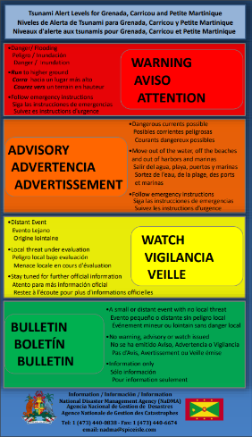
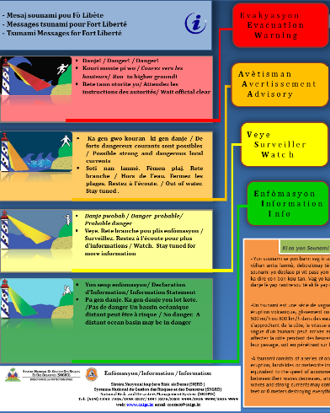
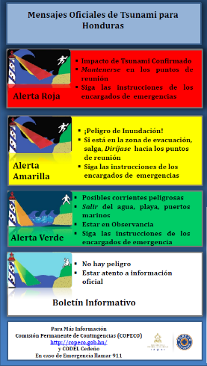
National Tsunami Products

Slide 34
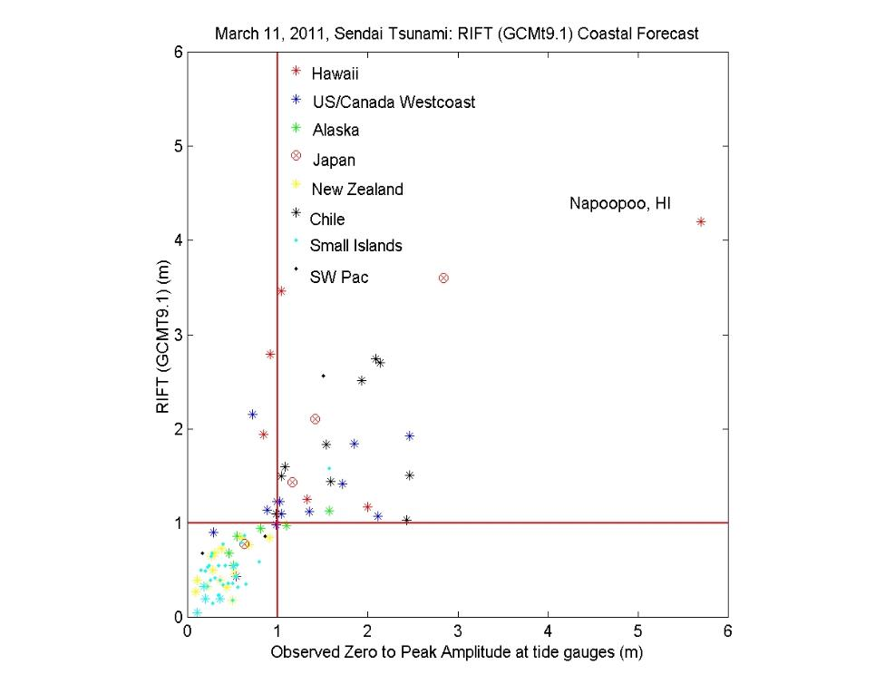
OVERWARNED
+ the rest
PROPERLY WARNED
PROPERLY NOT
WARNED
FAILED TO WARN

Slide 35
Benefits
Reduce conflict with Country NTWC Alert levels
Reduces over-warning
Provides estimated level of impact
Provide Country NTWC with additional decision-making information
  Graphical, as well as text products
  “kmz” file of forecast points allows drilling-down to finer spatial resolution
  Real-time model handles earthquake locations and mechanisms anywhere, not just shallow-thrust events in subduction zones (limitation of SIFT / ATFM models)
  RIFT model provides Green’s Law forecast for all coasts.
Notes:
Please see explanation in:
Users Guide for the Pacific Tsunami Warning Center Enhanced Products for the Pacific Tsunami Warning System. IOC Technical Series No 105, Revised edition. UNESCO/IOC, 2014 (English; Spanish)
Available for download at http://ptws-ptwcnewproducts.info

Slide 36
Communication Testing
MONTHLY SCHEDULED TESTS: Scheduled communication tests are sent at 1530 UTC on the first Thursday of each month. Very few problems are reported by TWFPs for these tests.
TWO UNSCHEDULED TESTS: Two unscheduled communications tests are made with responses required from all TWFPs and NTWCs.
CARIBE WAVE 19: Dummy messages will be sent to begin CaribeWave19 by all methods used for real events. Messages for each of the two scenarios to be sent by email only to TWFPs and NTWCs.

Slide 37
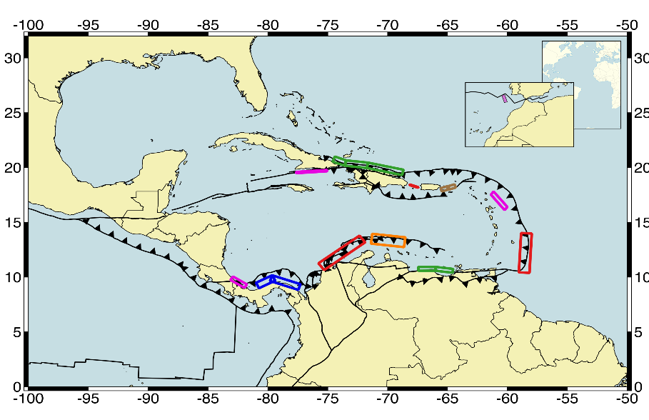
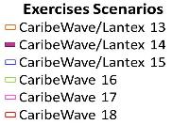
Regional Tsunami Exercises: CARIBE WAVE

Slide 38
Regional Tsunami Exercises: CARIBE WAVE

Slide 39
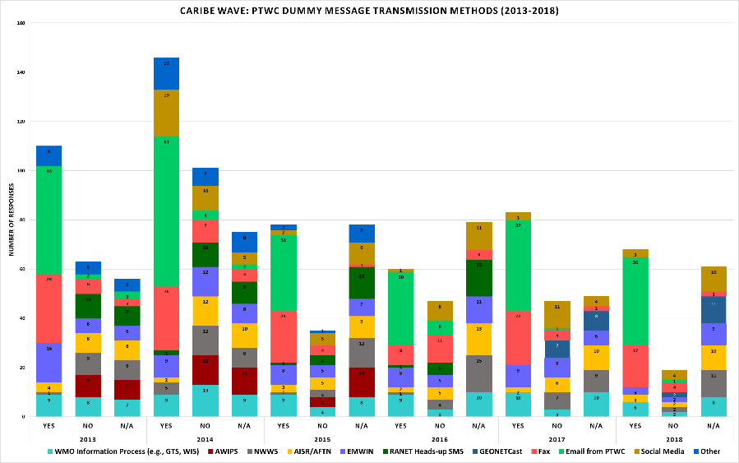
Regional Tsunami Exercises: CARIBE WAVE

Slide 40
CARIBE WAVE 19
Scenario | Origin Time | Mw | Epicenter
Panama | 14:00:00 UTC March 14, 2019 | 8.5 | 10.00⁰, -78.50⁰
Kick em’ Jenny |  | 6.0 | 12.34⁰, -61.65⁰

Slide 41
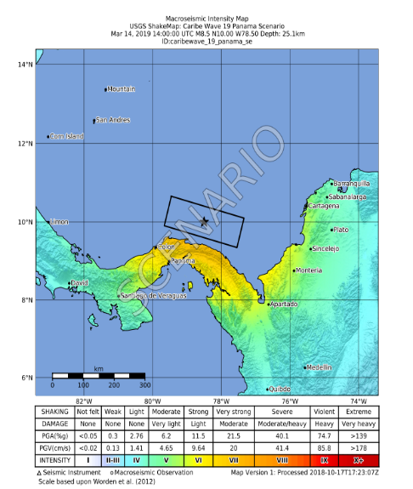
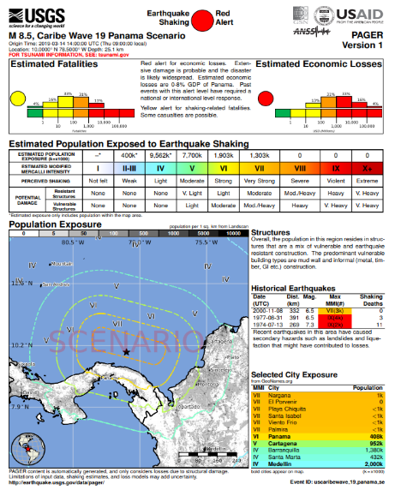
Earthquake Impact Panama Scenario

Slide 42
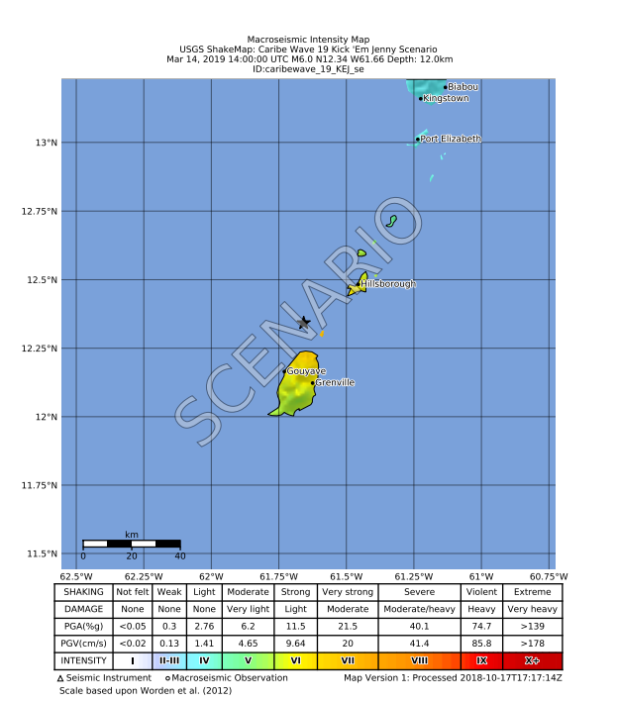
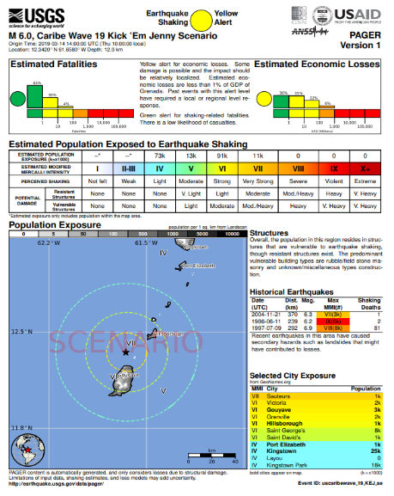
Earthquake Impact Kick em’ Jenny Scenario

Slide 43
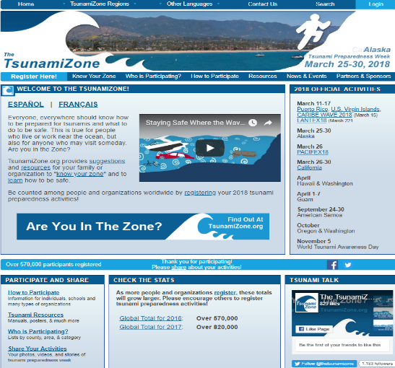
Member State Participation
The TsunamiZone Registration
Tsunami Zone Registration is used to track the number of people and organizations participating in the exercise.
TWFP and NTWC should register on Tsunami Zone to be part of the statistical count. Independent of registering, they will receive the simulated bulletins from PTWC.
Each member state needs to decide.

Slide 44
Timeline
ACTION | DUE DATE
Circular Letter Issued by IOC to MS | ✓Aug 2018
Handbook Draft Circulated among ICG CARIBE EWS TNC/TWFP and TT CARIBE WAVE 19 | ✓ Aug 2018
Deadline for Comments | ✓ Sept 2018
Exercise Handbook Available Online | ✓ Nov 2018
1st Webinar CW | 15 - Jan - 2019 - English 16 - Jan - 2019 - Spanish 17 - Jan - 2019 - French
2nd Webinar CW | 12 - Feb - 2019 - English 13 - Feb - 2019 - Spanish 14 - Feb - 2019 - French
Countries Indicate Selected Scenario | February 28, 2019
Exercise | March 14, 2019
Exercise Evaluation Due | March 29, 2019
Draft Final CARIBE WAVE Caribe 19 Report 5 April 2019

Slide 45
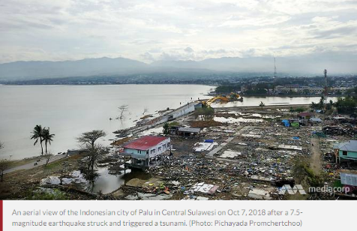
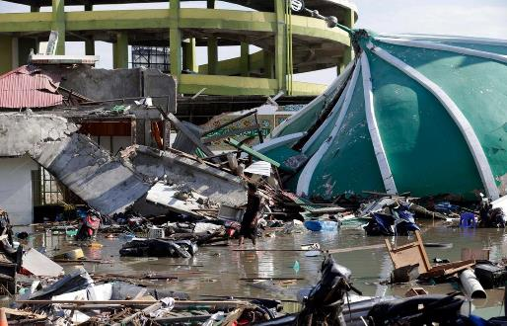
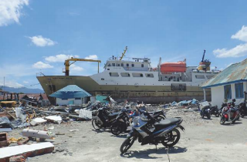
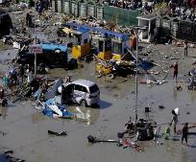
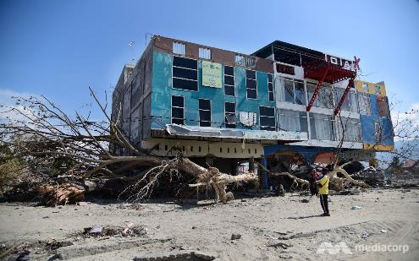

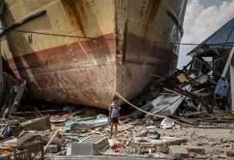
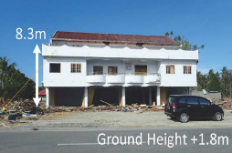

Education is Key: Sulawesi, Indonesia
https://www.channelnewsasia.com
https://www.thenational.ae
http://itic.ioc-unesco.org
Photo: Pichayada Promchertchoo
http://itic.ioc-unesco.org
https://www.thenational.ae
https://www.washingtonpost.com
http://itic.ioc-unesco.org

Slide 46
UNESCO IOC CARIBE/EWS TSUNAMI READY GUIDELINES
Categories
MITIGATION
Mit‑1. Have designated and mapped tsunami hazard zones
Mit‑2. Have a public display of tsunami information
PREPAREDNESS
Prep‑1. Produce easily understood tsunami evacuation maps as determined to be appropriate by local authorities in collaboration with communities
Prep‑2. Develop and distribute outreach and public education materials
Prep‑3. Hold at least three outreach or educational activities annually
Prep‑4: Conduct an annual tsunami community exercise
RESPONSE
Resp–1. Address tsunami hazards in the community’s emergency operations plan (EOP)
Resp–2. Commit to supporting the emergency operations center (EOC) during a tsunami incident if an EOC is opened and activated
Resp–3. Have redundant and reliable means for a 24-hour warning point (and EOC if activated) to receive official tsunami threats
Resp–4. Have redundant and reliable means for 24-hour warning point and/or EOC to disseminate official tsunami alerts to the public

Slide 47
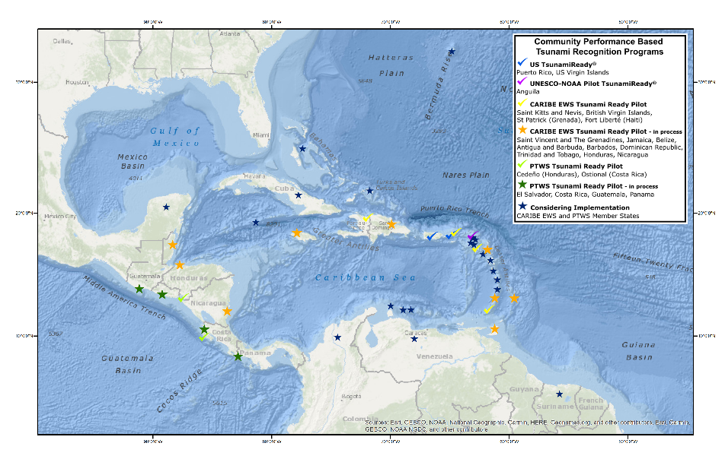
Status of Implementation of
Tsunami Ready Pilot Program

Slide 48
Thank You
Christa von Hillebrandt-Andrade
NOAA Caribbean Tsunami Warning Program
christa.vonh@noaa.gov

