Slide 1
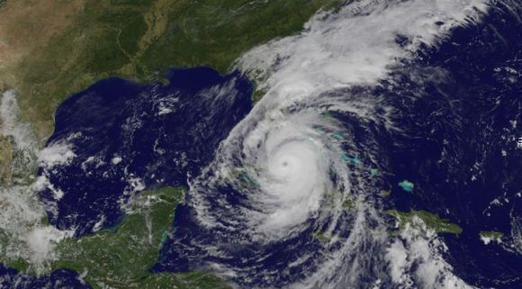
Lessons learned during chairing through natural disasters.
“Irma Hurricane”

Slide 2
Content
Antecedents of the event
Statutes of the MACHC
Comments about IHO Response to disasters resolutions 1/2005 amended
Actions taken during the event
Recommendations to improve the mechanisms in the MACHC

Slide 3
Antecedents of the event
“Hurricane Irma hit Florida as a Category 4 storm the morning of Sept. 10, 2017, ripping off roofs, flooding coastal cities, and knocking out power to more than 6.8 million people. By Sept. 11, Irma weakened significantly to a tropical storm as it powered north toward Georgia and Alabama. At 11 p.m. later that day, it weakened further to a tropical depression, and by Sept. 13, it had dissipated over western Tennessee”.
“The storm and its aftermath have killed at least 38 in the Caribbean, 34 in Florida, three in Georgia, four in South Carolina, and one in North Carolina. Irma is the fifth-costliest hurricane to hit the mainland United States, causing an estimated $50 billion in damage, according to the National Hurricane Center.”
Huber Chris, 2017 Hurricane Irma 2017 Hurricane Irma: Facts, FAQs, and how to help, (2017)

Slide 4
Statutes of the MACHC
ARTICLE 3: OF THE AIMS…
B) The Commission has a limited capacity for disaster response (IHO resolutions 1/2005).
The role of the Chair of the MACHC is that of a broker of hydrographic demand (from the affected countries) and supply (by countries offering assets).
The Chair cannot absorb Member States responsibilities for Diplomatic clearance needed to deploy those hydrographic assets.

Slide 5
Comments about IHO Response to disasters resolutions 1/2005 amended
2. Procedures and Directions…
B) By the side of the Regional Hydrographic Commissions. The Chair of the Regional Hydrographic Commission will be responsible to coordinate the required actions in the Region. To carry on the actions the regional hydrographic commission must develop an action plan “against disasters”, whose objective will support the States in the hydrographic damage evaluation area, give support and coordinate actions and efforts. Those plans will focus on the follow:
i) Communicate, through the fastest available means, with the focal points of the States of the Region, to make an initial assessment of the extent of the damage;
ii) Decide whether a regional technical working group needs to visit the States in the area to support the assessment of the damage and the support required;

Slide 6
Comments about IHO Response to disasters resolutions 1/2005 amended
2. Procedures and Directions…
iii) Decide, based on the information collected, if an Extraordinary Meeting of the CHR is needed, to discuss the problems in detail, to assess the damages and to respond to requests for support;
iv) Decide if the President needs to assume a coordinating role in the evaluation of damages, providing support and disseminating the information to the navigators;
v) Inform the IHB about the situation, the actions taken and the need, if any, for external support;
vi) Control the progress of the agreed actions in the area, keeping the Member States of the Region and the IHB informed in accordance with the above;
vii) Include this point as a permanent item on the agenda of the RHC meetings, to monitor the availability of the Commission to respond to disasters and conduct regular practical exercises to evaluate the procedures.

Slide 7
Actions taken during the event
On September 8, an email was sent with the first report in response to Hurricane Irma, proposing two requests, in order to prepare to provide support to the extent of the possibilities available to the Commission:
1.- The affected nations must indicate through their National Hydrographic Services (or equivalent) if and what type of hydrographic support is required for the recovery phase. Must indicate the purpose of the support that is being requested.
2.- Members and Associate Members indicate the hydrographic capacity of aid in the area that, pending diplomatic approval or national policy and pending other complementary international actions, could be available.

Slide 8
Actions taken during the event
On September 12, the status of the situation was updated by sending the second report, where some updates and reports of activities were received from different Organizations:
UKHO update. On several operations carried out by UKHO, the royal navy and the ministry of defense on the MACHC area.
Netherlands did not have any demand for hydrographic assistance
Report of the Armed Forces of Brazil about action taken for humanitarian aid in Haiti
SHOM report. Relief operations were provided by air and sea, without immediate hydrographic needs
NGA developed a support web page for Hurricane Irma that is available on the NGA World Wide Web page

Slide 9
Recommendations to improve the mechanisms in the MACHC
Keep contact information updated
Add additional contact information other ways of communication (email, whatsapp, radio satellite)
Contact MACHC chair in the case you need support
Open diplomatic channels

