Slide 1
19th Meeting of the Meso America – Caribbean Sea Hydrographic Commission National Report by
Suriname

Slide 2
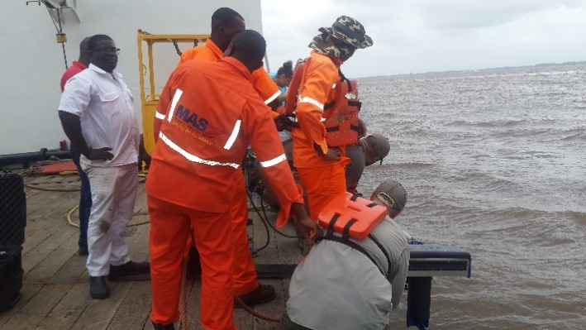
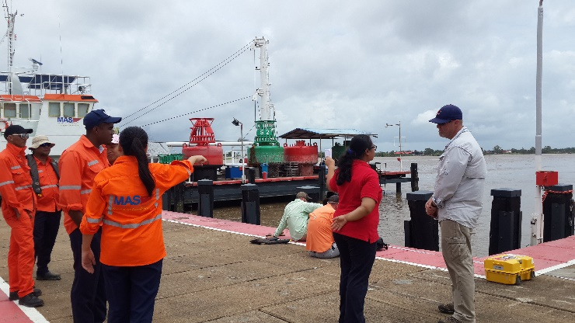
Main achievements during the year
This year MAS has received the following training:
Marine Cartography and Data Processing, UKHO
Multibeam Training Opportunity US Navy

Slide 3
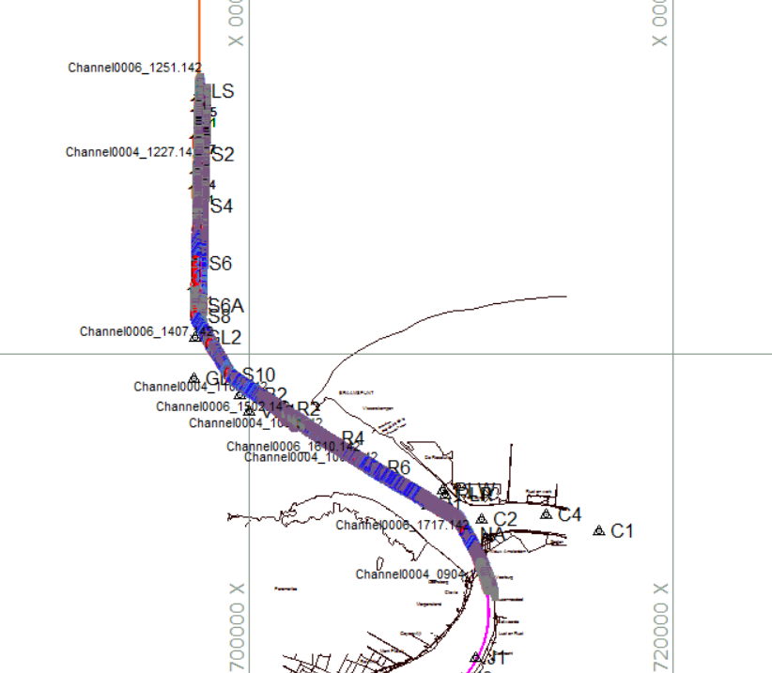
Main achievements during the year
This year MAS has received the following training (continued):

Slide 4
Main achievements during the year
This year MAS has received the following training (continued):
Remote sensing and GIS training (LULC)
National Workshop Oil Spill Contingency Planning and RETOS
Blue Planning in Practice Training

Slide 5
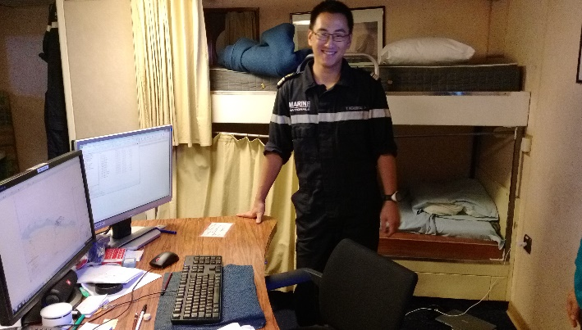
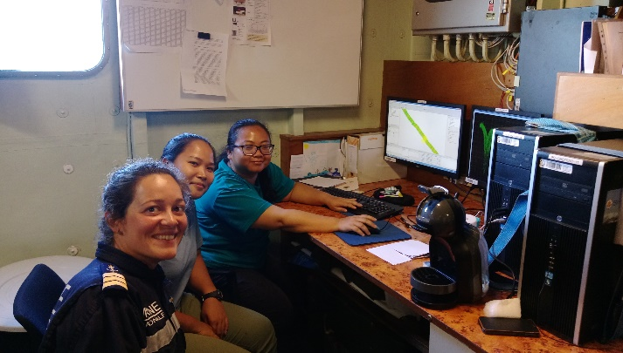
Main achievements during the year
This year MAS has received the following training (continued):
Multibeam Training Opportunity from SHOM

Slide 6
Main achievements during the year
Special thanks to the UKHO, US Navy and SHOM for their training opportunity

Slide 7
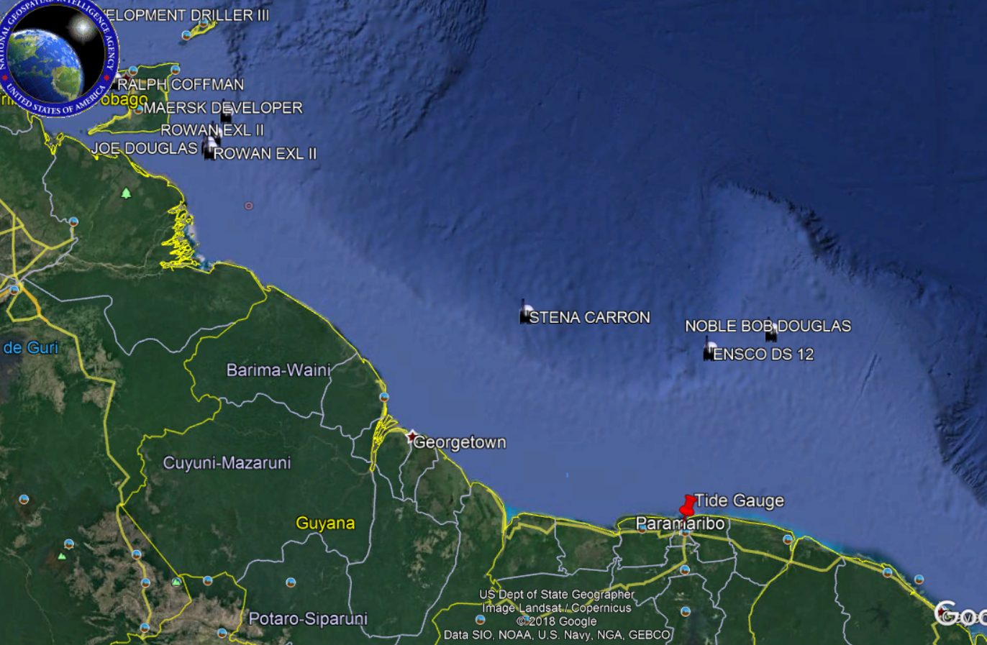
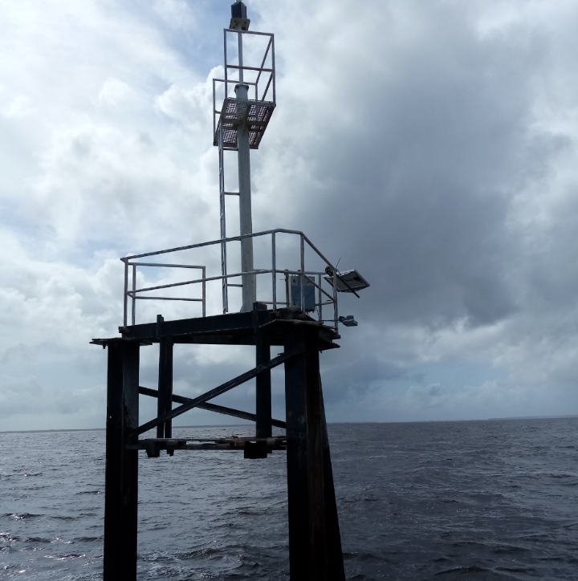
Main achievements during the year
Establishment of a sea tide gauge

Slide 8
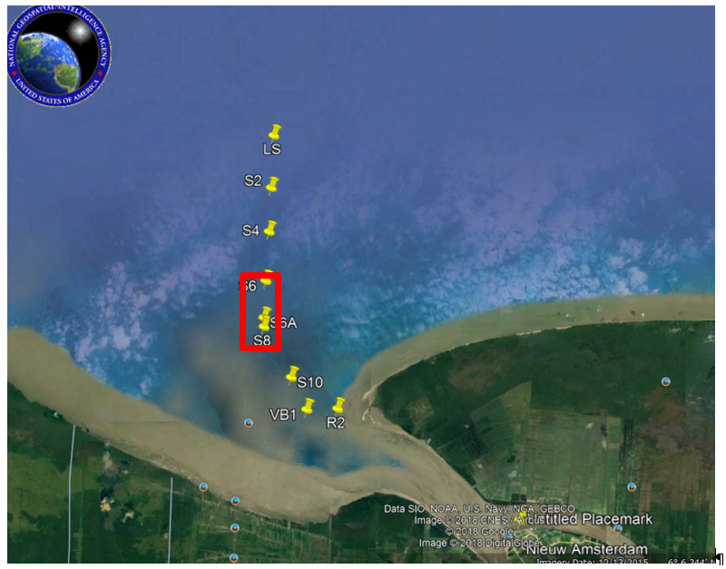
Main challenges and/or obstructions
Critical area in the entrance of the Suriname River.

Slide 9
Main challenges and/or obstructions
The resurvey of the Suriname River was not completely done, due to technical challenges with our survey vessel.

Slide 10
Progress on MSDI
Governance: geospatial framework in development with support of UN-GGIM
Standards: in development
Technology: training of employees in remote sensing and GIS
Data: hydrographic data have been collected. Hydrographic layers are available.

Slide 11
Plans that affect the region
Training offered:
IALA -Level 1 Aids to Navigation Manager Course, will be planned in 2019. This training has been canceled for 2018, because of few applications

