Slide 1
The Standards of Competence for Hydrographic Surveyors and Nautical Cartographers
Adam Greenland, IBSC Chair and Keith Miller, IBSC Board Member
(Presented by Alberto Costa Neves, IBSC Secretary)

Slide 2
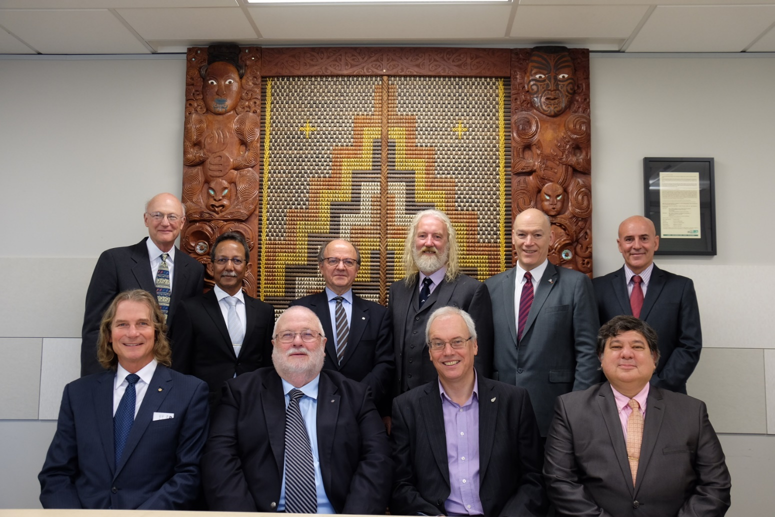
The Board
The Board maintains the standards and considers programs for recognition against the standards.
10 members (4 FIG, 4 IHO and 2 ICA), from government, education and industry;
Members from New Zealand, Australia (2), Brazil, Greece, USA, UK, Portugal, Indonesia and Trinidad and Tobago

Slide 3
The Standards
New standards:
S-5A Standards of Competence for Category "A" Hydrographic Surveyors
S-8A Standards of Competence for Category "A" Nautical Cartographers
S-5B Standards of Competence for Category "B" Hydrographic Surveyors
S-8B Standards of Competence for Category "B" Nautical Cartographers
Accompanying document: Guidelines for the Implementation of the Standards of Competence for Hydrographic Surveyors and Nautical Cartographers
Available from: www.iho.int/download

Slide 4
The Standards
New standards (2):
Replace S-5 and S-8.
Educational programs found to be compliant with the standards are awarded recognition for a period of 6 years.
Article published in the International Hydrographic Review (IHR), November 2017 Edition:
https://www.iho.int/mtg_docs/com_wg/AB/AB_Misc/IHR-Nov-2017-Article-Standards.pdf

Slide 5
Sectors offering programs
National agencies –for management of territorial waters
Civilian: labeled as Government
Military: labeled as Defense
Education – Institutions offering degrees at Bachelors and Masters as well as diplomas.
Industry – programs delivered commercially or internally for staff development.
Wide range of applications, many programs have a broad scope.
Standards must be flexible in meeting the demands while ensuring coverage of key competencies.

Slide 6
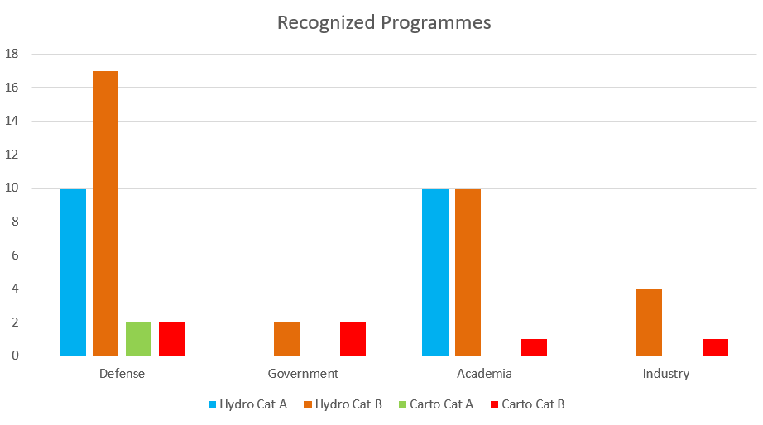
Sectors offering programs

Slide 7
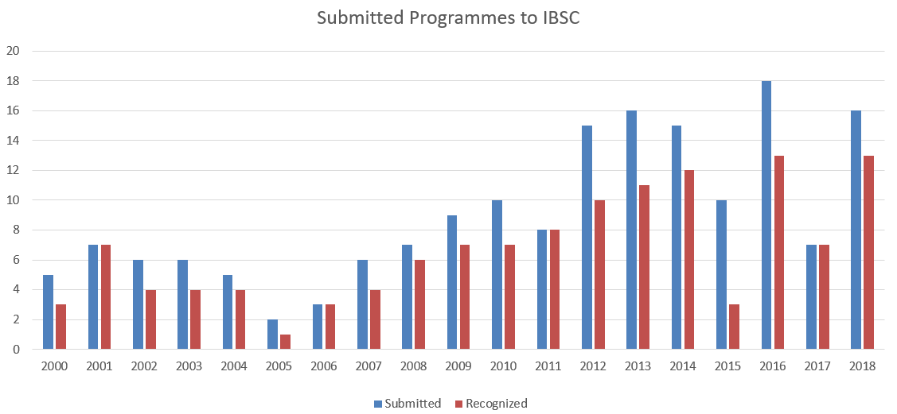
Sectors offering programs
November 2018:
61 Recognized Programmes
2 Schemes
32 Countries:

Slide 8
Subjects in the Standards
S-5A Subjects | S-5B Subjects
B1 Mathematics, statistics, theory of observations | B1 Mathematics, Statistics, Theory of Errors
B2 Information and Communication Technology | B2 Information and Communication Technology
B3 Physics | B3 Physics
B4 Nautical science | B4 Earth Sciences
B5 Meteorology | B5 Nautical science
F1 Earth Models | B6 Meteorology
F2 Oceanography | E1 Underwater Acoustics
F3 Geology and geophysics | E2 Remote Sensing
H1 Positioning | E3 Water Levels And Flow
H2 Underwater Sensors and Data Processing | E4 Positioning
H3 LiDAR and Remote Sensing | E5 Hydrographic Practice
H4 Survey Operations and Applications | E6 Hydrographic Data Management
H5 Water Levels and Flow | E7 Environment
H6 Hydrographic Data Acquisition and Processing | COMPREHENSIVE FINAL FIELD PROJECT
H7 Management of Hydrographic Data
H8 Legal Aspects
COMPLEX MULTIDISCIPLINARY FIELD PROJECT
S-8A Subjects | S-8B Subjects
B1 Mathematics, Statistics, Theory of Errors | B1: Mathematics, Statistics, Theory of Errors
B2 Information and Communication Technology | B2: Information and Communication Technology
B3 Earth Sciences | B3: Earth Sciences
F1 General Geodesy | E1: General Geodesy
F2 Hydrography and Nautical Products | E2: General Cartography
F3 Photogrammetry and Remote Sensing | E3: Hydrography and Nautical Products
C1 General Cartography | E4: Data for Nautical and Special Purpose Charting
C2 Data for Nautical and Special Purpose Charting | E5: Photogrammetry and Remote Sensing
C3 Geospatial Information and Processing | E6: Geospatial Information and Processing
C4 Nautical Cartography | E7: Nautical Cartography
C5 Legal aspects (Relating to nautical cartography) | E8: Legal aspects (Relating to nautical cartography)
C6 Special Purpose Charting | E9: Special Purpose Charting
C7 Map/Chart Reproduction | E10: Map/Chart Reproduction
COMPREHENSIVE FINAL CARTOGRAPHIC PROJECT | COMPREHENSIVE CARTOGRAPHIC PROJECT
Basic subjects cover general background principles and skills;
Foundation subjects cover specialized subjects that have a scope beyond the standards.
Essential subjects (Cat B) and specialist subjects (Cat A) relate directly to the discipline.
Students may be exempted from Basic and Foundation subjects on the basis of prior learning.

Slide 9
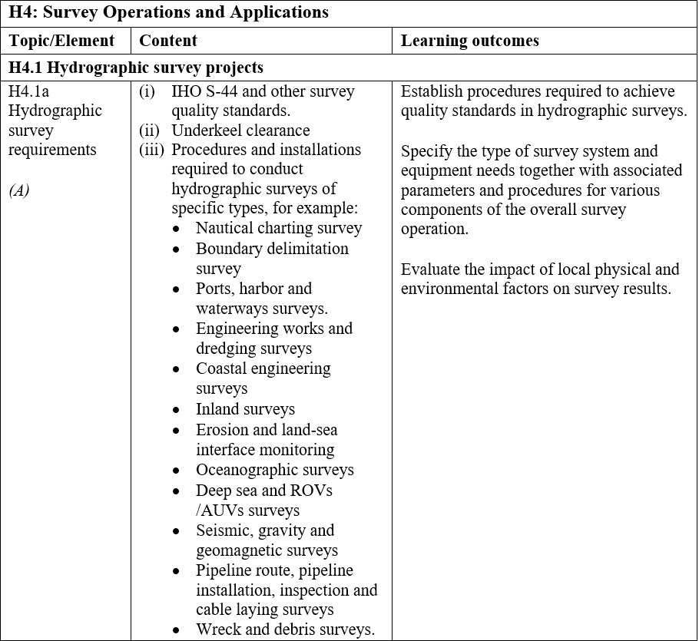
Expressing competencies
Competencies are now specified in the standard format used in education as generic learning outcomes.
Verbs such as ‘specify’, ‘analyze’, ‘apply’, ‘select’ and ‘identify’ indicate the depth of knowledge through a competency.
Content is given to provide a context for the learning outcome.

Slide 10
Bloom’s taxonomy
Used in education to express depth of learning.
Remembering – Define, describe, identify, list, …...
Understanding – Classify, report, discuss, demonstrate, …...
Applying – Apply, prepare, produce, implement, ……..
Analyzing – Analyze, classify, compare, examine, …..
Evaluating – Assess, evaluate, justify, select, …..
Creating – Compose, design, develop, plan, …..
There is some overlap, ‘produce’ could be an application or a creation, ‘select’ could be considered as an application or at the depth of evaluation.

Slide 11
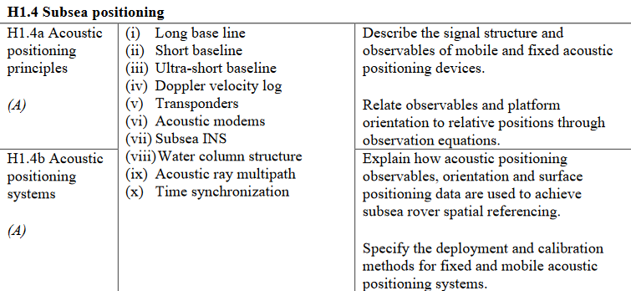
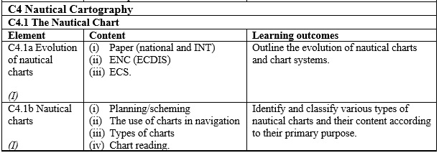
Guidance on level
An indication of the expected level is provided within the element, which is described as Advanced (A), Intermediate (I), or Basic (B).
While ‘describe’ and ‘relate’ used H1.4a are remembering and applying, but the principles on which they are based are advanced.
Similarly in elements C4.1a the verb ‘outline’ alone implies remembering, but to achieve this in context of the content the level is considered as intermediate.

Slide 12
Number of outcomes
Subject type | S-5B | S-5A | S-8B | S-8A
Basic | 49 | 62 | 34 | 38
Foundation | - | 49 | - | 35
Essential | 118 | - | 191 | -
Cartographic Science | - | - | - | 164
Hydrographic Science | - | 169 | - | -
TOTAL | 167 | 280 | 225 | 237
A typical Masters program at a University might contain 70 learning outcomes, these are all academic.
Competencies cover both academic knowledge and practical skills, many of the skills based learning outcomes in the standards require short delivery time and may be integrated within practical learning tasks.

Slide 13
Types of outcomes
Example skills based learning outcomes from S-5A:
B4.9 - Specify procedures for deployment and recovery of oceanographic and hydrographic equipment. Students must be involved in equipment deployment and mobilization, this should not be done by technical support staff.
F1.3e - Relate historical surveys to legacy positioning systems. Awareness that GNSS has not always existed, that historical data will not have the same accuracy that is available today.
H2.1e - Use the sound speed profile to compute the path of sound ray through the water column. A detailed task that each student must perform.
H2.4b - Tune acoustic parameters on-line for depth and backscatter. Can only be achieved through hands on practical work.
Competencies cover academic requirements and include core skills that a Category A surveyor must have demonstrated, these typically form an integral part of practical work, hence more learning outcomes exist than expected of an academic program.

Slide 14
Program duration
Guidelines that accompany the Standards specify:
Maximum - The time frame over which an individual studies towards a recognized program cannot be more than five (5) years for a Category "B" Program and no more than six (6) years for a Category "A" Program.
Minimum - In the experience of the Board, for a program (without exemptions sought) delivered full-time in a continuous manner an expected minimum time frame is.
At Category "B", twenty four (24) weeks including the final project.
At Category "A", forty (40) weeks, including the final project.
Students are expected to be engaged for 50 to 60 hours per week over this duration to include lectures, practical work and guided study.

Slide 15
Final project
All standards require a comprehensive final project of at least 4 weeks in duration. Students must be involved in:
Planning
Preparation and Mobilization
Data acquisition
Data Processing
Compilation of products and reporting.
The project should be specified to incorporate a variety of equipment. Use of multi-beam in hydrography and multi-beam data in cartography are requirements.

Slide 16
Program submissions
Submitting organizations must fully document program structure, content and assessment strategy for both practical and theoretical components. Elements considered by the Board include:
Level of assessment against expectations of specified learning outcomes.
Content of lectures, practical tasks and other exercises that underpin the knowledge base to achieve the learning outcomes.
Resources available for program delivery and assessment.
Specifications and assessment criteria for assignment tasks and for the final field project.

Slide 17
Guidelines for submission
Comprehensive guidelines are available to submitting organizations, these are continually being updated.
A pro-forma cross reference table is provided that duplicates the standards with space for institutions to add modules and teaching hours associated with delivery and assessment. This must accompany detailed information on the program.

Slide 18
Evidence of learning
The Board needs reassurance that student learning is taking place at the required level, this is evidenced by:
Past examination papers, even for new programs specimen papers are required.
Specifications for practical tasks and assignments together with assessment criteria.
Specifications for the final project with assessment criteria and previous student project reports where available. It is expected that there will be more than one form of assessment and that students will be assessed individually as well as in their group performance.

Slide 19
Quality assurance
Evidence is required that internal quality assurance mechanisms are in place that maintain currency of content in practice and theory and address problems associated with logistics of delivery:
Student progression criteria and remedial measures must be in place.
Programs should be reviewed every 5 years, more frequently for new programs with feedback from staff, stakeholders and students being considered.
Student exit surveys must be undertaken each year with a formal mechanism in place to immediately deal with reported problems that need urgent attention.

Slide 20
Submissions
Must demonstrate that:
Entry requirements are appropriate.
A structured program exists with a plan for progression.
Learning is taking place at the level specified in the standards.
Scope of the intended learning outcomes is covered.
Adequate time is given to theory and practice.
Requirements given in the guidelines are met.
It is up to the submitting organization to provide documentary EVIDENCE.
Representatives are encouraged to attend the Board meeting to answer questions.

Slide 21
Thanks from the IBSC
On behalf of the Board, I thank you for providing this opportunity to present the new standards.
The Board acknowledges support from stakeholders in the region in providing feedback on drafts of the standards prior to their ratification.
The Board looks forward to receiving further submissions for recognition from organizations offering education in hydrographic surveying and nautical cartography within the region.
I will be pleased to answer questions now, during the breaks and afterwards.

Slide 22
Alberto Costa Neves
IHO Assistant Director
IBSC Secretary
Email: alberto.neves@iho.int
More information at:
www.iho.int/ibsc and www.iho.int/cb

