Slide 1
20th Meeting of the Meso American – Caribbean Sea Hydrographic Commission HSSC 11 Update
6 - 9 May 2019, Cape Town, South Africa

Slide 2
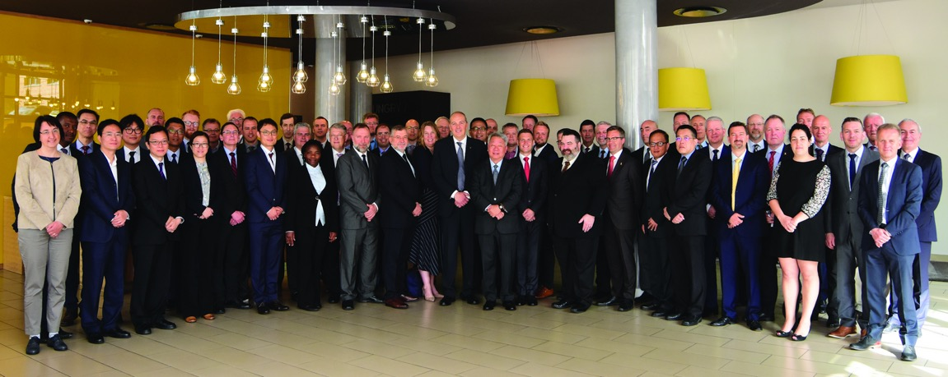
HSSC 11
HSSC Meeting:
HSSC 11 was held in Cape Town, South Africa, 6-9 May 2019
HSSC 12 to be held in Bristol, United Kingdom, 11-15 May 2020 (TBC)
HSSC 13 to be held in Bali, Indonesia, May 2021
MACHC Member States attending:
Brazil
Colombia
France
Mexico
Netherlands
United Kingdom
United States of America
Notes:
https://www.iho.int/mtg_docs/com_wg/HSSC/HSSC11/HSSC11Docs.html

Slide 3
HSSC-11 Key Priorities
Demonstration showcase of S-100 based products
Technical level
Strategic Level
Final remarks of the Resolution 2/2007 as amended
Future of Paper charts
Revised Strategic Plan
S-100 Implementation Strategy
Development of the S-1xx Product Specifications and operationalization of S-1xx framework
Priorities of IHO 2019 Work Plan 2
Interoperability S-101 and S1XX

Slide 4
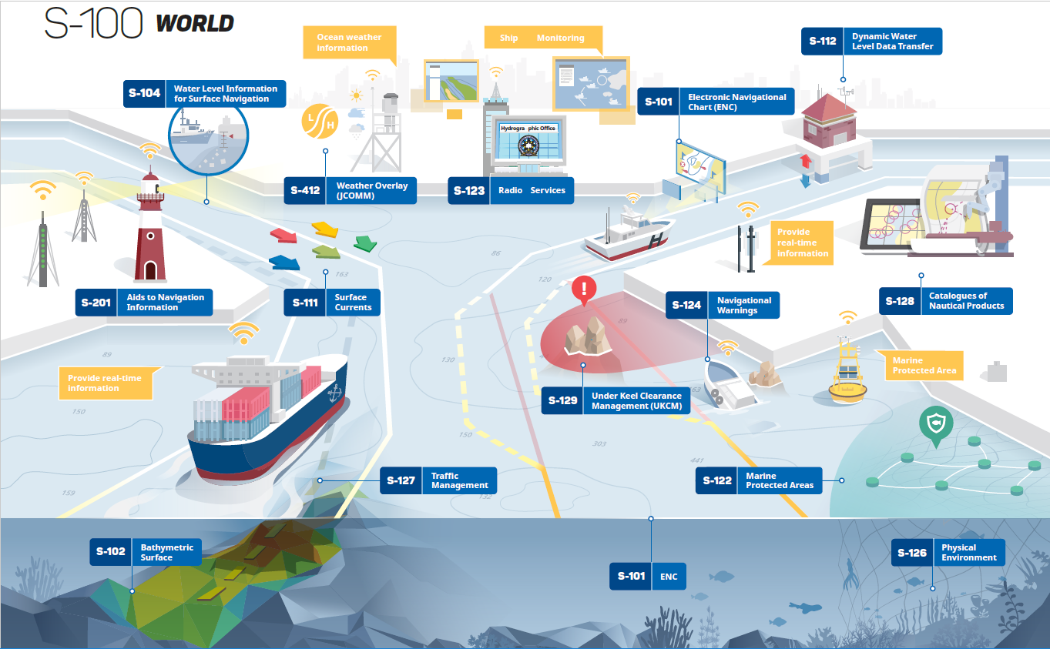
Actions taken on the priorities of IHO 2019
S-100 Product Specifications
1.0.0 under development
1.0.0 released
2.0.0 draft
Notes:
HSSC11 approved the amendments proposed by the HSSC WGs/PTsChairs to their Work Plans that constitute HSSC contribution to IHO Work Programme (see Action C2/54).
In order to continue to monitor activities the S-100 Timeline for Product Specifications was updated by S-100WG in accordance with HSSC11 outcomes
HSSC endorsed S-102 Ed. 2.0.0, deadline for S-100 Edition 5.0.0 publication date to be 2021, approved Edition 1.0.0 of S-97, approved Ed.1.0.0 of S-127, agreed on the renaming S-122 (Marine Protected Area), S-123 (Marine Radio Services), S-125 (Marine Navigational Services), S-126 (Marine Physical Environment), S-127 (Marine Traffic ,Management), S-128 (Catalogue of Nautical Products), agreed to ask IRCC to submit a survey about member states intention to produce S-122 and S-123, approved S-129 Edition 1.0.0, agreed to allocate to the WMO S-412 and S-413.

Slide 5
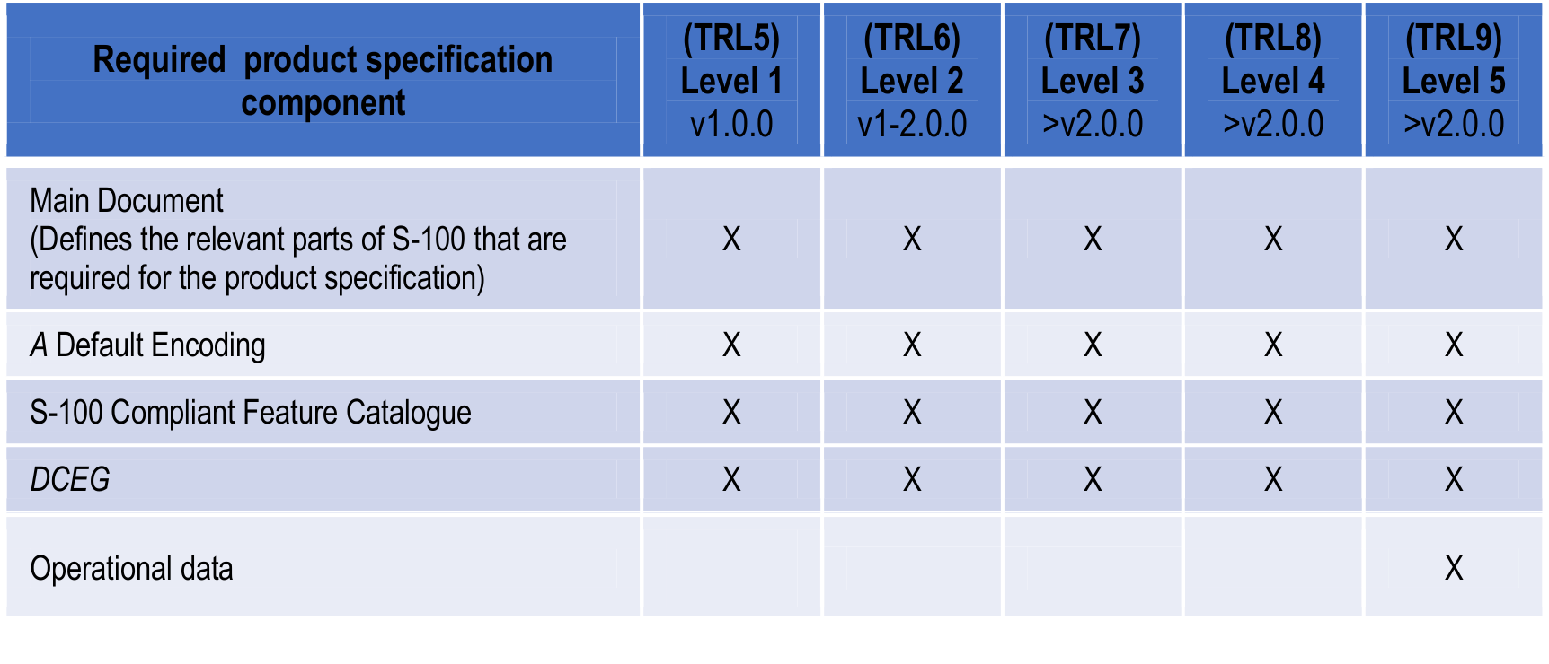
Actions taken on the priorities of IHO 2019
S-100 Readiness Level prerequisite components
Source: C3-4.1-page 7 from HSSC 11 Report to C3
Notes:
HSSC endorsed the concept of S-100 Technical Readiness Level where operational data will be available after any any updates to Edition 2.0.0.

Slide 6
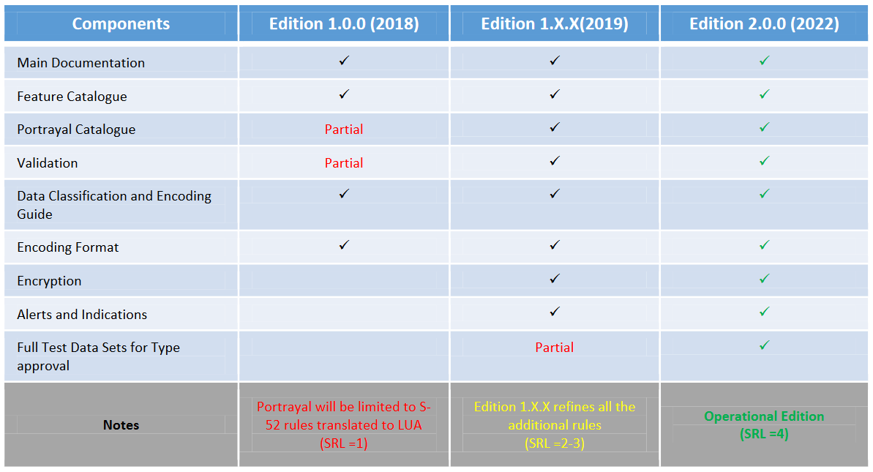
S-101 way forward
Source: C3-4.1-page 8 from HSSC 11 Report to C3
Notes:
HSSC-11 agreed that the first revision Ed. 1.1.0 of S-101 is expected in December2020. The plan for a S-101 Edition 1.1.0 is based on remaining action items deemed resolvable within the next calendar year as well as any feedback from initial industry implementation efforts.
HSSC-11 noted that the planned publication timeframe for Edition 2.0.0 is December 2022. The S-101 components for Encryption and Alerts and Indications are planned to be fully developed. The S-101 Full Test Data Sets for Type Approval are planned to be partially completed

Slide 7
Paper Chart, Ed. 6.0.0 of S-44 and Maritime Services in e-navigation
The Future of Paper Nautical Chart
HSPT is finalizing the drafting process of Edition 6.0.0 of S-44
Develop initial guidance on definition and harmonization of Maritime Services in context of e-navigation
Notes:
About Paperless:
Sales and use of paper nautical charts is declining while the use of electronic navigational charts (ENCs) is increasing. During HSSC-11 the final stage of the document “Future of Paper Charts” drafted by NCWG was discussed
HSCC-11 noted the following arguments of interest of IRCC/C-3/IHO Secretariat:
-Automated production of Paper Charts from ENCs;
-ENC regulation framework guidance from IMO;
-Front/back bridge requirements;
-Further Focus on ENCs as the preferred charting products of the IHO and Hydrographic Offices.
About S-44:
HSPT is finalizing the drafting process of Edition 6.0.0 of S-44. HSSC agreed on the recommendation made by HSPT that the final draft version 1.x.x of the 6th Edition of S-44 should be circulated to all stakeholders, prior to submission for endorsement to HSSC-12.
HSPT will submit final proposed version 2.0.0 of 6th Edition of S-44 to HSSC for endorsement, with the aim to submit it for approval to IHO Member States for approval by July 2020.
HSPT submitted a proposal to become a WG. This proposal will be taken into consideration after the 6th Edition is submitted at the next HSSC meeting, in accordance with the current HSPT TOR.
About MS e-navigation:
HSSC11 noted the responsibilities of Maritime Services relevant to IHO. In particular:
-WWNWS-CG No. 5 - Maritime Safety Information Service (MSI);
-NCWG, ENCWG No. 11 - Nautical Chart Service;
-NIPWG No. 12 - Nautical Publications Service;
-TWCWG No. 15 - Real-time hydrographic and environmental information Service.
NIPWG will continue to coordinate the provision of the Maritime Services descriptions under IHO.

Slide 8
HSSC 11
This meeting was characterized by two levels of discussion:
an operational/strategic level and
a technical level.
This new dual role results from Council guidance through C-2 Decisions and Actions and represents an added value, allowing WGs/PTs to have a wider view and prospective in relation with their efforts in the transforming navigation.
Notes:
The HSSC-11 meeting was characterized by two levels of discussion: an operational/strategic level and a technical level.
-An operational/strategic level, with the following topics being examined:
The final remarks of the Resolution 2/2007 as amended (Action C2/13)
The revised Strategic Plan (Action C2/40)
The S-100 Implementation Strategy (Action C2/31)
The future of paper nautical charts (HSSC11-05.4B)
-A technical level, with progresses in the development of the S-1xx Product Specifications (PSs) framework and their operationalization in accordance with the S-100 concept.
This new dual role results from Council guidance through C-2 Decisions and Actions and represents an added value, allowing WGs/PTs to have a wider view and prospective in relation with their efforts in the transforming navigation.
As result, it should be highlighted the great achievements in the field of Product Specifications development.

