Slide 1

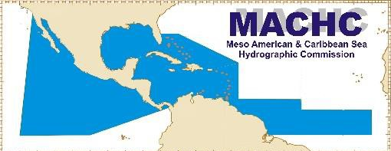

20th Meeting of the Meso America - Caribbean Sea
Hydrographic Commission
National Report by
United Kingdom of Great Britain and Northern Ireland
International Hydrographic Organization
Organisation Hydrographique Internationale

Slide 2
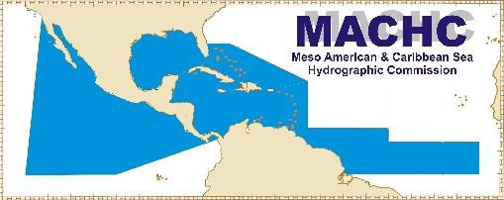

Top achievements during the year
7 New Charts, 57 New Editions and 6 New ENCs.
UK Government funded Commonwealth Marine Economies (CME) and Overseas Territories Seabed Mapping Programme (OTSMP) activity (Anguilla, Antigua, Belize, BVI, Caymans, Dominica, Guyana, Jamaica, Montserrat, St Lucia, TCI). Mixture of Surveys, equipment and charting.
Capacity Building - delivery of Nippon funded Cat B course, UWI student support.
International Hydrographic Organization
Organisation Hydrographique Internationale

Slide 3
Top challenges and/or obstructions
Remote locations
with limited face to face
opportunities to assist with Hydrographic Governance.
Funding / resources available for data collection.
Access to updated information and data needs to meet both SOLAS and Blue Economy aspirations including S-100 impact / developments.
International Hydrographic Organization
Organisation Hydrographique Internationale

Slide 4
Top Plans that affect the region
Future CME and OTSMP activity (funding dependent) / PCA nation plans.
Training in the MACHC region/ CME NHCC Governance course November.
Charting plans for next year still to be decided once we have received and processed the new data.
International Hydrographic Organization
Organisation Hydrographique Internationale

Slide 5
Top 2 recommendations for MACHC plenary
(Criteria: Greatest collective regional impact, return on investment, potential for leveraging resources/partnerships)
What is your greatest capacity building priority to recommend for IHO CB funding consideration (Phase 1)? (Select one)
  High-level visit (political awareness)
  Technical visit (assessment of national capabilities and awareness)
  Maritime Safety Information training
  Hydrographic Awareness Seminar (pre-MACHC meeting) - S-100 (2021) - Hydro Governance
What is your greatest capacity building priority (Phase 2 or Phase 3) for which to seek other partnership/funding opportunities outside of IHO CB?
Trinidad and Tobago, Jamaica and Dominican Republic (support for developing MS)
An example of Phase 2 training is the recently funded 2020 Tides and Water Levels course for Spanish speakers, or anything else related to hydrographic surveying or charting. Other examples can include participation in a CAT A or CAT B program. See slide 7 for reference below.
International Hydrographic Organization
Organisation Hydrographique Internationale

Slide 6
IHO Capacity Building Phase Reference
International Hydrographic Organization
Organisation Hydrographique Internationale

Slide 7
Reference: IHO Capacity Building Strategy
Phases of Development
Phase 1
Collection and circulation of nautical information, necessary to maintain existing charts and publications up to date.
Phase 2
Creation of a surveying capability to conduct:
  Coastal projects
  Offshore projects
Phase 3
Produce paper charts, ENC and publications independently.
International Hydrographic Organization
Organisation Hydrographique Internationale
7

