Slide 1
20th Meeting of the Meso America – Caribbean Sea Hydrographic Commission Guatemala Technical Visit 11-15 MARCH 2019 (CBWP Event A-02/2018) NGA Maritime Safety Office / US

Slide 2
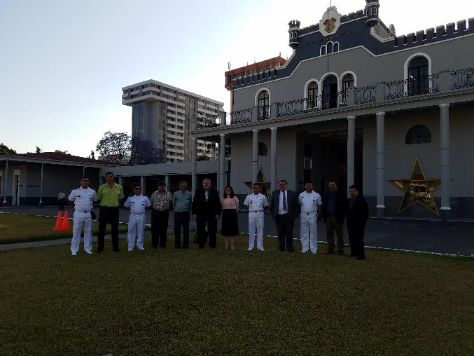
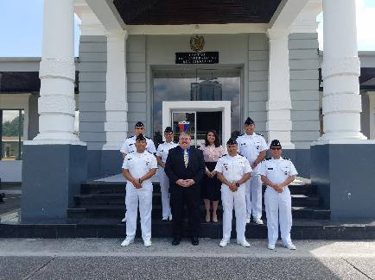
Guatemala Technical Visit - Overview
CIIHO Meeting Participants

Slide 3
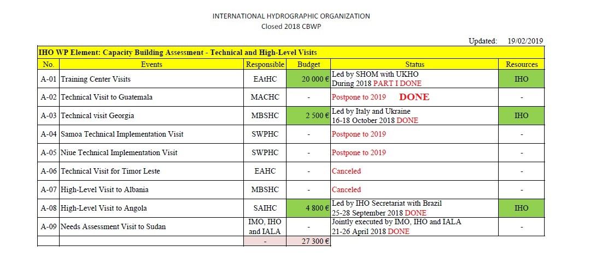
Guatemala Technical Visit - Overview

Slide 4
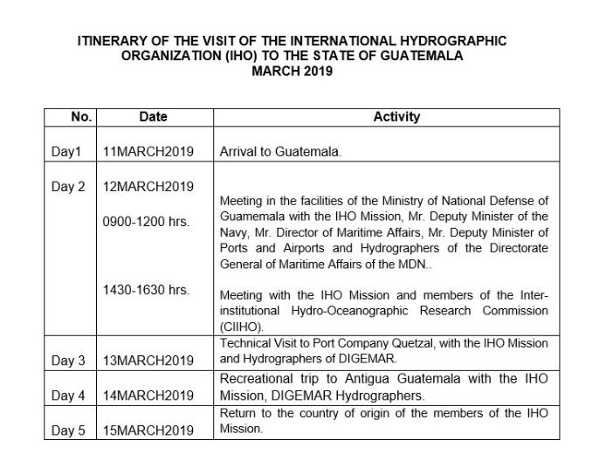
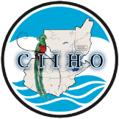
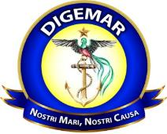
Guatemala Technical Visit - Schedule

Slide 5
Guatemala Technical Visit - Achievements
The Guatemala Navy (DIGEMAR) is a regular contributor of MSI information in support of their National Coordinator obligations.
Guatemala has a functioning hydrographic commission (CIIHO) that regularly meets to coordinate hydrographic issues across the government. The CIIHO is backed by regulated authority.
The Guatemala Navy (DIGEMAR) and the Port Authority perform regular hydrographic surveys in the Guatemalan Ports.
Puerto Quetzal is surveyed every 3 months
The CIIHO has coordinated several joint survey projects on the Lakes of Guatemala.
Guatemala is actively working in the IHO CB Phase 1 & 2 areas.

Slide 6
Guatemala Technical Visit - Recommendations
Guatemala and the US Primary Charting Authority (PCA) should work cooperatively to establish a new agreement with defined roles and clear lines of communication.
Establish a mechanism for regularly sharing Guatemala Navy (DIGEMAR) hydrographic surveys with the PCA to update the charts.
The Guatemala Navy (DIGEMAR) should work toward building an MSDI as a first step to a Phase 3 Cartographic capability.
The Guatemala Navy (DIGEMAR) should take initial GIS training to support a Guatemala MSDI capability.
Build a more complete Tide capability in Guatemala waters. Establish additional Tide Gauges on the Pacific Coast.
Expand hydrographic survey capability to support offshore surveys.

Slide 7
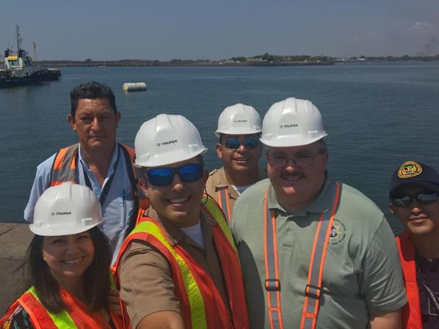
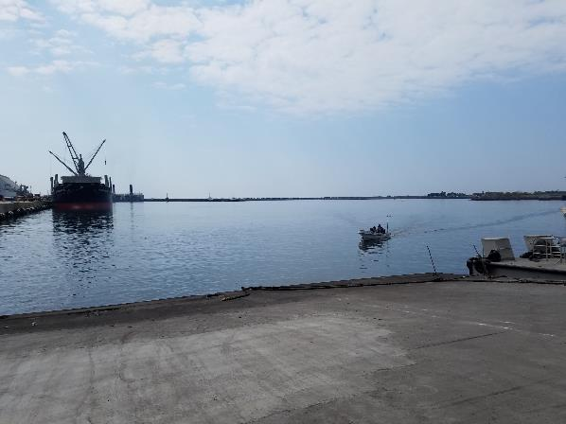
Guatemala Technical Visit
Please Note this Report

Slide 8
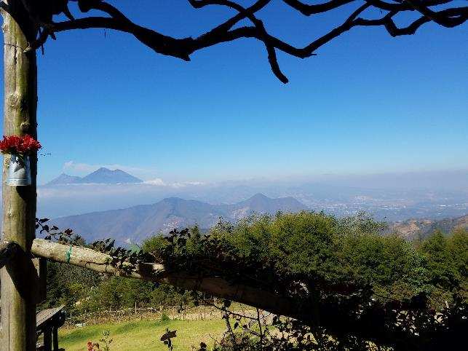
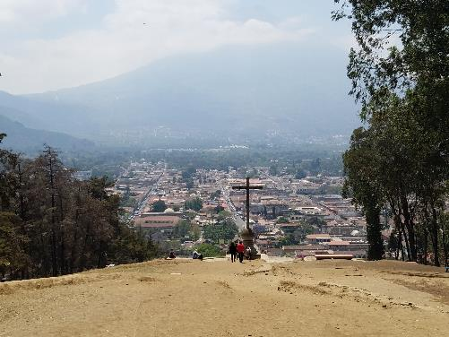
Guatemala Technical Visit
Questions?

