Slide 1
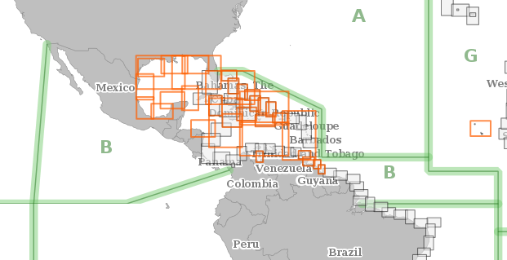
MesoAmerican and Caribbean Sea Hydrographic Commission
International Charting Coordination

Slide 2
Presentation Agenda
Membership and Work Procedures
MICC updates
ENC Progress
ENC Online
Work Plan 2020

Slide 3
Work Procedures
Quarterly calls
Member states actively work to resolve chart overlaps
ENC updates sent to MICC Technical Coordinator
Updates for ENC Online
Member states actively work to resolve MICC related matters

Slide 4
MICC Updates
IC-ENC to send quarterly updates for ENC Online data
INT chart coordinator send quarterly updates
MACHC Regional ENC scheme proposal update by Columbia
Notes:
A few updates to the Terms of Reference were made:
After requests from members it was agreed that there would be more frequent updates to the ENC Online data, IC-ENC will now send updates quarterly.

Slide 5
MACHC ENCs Available

Slide 6
MACHC ENCs by Usage Band
2018 | 12 | 34 | 108 | 283 | 424 | 53
2019 | 12 | 35 | 116 | 284 | 426 | 60

Slide 7
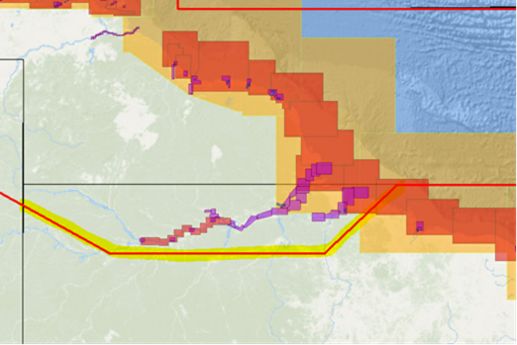
The MACHC ENC boundary
.
Some years ago a decision was made to extend the boundary to include parts of the Amazon river.
Below you can see the highlighted boundary in red. However the IC-ENC coverage maps and all other authoritative boundary data does not reflect this change.
This change should be reflected on the IHO and other sites.

Slide 8
ENC Overlap- IC ENC
ID | STATUS | RENC Membership | RHC | ENC 1 | ENC 2 | Usage Band | ENC 1 Scale | ENC 2 Scale | ENC 1 EN (ER) | ENC 2 EN (ER) | Overlap extent (Kmxkm) (m/square NM)
173 | ACCEPT | IC-ENC | MACHC | PA3AM929 | CO300023 | 3 | 180000 | 180000 | 2 (0) | 1 (20) | 1m x 9.9Km
668 | POTENTIAL | IC-ENC | MACHC | VE300600 | GB300500 | 3 | 180000 | 90000 | 3 (0) | 8( 6) | 2.5 km x 1.7 km
659 | POTENTIAL | IC-ENC | MACHC | VE300600 | GB380210 | 3 | 180000 | 90000 | 3 (0) | 9 (1) | 36.54 km x 27.51 km
658 | POTENTIAL | IC-ENC | MACHC | VE300600 | VE300500 | 3 | 180000 | 180000 | 3 (0) | 4 (1) | 31.88 km x 64.42 km
655 | POTENTIAL | IC-ENC | MACHC | VE300700 | GB300501 | 3 | 180000 | 90000 | 1 (0) | 7 (0) | 48 Km x 80 Km
656 | POTENTIAL | IC-ENC | MACHC | VE300700 | VE300600 | 3 | 180000 | 180000 | 1 (0) | 2 (1) | 168 Km x 21 Km
VE re-scheme validated which increases the coverage in the channel south of Grenada
expecting clips for the GB cells to be concluded once the verification of VE300700 has been completed

Slide 9
Cruise Ship Port Analysis Summary Update
2015 – Cruise Ship Ports Gap Analysis identified 43 ports in MACHC region with no large scale ENC coverage
2016 – Two large scale ENC’s cover gaps in Cuba and VZ
2017/2018 – 12 New large scale ENC’s cover gaps in VZ, Bahamas, Cuba, St. Vincent & Grenadines, Trinidad; total down to 29 ports from 43
Notes:
Update on the Cruise Ship AIS analysis:
From 2015 to 2018 the MACHC has produced 14 large scale ENC’s to cover gaps in port coverage.

Slide 10
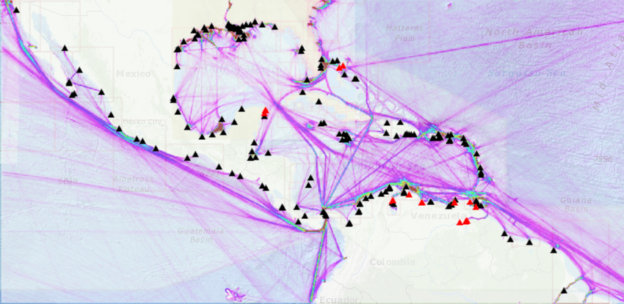
Cruise Ship Ports with Large Scale ENCs
Total ports : 92
Not covered : 32
Covered:60

Slide 11
Cruise ship port gaps 2019
UNIQUE_POR | COUNTRY | PORT | Informatio | Current_La | Planned_EN | Additional
P3557 | Bahamas | Great Stirrup Cay | Norwegian Cruise | UB 3 | Priority Port identified, no planned ENCs band 4, 5 or 6 coverage? | No knowledge of a requirement (from cruise company or other user)
P3578 | Bahamas | Coco Cay (Little Stirrup Cay) | Little Stirrup Cay - Royal Caribbean | UB 3 | Priority Port identified, no planned ENCs band 4, 5 or 6 coverage? | Also known as Little Stirrup Cay; I am aware that construction has started for a pier and dredging will be taking place. No large scale data available yet. The cruise company may well supply the survey data(?)
 | Bahamas | San Salvador Island (Rum Cay) | cruise ship gap analysis | UB 3 | Planned ENCs 5. | Is this known as 'Rum Cay'? No knowledge of a requirement (from cruise company or other user)
 | Belize | Vicinity of Lighthouse Reef | cruise ship gap analysis | UB 3 | No planned ENCs band 4, 5 or 6 coverage? | New lidar survey data received for The Narrows: no knowledge of requirement for ENC for cruise company (remove?)
 | Costa Rica | Bahia Coco | cruise ship gap analysis | UB 2 | New ENC band 5 (GB51798B) | Responsibility shared between US and UK
 | Costa Rica | Puerto de Quepos | cruise ship gap analysis | UB 2 | No planned ENCs band 4, 5 or 6 coverage?
 | Costa Rica | Vicinity of Drake Bay | cruise ship gap analysis | UB 2 | No planned ENCs band 4, 5 or 6 coverage?
 | Costa Rica | Vicinity of Dos Rios | cruise ship gap analysis | UB 3 | No planned ENCs band 4, 5 or 6 coverage?
 | Costa Rica | Drake Bay | cruise ship gap analysis | UB 2 | No planned ENCs band 4, 5 or 6 coverage?

Slide 12
Cruise ship port gaps 2019
 | Costa Rica | Vicinity of Playa Posa Colorado | Added from cruise ship gap analysis | UB 3 | No planned ENCs band 4, 5 or 6 coverage?
 | Costa Rica | Vicinity of Isla Tortuga | Added from cruise ship gap analysis | UB 3 | No planned ENCs band 4, 5 or 6 coverage?
 | Costa Rica | Herradura Bay | Added from cruise ship gap analysis | UB 3 | No planned ENCs band 4, 5 or 6 coverage?
 | Costa Rica | Potrero Bay | Added from cruise ship gap analysis | UB 2 | No planned ENCs band 4, 5 or 6 coverage?
 | Costa Rica | Culebra Bay | Added from cruise ship gap analysis | UB 2 | No planned ENCs band 4, 5 or 6 coverage?
 | Cuba | Isla de la Juventud | Added from cruise ship gap analysis | UB 3 | Planned ENCs band 4 | Band 4 coverage pending IC-ENC validation Nov. 2017
 | Dominican Republic | Isla Catalina | Added from cruise ship gap analysis | UB 3 | No planned ENCs band 4, 5 or 6 coverage? | US PCA
 | Dominican Republic | Boca de Chavon, La Romana | Added from cruise ship gap analysis | UB 3 | No planned ENCs band 4, 5 or 6 coverage? | US PCA
 | Mexico | Isla Carmen | Added from cruise ship gap analysis | UB 2 | Planned ENCs band 4 and 5.
 | Mexico | Isla Carmen | Added from cruise ship gap analysis | UB 2 | Planned ENCs band 4 and 5.
 | Mexico | Puerto Escondidio | Added from cruise ship gap analysis | UB 2 | Planned ENCs band 4 and 5.
 | Mexico | Puerto Agua Verde | Added from cruise ship gap analysis | UB 2 | Planned ENCs band 4.

Slide 13
Cruise ship port gaps 2019
 | Mexico | Isla Partida | Added from cruise ship gap analysis | UB 2 | Planned ENCs band 4.
 | Mexico | Isla Espirito Santo | Added from cruise ship gap analysis | UB 2 | Planned ENCs band 4.
 | Nicaragua | Islas del Maiz | Added from cruise ship gap analysis | UB 3 | No planned ENCs band 4, 5 or 6 coverage?
 | Panama | Isla de Coiba | Added from cruise ship gap analysis | UB 3 | No planned ENCs band 4, 5 or 6 coverage?
 | Panama | Isla Parida | Added from cruise ship gap analysis | UB 3 | No planned ENCs band 4, 5 or 6 coverage?
 | Panama | Isla Pacheca | Added from cruise ship gap analysis | UB 3 | No planned ENCs band 4, 5 or 6 coverage?
 | Panama | Isla de Coiba | Added from cruise ship gap analysis | UB 3 | No planned ENCs band 4, 5 or 6 coverage?
 | Saint Vincent and the Grenadines | Union Island Chatham Bay (Carriacou) | Added from cruise ship gap analysis | UB 3 | No planned ENCs band 4, 5 or 6 coverage? | New lidar data expected early 2017.
 | Saint Vincent and the Grenadines | L'Esterre Bay (Carriacou) | Added from cruise ship gap analysis | UB 5 | New Band 5 coverage (GB50795B)
 | Saint Vincent and the Grenadines | Hillsborough | Added from cruise ship gap analysis | UB 5 | New Band 5 coverage (GB50795B)
P3552 | Venezuela | Boca Grande Terminal |  | UB 3 | Priority Port identified, no planned ENCs band 4, 5 or 6 coverage? | Identified through Priority Ports list

Slide 14
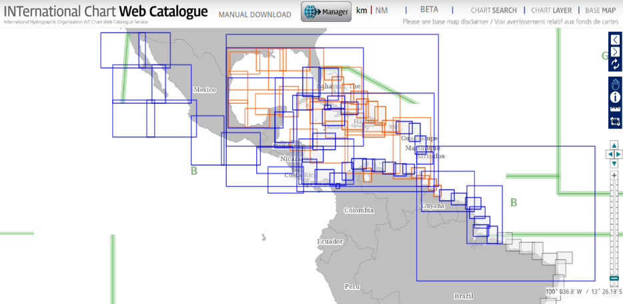
INT Charts
49 Produced
33 Schemed
Produced:51
Schemed : 33
Notes:
82 INT Charts in the MACHC Region

Slide 15
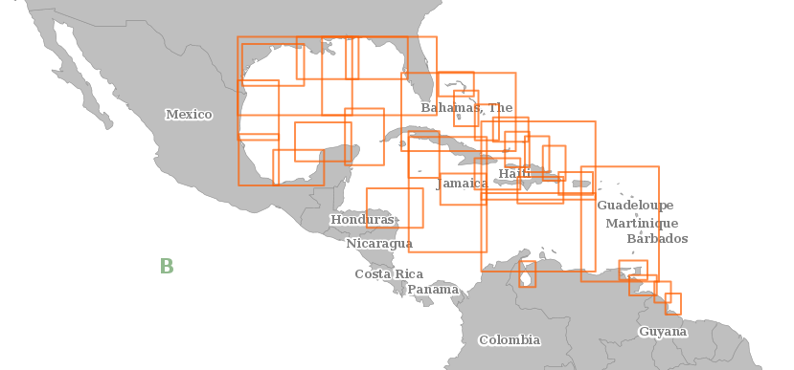
Schemed INT Charts
INT charts approved by ACDS 2019:
4190A, 4190B, 4191, 4182 and 4184

Slide 16
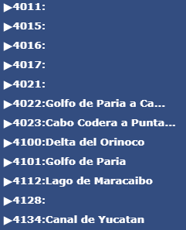
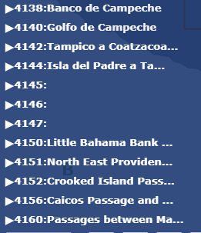
Schemed INT Charts

Slide 17
Regional ENC Scheme
real benefit for the navigator needs
(the opportunity to redesign and correct the ENCs before facing the challenge of the S-101 standard )
produced on a homogeneous compilation scale (1 / 180 000 or 1 / 90 000, in accordance with S-11 Part B)

Slide 18
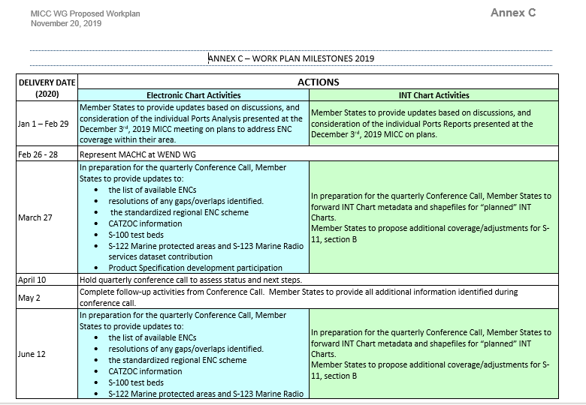
Work Plan

Slide 19
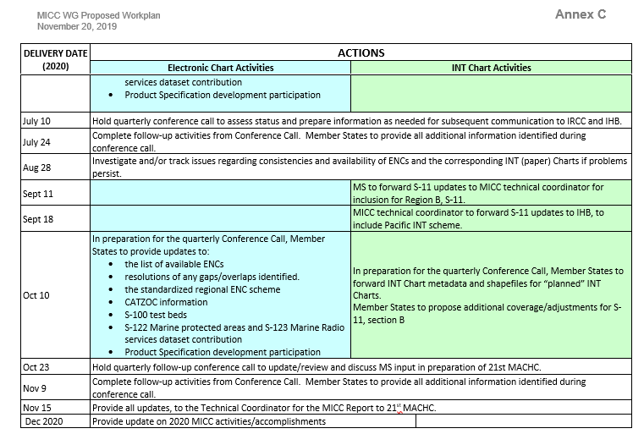
Work Plan Con’t.

Slide 20
Requests to the MACHC
Approve the Work Plan
Endorse the progress on ENC production throughout the region
Encourage MACHC ENC Online participation
Encourage to provide CATZOC information to RENC
Work towards approval 0f the standardized regional ENC scheme
Encourage S-100 test beds
Encourage S-122 Marine protected areas and S-123 Marine Radio services dataset contribution
Encourage Product Specification development participation
Note the WEND and IRCC Updates

Slide 21
Thank You
Thank You

