Slide 1
MACHC20
Santo Domingo, Dominican Republic
2-6 December 2019
On the Future of the Paper Nautical Chart
based on reports submitted to the
Nautical Cartography Working Group
NCWG5, Stockholm, Sweden, 5-8 November 2019

Slide 2
Perception of impacts of a paperless world
Survey of IHO Member States
on the future of nautical paper charts

Slide 3
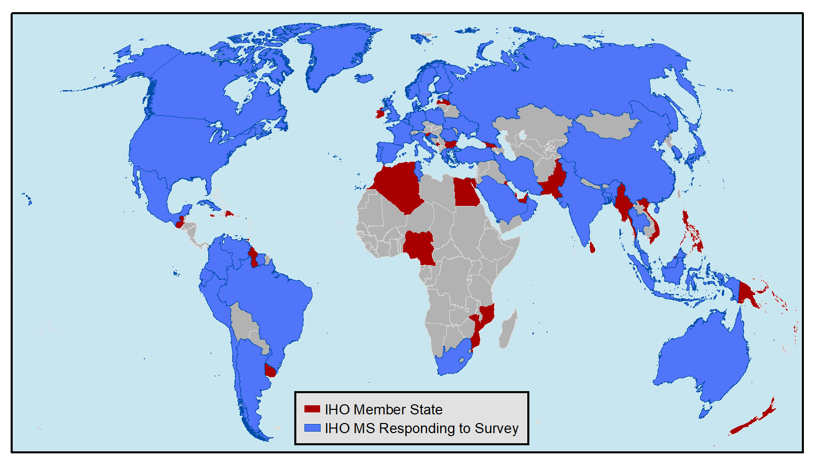
IHO Member States responding to the Survey

Slide 4
52 IHO Member States responded to Survey
Argentina Australia Bahrain Bangladesh Belgium Brazil Canada Chile China^{[1]} Colombia Croatia Cuba Cyprus | Ecuador Estonia Denmark^{[1]} Finland France Germany Greece Iceland India Indonesia Iran Italy Japan | Korea (Rep of) Malaysia Malta Mauritius Mexico Netherlands Norway Oman Peru Poland Portugal Romania Russian Federation | Saudi Arabia^{[2]} Singapore South Africa Spain Suriname Sweden Thailand Tunisia Turkey Ukraine United Kingdom United States Venezuela
[1] Survey responses from China and Denmark were received too late to incorporate into report to NCWG-5.
[2] Saudi Arabia responded to IHO Circular Letter 29/2019, but abstained from submitting a survey questionnaire.

Slide 5
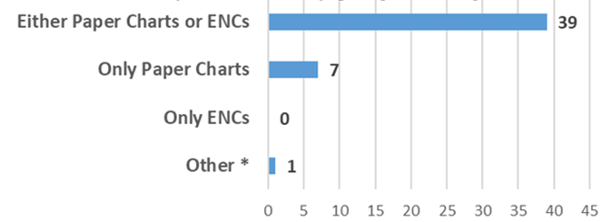
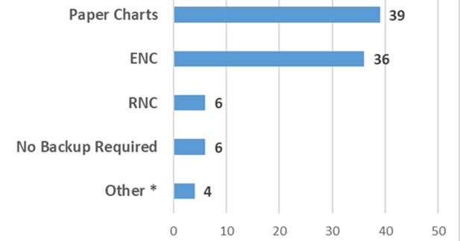
Carriage requirements for domestic voyages
Primary - Required
* One member state responded "ENCs and Paper Charts."
Backup – Allowed
* Four member states responded “Other” and referred to ECDIS or ECS usage.

Slide 6
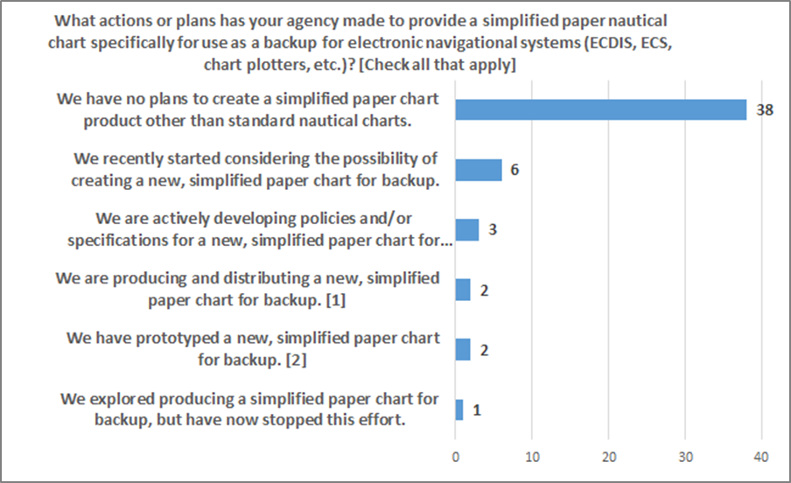
Plans for developing simplified Paper chart as backup for electronic systems
No – 39
Yes – 13

Slide 7
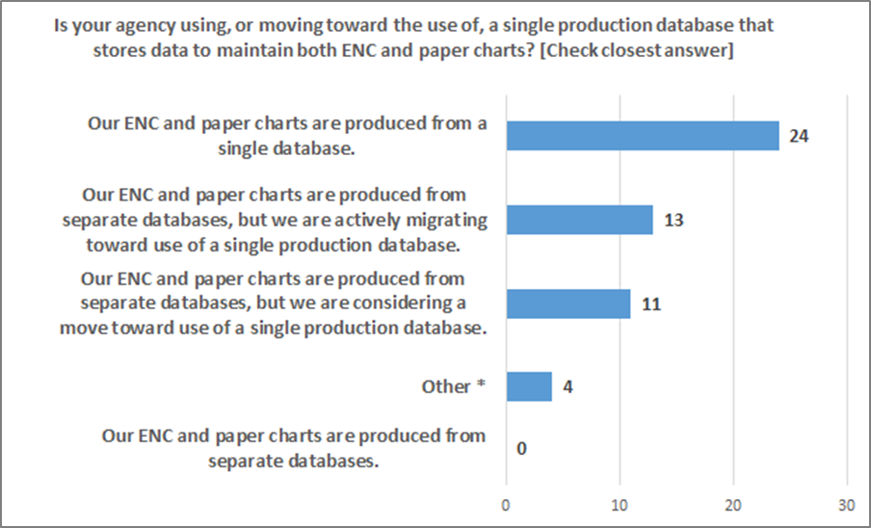
Single production database for both paper - enc
Have or are moving toward a single database

Slide 8
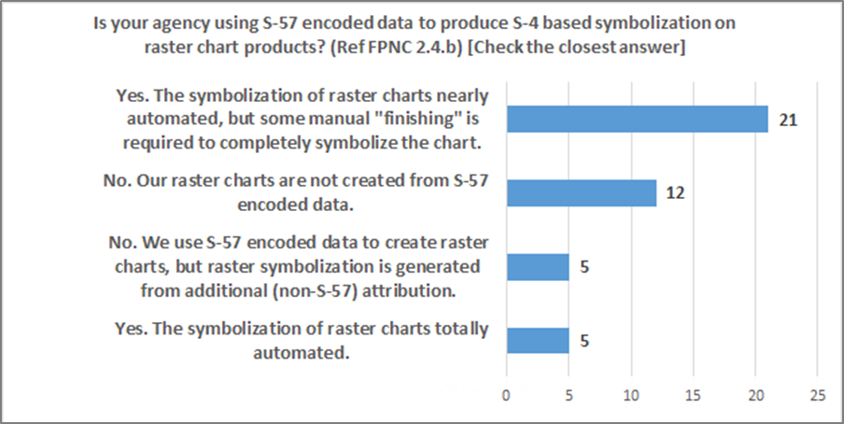
USE S-57 ENCODED DATA TO PRODUCE S-4 symbols on Raster charts
No – 17
Yes – 26

Slide 9
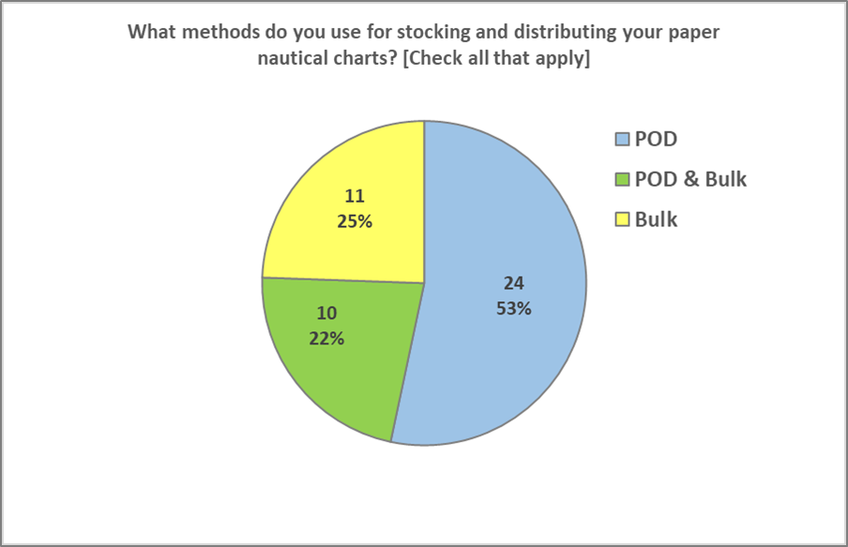
Paper chart Distribution method by agency

Slide 10
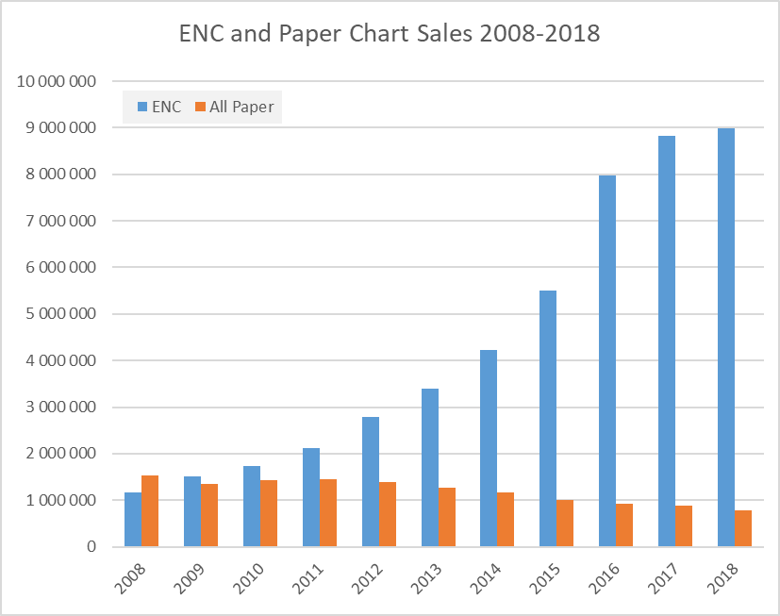
ENC and Paper chart sales compared

Slide 11
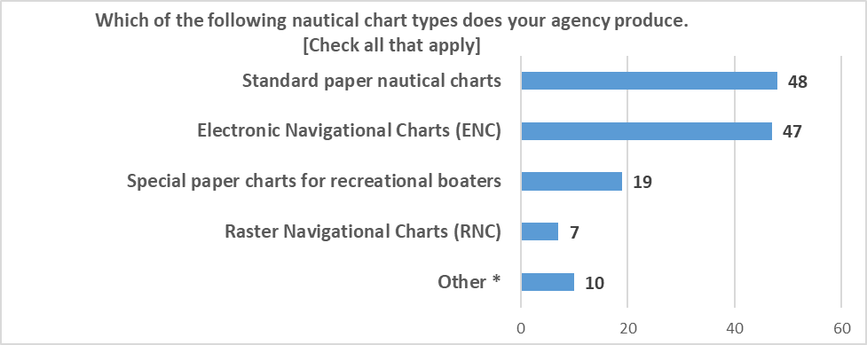
Types of Nautical charts being Produced

Slide 12
21 Countries maintaining 55K km of inland enc
Inland ENC Harmonization Group reports that
55 629 km of iENC coverage has been produced by the countries listed below.
Australia Belgium Brazil Bulgaria China Croatia Czech Republic | France Germany Hungary Luxembourg Netherlands Poland Romania | Russian Federation Serbia Slovakia Switzerland Ukraine United States

Slide 13
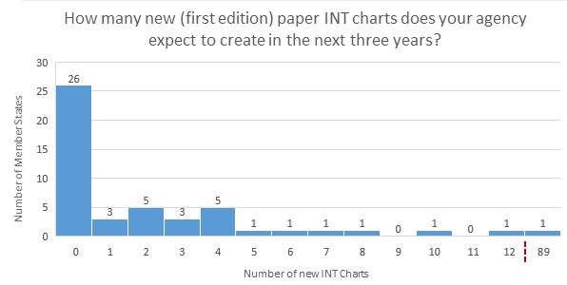
Planned int chart production
23 countries will produce 179 new/first edition of paper INT Charts

Slide 14
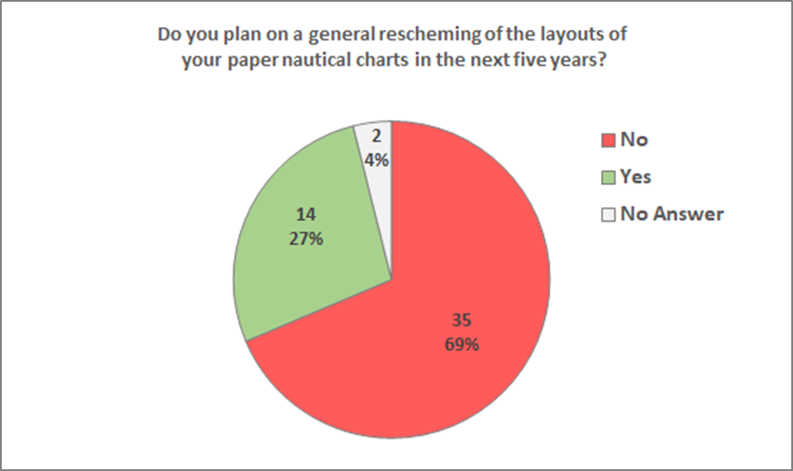
Plans to rescheme paper/raster charts

Slide 15
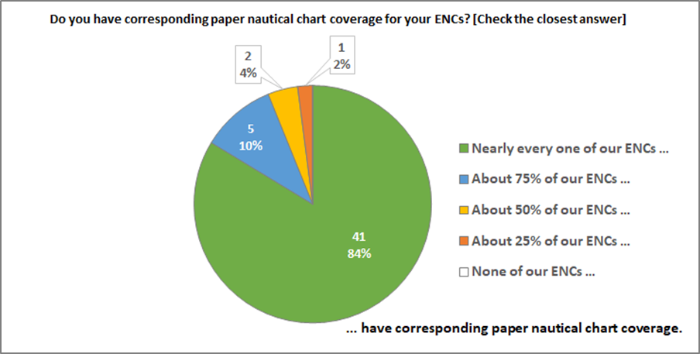
Corresponding paper chart coverage

Slide 16
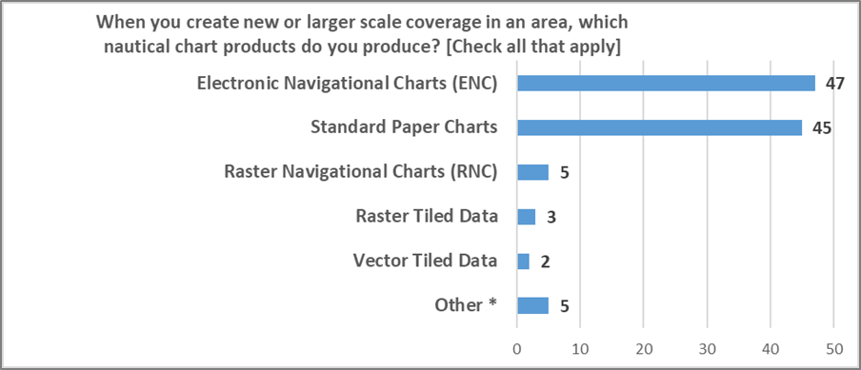
Products created for new coverage

Slide 17
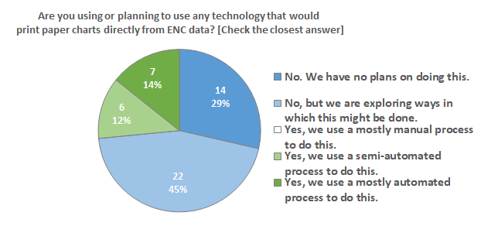
Paper charts directly from enc data
29% – No
71% – Yes, in some manner or considering doing so

Slide 18
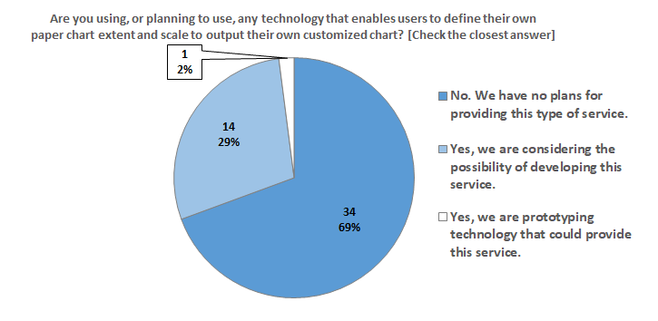
Customized charts
69% – No
31% – Considering the option or already doing so.

Slide 19
Perception of impacts of a paperless world
Report of the team on Finalizing the Future of the Paper Nautical Chart
The final report will be submitted to HSSC12 in May 2020

Slide 20
Perception of impacts of a paperless world
Possible recommendations for activities to be undertaken by NCWG:
1. S-4 Portrayal Catalogue - Implement standard S-4 symbology in an S-100 Portrayal Catalogue for raster paper/charts
2. Freezing S-4 and the S-4 based portions of national INT1 and Chart 1 documents, so that future NCWG efforts can focus exclusively on enhancing the portrayal of S-57 and S-101 ENCs and other S-100 based products.

Slide 21
Perception of impacts of a paperless world
Possible recommendations for activities to be undertaken by NCWG:
3. Enhance ECDIS Portrayal of ENC for both S-57 and S-101 and help facilitate ways to make the current and future display of ENCs as acceptable to mariners as the presentation on paper charts.
4. Raster from ENC - Develop a standard means of generating raster nautical charts from ENC data.
5. Backup Chart Specification - Develop a specification for – or general guidelines for – a simplified paper/raster chart that would be suitable as a back-up for ECDIS and ECS.

Slide 22
Perception of impacts of a paperless world
Possible recommendations for activities to be undertaken by NCWG:
6. Chart on Demand / Custom Chart – Coordinate efforts of various HOs that are developing online "Chart on Demand" or bespoke "Custom Chart" capabilities
7. INT Chart Production and Coordination – What, if any, recommendations does NCWG want to make regarding the future of production or INT charts and coordination efforts related
to INT charts or ENC within ICCWGs? Does it make sense to freeze INT Charts Schemes for instance. If yes, what is the impact on S-11?

Slide 23
Perception of impacts of a paperless world
Possible recommendations for activities to be undertaken by NCWG:
8. Minimum Paper Chart Standard - Develop a new “minimum” standard for Paper Chart Production derived from Chart Content Databases (also used for ENC Production), meeting functional requirements and regulatory obligations (SOLAS back-up for instance, but not only, national as well).

Slide 24
Perception of impacts of a paperless world
Food for thought

Slide 25
Perception of impacts of a paperless world
What are your national needs as a producer?
What do your customers and users need?
What are the legal aspects?
Why to change your national framework?
What are the needs for international voyages?
Why to participate in the discussions?

Slide 26
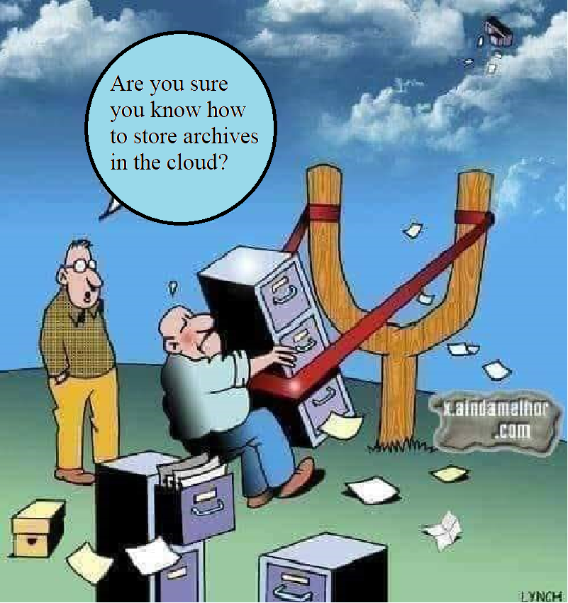

Slide 27
Perception of impacts of a paperless world
Thank you!

