Slide 1
Hellenic Navy Hydrographic Service (Proposal for solving the MBSHC Cartographic Issues using the concept of the Cartographic Boundary for ENCs)

Slide 2
WEND Principles Cartographic Boundary
A limit for cartographic convenience only without any significance or status regarding political or other jurisdictional boundaries.

Slide 3
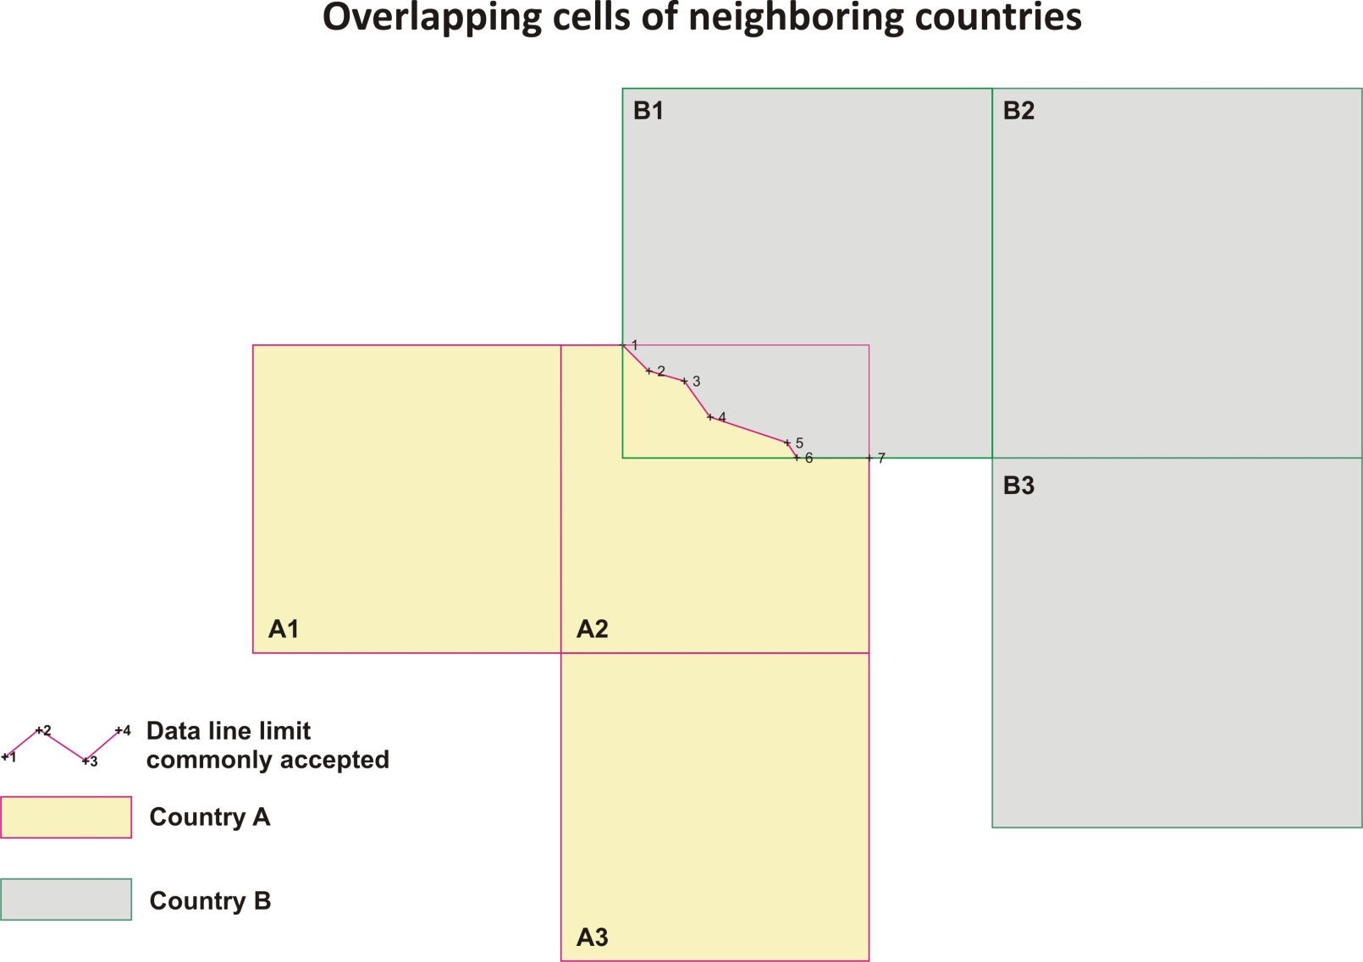
Cartographic Boundary Concept

Slide 4
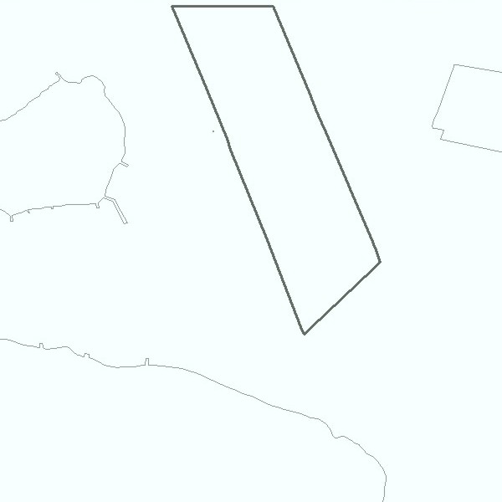
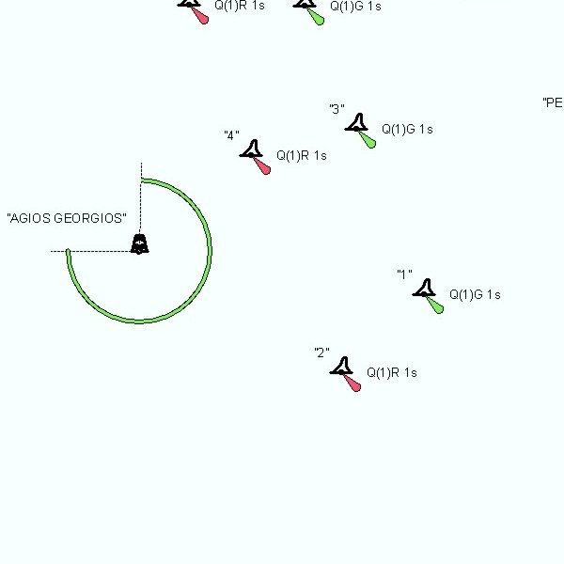
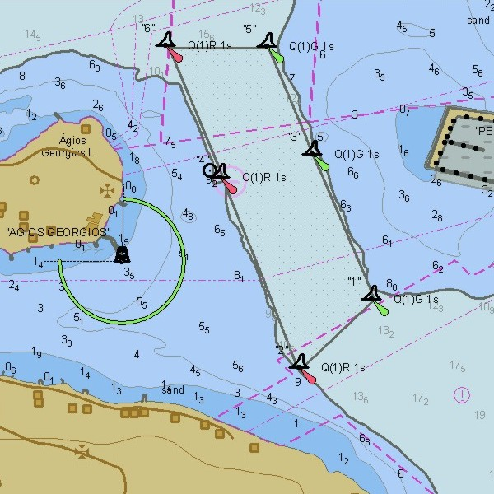
CDB – Organization in Thematic Layers
S-57

Slide 5
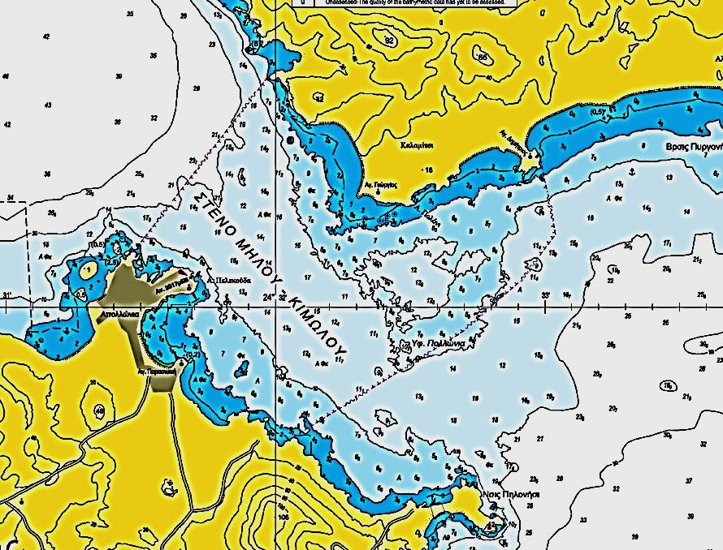
INT Chart based on S-57 Data
S-57
SW

Slide 6
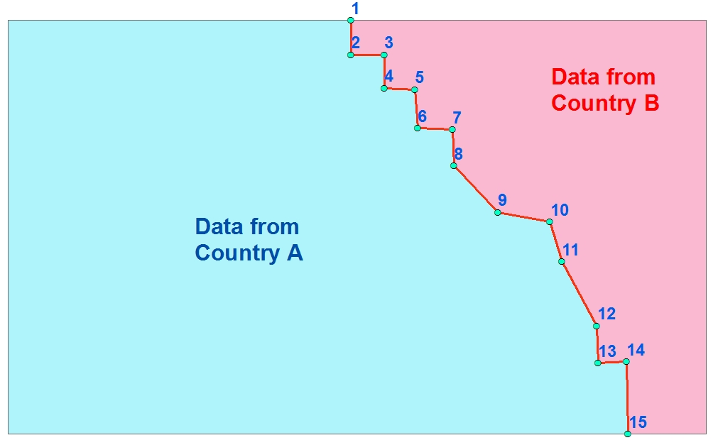
INT Chart based on S-57 Data
CB
Country B
S-57
Country A
S-57
CB

Slide 7
Technical Arrangement
An MOU between countries A and B who will co-produce a paper chart based on S-57 data and the Cartographic Boundary

Slide 8
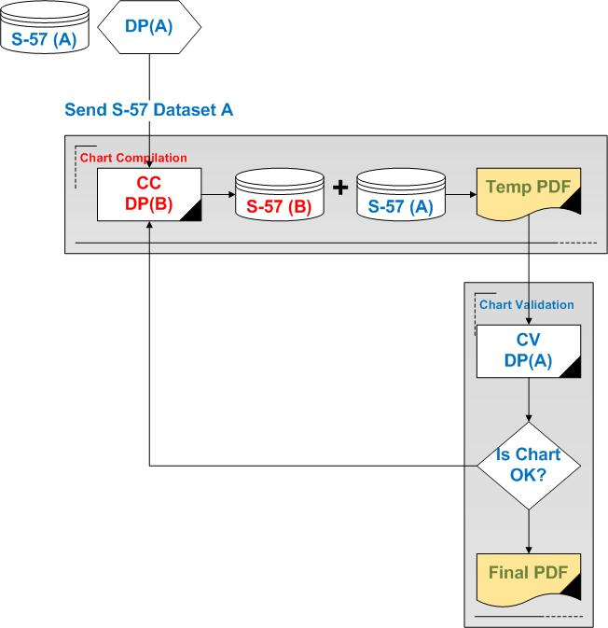
INT Chart Co-production Flow Chart
Data Provider (DP)
Chart Compiler (CC)
Chart Validator (CV)

Slide 9
Benefits from this proposal
Settlement of the INT chart issue in the Aegean.
Common solution for ENCs and INT paper charts ensuring harmonization between products.
Avoidance of errors in toponyms and data in general of the neighboring country.

Slide 10
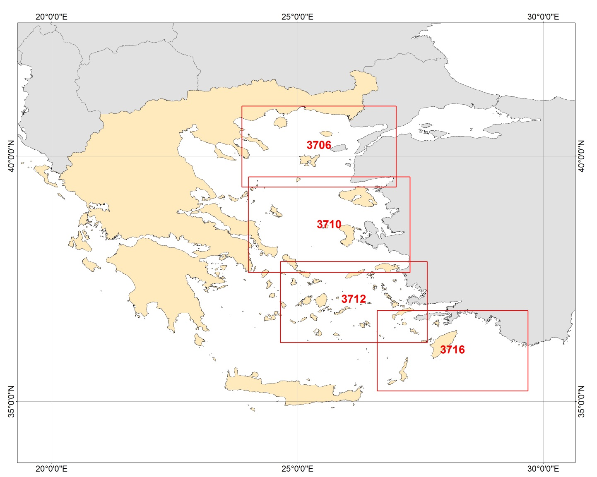
INT Charts 3706, 3710, 3712, 3716
Notes:
For more than 20 years there is dead end for the production of INT Charts 3706, 3710, 3712, 3716 at scale 1:300000
During the MBSH 18, Greece and Turkey have announced that they will cooperate and find a workable solution to this problem.

Slide 11
Questions

