Slide 1
IRCC11 main outcome that may affect MBSHC IRCC-10 Genova, Italy (3-5 June 2019)
Rear Admiral Luigi Sinapi – MBSHC Chair

Slide 2
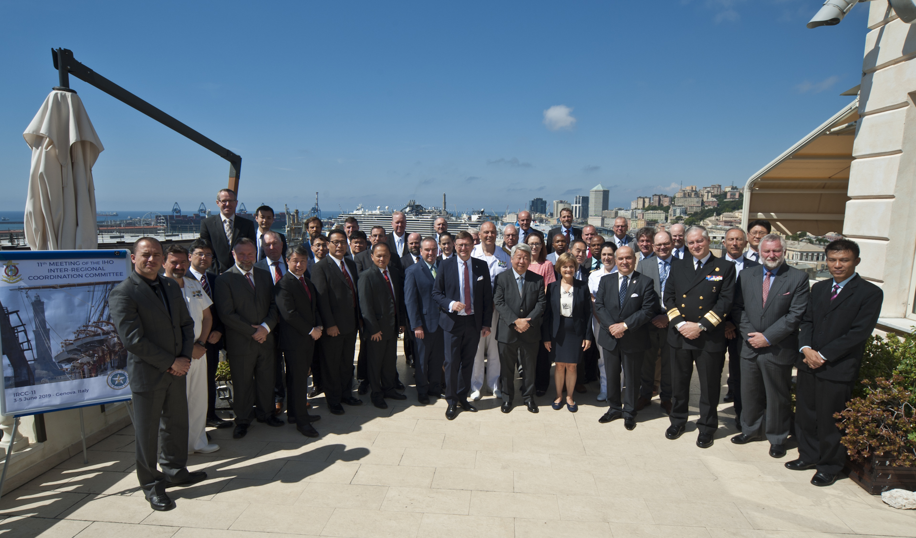
Introduction
IRCC-11, Genova, 3-5 June
Rear Admiral Luigi Sinapi – MBSHC Chair

Slide 3
RHC’s Reports outcomes
Communication and cooperation as key
Extended the buffer limit of ENC overlap especially for UB1, UB2 and UB3 to be proposed
Products/services distribution through RENCs
MSDI activities at national and regional level
Regional level initiatives welcomed (eg. WGs, workshops….)
Rear Admiral Luigi Sinapi – MBSHC Chair

Slide 4
Resolution 2/1997
CL 8/2019 – 1st Revision approval
New comments provided to NGA and discussed at IRCC -11
2nd revision endorsed at IRCC-11
Structure of National Report
New section encouraging Regional Level initiatives (eg. Charting WGs, MSDI WGs, Bathymetry WGs)
MBSHC Statutes to be checked accordingly
Resolution to be submitted at C-3
Rear Admiral Luigi Sinapi – MBSHC Chair

Slide 5
Seabed 2030 involvement
Joint initiative (IT, FR, UK, USA, IHO Secr.)
Proposal to designate a REGIONAL SEABED DATA COORDINATOR:
Coordinate HOs contribution at Regional Level
Provide support to HOs
Clarify connection with GEBCO
Liase with GEBCO representatives and the IHO DCDB Manager
Encourage data submission
Report the state of regional mapping efforts

Slide 6
Actions
Provide a brief history about the MBSHC to be posted on the IHO web page (action 2)
RHC Chair to request National Coordinators to review (Action 8)
→ Relevant Annex of GMDSS Master Plan
→ IHO Publ. C-55
RHC Chairs to consider the duties for the Regional Seabed 2030 Coordinator/ Mechanism (Action 12)
Include Seabed 2030 in the RHCs work plan (Action 12)
RHCs Chairs to report to A-2
Rear Admiral Luigi Sinapi – MBSHC Chair

Slide 7
Recommendations
Encourage closer engagement of the National MSI Coordinators of MSs with the relevant NAVAREA Coordinators
RHCs to encourage MSs to use appropriate CATZOC values as input for for C-55
RHCs to encourage MSs to use meaningful CATZOC values (CATZOC U not to be used)

Slide 8
Recommendations
MSs to support the production of S-100 showcase and S-100 products test bed platform
MSs to contribute to S-122 and S-123 dataset
MSs to participate to PSs development
MSs to Support development of IHO Hydrographic dictionary (Spanish and Russian)
RHC Chair to consider to include an agenda item in RHC meetings to support the IHR Editorial Board

Slide 9
Action requested of MBSHC
The MBSHC21 is invited to:
Note the report
Take any action deemed necessary
Rear Admiral Luigi Sinapi – MBSHC Chair

