Slide 1
International Centre for Electronic Navigational Charts
1

Slide 2
IC-ENC Update to MBSHC21
Current Status / membership
RENC Service
  S-58 Standard
Value Added Reseller Services
What next? / targets
2

Slide 3
IC-ENC Current Status
IC-ENC - Regional ENC Coordination Centre as referenced in the IHO WEND principles
Formed in 2002 with 6 members (participating HOs) – now has 45 members
Our focus is ENC Quality Assurance & Distribution
Notes:
RENC definition from WEND Resolution
RENCs are organisational entities where IHO members have established co-operation amongst each other to guarantee a world-wide consistent level of high quality data, and for bringing about coordinated services with official ENCs and updates to them.
https://www.iho.int/iho_pubs/misc/M3-E-JUNE17.pdf
https://www.iho.int/mtg_docs/com_wg/WEND/WEND_Misc/Guidelines_en_June_2014.pdf

Slide 4
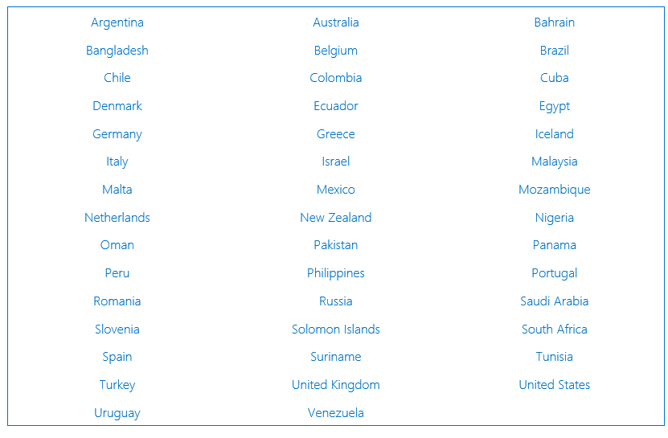
IC-ENC Members – 45
Notes:
41 – the dominant RENC

Slide 5
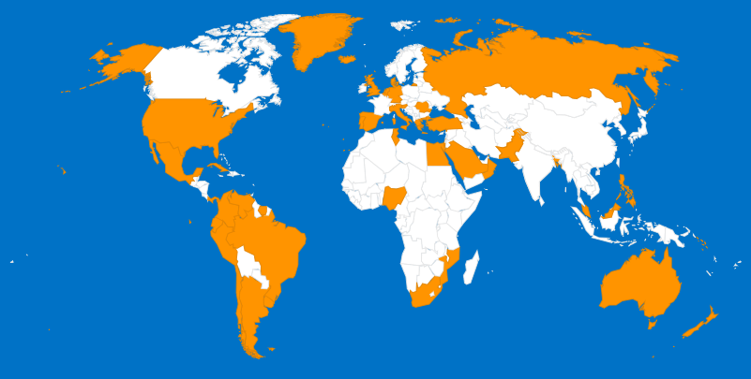
Membership & IC-ENC Offices
IC-ENC Head Office -
Taunton, UK.
IC-ENC North America -
Washington, USA.
IC-ENC Latin America -
Niterói, Brazil.
IC-ENC Australia -
Wollongong.
5

Slide 6
IC-ENC ENC Folio - MBSHC
Notes:
Services are beneficial to all sizes and maturity levels of every HO

Slide 7
IC-ENC ENC Folio - Total
Notes:
Services are beneficial to all sizes and maturity levels of every HO

Slide 8
IC-ENC Core Services
ENC Production Support
ENC Validation
ENC Distribution
Revenue Management
8

Slide 9
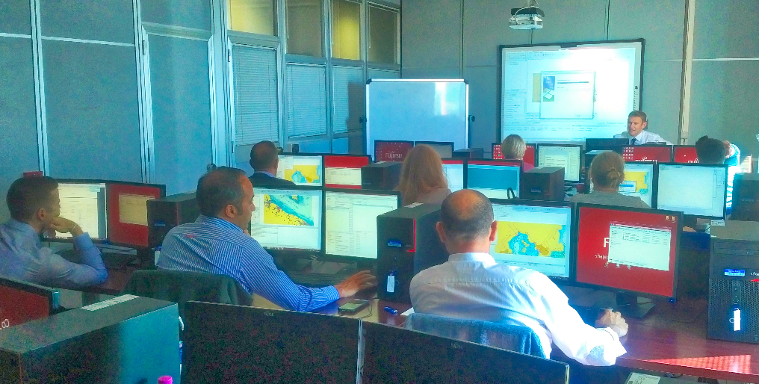
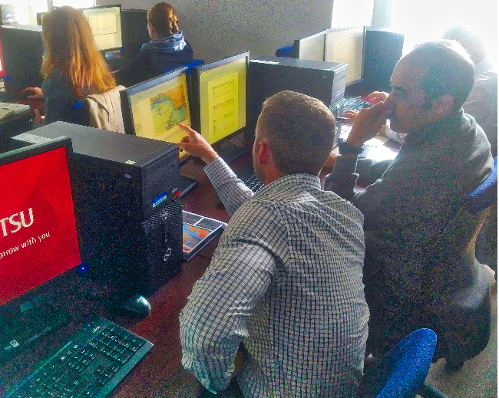
ENC Production Support
ENC Validation Training
Technical Conferences
Bespoke Support & Advice
Notes:
IC-ENCF can help emerging ENC producers

Slide 10
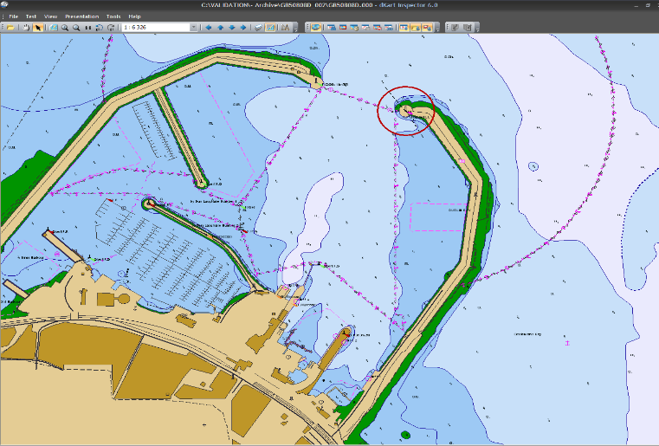
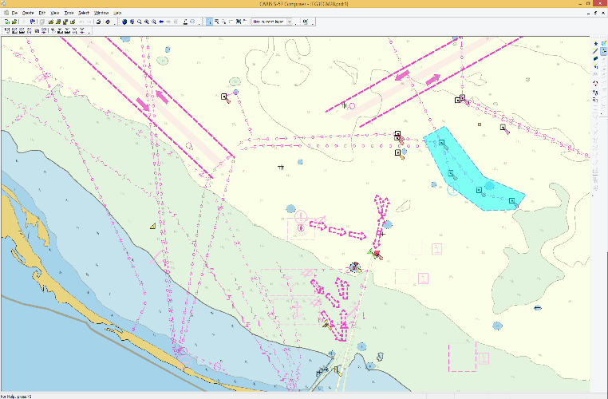
IC-ENC Validation
Software analysis and testing
  Assessment of S-58 errors
  Exchange set checks
IC-ENC validation team expertise
  Consistency Checks
  ECDIS Checks
10

Slide 11
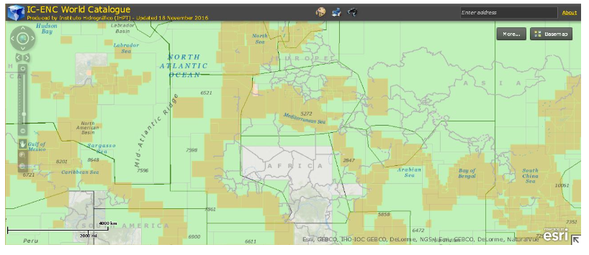
Ensuring seamless coverage
IC-ENC act as coordinators for consistency between HOs in resolution of overlap and gaps
Coordinate cancellation and replacement coverage on behalf of new and developing producers
11
Notes:
Tomorrow (13 Jun) - confirmation from the UKHO that they are preparing clips to the following existing coverage so that IC-ENC can release these cells without any overlaps between the cells.
TN313208 - GB302121 - clip
TN313210 - GB302122 - Replace/cancel

Slide 12







ENC Distribution - VARs
Value Added Resellers
12

Slide 13
Examples of VAR services
VARs invest and develop their own services regarding ENCs
The advantage of this is that is gives choice and drives innovation and high quality customer service

Slide 14
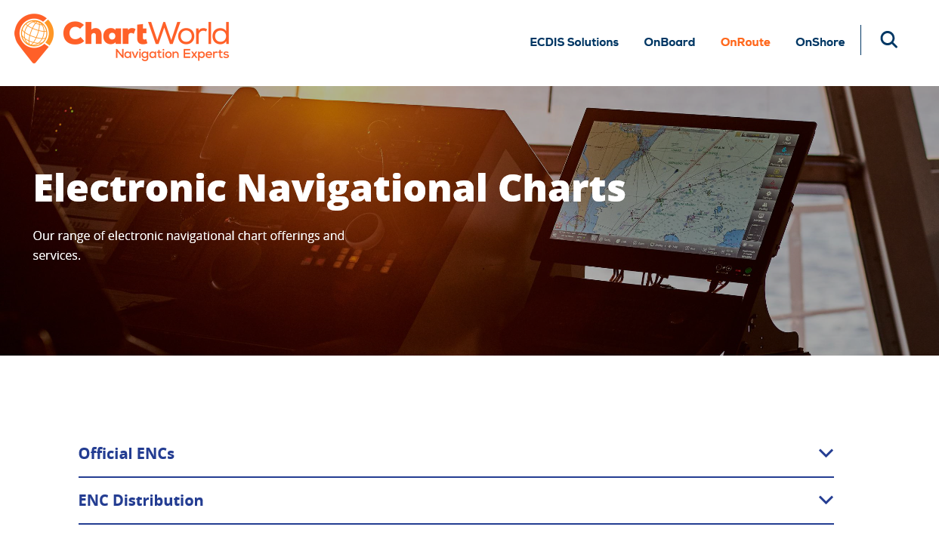
Chartworld

Slide 15
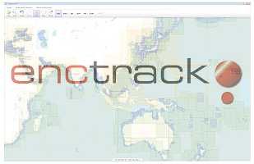
Datema

Slide 16
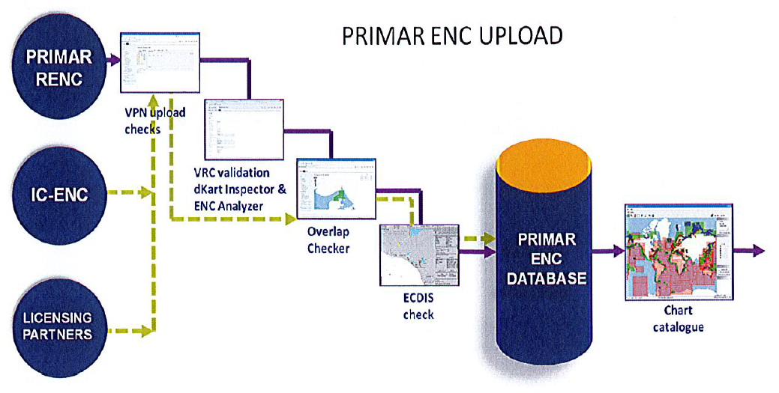
PRIMAR

Slide 17
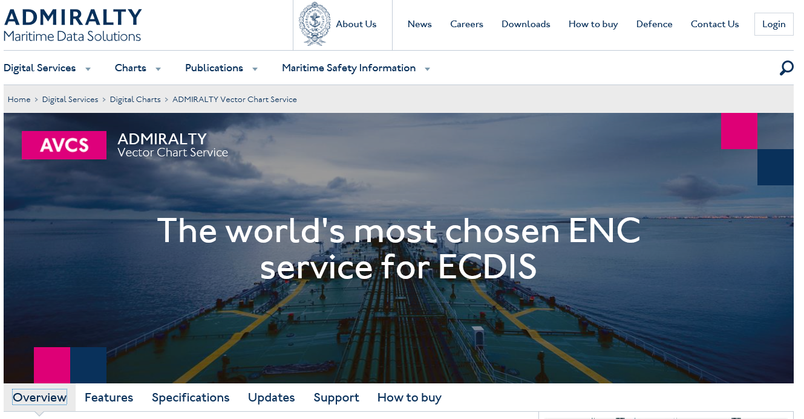
Admiralty

Slide 18
IC-ENC and the VARs
Monitor & audit VAR activity according to the contractual terms & the licensing permissions (VAR Agreement)
Every ENC sale must be recorded within 24 hours of being made
IC-ENC manages the collection and settlements of ENC revenue generated.

Slide 19
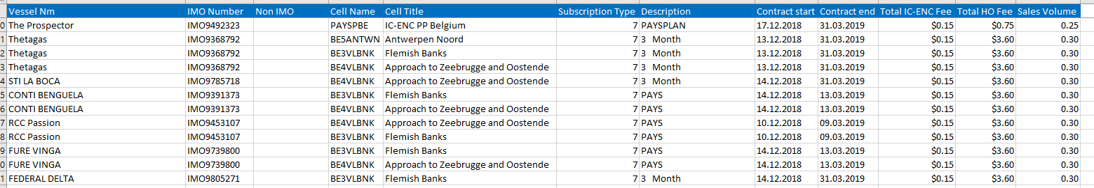
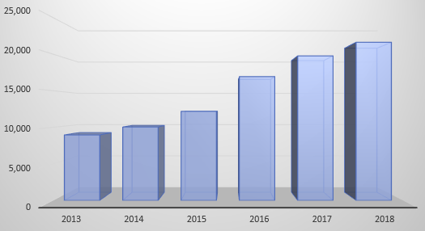
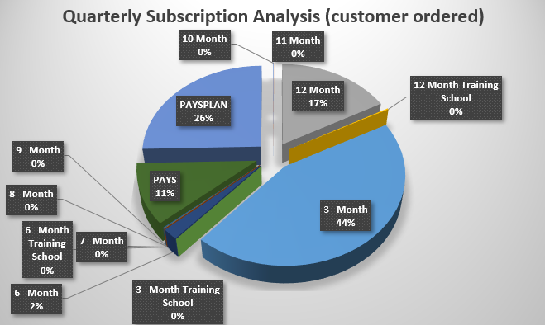
Sales report information

Slide 20

IC-ENC Steering Committee
Agrees IC-ENC services, budget, provides support and guidance. Next convenes in July to consider future opportunities.

Slide 21
What next for ENCs?
S-101 ENC Standard
  Interoperability with other S-10x data standards
S-10x new data types
Core service in line with S-57 services
Using ENCs more widely
  Licensing service to support safe navigation of non-ECDIS equipped craft
Notes:
S10x - Seek input from members

Slide 22
Non-ECDIS navigation management service
IC-ENC members consulted – mixture of responses (non-core service)
Challenge is to replicate the benefits of ECDIS distribution, but without the ‘backing’ of such strong regulation, nor the Standards

Slide 23
Non-ECDIS navigation management service
Data Coverage, Data Supply & Updating,
System – Display and functionality
Data Protection / Integrity,
Licensing terms (duration etc)
Costs & Revenue

Slide 24
Summary
24
IC-ENC’s services support HOs with their ENC requirements.
The VAR network is a key concept in the ENC distribution chain.
45 Member HOs with over 8000 ENCs
S-57 WEND is established, and successful
  S-101 WEND is coming
  S-10x is coming too
  Quality Assured, Official, data to as many users as possible – safe navigation!

