Slide 1
Ahti
Nautical Chart production and
data management system
Kalle Hyyrynen 10.4.2019

Slide 2
Ahti-project, background and goals
System development demands: outdated technology, functional, integration , etc. needs
Changes in operational/business environment
Goverment’s productivity policies
Traffic increase at the Baltic Sea
Development of navigation and survey technologies
Spread of electronical nautical chart products and data
New hydrographical standards
Harmonizing the system, system architecture, data model, international standards, COTS-software
Print On Demand
New System and process enables more efficient Nautical Chart production and Data management

Slide 3
Ahti-project, result
Modern system
technology
COTS
life cycle management
support services
system integrations
…
Outputs from the new system:
standardized ENC-products
(S-57, S-101 and S-102 later)
standardized printed charts (S-4)
military nautical chart production system SAhti (AML, printed charts)
paper chart rasters (not official products)
source for data delivery and services: official products, open data, Inspire, NtM service..

Slide 4
Ahti-project, schedule
Preliminary survey 2015-2016
System evaluations / POC
Market research, user interviews
Requirements for the new system
Procurement phase Q1-Q2 2017
Preparations for the procurement 1-4/17
Call for tenders 5/17
Award decision 6/17

Slide 5
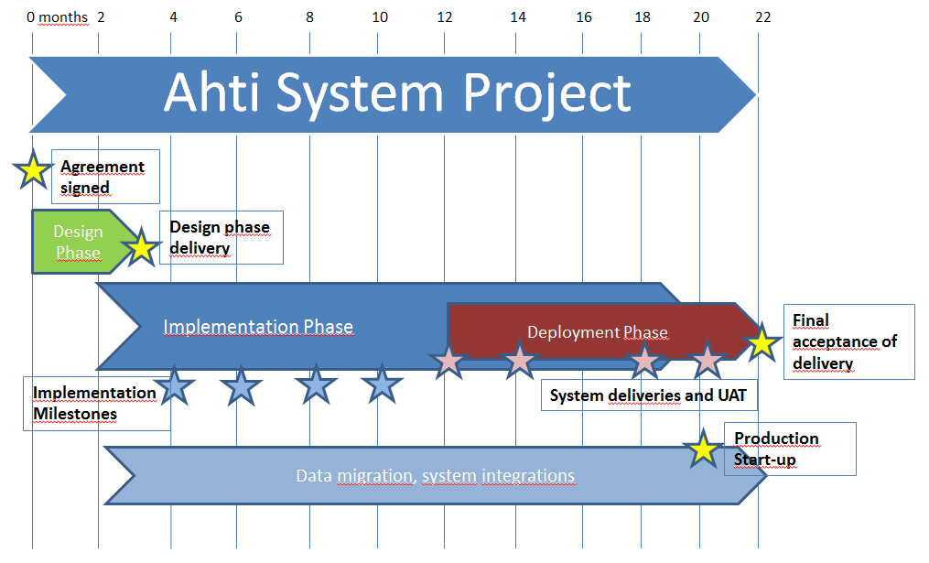
Ahti-project, schedule
System development project Q3 2017 →
Design phase 9-11/17
Implementation Phase 9/17-8/18
Deployment Phase 9/18 →

Slide 6
1. Processes and Source Data Management
2. Nautical Chart Production
and Data management
3. Data and Product Delivery
and Services
Loki
Source Data, Workflow, NtM Management System
Custom Web application
Spring, JPA, JQuery, Bootstrap, OpenLayers..
Traficom Web Services
NtM Service
Chart feedback service
Ahti
Nautical Chart Production and Data Management System
Caris HPD, Oracle 12c
GeoServer
Official products
S-57 ENCs
S-4 Paper Charts
S-101 and S-102 in the future
Other Sources
Harbors
Cable companies
National Land Survey
Other Hydrographic Offices
…
Merta
Hydrographic Survey Data
Management System
Caris BDB, HIPS and SIPS
Traficom data services
Open data
Paper Chart rasters
S-57 ENCs
Haavi / VATU
Waterways Data Management System (Navigational Aids, Fairways..)
Web application (Louhi/SpatialWeb) , Oracle Spatial

Slide 7
Thank you!
kalle.hyyrynen@traficom.fi
www.traficom.fi
@TraficomFinland

