Slide 1

Maximising the value of HO Data
John Pepper
Marketing Director, OceanWise

Slide 2
Content
About OceanWise
Effective Data Management
Marine Spatial Data Infrastructure (MSDI)
Marine Spatial Planning
OceanWise Products and Services
Case Study - Ports and GIS
Conclusions

Slide 3
About OceanWise
Independent UK based company specialising in all aspects of
marine environmental data acquisition, data and
knowledge management and GIS
Expertise in gathering and applying marine data to solving offshore environmental and engineering challenges
Off-the-shelf software provision and system development
Key partners – instrument manufacturers, software vendors, public service data holders, standards bodies & distributors
Provides customers with comprehensive and efficient end-to-end coastal and ocean data management solutions
International Consultancy Services: Technical and Managerial Training, Capacity Building and Change Management
Vector and Raster Marine Mapping Products and Services (e.g. WMS, WMTS)

Slide 4
Some OceanWise Customers
Peel Ports Group
Defra
Dorset County Council
Environment Agency
Natural England
NERC (UK)
Arup & Partners
Royal Thai Navy
The Crown Estate
Isle of Man Government
UK Hydrographic Office
Welsh Government
Natural Power Consultants
Metropolitan Police
KHOA (South Korea)
Cefas
Centrica
EU (EMODNet)
BP Shipping Ltd
Titan Environmental Surveys
Subsea Asset Technology
NARA (Sri Lanka)
Partrac
Vattenfall Wind Power
Geodata Institute UK
Synergy
Associated British Ports
SeaRoc
Port of London
E-ON

Slide 5
Data - Information - Knowledge
Knowledge
Information
Data
Users
Action
Services
Products
Sources
Governance and Standards
RSAHC, Riyadh, 4th-6th March 2013
Notes:
To understand data management there is a need to define and understand the differences between data, information and knowledge.
What do you understand by the terms data and information? These are English terms.
In your own languages are there different words for data and information or are they synonymous?
In English they are often used synonymously.

Slide 6
Key Elements of Good Data Management
Capture once, use many times
Manage data as close to source as possible
Minimise work on input
Maximise work on outputs (multiple products and services)
Interoperability of systems, standards and specifications
Data Exchange and Sharing using agreed standards and protocols
Implement data strengthening with stakeholders

Slide 7


Data Management Approaches
1) Process Management Driven or Product Centric
2) Data Management Driven or Data Centric
✔
RSAHC, Riyadh, 4th-6th March 2013
Notes:
Data Management and Process Management are interlocking. As data became more accessible, it became more likely to be misused and hence its management became as important as process management so that they are now equal.
The concept of "Data Management" arose in the 1980s as technology moved from sequential processing (first cards, then tape) to random access processing. Since it was now technically possible to store a single fact in a single place and access that as and when required, those suggesting that "Data Management" was more important than "Process Management" used arguments such as "a customer's home address is stored in 75 (or some other large number) places in our computer systems." During this period, random access processing was not competitively fast, so those suggesting "Process Management" was more important than "Data Management" used batch processing time as their primary argument. As applications moved more and more into real-time, interactive applications, it became obvious that both management processes were equally important.
If the data was not well defined, the data would be misused in applications. If the process wasn't well defined, it was impossible to meet user needs. In other words, use the same data multiple times for multiple purposes. An analogy might be that specifically designed bricks can be used for one purpose i.e. a single product, howsoever magnificent. However, generic bricks can be for many different purposes i.e. multiple products, providing flexibility, wider use and hence value.

Slide 8
What is MSDI?
MSDI is the component of an SDI that encompasses marine geographic and business information in its widest sense and could typically include:
  seabed topography (bathymetry)
  geology and geomorphology
  marine infrastructure (e.g. wrecks, offshore installations, pipelines and cables)
  administrative and legal boundaries
  areas of conservation and marine habitats
  physical oceanography
  maritime transport and ports

Slide 9
Why is MSDI important?
Stimulates organisations to make data accessible
Improves data management practises
Increases market exposure for information
Generates economic benefits
Allows better use of public funds
Eliminates organisational isolation
Enables co-operation and working together
Improves security and reduces risk
Brings cost savings
Stimulates access to additional resources and funding

Slide 10
Key MSDI Components
Policy & Governance
(People)
Technical Standards
(Standards)
Information Systems
(ICT)
Geographic Content
(Data)

Slide 11
SDI Issues and Challenges
People
Data inaccessible or restrictive licensing conditions
Standards
Data acquired or processed to differing standards
ICT
Creation and discovery of metadata difficult
Standards used are incomplete or misunderstood
No basic data management or publishing facilities
Data
Data often captured from product and used inappropriately
Little or no requirement to collaborate or share data
Data acquired or processed for single use only
Notes:
Reference to UNESCO report.
Peel back the layers and what you see isn’t pretty.
There are fundamental issues with practically every dataset that is required as input to the evidence base and marine planning.
Hopefully what this paper demonstrates – is by putting in foundations and building the evidence base block by block within an overarching data management framework and by utilising current best practice, standards and initiatives it is achievable.
However, many of the changes needed to do this successfully and efficiently are depressingly familiar to those of us involved in the management of marine data for many years real and represent almost insurmountable obstacles.
My fear is – in the face of reducing budgets - organisations entrench by cutting back on the people and initiatives that would make a real difference. We carry on repeating the mistakes of the last 20 years with more wasted effort, self interest and in fighting preventing real progress.

Slide 12

Wider Use of Hydrographic Office Data
Marine Spatial Planning (MSP)
Integrated Coastal Zone Management (ICZM)
Strategic Environmental Assessment (SEA)
Shoreline Management Plans (SMP)
Emergency Response
Offshore Renewable Energy
Aggregates Extraction
Oil and Gas
Infrastructure Development (e.g. Ports and harbours)
Economic Development (e.g. Tourism)
E-Navigation

Slide 13
MSDI
MARINE SPATIAL PLANNING
Renewable Energy
Leisure & recreation
Marine Conservation & Protection
Aggregates Extraction
Fisheries
Aquaculture
Oil & Gas exploration
Maritime Transportation
Defence
Courtesy of UNESCO-IOC

Slide 14
The Benefits of Marine Spatial Planning
Ecological benefits through an ecosystem based management approach
Management and monitoring measures
    Input measures (e.g. shipping vessel size, fishing activity)
    Process measures (e.g. best environmental practise)
    Output measures (e.g. tonnage limitation for aggregates)
    Spatial and Temporal measures (e.g. designation of commercial activities , conservation areas)
Social and community participation and “ownership”
Economic benefits
...delivered through a Vision and Implementation Plan

Slide 15
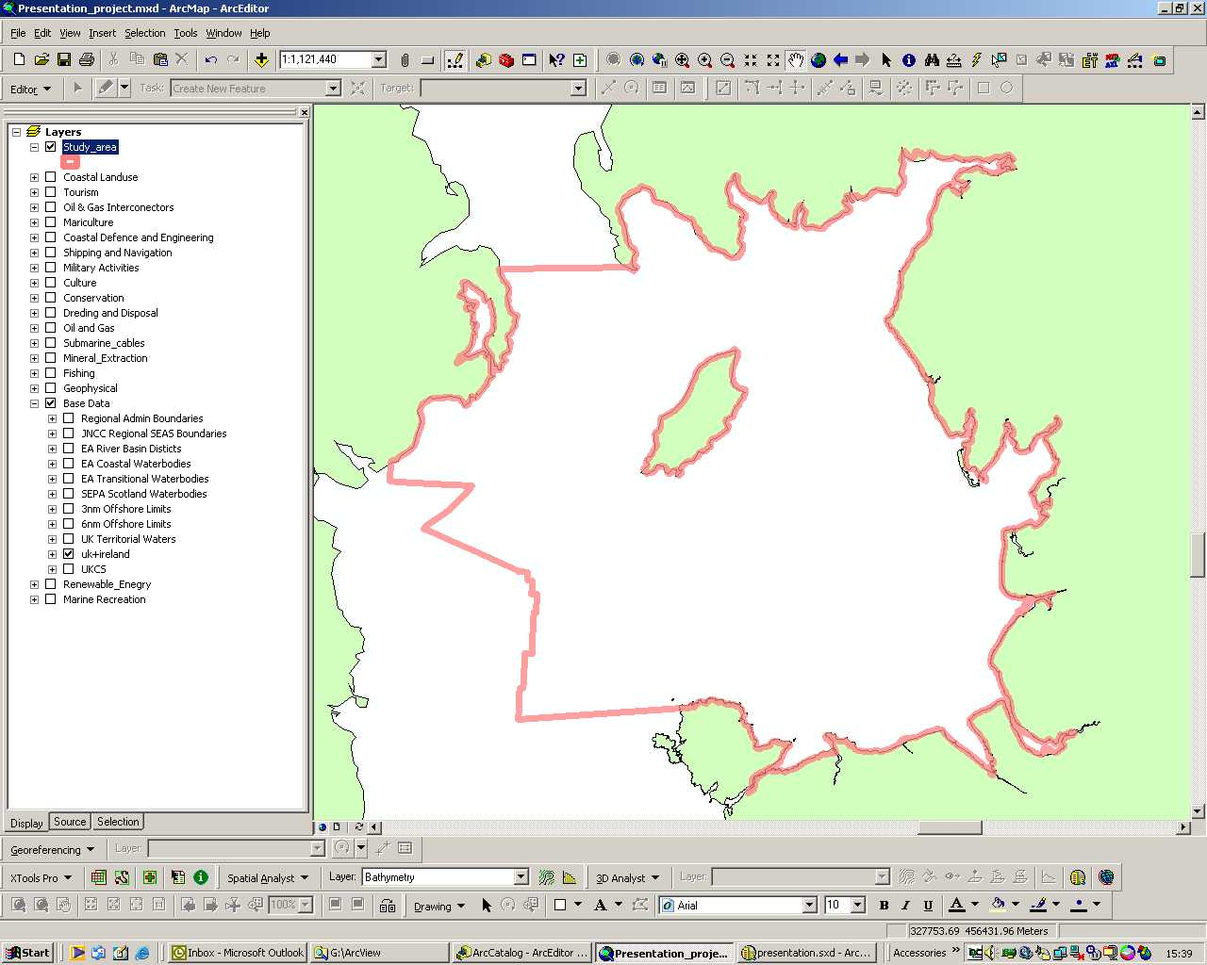
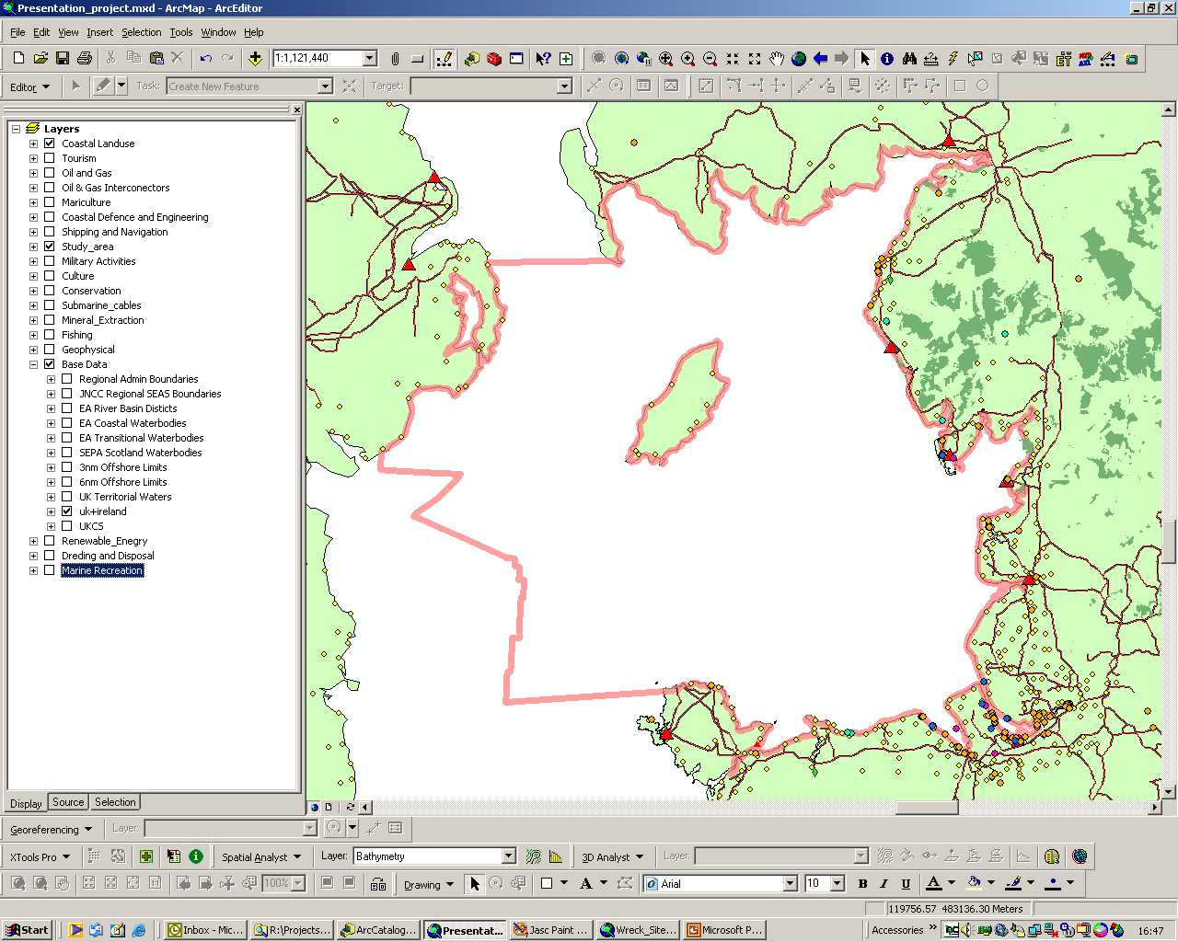
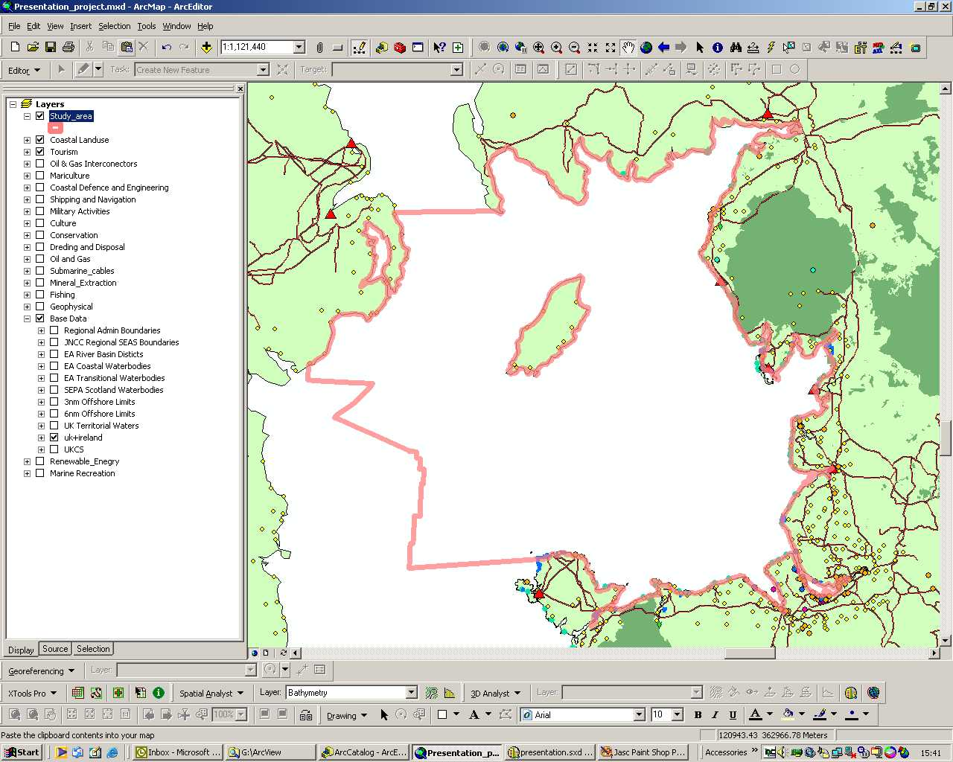
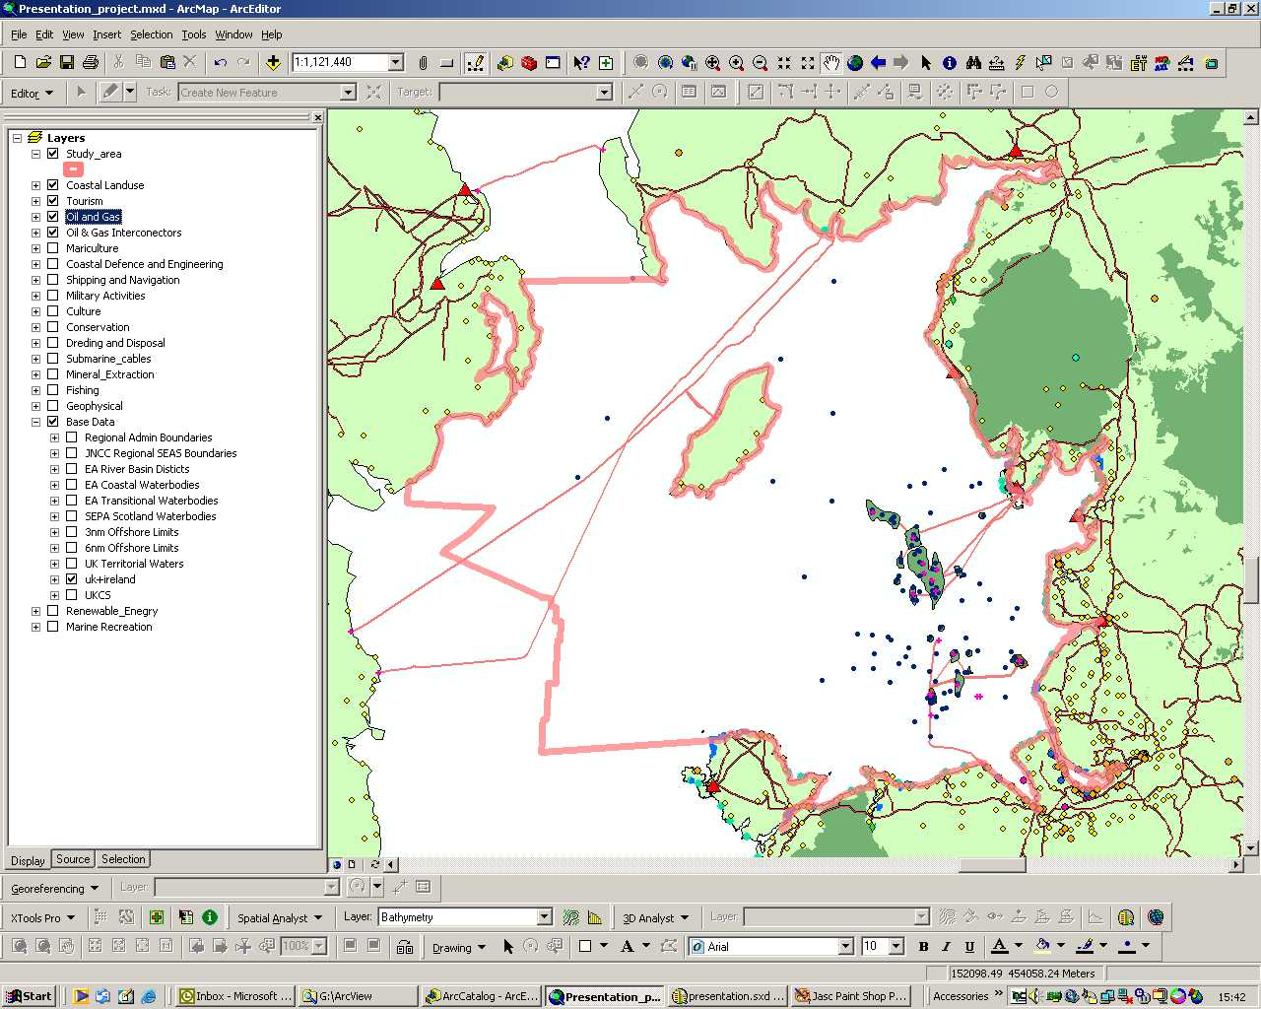

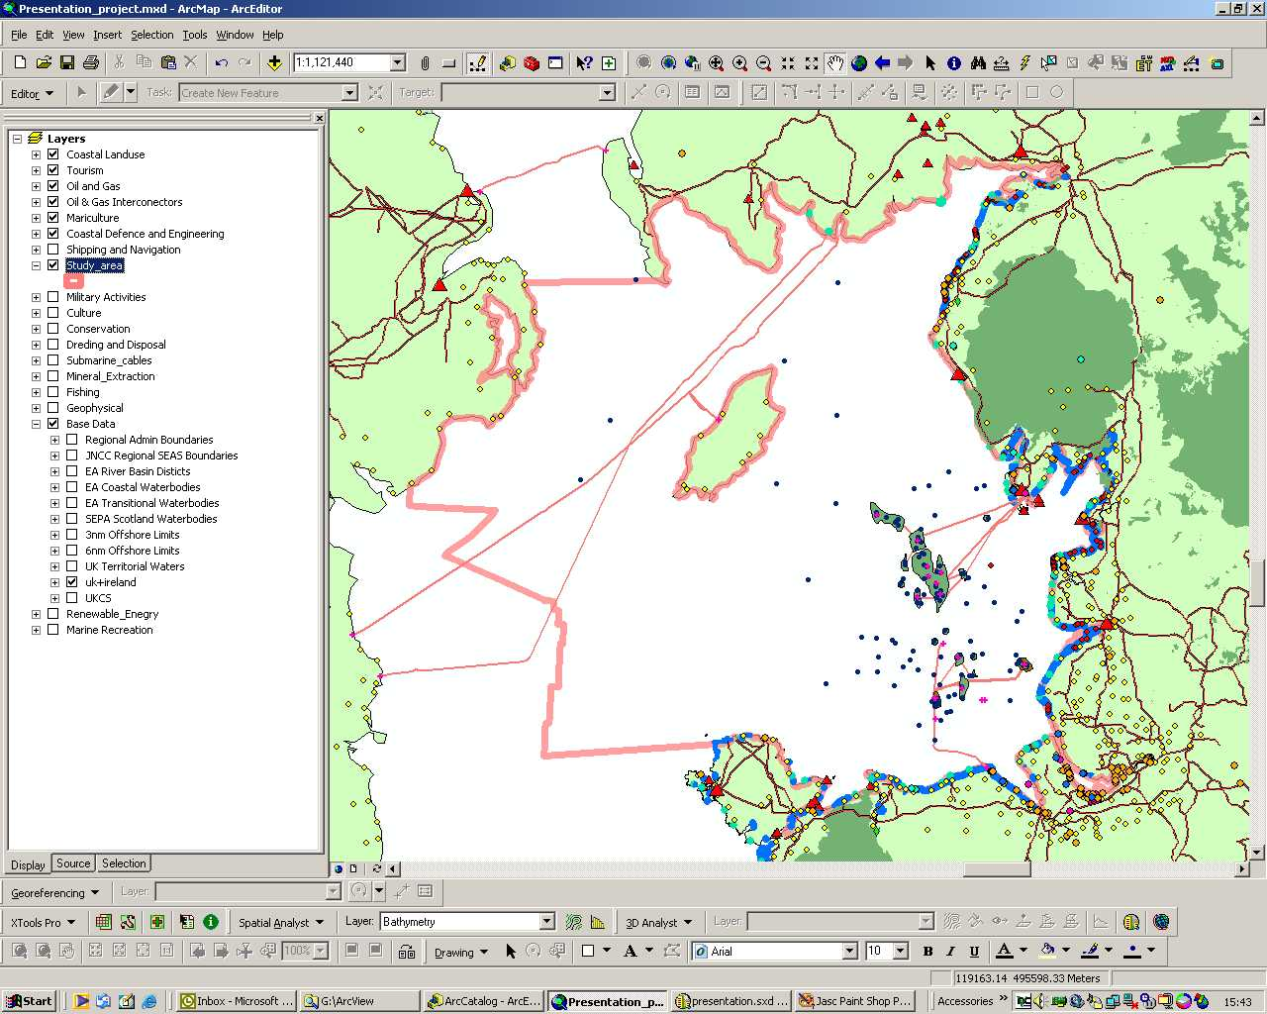
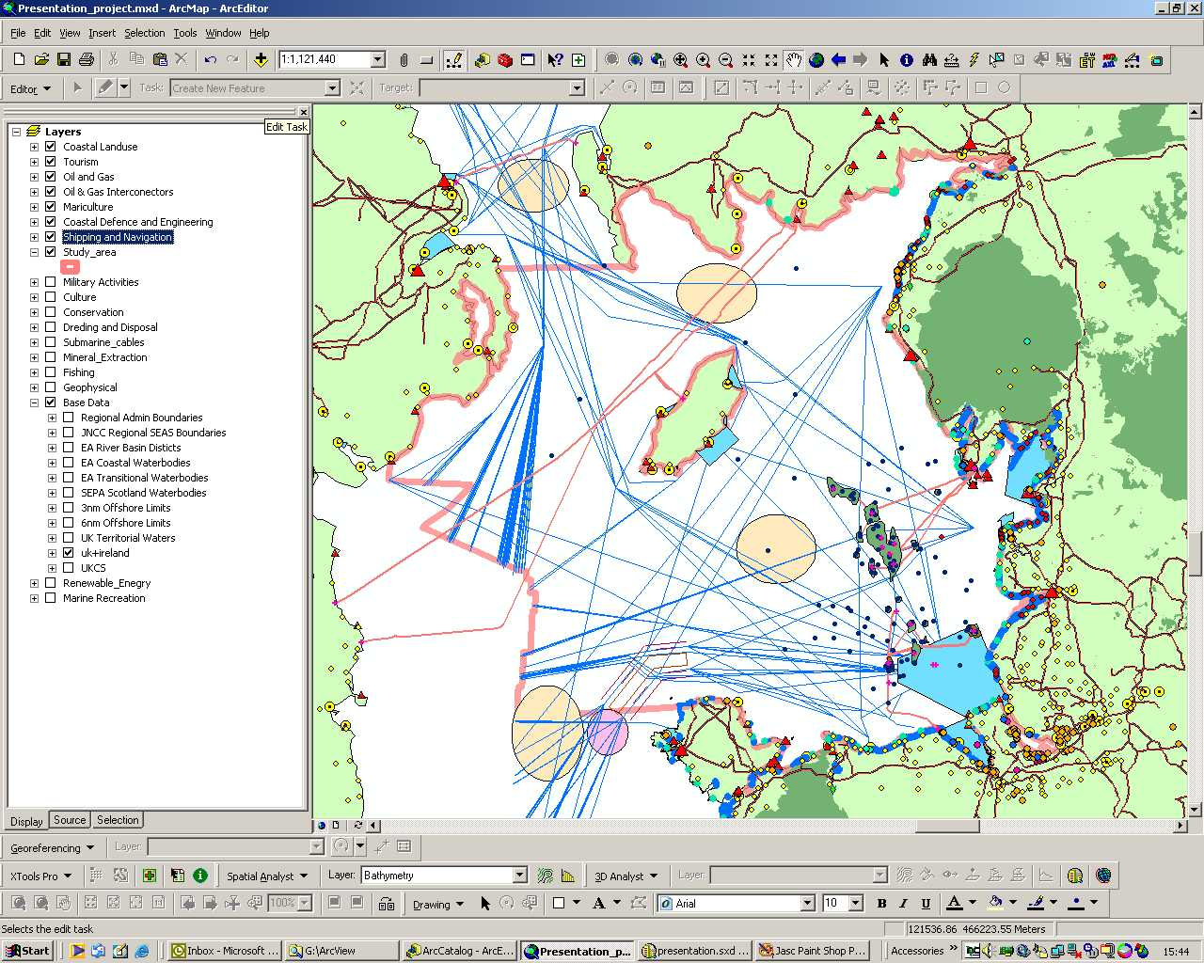
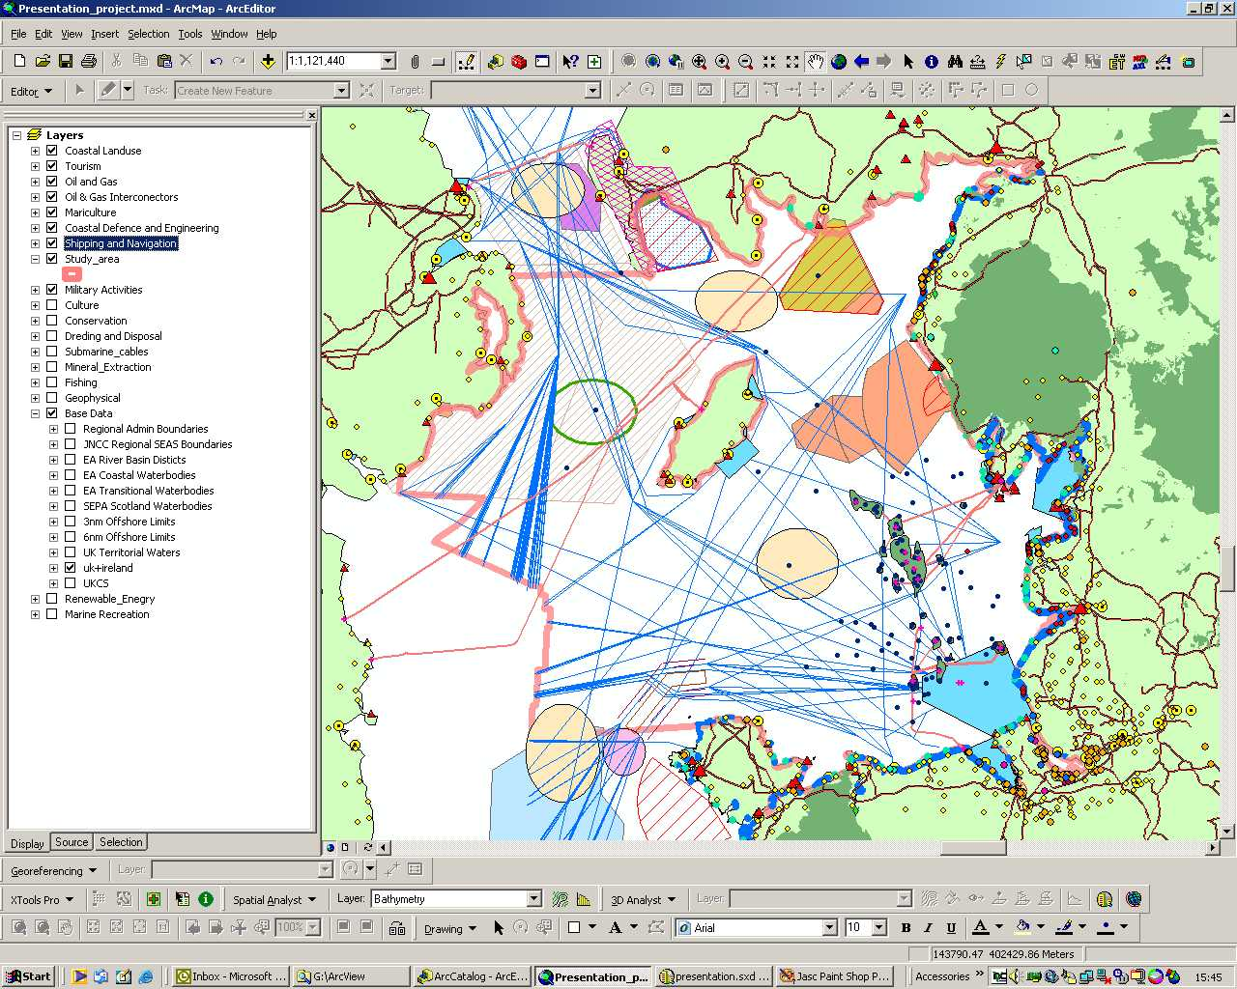
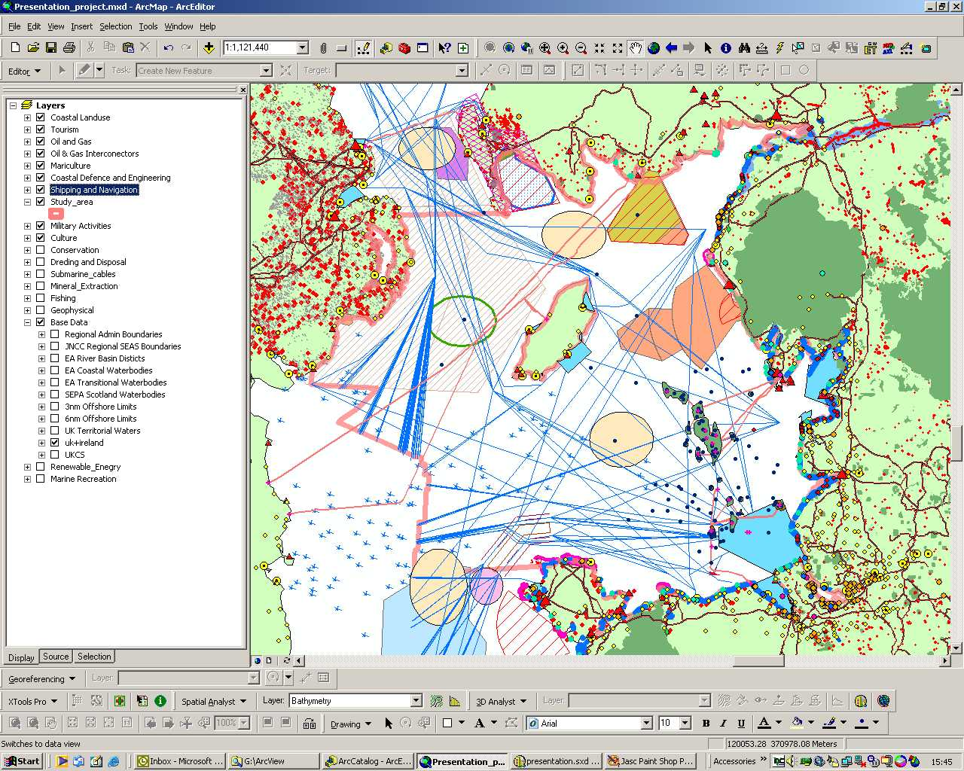
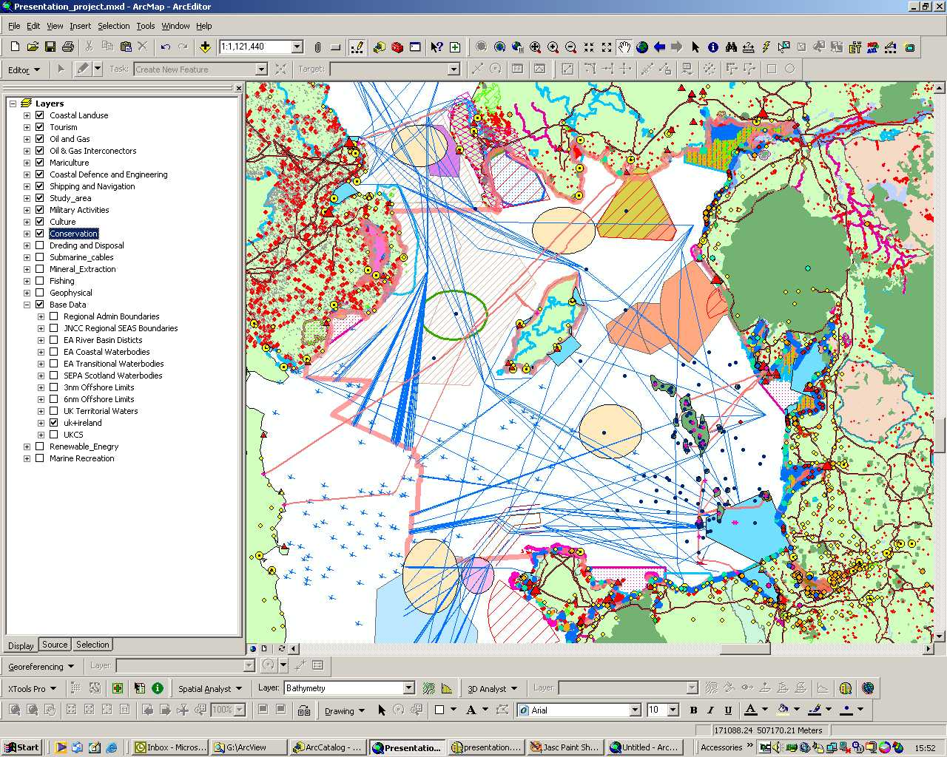
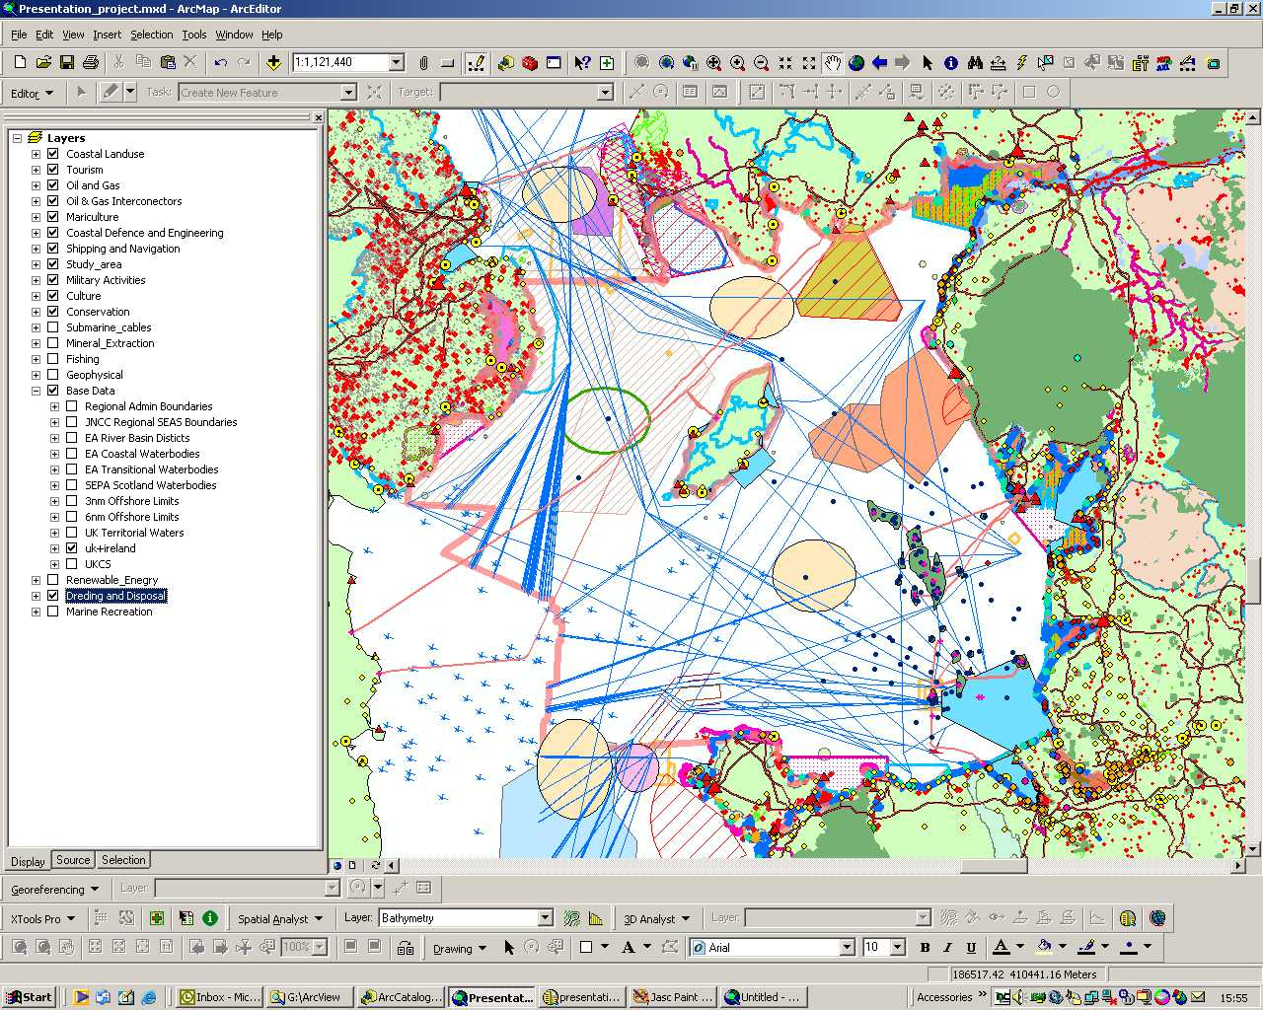
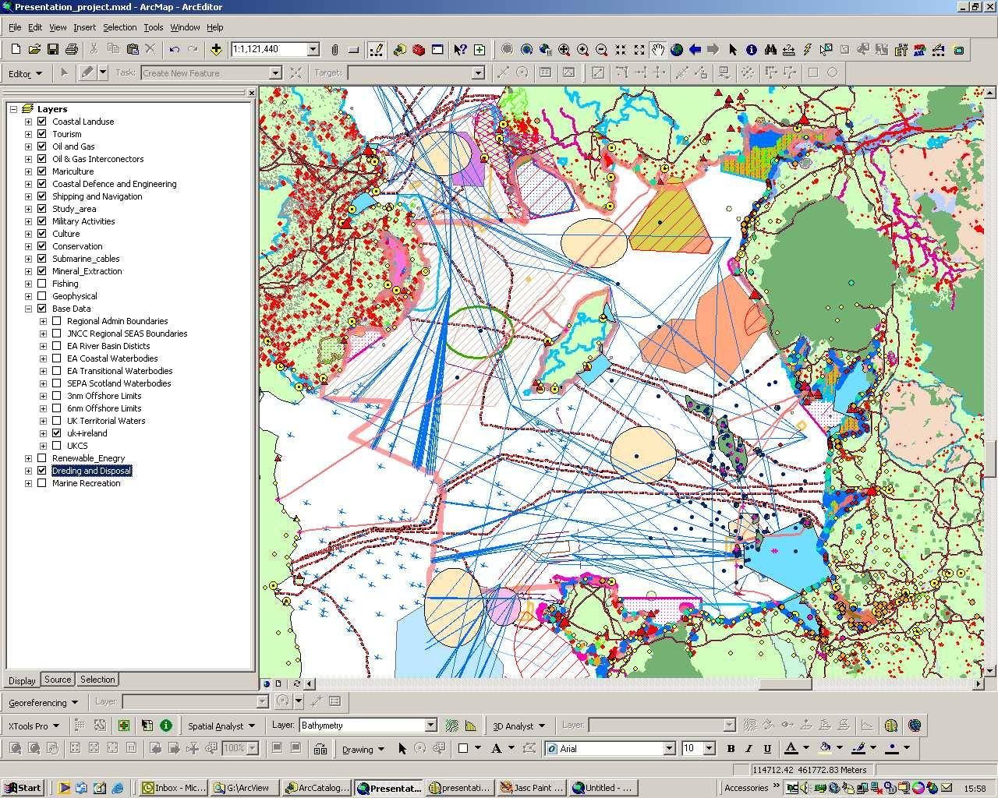
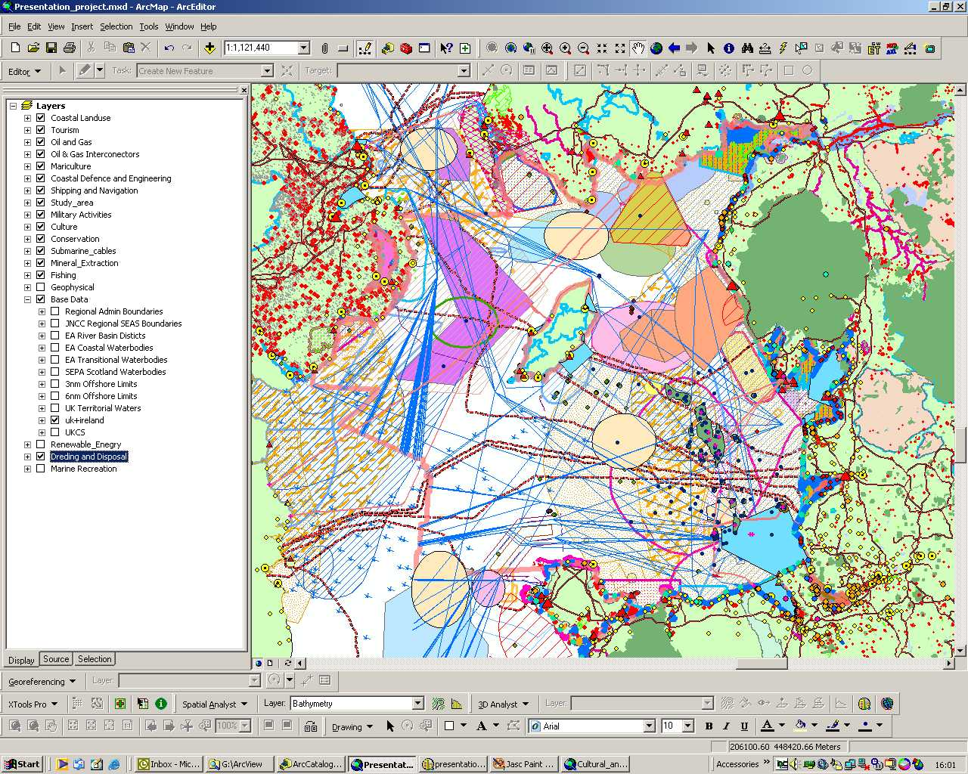
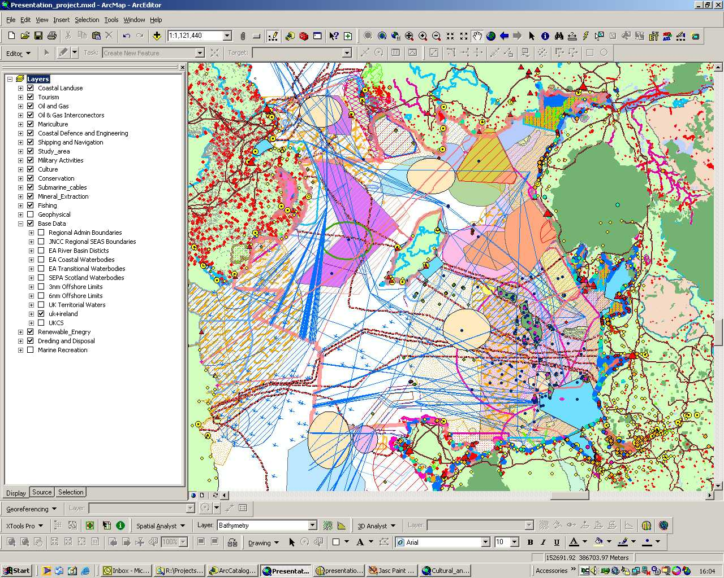
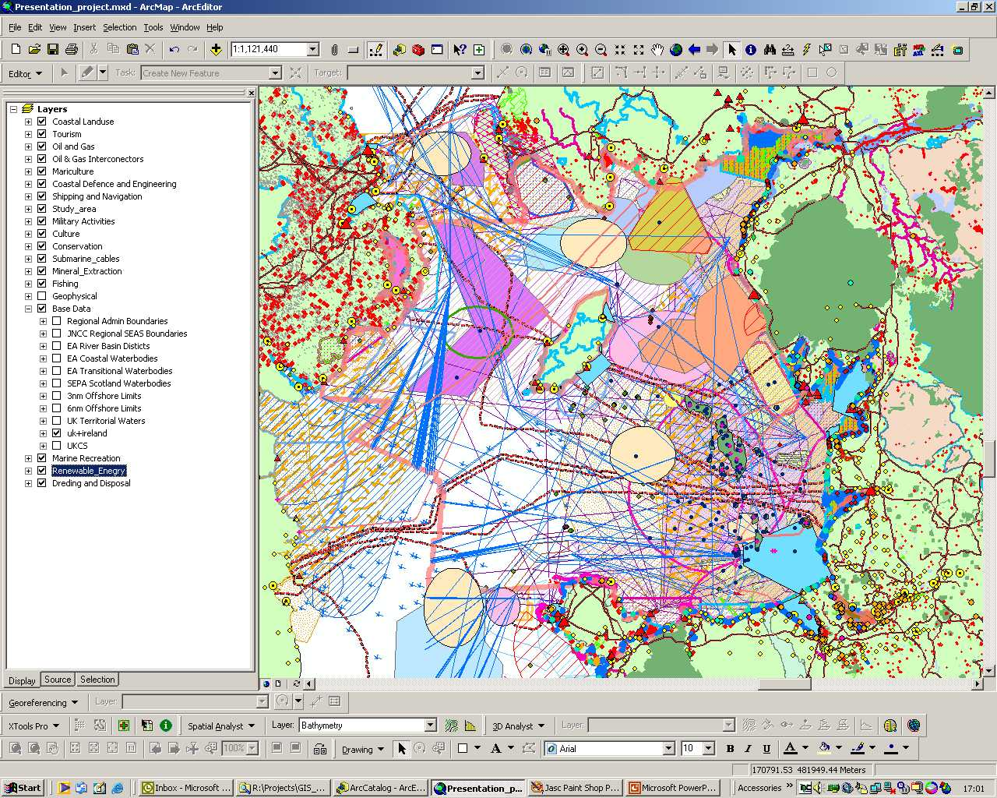
Economic activity in the Irish Sea and coastal hinterland
Source: Defra Irish Sea Planning Pilot - 2006
Land Use
Tourism
Oil &Gas
Mariculture
Coastal
Defence
Ports &
Navigation
Military
Activities
Culture
Conservation
Dredging &
Disposal
Submarine
Cables
Fishing
Renewable
Energy
Marine
Recreation
Mineral
Extraction

Slide 16
What should be the goal?
An MSDI populated with authoritative spatial data that will facilitate effective wider marine stewardship thereby enabling countries to achieve the goal of having
“clean, safe, healthy, productive and biologically diverse” oceans and seas

Slide 17
OceanWise Products and Services
Digital Marine Mapping
Data designed for immediate use as a reference map in GIS
Ocean Database
Proven management solution for all common types of marine data
Port-Log.net
Quick and easy storage and publishing of environmental data
Maritime Toolbar and Workflow Extensions
Powerful tools for manipulating maritime data directly in GIS
Marine Data Management, GIS , Training & Mentoring
Capacity and capability building, policy and strategy, integration

Slide 18
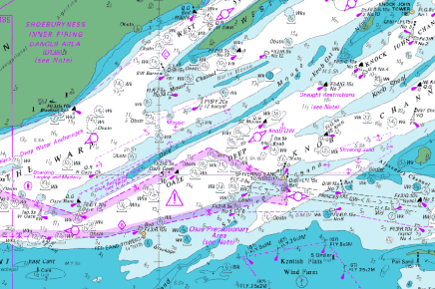
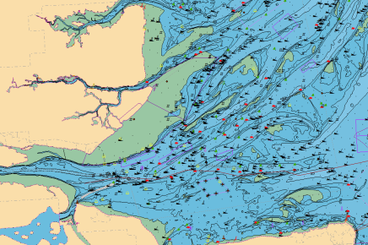
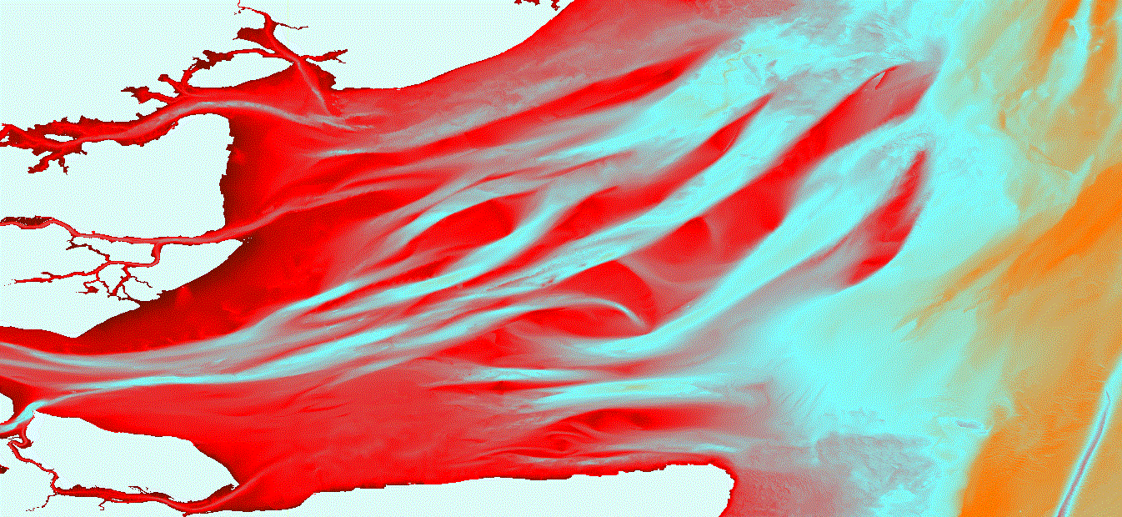
Marine and Coastal Mapping
Raster Charts
Popular Admiralty Chart series supplied as GeoTIFFs so no need for additional software
Marine Themes
Hydrographic Office (and other) data engineered into logical layers for easy use in GIS
Marine Themes DEM
1 & 6 arc second gridded dataset created from de-conflicted surveys, backfilled with chart data

Slide 19
Solution
Vision is for a Marine Data and Information Strategy and Framework that:
  Defines the need for marine ‘evidence’ holistically
  Identifies common requirements and existing resources
  Realises opportunities for sharing data and services
  Allocates adequate budget to data management
…an integrated approach to Marine Management
Data
∧
Notes:
Management includes data acquisition, product creation and maintenance.
All must be professionally coordinated and any self interest rigorously driven out.
Maximum use must be made of data being used and acquired elsewhere.
DPA and commercial obstacles must be addressed head on through sanitising data and legislation.

Slide 20
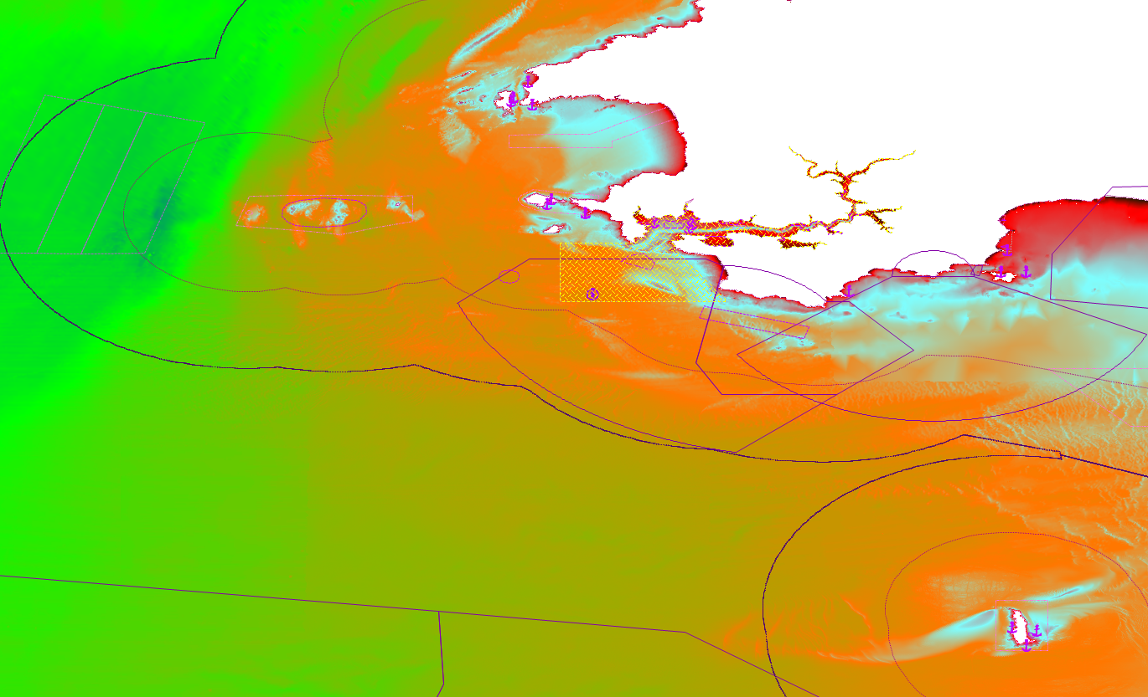
Marine Themes
Best available chart derived or source data used as input
Improved de-confliction
Contiguous feature geometry
Uncomplicated easy to use attribution
Retains scaled Elevation Layers
Source: UKHO, OceanWise

Slide 21
Marine Themes - Features
Third Generation Digital Marine Mapping
Converts HO source data formats e.g. S-57 to GIS
Starts to address problems of re-engineering data from product i.e. ENCs to seamless GIS layers i.e. no fragmented geometry
Categorised according to INSPIRE Annexes (Themes)
Simplified and easily understood attribute structure
Supports MEDIN vision of definitive reference data sets
Shared Public Sector pricing model
Land – Sea harmonisation “ready”

Slide 22
Specification
Themes developed according to EC INSPIRE Annexes
  Elevation (always scaled)
  Industrial Facilities (somewhat simplified/defined by regulator/asset owner)
  Administrative & Management Units (somewhat simplified/defined in law)
  Geographical Regions (areas hierarchical plus points on interest - gazetteer)
  Shipwrecks and Obstructions (position/multiple geometry/attributes)
  Geology (scaled)
  Tides (hierarchical)
Elevation data aggregated into three scale bands
  Small (<1: 150,000)
  Medium (1:30001 to 1: 150,000)
  Large (> 1: 30,000)

Slide 23
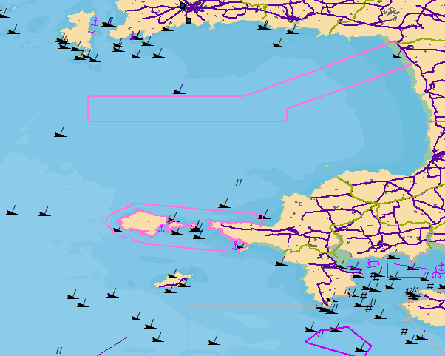
Marine Themes – Feature Layers
Elevation --
Small Medium & Large Scale
Shipwrecks & Obstructions
Industrial Facilities
Transport
Administrative & Management Units
Geographical Regions (L/M/S)
© Ordnance Survey 2012, Vector Map District
Notes:
OS Open Data – Vector Map District

Slide 24
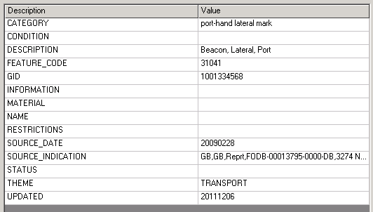
Marine Themes – Attribution
Supplied as GML
Simplified attribute structure
Akin to OS MasterMap Topography Layer
Understandable names
Descriptive terms for easier querying
Unique IDs (GIDs)
Source information where available

Slide 25
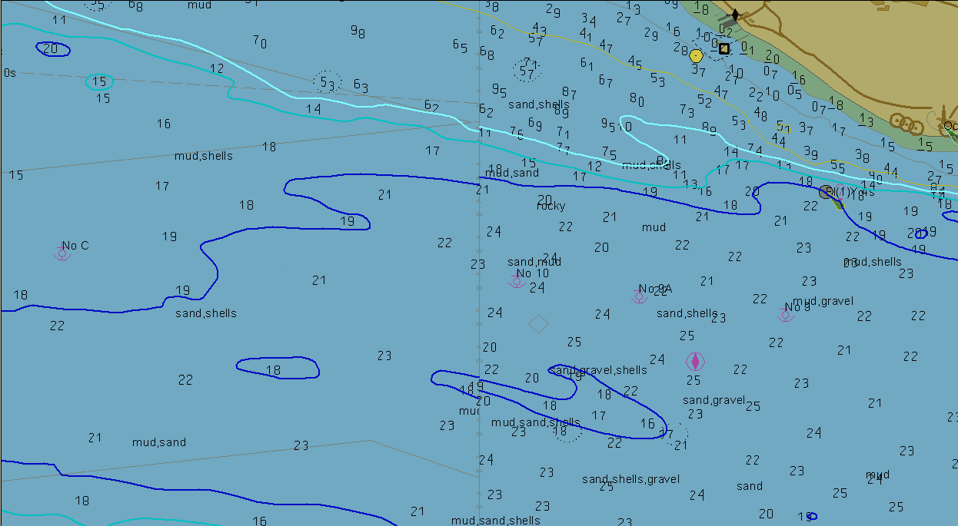
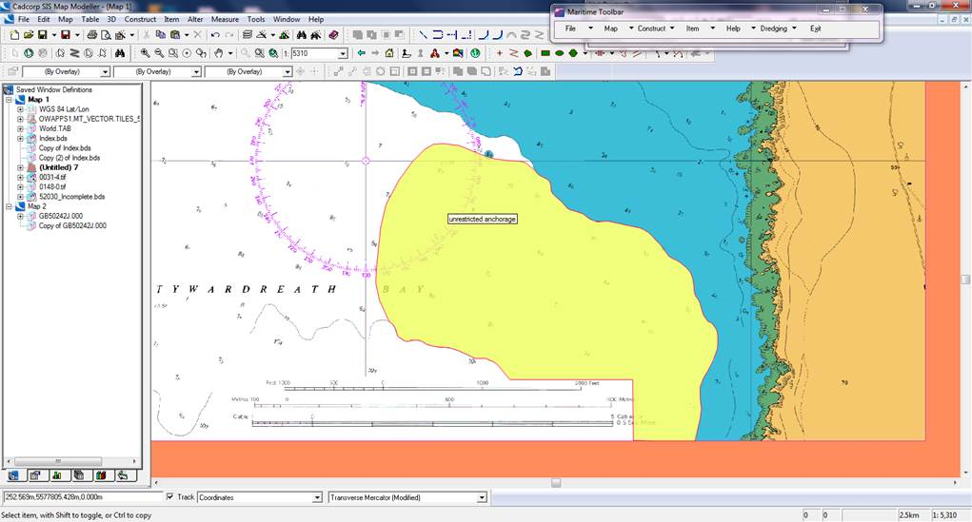
Legacy Issues – Data from Product
Chart
Boundary
Anchoring Area - UKHO ENC
Individual charts contain inconsistent and discontinuous features
Many important features only exist in ‘paper’ form and appear in re-purposed products unless resolved carefully
Ultimate solution is to go back to source records and re-create

Slide 26
Linking Digital Mapping to Legislation and Policy
Anchor Area:
An area in which vessels anchor or may anchor. (IHO Dictionary, S-32, 5th Edition, 130)
But how real is the constraint, can it be amended or restrictions and risk mitigated? How do I find out more and who do I contact? What am I missing?

Slide 27
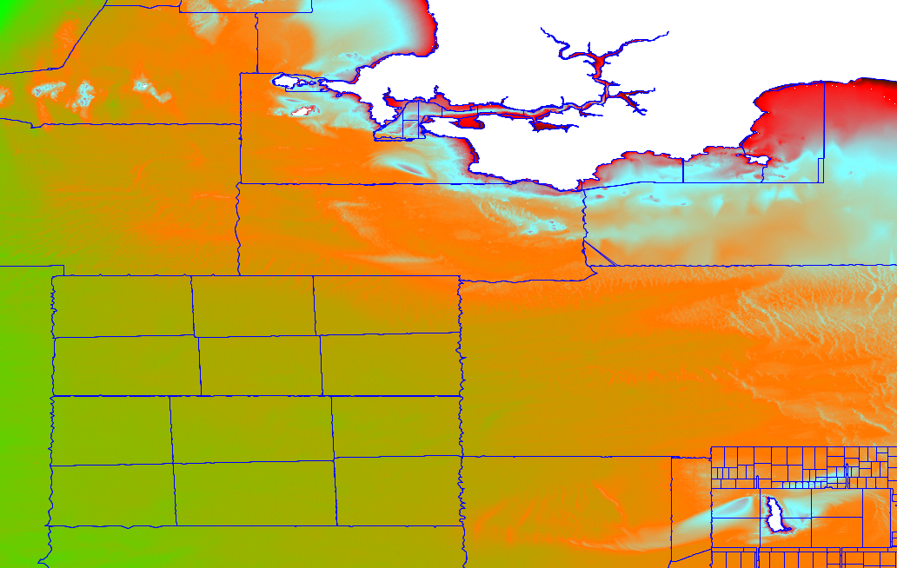
Marine Themes DEM - UK & Ireland
Up to date data from CHP / UKHO
Contiguous and accurate coastline
Height attributed coastline (VORF)
Improved de-confliction
Nearest neighbour interpolation
Comprehensive evaluation metadata
Source: UKHO, OceanWise
Notes:
Coastline attributed with type (to determine slope to nearest sounding) and height (from VORF). Accurate (under piers etc).

Slide 28
DEM Creation & Maintenance
Data Sources (in order of preference):
  Surveys received digitally from UKHO (visually inspected & assessed)
    Single-beam surveys (SBES) –1: 25,000 or 1: 50,000 compilation scale
    Multi-beam surveys (MBES) & LiDAR – 1m, 2m, 5m or 10m bin size (depth dependent)
  Survey data captured from analogue survey sheets, rigorously checked and quality controlled. Inshore surveys now being digitised.
  Depth contours and soundings derived from largest available scale of Electronic Navigation Charts (ENCs)
High density multi-beam (RAW or GSF) thinned (by UKHO)
Original datum of input data (i.e. Chart Datum) retained

Slide 29
Digital Survey Data
SBES, MBES and LiDAR data batch loaded by a background service residing on the server
Files scanned, statistics and MBR extents calculated
Metadata associated by filename (as advised by UKHO)
Each survey loaded, and the larger surveys split into blocks for manageability, and triangulated through GeomodTeraSurf software
A thumbnail image of each surface is generated to highlight potential errors e.g. steep triangles etc indicating spikes
Imported surveys assessed for inclusion in DEM

Slide 30
Port-Log.net
Quick and easy storage and publishing of environmental monitoring data
  Service provided is proven and low risk
  Instrument and manufacturer independent
  RS232, TCP/IP and FTP data uploads
  Standard and customised web interfaces
  Cost effective and quick to set up
  Range of oceanographic interfaces
  E-mail and SMS alerts as standard
  Extensible data model

Slide 31
Ocean Database
Flexible data management solution for ALL common types of data:
  Instrument and manufacturer independent
  Flexible and extensible data model
  Integrated metadata to industry standards
  Imports and applies calibration records
  Accessible to 3rd party applications
  Proven low risk solution
Includes:
  IT infrastructure and operation environment
  Ocean data model
  Management and data loading software

Slide 32
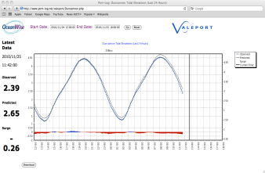

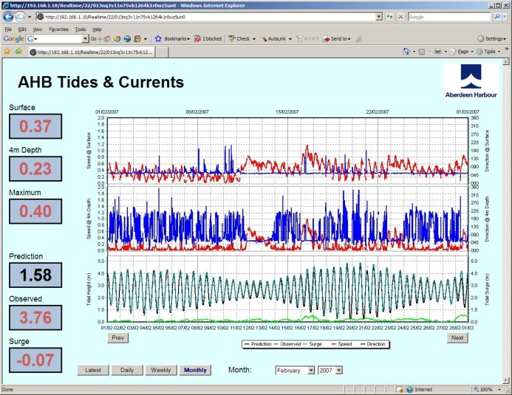
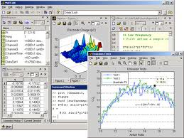

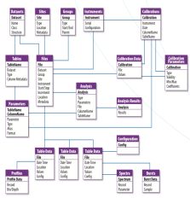
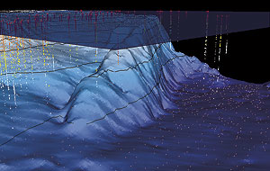
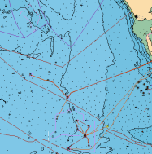
Port-Log Sensor Side
UHF, GPRS, Iridium,
RS232, TCP/IP
Server and RDBMS supplied by customer or OceanWise Ltd
Port-Log Client Side
Real-time sensor stream via modem, cable and/or Internet
Modem
Standard or customised web pages provide view and download to real-time and historic datasets
Sensor 2
Software decodes data stream and relays or loads data into ODB
Sensor 1
Ocean Database
Sensor 4
External Applications
Data in the ODB is accessible by third party applications designed for a particular purposes or embedded with your organisation.
Examples include
- MATLAB
GIS (e.g. Cadcorp)
Port-Display
Maritime Toolbar
Sensor output
via DSU / media
Sensor 3
ODB
Software loads sensor and laboratory output to ODB.
Handles actual, QA, location and calibration data and metadata
Reference data loaded via GIS component.
Laboratory results
via email / media
Reference datasets e.g. maps, assets
via LAN or media

Slide 33

Case Study - Port Environment
Multi faceted business
Land and marine operations
Responsible for safety, security and environment
Wide range of stakeholders
Data is key to business and operational success
Majority of port data has a spatial component
RSAHC, Riyadh, 4th-6th March 2013

Slide 34

Ports Operations and GIS
Planning & Communication
Situation awareness; access to reference data and associated policy and compliance documents; licensing; environmental reporting
Marine Operations
Hydrographic survey planning, data management and chart production; management and publishing of weather and tidal information e.g. to pilots
Asset and Facilities Management
Location and details of assets; building and infrastructure planning and maintenance; navigational aids, details and allocation of berths and moorings
Safety and Security
Wrecks and obstructions; information exchange e.g. with UKHO; contingency planning; emergency response; ISPS code planning and monitoring

Slide 35
Maritime Toolbar
Powerful easy to use tools for manipulating maritime data directly in GIS
    Common and complex tasks made easy
    Simple handling of bathymetric data
    Handles all common maritime datasets
    Batch tools to simplify repetitive tasks
    Designed specifically for marine GIS user
    Connects directly to Ocean Database
    Extensible operating environment...
        Infrastructure
        Bathymetric surveys
        Infrastructure
        Environmental
        Asset Management

Slide 36
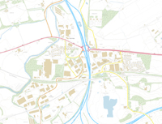
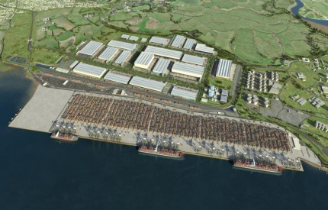
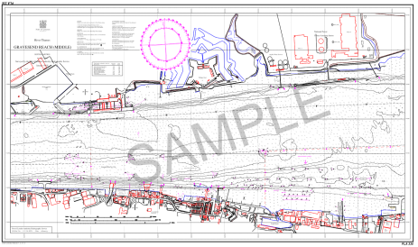
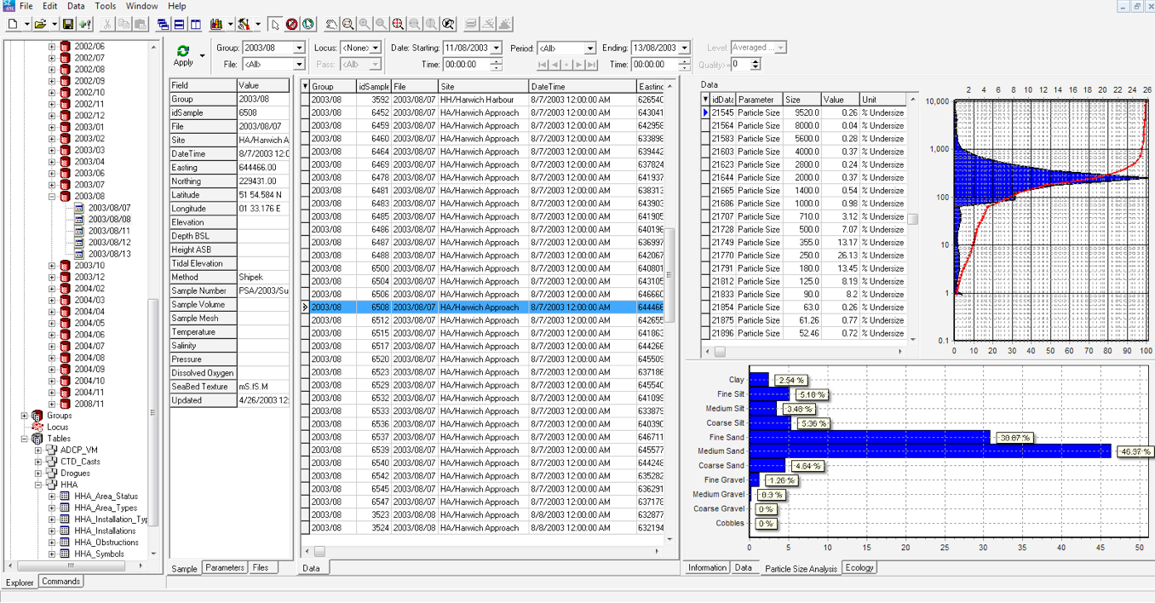
GIS Components
Data inputs
Productivity tools
Reference Spatial Data
Port Spatial Data
Linked Business Data
RSAHC, Riyadh, 4th-6th March 2013
Notes:
Marine Reference Data
Land Reference Data
Port Spatial Data (Location of Assets)
Business Data Linked to Spatial Objects
Existing Central Databases
Distributed Datasets
OWL Ocean Database (Bathymetry and Environmental Monitoring
Web Display of Map and Time Series
Desktop Analysis of Environmental Data
Paper and PDF Output (Map, Reports etc)
Digital Outputs (GIS Format, XML for Data Exchange with Regulator, UKHO etc)

Slide 37
Typical Maritime Information Infrastructure
Notes:
Relies on open standards etc AND MSDI principles

Slide 38
Conclusions
There is an urgent need for quality spatial data services to satisfy growing demand in our marine space (PANACEA)
Data is still difficult to access, share and exchange (PAIN)
The need still exists to re-purpose chart product data (PAIN)
Core Reference data is a “must” for asset management and decision support (PANACEA)
MSDI allows stakeholders to act together to deliver interoperability
however…OceanWise has unparalleled access to data sources globally and is satisfying customers across the World!

Slide 39
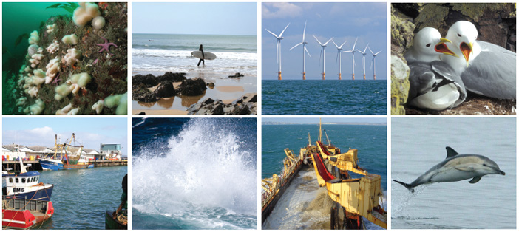
Thank You! www.oceanwise.eu john.pepper@oceanwise.eu

