Slide 1
Vicente Carrasco
Jefe de Ventas
Kongsberg Maritime SUBSEA para Sudamérica
Kongsberg Maritime
Optimizacion de toma de datos batimetricos

Slide 2
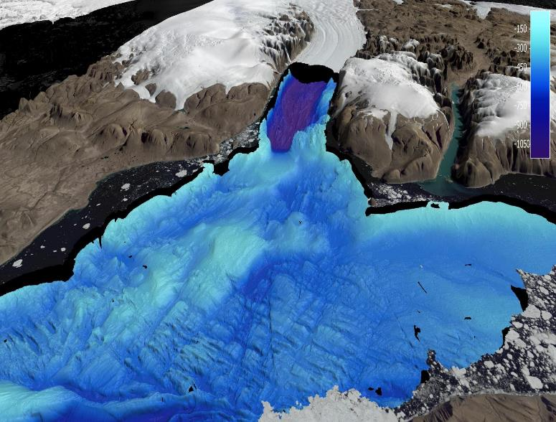
Agenda
Introducción
Resolución/ Productividad
Autonomía
Mapping Cloud

Slide 3
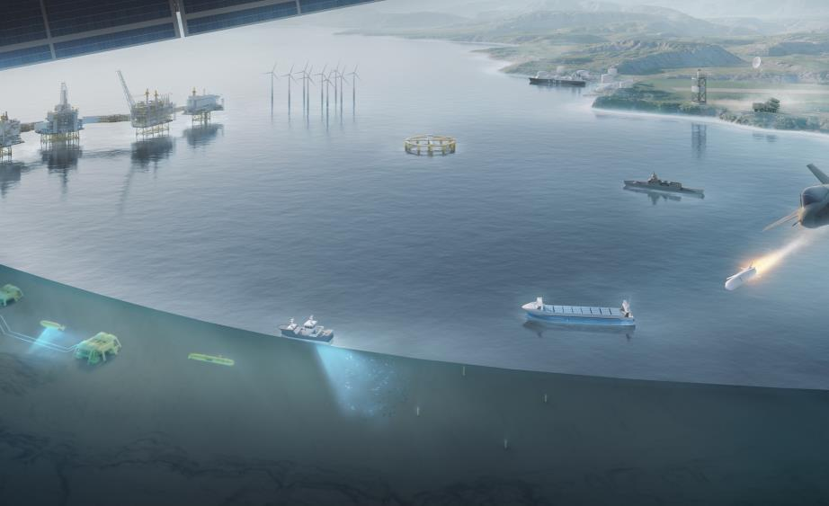
WE DELIVER SOLUTIONS
From deep sea to outer space
Notes:
We have delivered products and solutions for operations in the world’s deepest seas.
You can find KONGSBERG’s products in every segment of the maritime industry.
We are also leaders in the defence and aerospace industries
Our product portfolio is wide.
At our core is technology, innovation and customer focus.

Slide 4
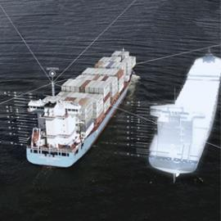
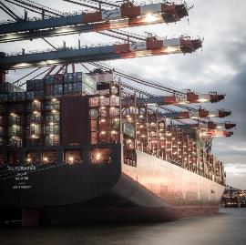
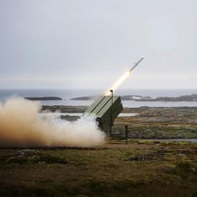
Business Areas
Technology is our common core
KONGSBERG DIGITAL
KONGSBERG MARITIME
KONGSBERG DEFENCE & AEROSPACE
Maritime simulation
Industrial digitalization
Seaborne transportation
Robotics and Sensors
Offshore, Oil & Gas
Defence
Space and Surveillance
Notes:
KONGSBERG is organized into three business areas:
Kongsberg Digital is truly within the fourth industrial revolution. This business area aims to be an industry leader in the digitized industry of tomorrow. The company has more than 500 software experts with leading competence within internet of things, smart data, artificial intelligence, and automation and autonomous operations.
Kongsberg Defence Systems is Norway's premier supplier of defence and aerospace-related systems. The business area came with the first industrial revolution. Their portfolio comprises products and systems for command and control, weapons guidance and surveillance, communications solutions, weapon systems and missiles.
Kongsberg Maritime is our part. You will get to know this business perfectly well in the months to come.
Together we are ONE KONGSBERG

Slide 5
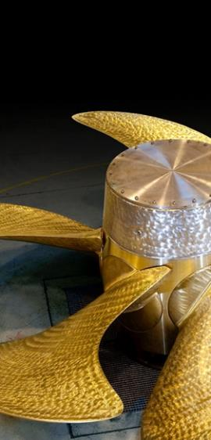
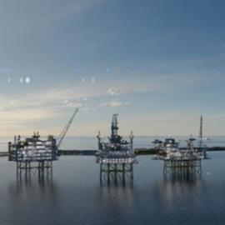
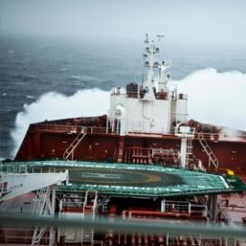

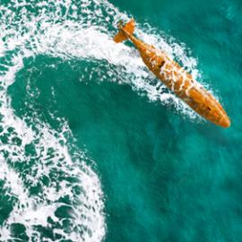
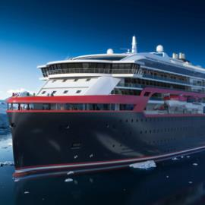
The Broadest Portfolio of Products
PROPULSION & ENGINES
INTEGRATED SOLUTIONS
DECK MACHINERY
Throughout the entire maritime industry
SENSORS & ROBOTICS
SHIP DESIGN
Notes:
We are proud of the scope of deliverability of Kongsberg Maritime
We are well positioned within all these segments.
We are world class, and will always strive to be even better.
With the two companies performing together, we know that we will succeed.

Slide 6
Our Global Reach
Notes:
Together we are strong and well positioned.
As RRCM and KONGSBERG products are installed on some of the same vessels, our new installed base is approximately 30,000.

Slide 7
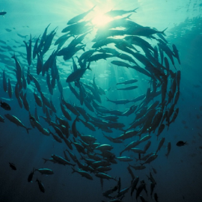
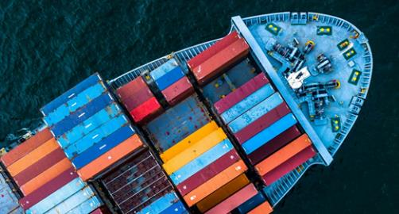
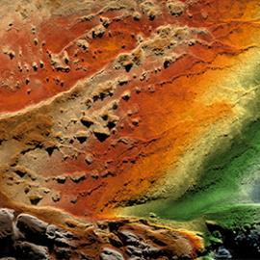
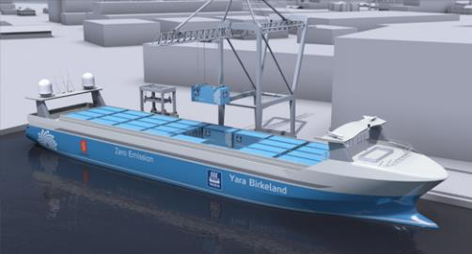
We are the Ocean Experts
80% of our business directly relates to the sea
Notes:
The ocean has always been important to humanity and global development.
70 per cent of the globe is covered with water.
80 per cent of the transportation of goods are at sea.
90 per cent of the worlds biomass are in the ocean.
A huge amount of the global challenges we face are related to the ocean – and the ocean is where we will find the solutions
The ocean will become even more important in the years ahead, and we are perfectly positioned to take part in the value creation related to it.
We have the expertise and technology solutions that can spearhead the utilization and sustainable management of ocean resources.

Slide 8
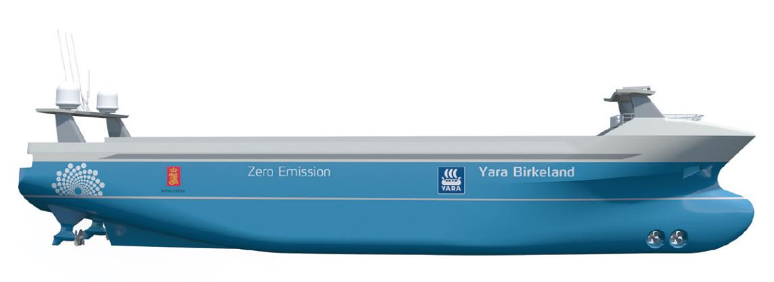
The Maritime Industry is Changing
COST OPTIMIZATION
DIGITALIZATION
SUSTAINABILITY
SIZE MATTERS
Notes:
The maritime industry is becoming increasingly globalized and is undergoing considerable technological and market driven changes.
Sustainability has become a matter of course.
There is a strong dedication to cost optimization.
Digitalization is an important part of the answer to the challenges for our customers.
Globalization has made size and global footprint for suppliers to a key qualification.
We are capable to deliver on all of these challenges. We already have the technology that will take us to the next level.

Slide 9
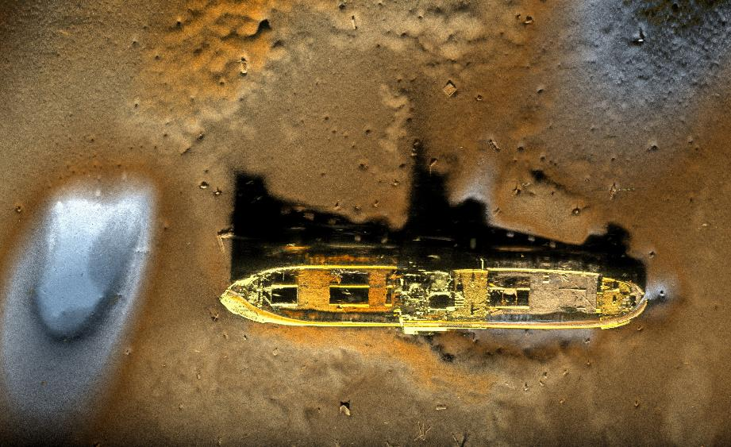
Datos de alta calidad
HISAS 1032 con Doble Receptor
Courtesy of RNoN and FFI

Slide 10
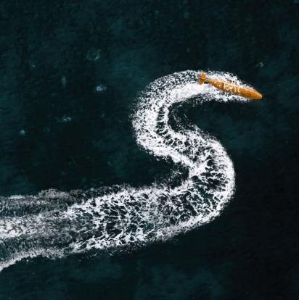
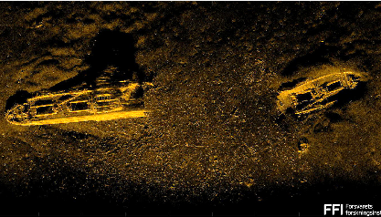
HUGIN Superior
Best quality data collected in the most safe and cost effective manner
6000 m depth rating
Superior data coverage
Superior resolution
Superior position accuracy
Superior endurance

Slide 11
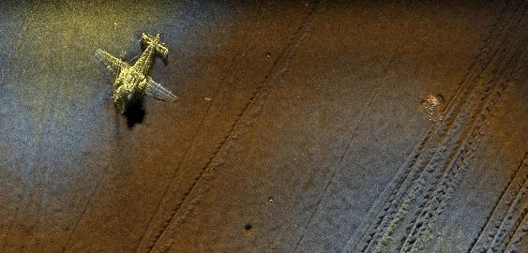
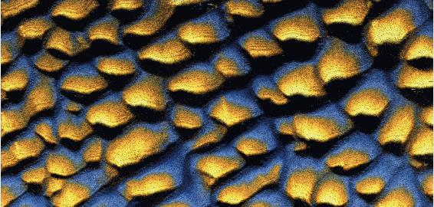

Cobertura de datos
HISAS 1032 Doble Receptor: cobertura de área mejorada para imágenes y batimetría
IMANGEN SAS
BatIMETRIA
Imágenes de alta resolución con alcances de hasta 500 m a cada lado de la AUV, que proporcionan una cobertura total de hasta 1000 m a 2,5 nudos o 600 m a 4 nudos
Batimetría SAS en una franja de 1 km que produce una resolución de 20 x 20 x 20 cm en rangos de 200 m, duplicando la cobertura de área para levantamientos hidrográficos
El nuevo procesamiento HISAS de datos genera batimetrías e imagen SAS del alcance completo, la cobertura de área aumenta hasta 4,5 km2 por hora

Slide 12
Área de Cobertura del HUGIN Superior
HISAS 1032
Nuevo HiSAS 1000m

Slide 13
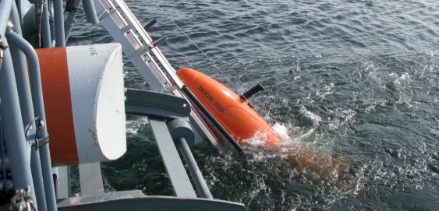
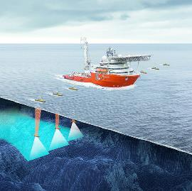
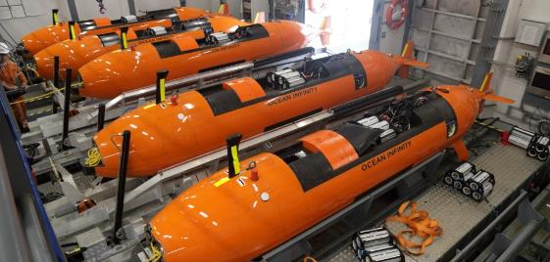
Force Multipliers
Cubre una gran area en menos tiempo
La aplicacion eficiente del uso de varios sistemas operando simultaneamente es el resultado del descubrimiento del ARA San Juan

Slide 14
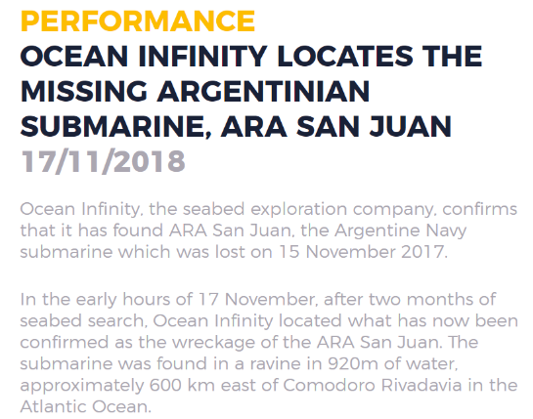
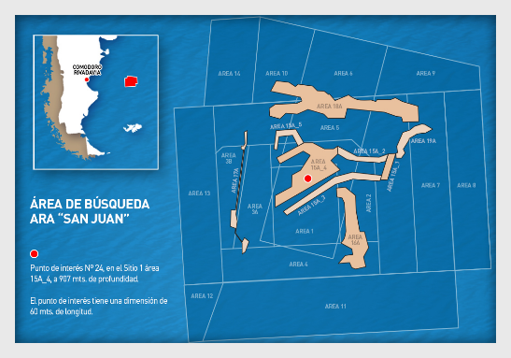
Aplicación de Busqueda y Rescate

Slide 15
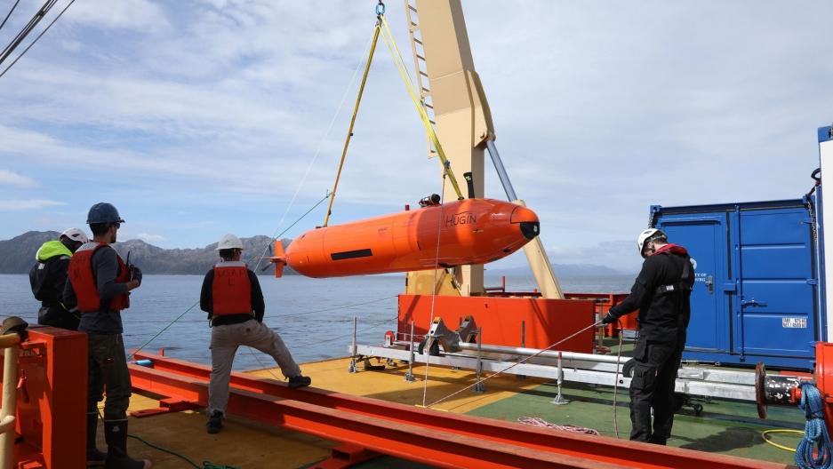
Aplicación de Investigación de Iceberg en Antártica
Scientists aboard the icebreaker Nathaniel B. Palmer this month are getting their first up-close look ever at a massive Antarctic glacier that could play a big role in global sea level rise.

Slide 16
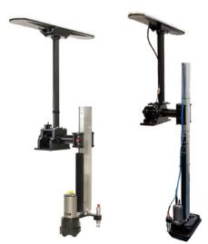
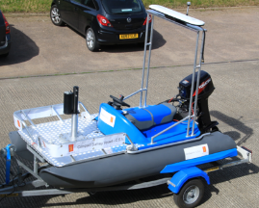
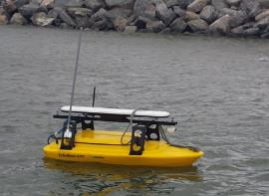
A range of Portable Hydrographic Systems
Open to suggestions for new ways to integrate
Pole mounted
C.S.V mounted
USV Mounted
Geoswath
M3 Sonar
EM 2040P
EM 2040C
GeoSwath
M3 Sonar
EM 2040P
EM 2040C
Geopulse Compact
GeoSwath
M3

Slide 17
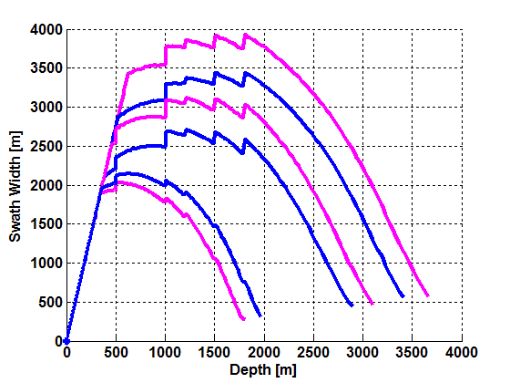
EM 710, EM 710-MK2 y EM 712
Comparativa coberturas
Sistema 0.5º * 1º
Magenta – Verano
Azul – Invierno
NL= 45 dB para EM 710
y EM 710-MK2
NL= 35 dB para EM 712
EM 712
EM 710
EM 710-MK2

Slide 18
Productividad
Profundidad de trabajo >70 % de Actividad
Cobertura de los diferentes modelos
Solape entre líneas
Diferencia de precios entre modelos
Estimación de calculos de operación del buque
Conclusión de detrminación del sistema óptimo condierando el ahorro en costes operativos

Slide 19
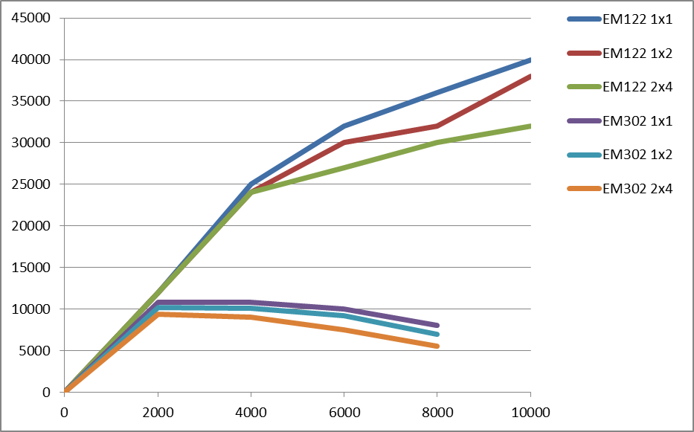
EM122 vs EM302 cobertura
78%
30%

Slide 20
EM 122 cobertura
Para que la EM302 cubra 288,023 km se requiren 202 dias de campaña esto supone 157 días extra.

Slide 21
Kongsberg Maritime
ENHANCE CAPABILITIES
AUTONOMY

Slide 22
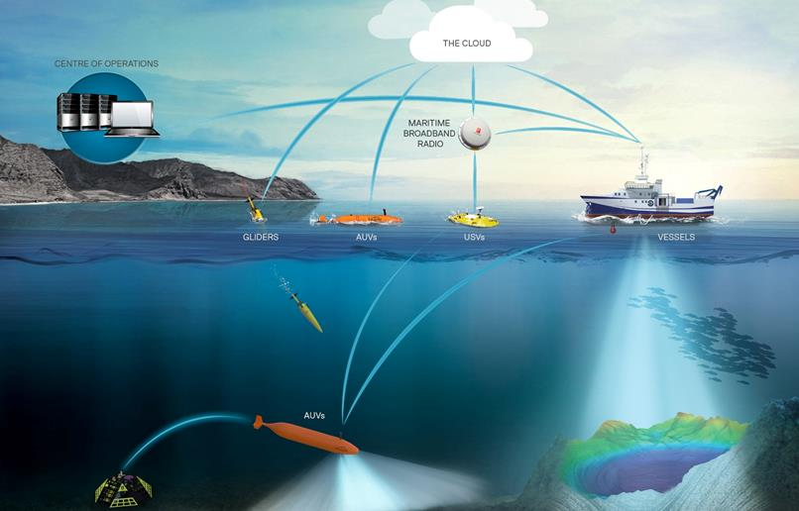
Autonomy
Improved operation and safety at lower cost

Slide 23
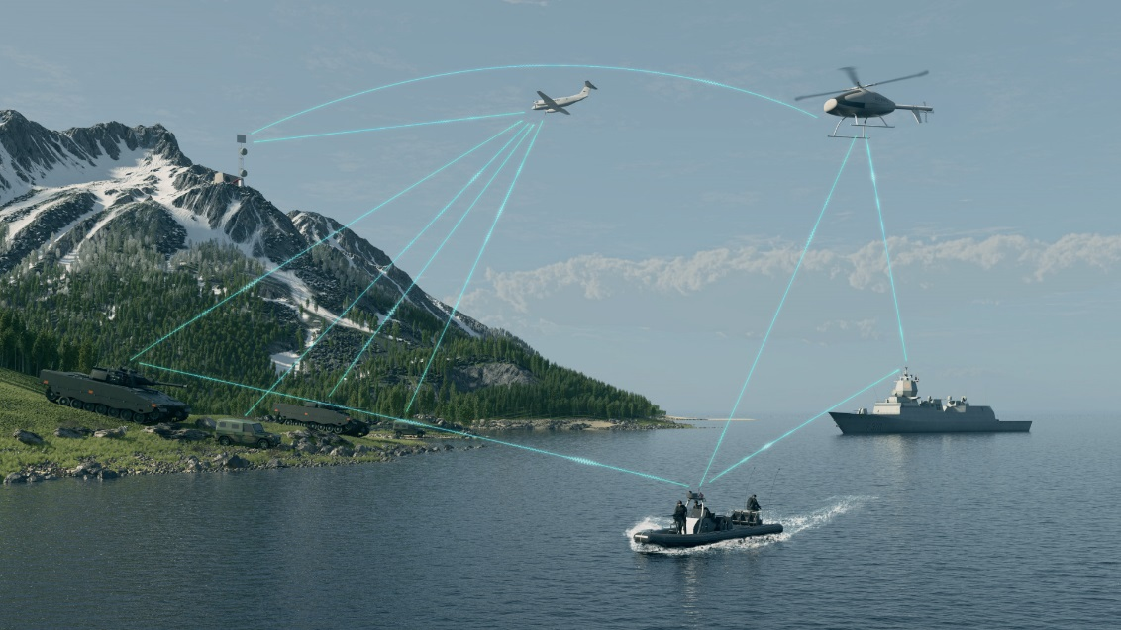
MARITIME BROADBAND RADIO

Slide 24
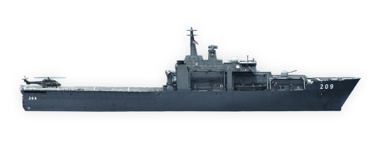
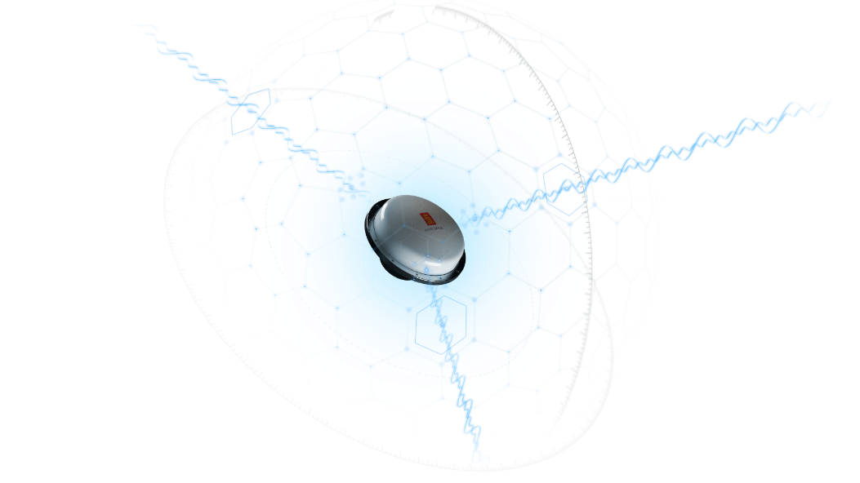
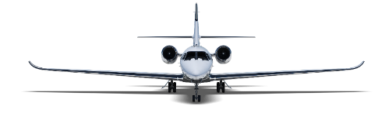
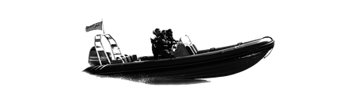
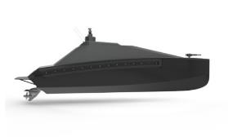
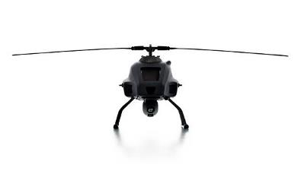

Operativa comun en tempo real, anywhere!
Vessel
Aircraft
RIB
ASV
UUV
UAV

Slide 25
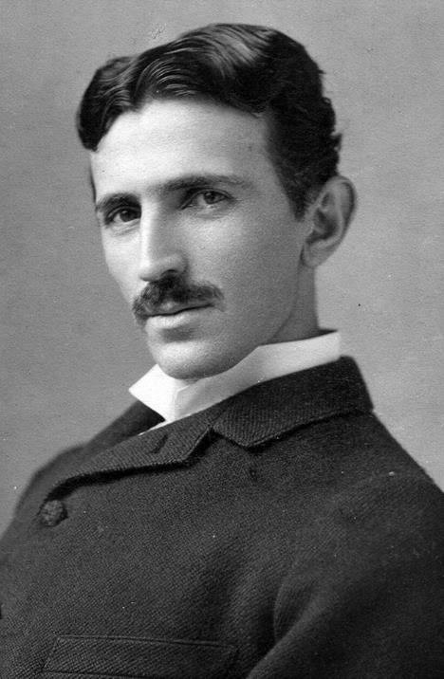
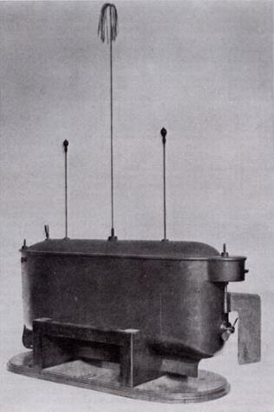
A brief history of Radio controlled Boat
    Tether-less control made its first appearance in the 19th Century
    Nikola Tesla demonstrated a remote controlled boat during an exhibition at Madison Square Gardens in 1898
    In typical Tesla style, he convinced the audience they could control it with their thoughts!
    This was before the Radio was invented by Marconi brothers ?

Slide 26

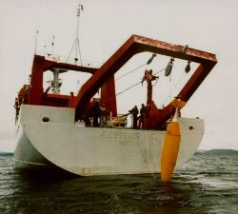
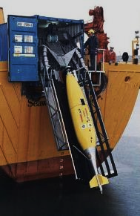
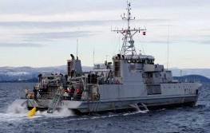
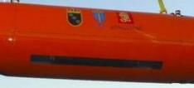
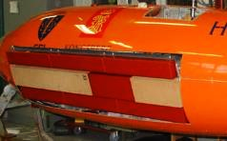
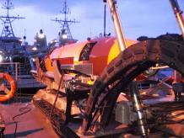
Kongsberg Maritime and AUVs, 26 years of development
    Key Milestones: KM AUV Development
    1993: HUGIN I - 110 nautical mile dive
    1997: First commercial survey
    2000: First commercial sale
    2001: First Military demonstration
    2003: SAS prototype on HUGIN
    2005: HISAS prototype on HUGIN
    2007: Introduction of HUGIN 1000 model
    2012: 6 battery HUGIN introduced
    2014: In-Mission SAS developed
    2015: Depth record for HUGIN 4449 m (fully supervised)
    2015: 800,000 line-km of commercial survey completed
    2016: Magnetometer, colour camera & laser profiler introduced
    2016: HUGIN rated to 6000 m developed
    2017: Sworm of AUV, USV
    2018: Resident AUV - Eelume
1993: 110 nm dive
1997: First commercial survey
2003: SAS on AUV
2001: Military demo
2005: HISAS prototype trials
2007: HUGIN 1000

Slide 27
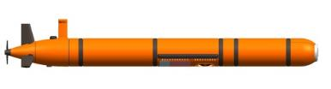

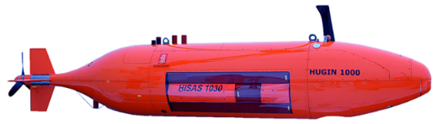
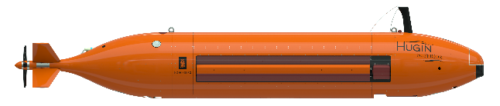
Gama de Vehículos Autónomos Submarinos
MUNIN 600
  Baja Logistica – Maletas de transporte, gruas de cubierta, etc
  Profundidad hasta 600 m Ø12.75”
  HISAS2040, EM2040P.
  Autonomía 10-12h.
MUNIN+
  Modular – Maletas peli.
  Profundidad hasta 1.500 m Ø19”
  HISAS2040, EM2040P, SBP, camara.
  Autonomía 24h.
HUGIN
  Aguas profundas.
  Profundidad hasta 6000m .
  HISAS1032, EM2040, SBP, camara, laser, senosres medioambientales++.
  Autonomía 48h – 60 h.
HUGIN SUPERIOR
  Aguas profundas.
  Profundidad hasta 6000m .
  HISAS1032 doble receptor, EM2040 MkII, SBP, camara, laser, sensores medioambientales++.
  Autonomía 52h – 72 h.

Slide 28


K-MATE: Yara Birkeland
    Key Facts:
    Fully battery powered ship
    Prepare for remote control and fully autonomous operations
    Dimensions & Performance
      LOA: >70 m
      Beam: 15 m
      Depth: 12 m
      Draft: (full) 5m
      Service speed: 6 Knots
    Purpose and Performance:
    To replace road journeys
    Sail within 3 ports
      Herøya to Brevik: 7 nm
      Herøya to Larvik 30 nm
    Controlled by:
      YARA at Porsgrunn
      Kongsberg Maritime
    Schedule:
    2017: design finalized
    2018 Delivery & testing with small crew
    2019: Remote operation
    2020: Fully autonomous operation

Slide 29

GeoSwath 4R USV
Vehículos Autónomos de Superficie - GeoSwath 4R USV ofrece mapeos de fondo simultaneamente batimetria y sonar de barrido lateral mediante una plataforma operada remotamente en superficie.

Slide 30

K-MATE: Odin
    Proyecto:
    Desarrollo conjunto entre KM y FFI (Dept Desarrollo de la Defensa)
    Se puede manipular o operación remota
    Plataforma Multipropósito para investigación de la defensa
      Hidrografía
      Propección de Medidas Contraminas
      Lanzamiento y Recogida AUV
    Configurado para portar un AUV
    Equipos:
    Sistemas:
      Dos motores
      Ancla Electrónica
    Navegación, Comunicación y Prevención a la Colisión:
      Sistema de Referencia Seapath 136
      AIS 300
      Radar, Camara & LIDAR
      MBR – Radio de Banda Ancha
      Iridium

Slide 31

K-MATE: SEA-KIT Batimetria
    Dimensiones:
    Eslora: 11 m
    Manga: 3 m
    Altura: 3 m
    Deseñado para portar un HUGIN AUV
    Operación:
    Autonomia:
      Estandar: >30 días
      Mejorado: >300 días
    Velocidad: <8 Nudos
    Equipos:
    Sistemas:
      Dos Generadores Diesel Electricos
      Dos Helices de popa más una en proa
      Ancla Electronica
    Navegación, Comunicación y Prevención de Colision:
      Sistema de Referencia Seapath 136
      AIS 300
      Radar y Camara
      MBR – Radio de Banda Ancha
      INMARSAT & Iridium

Slide 32


Product Overview
SISTEMA USV

Slide 33


La clave esta en los datos

Slide 34

El sistema USV Sounder proporciona detección y clasificación de bancos de peces a menos de $50 de coste de combustible diarios

Slide 35


Aplicaciones de Mapeo
El sistema USV Sounder se puede equipar para aplicaciones de batimetria con sonda multihaz EM2040

Slide 36


Sistema Completo
USV Sounder
Cerebro Autonomo K-MATE
Sistema de Lanzamiento y Recogida
Contenedores de transporte
Estacion de Operación en Tierra o a Bordo
Dirección de Flotas USV
Sensores de Montaje
Mantenimiento y conjunto de repuestos
Soporte 24/7-365 Internacional

Slide 37

Percepción de la Situación y Previsión de Anti-Colisión
El sistema USV Sounder cuenta con un sistema de vanguardia para el análisis y conocimiento de la situación que permite evitar colisiones.

Slide 39

Sistema USV Sounder
Especificaciones Técnicas
Operación
  Autonomía: 10 días @ 4 nudos (300L Tanque de Combustible)
  Velocidad Maxima: 12 nudos (Sin Carga)
  Relación de Giro 15 m @ 11 knots
Caracteristicas Especiales
  Moon pool
  Guinche CTD
  Refuerzo de Acero para equipos montados en proa
  Mastil abatible
  Diseño único para l a estabilidad y la operación hidroacústica optima
  Rack desmotable de 19’ para equipamiento
  Un único punto de enganche para carga y descarga

Slide 40
Kongsberg Maritime
STORAGE, PROCESS, VISUALIZE
KOGNIFAI

Slide 41
Kognifai
Kongsberg’s Open Digital Environment
▪ Data upload
▪ Data sharing
▪ Combining data from many sources
▪ Big Data makes Machine Learning possible
▪ Scalable computer resources
▪ Easy access to Kognifai
▪ Secure storage
▪ Hybrid Cloud
▪ Software Development Kit for developers
▪ Virtual PC
▪ Processing on site/boat
- Reduce data volume to be transmitted into Storage
- Adapt data volume to available Internet bandwidth and cost

Slide 42

Open Standards and Cloud Ecosystems
Handle, process, visualize and share vessel data and ocean data efficiently
Notes:
Mapping Cloud significantly simplifies the workflow of seabed mapping.
It is an open ecosystem where software from partners can run. We are actively and successfully getting partners.
Mapping Cloud supports remote operation and easy handling and sharing of data.
Our system supports fleet coordination, support from shore to vessel for adjustment and improvement of data collection,

Slide 43


Slide 44


MUCHAS GRACIAS
Vicente Carrasco
Jefe de Ventas – Sensor & Robotics
+1 346 312 3553
Vicente.carrasco@km.kongsberg.com

