Slide 1
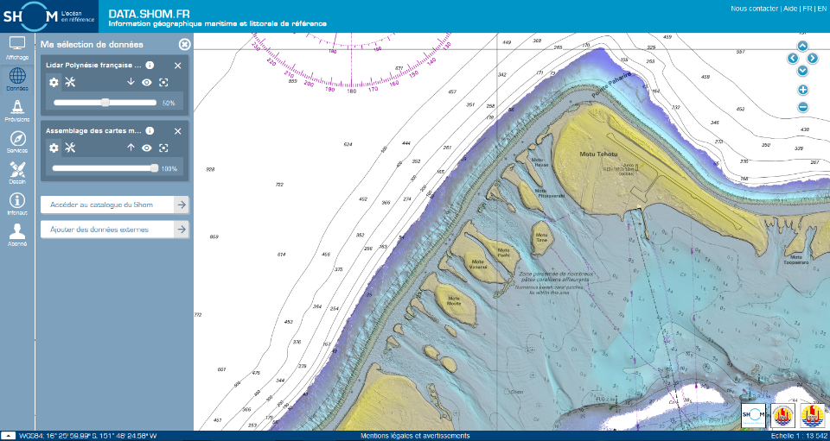
15th South West Pacific Hydrographic Commission Conference France National Report
Nadi - Fiji

Slide 2
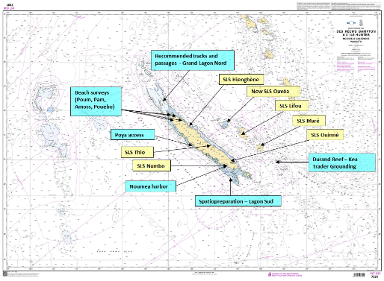
new surveys – New Caledonia
Surveys scheme overseen by the hydrographic commission of New Caledonia and executed by Shom’s Pacific survey unit (GOP)
Main focus on the Grand Lagon Nord (in support to maritime surveillance and development of cruise activity)
And
Harbor and access channel surveys
Spatiopreparation (field survey in support to SDB)
SLS deployment and maintenance
Hydrographic support to Kea Trader grounding
Beach surveys
Notes:
GOP : permanent survey unit – led by Shom in cooperation with NC government
Executing planned surveys, but also have a capability that can be deployed on request for assistance / disaster relief

Slide 3
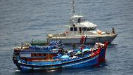
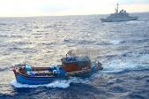
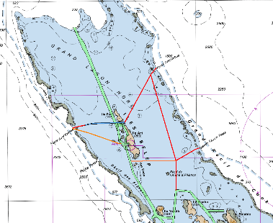
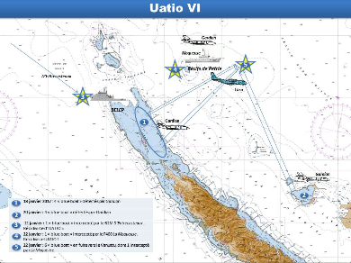
new surveys – New Caledonia
Support to maritime surveillance
New recommended tracks in unsurveyed & unfrequented areas
4 « blue boats » arrested in January 2017
2 « blue boats » arrested in November 2017
by French Navy using these new tracks

Slide 4
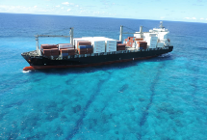
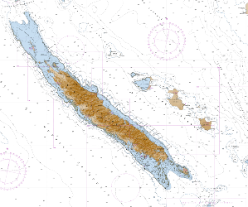
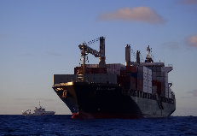
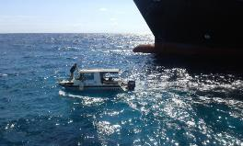
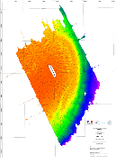
new surveys – New Caledonia
KEA TRADER GROUNDING - DURAND REEF – July 2017
Surveys – including cooperation with SPC
Very short notice and quick product delivery
1st survey (SBES) to secure the area for rescue operations
2nd survey (MBES) in support to refloating attempt
Support – from July to December 2017
Seafloor models and analysis
Tide predictions improvement
Water level analysis (ocean dynamics, uncertainties)

Slide 5
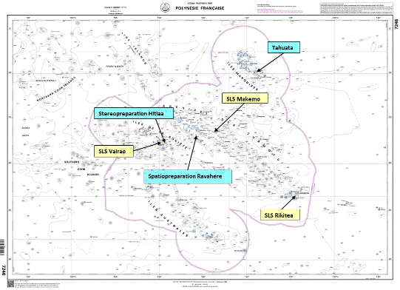
new surveys – French Polynesia
Survey scheme validated by the sub-committee for hydrography of French Polynesia and executed by Shom/GOP
Mooring areas
Spatiopreparation (field survey in support to SDB)
Stereopreparation (field survey for exploitation of aerial images)
SLS deployment and maintenance
Notes:
Iles de la Société – Tuamotu - Gambiers

Slide 6
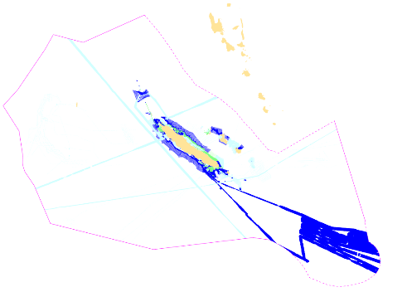
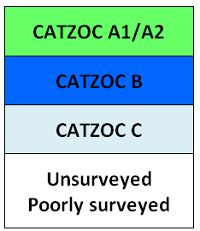
Status of hydrographic surveys & survey plan 2018-2020
New Caledonia
Prioritized survey works defined by the hydrographic commission of New Caledonia:
see New-Caledonia Hydrographic master plan (updated annually)
And Shom’s 2017-2020 national hydrographic survey programme
N/O L’Atalante should be deployed in the area in 2019 (tbc)
http://www.shom.fr/fileadmin/data-www/01-LE_SHOM/01-PRESENTATION_GENERALE/06-LE_PROGRAMME_ANNUEL/PNH_2017-2020_WEB_BD.pdf

Slide 7
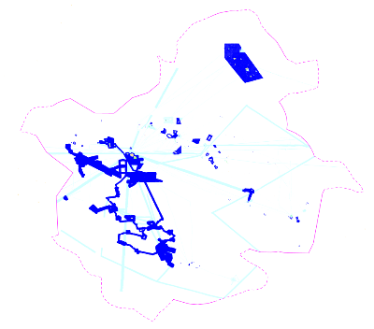
Status of hydrographic surveys & survey plan 2018-2020
French Polynesia
Prioritized survey works defined by the sub-committee for hydrography of French Polynesia:
see French Polynesia hydrographic master plan (updated annually)
And Shom’s 2017-2020 national hydrographic survey programme
N/O L’Atalante should be deployed in the area in 2019 (tbc)
Airborne Lidar survey project covering Iles de la Société (funded – to be specified and contracted )
http://www.shom.fr/fileadmin/data-www/01-LE_SHOM/01-PRESENTATION_GENERALE/06-LE_PROGRAMME_ANNUEL/PNH_2017-2020_WEB_BD.pdf

Slide 8
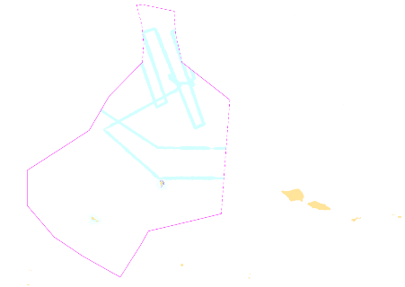
Status of hydrographic surveys & survey plan 2018-2020
Wallis & Futuna
Survey works in lagoon waters (using deployable equipment) and opportunity surveys
See Shom’s 2017-2020 national hydrographic survey programme
No survey planned in 2018
2019-2020 – requirements TBC
http://www.shom.fr/fileadmin/data-www/01-LE_SHOM/01-PRESENTATION_GENERALE/06-LE_PROGRAMME_ANNUEL/PNH_2017-2020_WEB_BD.pdf
Notes:
No formal commission, but still coordination with main stakeholders

Slide 9
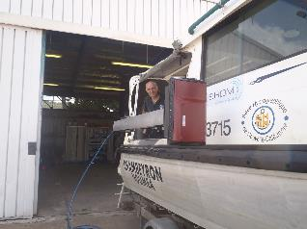
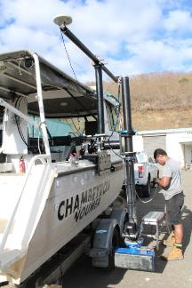
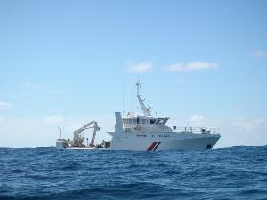
GOP improved survey capability
NEW MULTIBEAM ECHOSOUNDER
Deployable MBES (Kongsberg 2040P)
Depth range : 1-500 meters
800 soundings/ping (High density – dual swath)
1 MBES installed on hull: Louis-Hénin (NC-2018)
2 MBES installed on pole: Chambeyron (NC-2018) & BHPF.1 (FP - 2019)

Slide 10
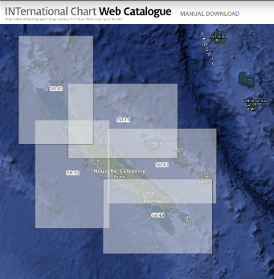
Charting – region L
INT charts
7 new INT charts produced (1 publication & 6 new editions)
3 new INT charts planned in 2018-2019 (INT6840, INT6841 & INT654)
INT Charts approved since last conference :
INT6840 (FR7760) : to be published
INT6841 (FR7761) : to be published
INT6842 (FR7762) : published 2017/11/17
INT6843 (FR6686) : to be published
INT6844 (FR6768) : to be published

Slide 11
Charting – region L
INT charts
FR7283 will remain a national chart. Action 14.08 can be closed.
FR intends to produce a band 3 cell derived from FR7283 to cover W&F EEZ (the only ENC cell intersecting W&F EEZ: FR368760 will be transformed into band 4 cell)
SWPHC14 Action Item | SWPHC14 Agenda Item | SWPHC14 Action | Action by | Deadline
14.08 | 9 | Producer Nations to review INT Chart proposal from France for Wallis and Futuna. | Producer Nations | End Feb 2017
Notes:
Recouvrement / overlap à voir

Slide 12
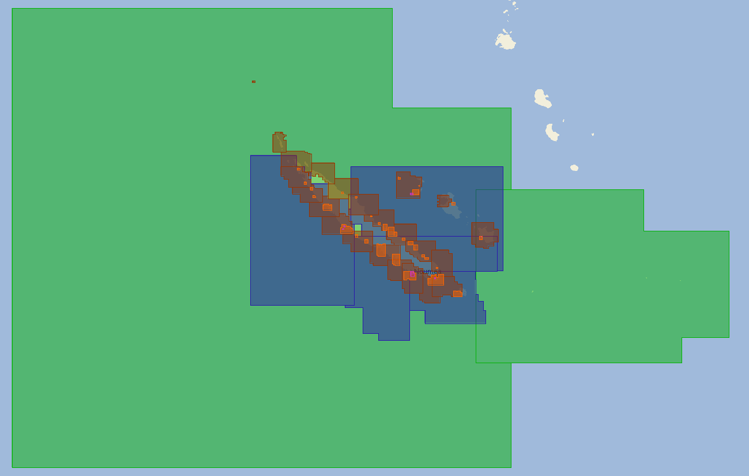
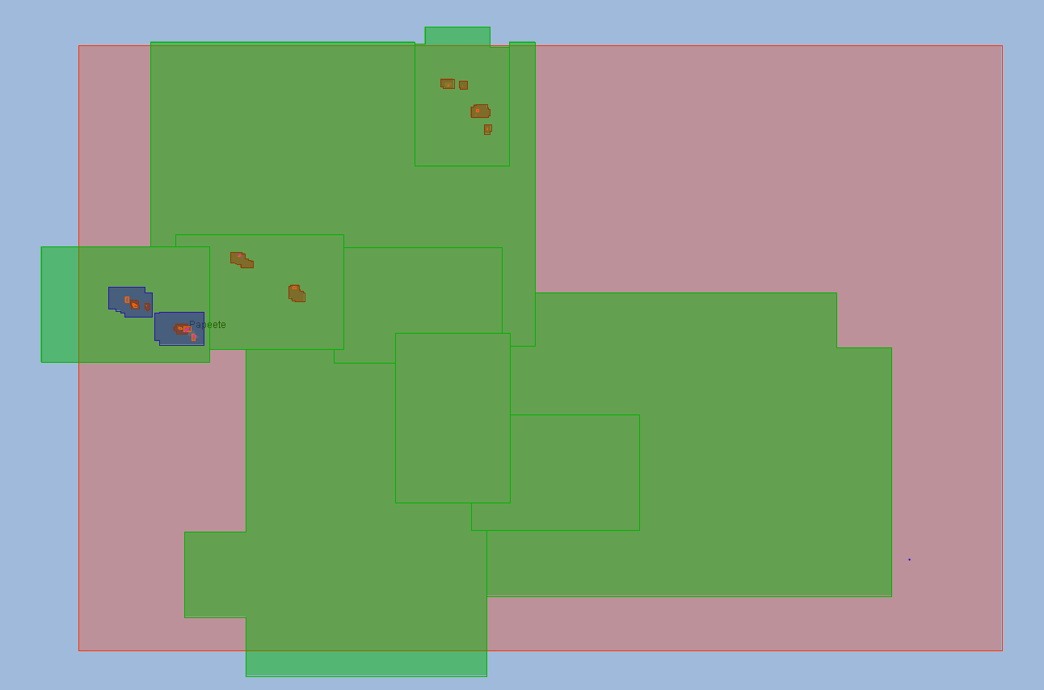
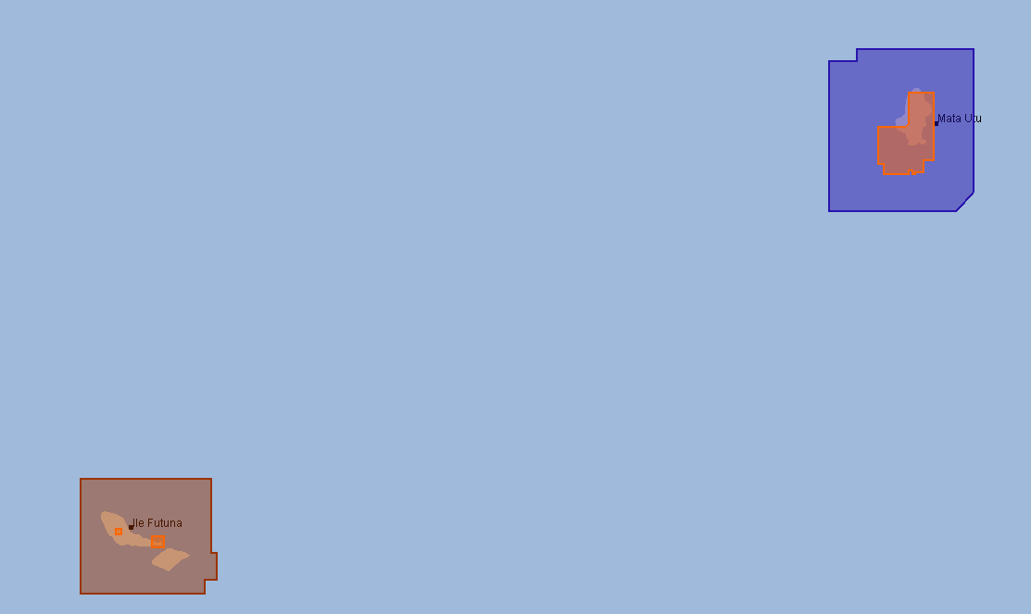
Charting – region L
ENC
7 new cells published since the last conference
55 new cells planned in 2018-2019
Full coverage of New Caledonian waters by the end of 2018

Slide 13
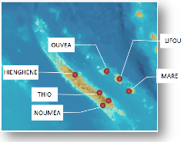
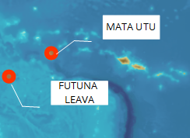
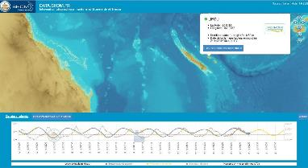
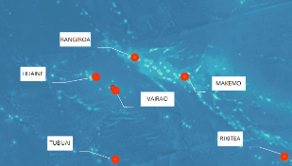
Sea level observation
All 14 stations installed (last one in Ouvéa - March 2017)
Maintenance operated by Shom on yearly basis
Funding remains a challenge
Contribute to PTWS, monitoring of sea level rise & storm surge
http://data.shom.fr/#donnees/refmar
Notes:
Funding is still a challenge

Slide 14
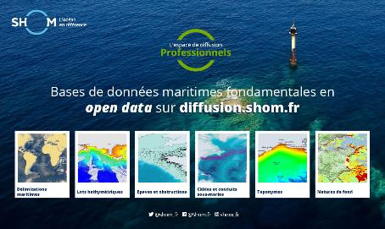
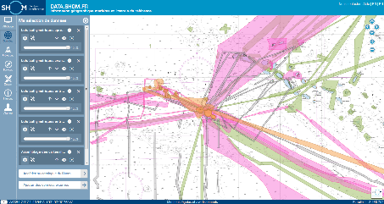
Msdi developments
Since December 3rd 2017, easier access to Shom core data: bathymetric data, wrecks, cables, bottom types, maritime limits, and toponyms databases.
Distributed under Creative Commons « CC-BY-SA 4.0 » licence
Shom’s portals
Data.shom.fr
Diffusion.shom.fr
Regularly updated with new data and products
Notes:
Including archives – fair sheets – older marine charts

